Slide 1
Arrays

Slide 2
Array basics

Slide 3
Data Structures
Sometimes, we have data that have some natural structure to them
  A few examples:
  Texts are sequences of characters
  Images are matrices of pixels
  Classes contain sets of students
Java provides a variety of classes and tools called data structures
  They help organize your data
  They make it convenient to access and update your data

Slide 4
Data Structures
Some common data structure classes in Java
  Array/Arrays (the data structure we will cover)
  ArrayList
  HashSet
  LinkedHashSet
  LinkedList
  TreeSet
  Vector
  HashMap

Slide 5
Arrays
array: An object that stores many values of the same type.
  element: a value in an array
  index: an integer indicating the position of a value in an array
index
0
1
2
3
4
5
6
7
8
9
value
12
49
-2
26
5
17
-6
84
72
3
element 0
element 4
element 9

Slide 6
Array declaration
Declaring/initializing an array:
  <type>[] <name> = new <type>[<length>];
Example:
  int[] numbers = new int[10];
The length can be any integer expression:
  int x = 2 * 3 + 1;
  int[] data = new int[x % 5 + 2];
index
0
1
2
3
4
5
6
7
8
9
value
0
0
0
0
0
0
0
0
0
0

Slide 7
Array auto-initialization
When arrays are initially constructed, every element is automatically initialized to a "zero-equivalent" value.
  int: 0
  double: 0.0
  boolean: false
  object type: null (null means "no object")‏

Slide 8
Array auto-initialization: Example
An array of doubles
An array of booleans
index
0
1
2
3
4
value
0.0
0.0
0.0
0.0
0.0
index
0
1
2
3
value
false
false
false
false

Slide 9
Don't go out of bounds!
Reading or writing any index outside the valid range will throw an ArrayIndexOutOfBoundsException.
Example:
  int[] data = new int[10];
  System.out.println(data[0]); // okay
  System.out.println(data[-1]); // exception!
  System.out.println(data[9]); // okay
  System.out.println(data[10]); // exception!
index
0
1
2
3
4
5
6
7
8
9
value
0
0
0
0
0
0
0
0
0
0

Slide 10
The length field
An array's length field stores its number of elements.
General syntax:
  <array name>.length
NB: Because it's a field (i.e. not a method), it does not use parentheses like a String's .length()!

Slide 11
Array initialization statement
Quick array initialization, general syntax:
  <type>[] <name> = {<value>, <value>, ..., <value>};
Example:
  int[] numbers = { 12, 49, -2, 26, 5, 17, -6 };
Useful when you know in advance what the array's element values will be.
index
0
1
2
3
4
5
6
value
12
49
-2
26
5
17
-6

Slide 12
Printing arrays: Arrays.toString
Arrays.toString accepts an array as a parameter and returns the String representation, which you can then print.
Example:
  int[] a = { 2, 5, 1, 6, 14, 7, 9 };
  for (int i = 1; i < a.length; i++) {
  a[i] += a[i - 1];
  }
  System.out.println("a is " + Arrays.toString(a));
  Output:
  a is [2, 7, 8, 14, 28, 35, 44]

Slide 13
Enum
Use Enum to create a data type that has a set of possible discrete values
Example:
public enum Monster{ZOMBIE, VAMPIRE, DEMON, WEREWOLF};
Enum names are capitalized because an enum defines a type, not a variable
Values are in all-caps because they are constants; each instance of the enum has one of these constant values

Slide 14
Enum
Define a variable of an enum type:
Monster m = Monster.ZOMBIE;
Test whether a variable has a particular value:
  if(m == Monster.ZOMBIE) System.out.println(“Zombie approaching!”);
Use as method parameter:
myMethod(Monster m){}
Send as argument:
myMethod(Monster.ZOMBIE);

Slide 15
Text processing

Slide 16
Text processing
text processing: Examining, editing, formatting text.
  Text processing often involves for loops that examine the characters of a string one by one.
Two data types involved
char | String
Represents individual characters | Represents sequences of characters
Primitive type | Object type (i.e., not primitive)
Written with single quotes | Written with double quotes
e.g.: ‘T’ ‘t’ ‘3’ ‘%’ ‘\n’ | e.g.: “We the people” “1. Twas brillig, and the slithy toves\n” “” “T”

Slide 17
Characters
char: A primitive type representing single characters.
Individual characters inside a String are stored as char values.
Literal char values are surrounded with apostrophe
(single-quote) marks, such as 'a' or '4' or '\n' or '\''
Like any other type, you can create variables, parameters, and returns of type char.
  char letter = 'S';
  System.out.println(letter); // prints S

Slide 18
Strings
String: an object type for representing sequences of characters
  Sequence can be of length 0, 1, or longer
  Each element of the sequence is a char
  We write strings surrounded in double-quotes
  We can declare, initialize, assign, and use String variables in expressions just like other data types
  String s = “Hello, world\n”; // declare, init
  System.out.println(s); // use value
  s = s + “I am your master\n”; // concatenate
  // and assign

Slide 19
String Methods
Unlike primitive types, object types can have methods.
Here is a list of methods for strings:
Method name
Description
charAt(index)‏
returns the character at the given index
indexOf(str)‏
returns the index where the start of the given string appears in this string (-1 if not found)‏
length()‏
returns the number of characters in this string
substring(index1,index2)‏
returns the characters in this string from index1 up to, but not including, index2
toLowerCase()‏
returns a new string with all lowercase letters
toUpperCase()‏
returns a new string with all uppercase letters

Slide 20
The charAt method
The characters of a string can be accessed using the String object's charAt method.
  String indices start at 0.
String word = “cola”;
char firstLetter = word.charAt(0);
if (firstLetter == 'c') {
System.out.println("C is for cookie!");
}
Starts at 0!
charAt(i): | ‘c’ | ‘o’ | ‘l’ | ‘a’
Index i: | 0 | 1 | 2 | 3

Slide 21
Calling string methods
Let s be a variable of type String
General syntax for calling a String method:
s.<method>(<args>)
Some examples:
String s = “Cola”;
int len = s.length(); // len == 4
char firstLetter = s.charAt(0); // ‘C’
int index = s.indexOf(“ol”); // index == 1
String sub = s.substring(1,3); // “ol”
String up = s.toUpperCase(); // “COLA”
String down = s.toLowerCase(); // “cola”

Slide 22
Comparing strings
Objects (such as String) should be compared for equality by calling a method named equals.
Example:
  Scanner console = new Scanner(System.in);
  System.out.print("What is your name? ");
  String name = console.next();
  if (name.equals("Barney")) {
  System.out.println("I love you, you love me,");
  System.out.println("We're a happy family!");
  }

Slide 23
Comparing strings
There are more methods of a String object that can be used in <test> conditions.
Method
Description
equals(str)‏
whether this string contains exactly the same characters as the other string
equalsIgnoreCase(str)‏
whether this string contains the same characters as the other, ignoring upper- vs. lowercase differences
startsWith(str)‏
whether this string’s beginning matches the argument
endsWith(str)‏
whether this string’s end matches the argument

Slide 24
What about String typecasts?
The (String) typecasts don’t work with primitive types, like char, int, and double.
However, there are easy ways to convert to and from strings:
Converting from strings:
String s to int: Integer.parseInt(x)
String s to double: Double.parseDouble(x) …
String s to char: Character.parseChar(x)

Slide 25
Reading in Strings
Remember the Scanner method called nextInt()?
You can also use Scanners to read in Strings with the next() and hasNext() methods.
Example:
Please enter your name: Alexander Pieter Yates
Name 1 has 9 letters
Name 2 has 6 letters
Name 3 has 5 letters

Slide 26
Solution
import java.util.Scanner;
public class NameLength {
public static void main(String [] args) {
Scanner scan = new Scanner(System.in);
System.out.print(“Please enter your name”);
int i=1;
while(scan.hasNext()) {
String s = scan.next();
int length = s.length();
System.out.println(“Name “ + i + “ has “ + length + “ letters”);
i++;
}
}
}

Slide 27
Scanner class (so far)
return | method | Description
int | nextInt() | Reads the next token, converts it to an int (if possible), and returns the int value.
double | nextDouble() | Reads the next token, converts it to a double (if possible), and returns the double value.
String | next() | Reads the next token, and returns it.
boolean | hasNext() | Returns true if there are more tokens.

Slide 28
StringBuilder
The StringBuilder class is a supplement to the String class.
StringBuilder is more flexible than String. You can add, insert, or append new contents into a string buffer, whereas the value of a String object is fixed once the string is created.
You will often have to parse the StringBuilder to a String when you are done constructing it.

Slide 29
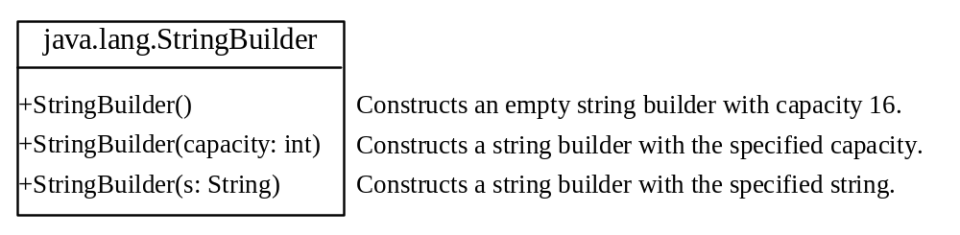
StringBuilder Constructors

Slide 30

Modifying Strings in the Builder

Slide 31

Modifying Strings in the Builder

Slide 32
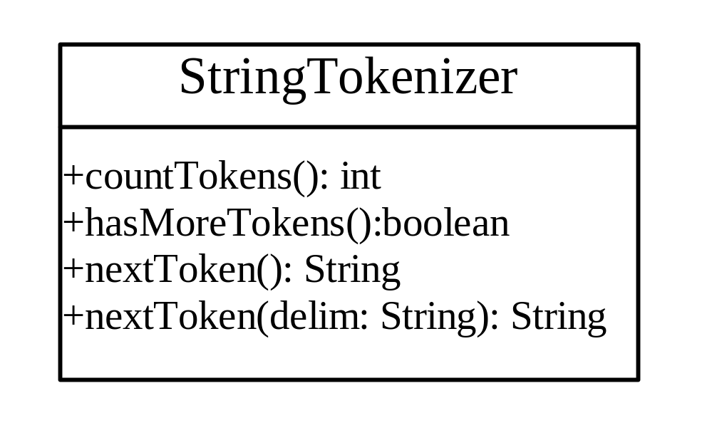
StringTokenizer
boolean hasMoreTokens()
String nextToken()
String nextToken(String delim)

