Slide 1


FIREMAN ML workshop
Pavol Mulinka, Czech Technical University in Prague (Thesis submitted)

Slide 2
Goal
Understand batch ML pipeline
Understand basic stream-based ML concepts
Apply batch/stream ML on TEP dataset
Hands-on exp. with both batch/stream ML
How it can be used in the context of FIREMAN?
Establish a FIREMAN ML experiment tested
Add new steps to pipeline etc…
Notebooks available on github:
https://github.com/5uperpalo/FIREMAN-project/tree/master/workshop_05132020

Slide 3
Datasets
stream-based ML datasets
TEP dataset
emulate imbalance
shuffle dataset
dataset_shuffled
dropped slices
batch ML dataset
dataset_orig
drop continuous slice from each class
stream testing dataset
stream testing dataset
3

Slide 4
Batch ML scenario
dataset
preprocessing
classification
evaluation
parameter calibration
feature engineering
Class imbalance
Scaling
Imputation – missing values, dropping, interpolating
Other – OneHotEncoding, DataType(float, int,..)
Feature Selection – analysis, correlation, variation, algorithms
Feature creation – mean,min,max,percentile, entropy, etc. of the surrounding points
Cross Validation
Classification report
Metrics – Precision, Recall, F1, etc.
RandomForest – feature importance, fast, promising results
Investigation
Brute force - GridSearch

Slide 5
Stream-based ML scenario
data stream
concept drift
classification
evaluation
data is processed incrementally
“statistical properties of variable changed in unforeseen ways” Wiki
not every algorithm can become incremental algorithm
Holdout –like in batch mode
Prequential – test then train, use every sample
ADWIN – adaptive windowing
DDM – Drift Detection Method
EDDM – Early Drift Detection Method
Page Hinkley test

Slide 6
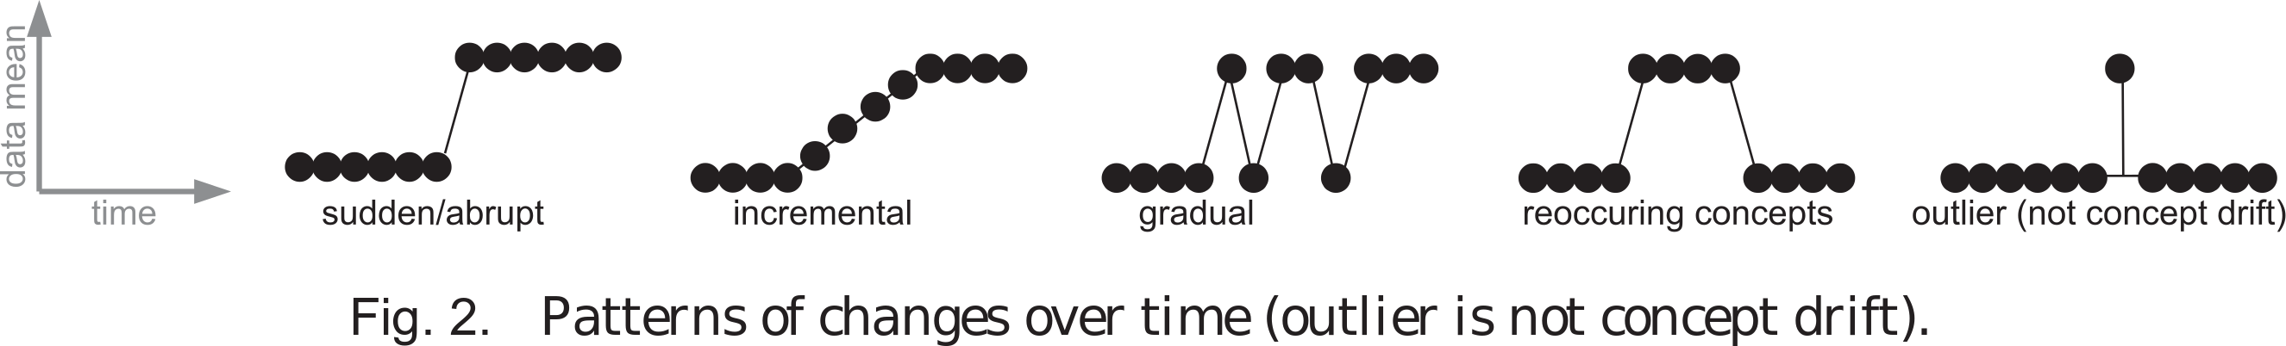
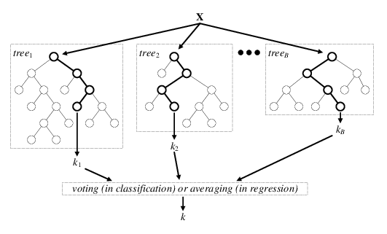
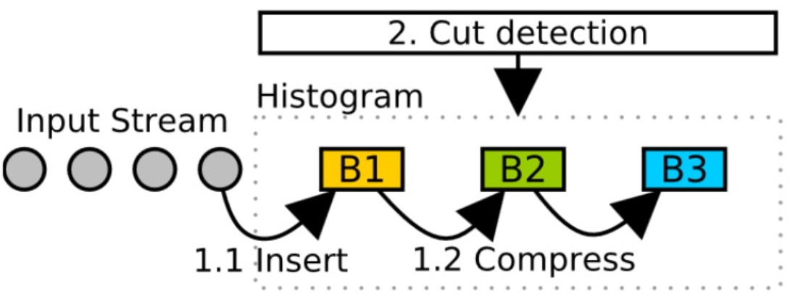
Important concepts
How concept drift looks like?
[1]
Random Forest classifier
ADWIN
concept drift detection
[4]
[2-3]
[1] Gama, J., Žliobaitė, I., Bifet, A., Pechenizkiy, M., & Bouchachia, A. (2014). "A survey on concept drift adaptation." ACM computing surveys (CSUR), 46(4), 1-37.
[2] Grulich, Philipp Marian, et al. "Scalable Detection of Concept Drifts on Data Streams with Parallel Adaptive Windowing." EDBT. 2018.
[3] Bifet, Albert, and Ricard Gavalda. "Learning from time-changing data with adaptive windowing." Proceedings of the 2007 SIAM international conference on data mining. Society for Industrial and Applied Mathematics, 2007.
[4] Verikas, Antanas, et al. "Electromyographic patterns during golf swing: Activation sequence profiling and prediction of shot effectiveness." Sensors 16.4 (2016): 592.
6

Slide 7
Discussion topics
Performance improvement (Java implementations?)
https://samoa.incubator.apache.org/
https://moa.cms.waikato.ac.nz/
Distributed batch and stream-based machine learning
(PySpark, Pandas UDF, Kafka, SAMOA, etc.)
Performance comparison to QARMA
Evaluation of real-world CPS (Cyber Physical Systems) datasets
Anomaly detection (DBSCAN, OPTICS, etc. )
Unsupervised machine learning analysis of CPS
Deep learning approaches?
Influence of selected features on the results etc.
…

