Slide 1

CSC computation environment for FIREMAN - Setup
Request access:
create a CSC account https://my.csc.fi/csc-customer-registration
apply for FIREMAN project csc group membership https://my.csc.fi/project-invitation/4188b608-62d9-445a-b569-98cddd765dad
notify Pedro Nardelli (there are no csc notification emails)
Setup environment:
login to cPouta service https://pouta.csc.fi/dashboard/auth/login/?next=/dashboard/project/instances/
create ssh keypair https://pouta.csc.fi/dashboard/project/key_pairs
create a security group that allows ssh https://pouta.csc.fi/dashboard/project/security_groups/
create VM instance
assign security group and ssh key pair
assign public IP
Access VM instance:
download pem file https://pouta.csc.fi/dashboard/project/security_groups/):
connect
[linux]
e.g. : ssh -v ubuntu@195.148.22.66 -i mulinka.pem
[windows]
use puttygen to extract private key and putty to connect

Slide 2
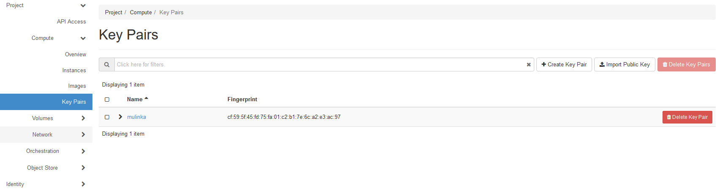
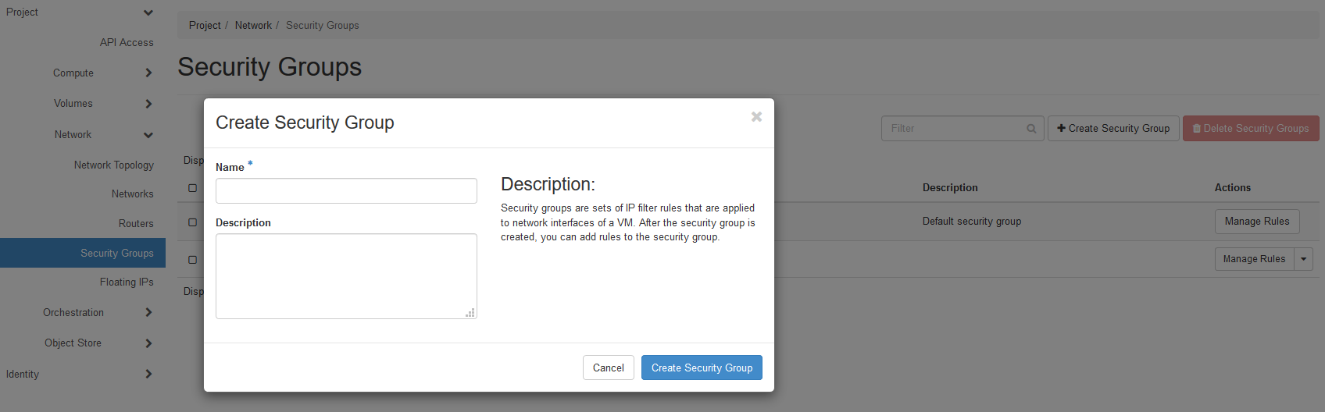
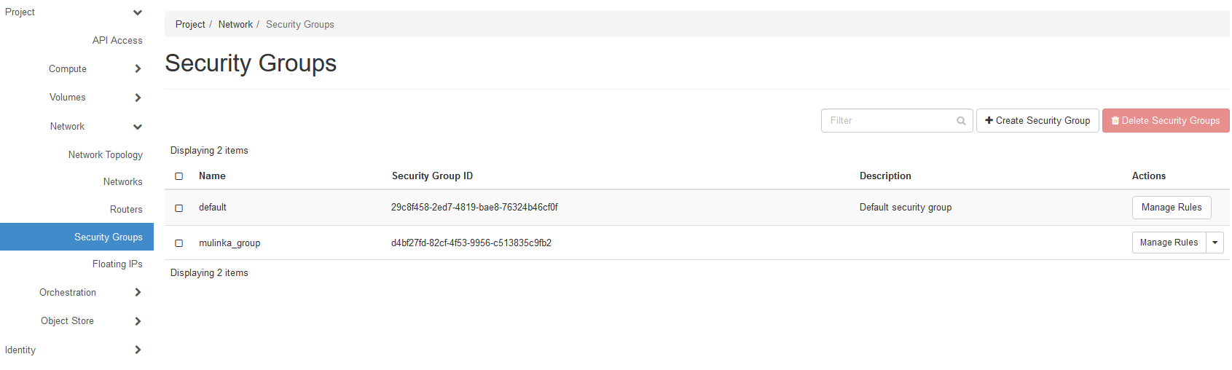
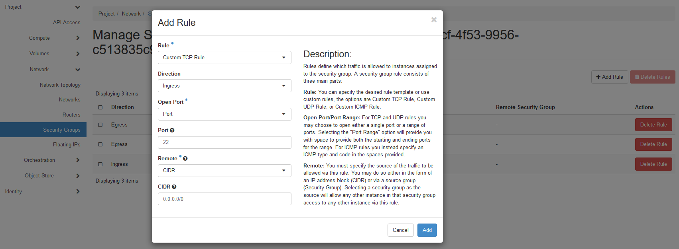
Setup environment (part 1)
2. create ssh keypair
3.1 create a security grou
3.2 create a security grou
3.3 allow ssh in the group

Slide 3
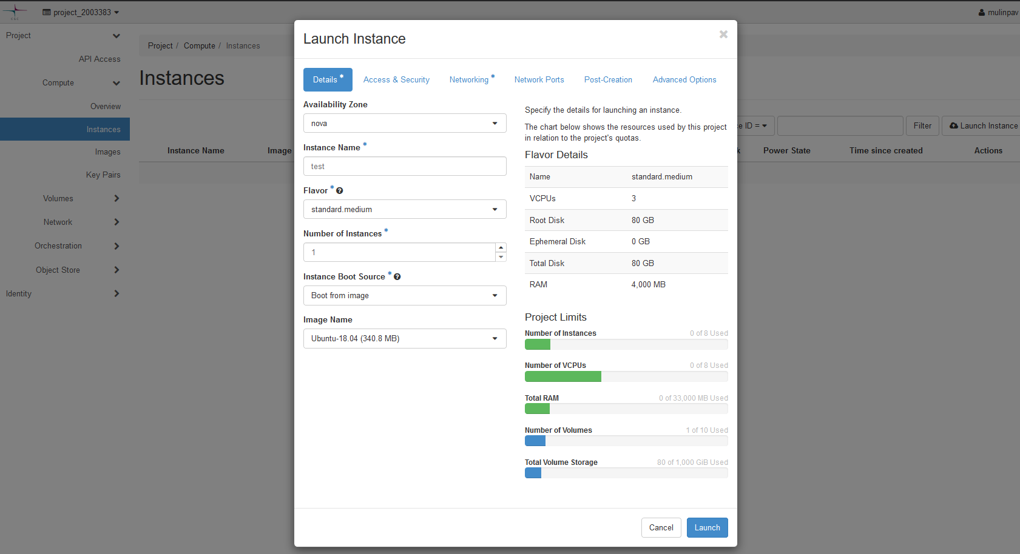
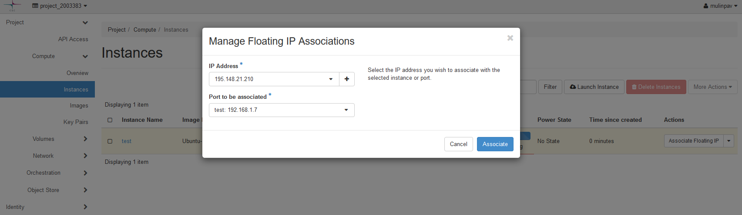
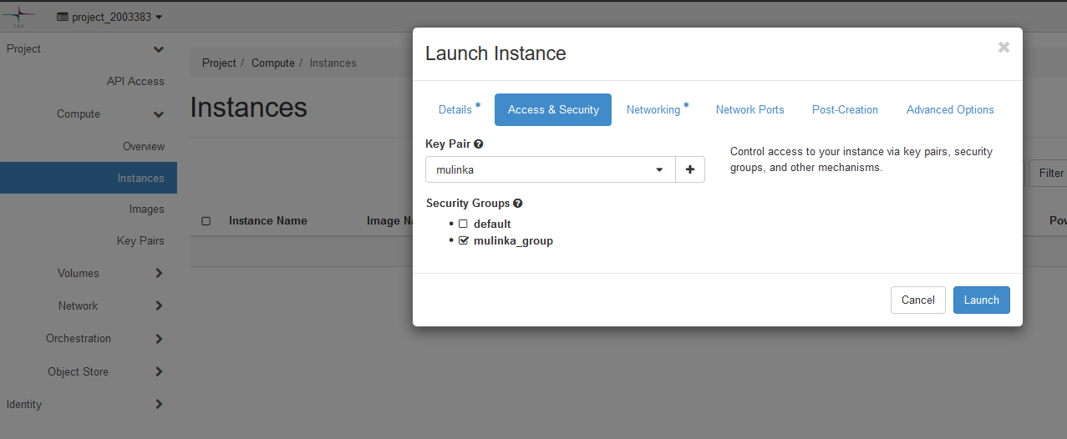
Setup environment (part 2)
4. create VM instance
5. assign security group and ssh key pair
6. assign public IP

Slide 4
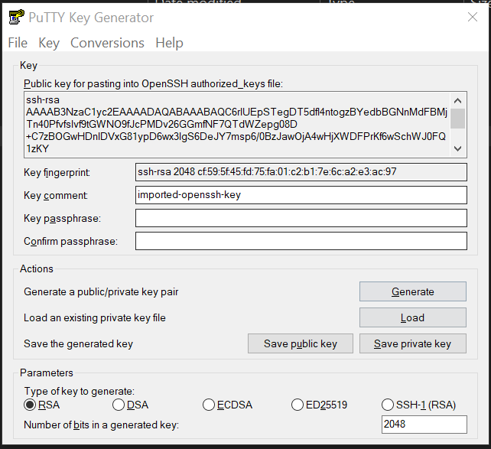
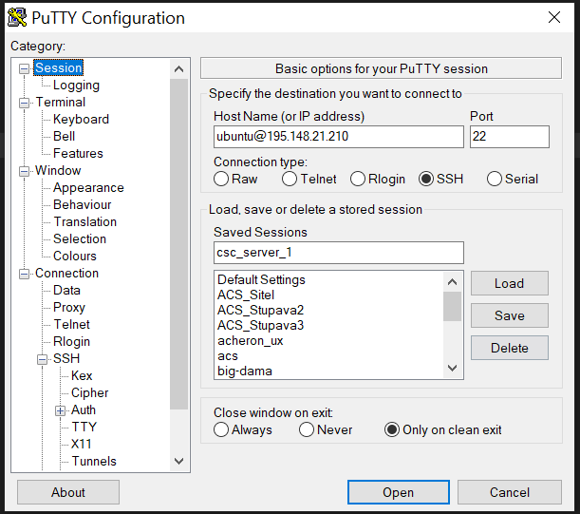
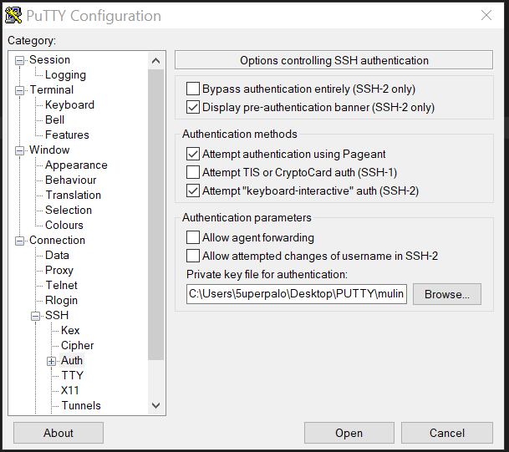
Access VM instance
puttygen
load pem file and save private key
putty
1.1 create connection
putty
1.2 load private key

Slide 5
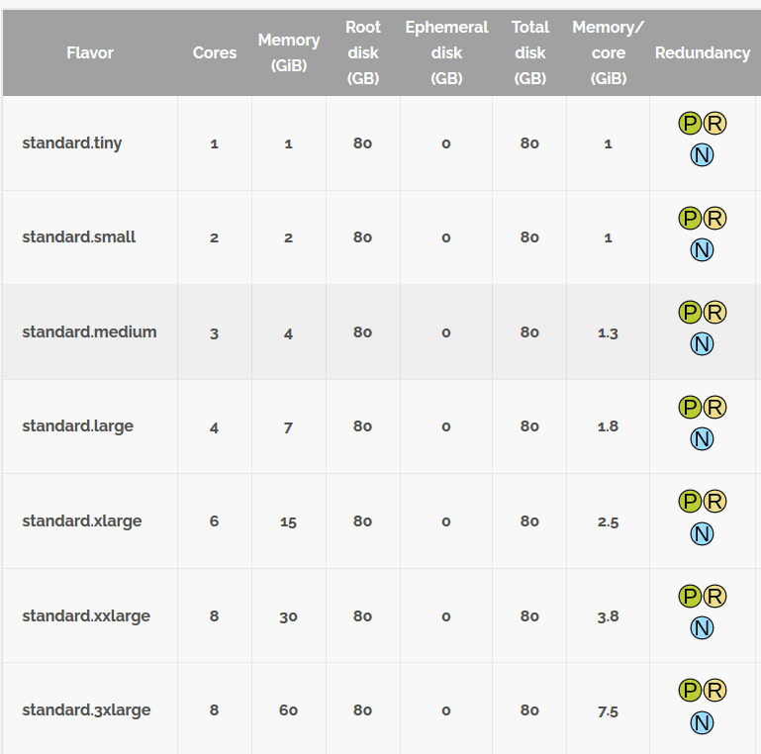
CSC Pouta service
cPouta is a service where you can create VM instance and do whatever you want, e.g. download Miniconda (wget MINICONDA_LINK), install libraries and run script
billing is done per hour, please DELETE INSTANCE IF YOU ARE NOT USING IT!
billing unit rates per “vm instance flavor” : https://docs.csc.fi/cloud/pouta/vm-flavors-and-billing/
documentation is available at https://docs.csc.fi/cloud/pouta/
there are other services that can be requested; services include databases, storages etc. https://research.csc.fi/computing

