Slide 1
Basic Architecture Overview
Operator
(user)
Kubernetes
Core
Ingress
Vehicle
Edge node
On Board Unit(OBU)
Edge pod #1
Redis Database
Edge pod #2
Kserve
inference service
InfluxDB
Dashboard (Grafana)
Prometheus
Kepler
Kserve
Minio Storage
energy, CPU,
memory usage stats
model serving

Slide 2
Simple single cluster Architecture Overview
Edge Node #1
Edge Node #2
Core Node/Nodes
Vehicle API
Pod A
Kserve inference
Pod B
Vehicle API
Pod C
Kserve inference
Pod D
Kepler
Prometheus
Kserve
MLflow
Minio Storage
Dashboard
(Grafana)
Knative
InfluxDB
kube-proxy
kube-proxy
kube-proxy
ingress
Vehicle
IF(e.g. Eth0)
IP address
Anycast address
IF(e.g. Eth0)
IP address
Anycast address
On Board Unit(OBU)
…
IF(e.g. Eth0)
IP address
Antenna
(5G network)
Data Network
(IPv4/IPv6)
AnycastIP:nodePort
User
Data Network
(IPv4/IPv6)
FQDN

Slide 3
Advanced single cluster Architecture Overview
Edge Node #1
Edge Node #2
Core Node/Nodes
Vehicle API
Pod A
Kserve inference
Pod B
Vehicle API
Pod C
Kserve inference
Pod D
Envoy proxy
Envoy proxy
Envoy proxy
Envoy proxy
Kepler
Prometheus
Kserve
MLflow
Minio Storage
Dashboard
(Grafana)
Knative
InfluxDB
Istio
kube-proxy
kube-proxy
kube-proxy
ingress
Vehicle
IF(e.g. Eth0)
IP address
Anycast address
IF(e.g. Eth0)
IP address
Anycast address
On Board Unit(OBU)
…
IF(e.g. Eth0)
IP address
Antenna
(5G network)
Data Network
(IPv4/IPv6)
AnycastIP:nodePort
User
Data Network
(IPv4/IPv6)
FQDN

Slide 4
Multi cluster Architecture Overview
Cluster Management
(e.g. Rancher, KubeSphere, NearbyOne)
Edge Cluster #1
Edge Cluster #2
Core Cluster
dUPF
dUPF
Kserve
Prometheus
Kepler
Kserve
Prometheus
Kepler
Kepler
Prometheus
MLflow
Minio Storage
Dashboard
(Grafana)
Vehicle API
Vehicle API
InfluxDB
Istio
Knative
kube-proxy
Istio
Knative
kube-proxy
Istio
kube-proxy
ingress
Vehicle
IF(e.g. Eth0)
IP address
Anycast address
IF(e.g. Eth0)
IP address
Anycast address
On Board Unit(OBU)
…
IF(e.g. Eth0)
IP address
Antenna
(5G network)
Data Network
(IPv4/IPv6)
AnycastIP:nodePort
User
Data Network
(IPv4/IPv6)
FQDN

Slide 5
Architecture Overview – Networking – Vehicle data processing
Vehicle sends measurements to Vehicle API service (provided by Idneo – data preprocessing +Redis DB)
transmission is received by antenna
Transmission enters data(IPv4/IPv6) network
Data is forwarded to the closest Kubernetes Edge node using (i) Anycast IP address, shared by all Edge Nodes, and (ii) nodePort defined in NodePort service
Edge Node receives the data, checks the IP table in kube-proxy, and forwards it to local Pod A as the service is configured with `externalTrafficPolicy: Local`
If there is no local Pod for Vehicle API service, the packet is dropped
Vehicle API service forwards the data to the ML prediction service(Kserve inference)
Data is forwarded to Pod B as Kserve inference service is configured with `internalTrafficPolicy: Local`
If there is no local Pod for Kserve inference service, the packet is dropped
or ML prediction service pod periodically queries local Redis DB in Vehicle API service – as Vehicle API service is also configured with `internalTrafficPolicy: Local`
If there is no local Pod for Vehicle API service, the queries/requests are dropped
Kserve inference service pushes the data into InfluxDB
Grafana periodically queries data from InfluxDB
Service name | Service type | Note
Vehicle API | NodePort | externalTrafficPolicy: Local internalTrafficPolicy: Local Externally Accessible through Anycast/NodeIP:nodePort
Kserve Inference | ClusterIP | internalTrafficPolicy: Local
Kepler | ClusterIP
Prometheus | ClusterIP
Kserve | ClusterIP
MLflow | ClusterIP/Nodeport/Loadbalancer | GUI accessible through Ingress
Minio Storage | ClusterIP
Grafana | ClusterIP | GUI accessible through Ingress
Edge Node #1
Edge Node #2
Core Node/Nodes
Vehicle API
Pod A
Kserve inference
Pod B
Vehicle API
Pod C
Kserve inference
Pod D
Kepler
Prometheus
Kserve
MLflow
Minio Storage
Dashboard
(Grafana)
2
4
Knative
InfluxDB
kube-proxy
kube-proxy
kube-proxy
ingress
Vehicle
IF(e.g. Eth0)
IP address
Anycast address
IF(e.g. Eth0)
IP address
Anycast address
On Board Unit(OBU)
…
IF(e.g. Eth0)
IP address
1
3
Antenna
(5G network)
Data Network
(IPv4/IPv6)
AnycastIP:nodePort
User
Data Network
(IPv4/IPv6)
FQDN

Slide 6
Architecture Overview – Networking – Energy consumption monitoring
Kepler exporter uses eBPF to probe CPU, GPU, RAM performance counters and exposes them over time via HTTP
Prometheus periodically queries Kepler exporter for a new data
Grafana periodically queries Prometheus for anew data
Service name | Service type | Note
Vehicle API | NodePort | externalTrafficPolicy: Local Externally Accessible through Anycast/NodeIP:nodePort
Kserve Inference | ClusterIP | internalTrafficPolicy: Local
Kepler | ClusterIP
Prometheus | ClusterIP
Kserve | ClusterIP
MLflow | ClusterIP/Nodeport/Loadbalancer | GUI accessible through Ingress
Minio Storage | ClusterIP
Grafana | ClusterIP | GUI accessible through Ingress
Edge Node #1
Edge Node #2
Core Node/Nodes
Vehicle API
Pod A
Kserve inference
Pod B
Vehicle API
Pod C
Kserve inference
Pod D
Kepler
Prometheus
Kserve
MLflow
Minio Storage
Dashboard
(Grafana)
2
3
Knative
InfluxDB
kube-proxy
kube-proxy
kube-proxy
ingress
Vehicle
IF(e.g. Eth0)
IP address
Anycast address
IF(e.g. Eth0)
IP address
Anycast address
On Board Unit(OBU)
…
IF(e.g. Eth0)
IP address
1
Antenna
(5G network)
Data Network
(IPv4/IPv6)
AnycastIP:nodePort
User
Data Network
(IPv4/IPv6)
FQDN

Slide 7
Architecture Overview – Networking – Vehicle data and energy consumption monitoring
User enters Grafana FQDN in the web browser and is forwarded to the Ingress controller
Ingress controller translates the FQDN to the appropriate service and forwards it
Grafana GUI comes up in the Users web browser
Service name | Service type | Note
Vehicle API | NodePort | externalTrafficPolicy: Local Externally Accessible through Anycast/NodeIP:nodePort
Kserve Inference | ClusterIP | internalTrafficPolicy: Local
Kepler | ClusterIP
Prometheus | ClusterIP
Kserve | ClusterIP
MLflow | ClusterIP/Nodeport/Loadbalancer | GUI accessible through Ingress
Minio Storage | ClusterIP
Grafana | ClusterIP | GUI accessible through Ingress
Edge Node #1
Edge Node #2
Core Node/Nodes
Vehicle API
Pod A
Kserve inference
Pod B
Vehicle API
Pod C
Kserve inference
Pod D
Kepler
Prometheus
Kserve
MLflow
Minio Storage
Dashboard
(Grafana)
Knative
InfluxDB
2
kube-proxy
kube-proxy
kube-proxy
ingress
Vehicle
IF(e.g. Eth0)
IP address
Anycast address
IF(e.g. Eth0)
IP address
Anycast address
On Board Unit(OBU)
…
IF(e.g. Eth0)
IP address
Antenna
(5G network)
Data Network
(IPv4/IPv6)
AnycastIP:nodePort
3
User
Data Network
(IPv4/IPv6)
FQDN, e.g: success6g.grafana.es
1

Slide 8
Architecture Overview – Networking – ML model development/update
User enters MLflow FQDN in the web browser and is forwarded to the Ingress controller
Ingress controller translates the FQDN to the appropriate service and forwards it to Mlflow GUI where user can check current models
User updates the model locally or in cloud and uploads it to MLflow API
Mlflow API forwards the model to the backend database - Minio
Service name | Service type | Note
Vehicle API | NodePort | externalTrafficPolicy: Local Externally Accessible through Anycast/NodeIP:nodePort
Kserve Inference | ClusterIP | internalTrafficPolicy: Local
Kepler | ClusterIP
Prometheus | ClusterIP
Kserve | ClusterIP
MLflow | ClusterIP/Nodeport/Loadbalancer | GUI accessible through Ingress
Minio Storage | ClusterIP
Grafana | ClusterIP | GUI accessible through Ingress
Edge Node #1
Edge Node #2
Core Node/Nodes
Vehicle API
Pod A
Kserve inference
Pod B
Vehicle API
Pod C
Kserve inference
Pod D
Kepler
Prometheus
Kserve
MLflow
Minio Storage
Dashboard
(Grafana)
4
Knative
InfluxDB
2
kube-proxy
kube-proxy
kube-proxy
ingress
Vehicle
IF(e.g. Eth0)
IP address
Anycast address
IF(e.g. Eth0)
IP address
Anycast address
On Board Unit(OBU)
…
IF(e.g. Eth0)
IP address
Antenna
(5G network)
Data Network
(IPv4/IPv6)
AnycastIP:nodePort
3
User
Data Network
(IPv4/IPv6)
FQDN, e.g: success6g.mlflow.es
1

Slide 9
Architecture Overview – Networking – ML model deployment
Admin user instructs Kserve to deploy a model
Kserve queries the model from Minio storage
Kserve updates/”serves” the model in all Kserver inference Pods
Service name | Service type | Note
Vehicle API | NodePort | externalTrafficPolicy: Local Externally Accessible through Anycast/NodeIP:nodePort
Kserve Inference | ClusterIP | internalTrafficPolicy: Local
Kepler | ClusterIP
Prometheus | ClusterIP
Kserve | ClusterIP
MLflow | ClusterIP/Nodeport/Loadbalancer | GUI accessible through Ingress
Minio Storage | ClusterIP
Grafana | ClusterIP | GUI accessible through Ingress
Edge Node #1
Edge Node #2
Core Node/Nodes
1
Vehicle API
Pod A
Kserve inference
Pod B
Vehicle API
Pod C
Kserve inference
Pod D
Kepler
Prometheus
Kserve
MLflow
Minio Storage
Dashboard
(Grafana)
2
Knative
InfluxDB
kube-proxy
kube-proxy
kube-proxy
ingress
Vehicle
IF(e.g. Eth0)
IP address
Anycast address
IF(e.g. Eth0)
IP address
Anycast address
On Board Unit(OBU)
…
IF(e.g. Eth0)
IP address
3
Antenna
(5G network)
Data Network
(IPv4/IPv6)
AnycastIP:nodePort
User
Data Network
(IPv4/IPv6)
FQDN

Slide 10
Real-world testing and data gathering - Parcmotor Castellolí; Basic overview
steps:
prepare the Kserve model and helm charts
make testing requests before the day of testing
run the real-world test with vehicles in Castelloli
query and save Kepler stats (CPU,RAM usage + CO2 estimation) from Prometheus
query and save measurements and predictions from Prometheus
make screenshots: Grafana, NBC environment
make vehicle pictures
Radio node #1
Radio node #2
Control room
Edge node #1
D-UPF-1
(SE350-1)
10.17.7.158
Edge node #2
D-UPF-2
(SE350-2)
10.17.7.52
Internet
Local Cloud VMs
VM Druid 5G
Network Core
10.17.7.47
VM1
Backend
10.17.252.101
VM3
Backend
10.17.252.103
VM2
Database testing
10.17.252.102

Slide 11
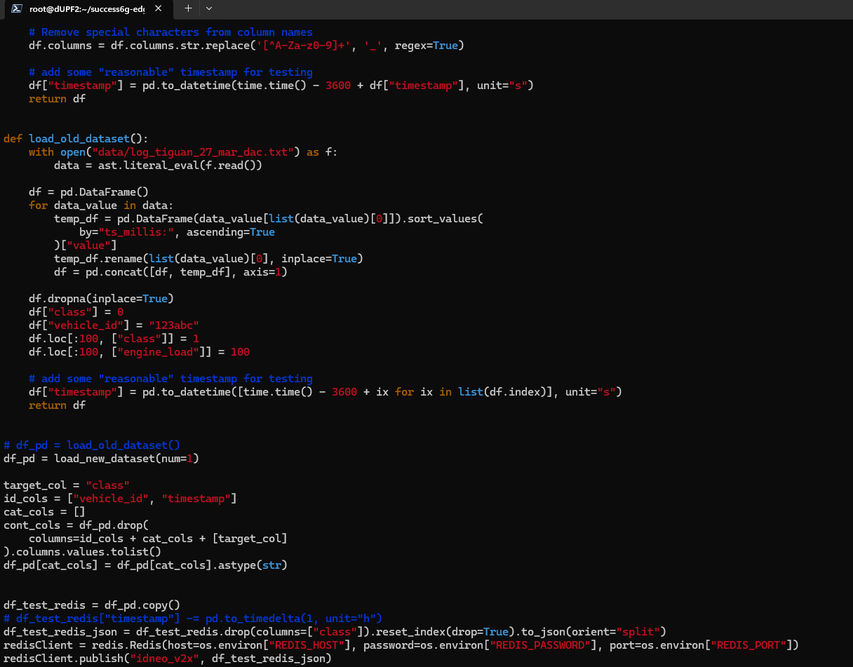
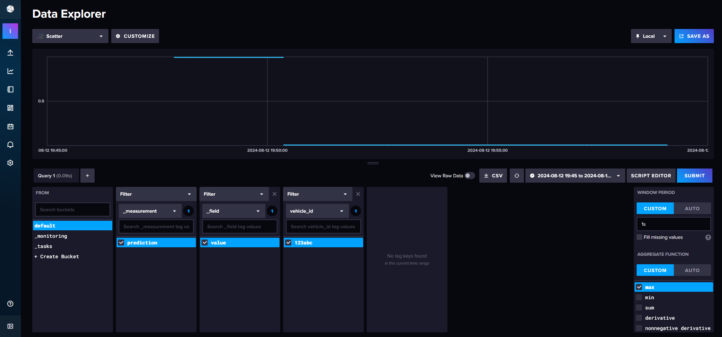
Edge node #2
D-UPF-2 (SE350-2)
10.17.7.52
Edge node #1
D-UPF-1(SE350-1)
10.17.7.158
VM1
Backend
10.17.252.101
test_script.py
Vehicle API
Redis db 10.17.7.158:17935
Prediction SVC
simple-helm-chart
Central DB
InfluxDB
10.17.252.101:30567

Slide 12
Real-world testing and data gathering - Parcmotor Castellolí; Services
Radio node #1
Radio node #2
Control room
Edge cluster #1
(Edge node #1)
Edge cluster #2
(Edge node #2)
Prediction service
(Kserve Inference)
Prediction service
(Kserve Inference)
Knative
Vehicle API
(Redis db)
Kserve
Knative
Vehicle API
(Redis db)
Kserve
Internet
Istio
Prometheus
Kepler
Istio
Prometheus
Kepler
Local Cloud VMs
VM Druid 5G
Network Core
Core cluster
(VM1 & VM3)
Dashboard (Grafana)
Kepler
Minio Storage
Prometheus
InfluxDB

Slide 13
R&D – Testbed (SUPERCOM/Cloud)
steps:
setup full testbed
use RaspberryPis to emulate edge nodes
send gathered data using python script and target specific edge nodes (emulation of vehicle moving between base stations)
test centralized vs edge computation vs federated learning
query and save Kepler stats (CPU,RAM usage + CO2 estimation) from Prometheus
query and save measurements and predictions from Prometheus
make screenshots: Grafana, Testbed environment
make pictures of used HW (RaspberyPis, workstation, SUPERCOM servers rack?)
Operator
(user)
Kubernetes
Core
Ingress
laptop
Edge node #1 (RaspberryPi)
Python script
Edge pod #1
Redis Database
Edge pod #2
Kserve
inference service
InfluxDB
Dashboard (Grafana)
JupyterHub
Prometheus
MLflow
Edge node #2
Edge node #3
Kepler
Kserve
Minio Storage
energy, CPU,
memory usage stats
model serving

