Slide 1
Uğurcan Laçin Simply Can => John Software Engineering,Bachelor Istanbul,Turkey

Slide 2


Slide 3
Contents
Version Control Systems
Git
Live Coding
Web based services

Slide 4
Git is a Version Control System

Slide 5
What is Version Control System?

Slide 6
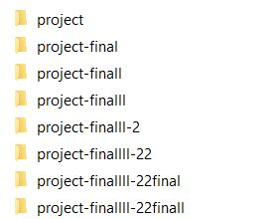
The easiest Version Control System

Slide 7
Version Control Systems
Local
Centralized
Distributed

Slide 8

Local Version Control Systems
Local VCSs have a simple database that keep all the changes to files under revision control.

Slide 9
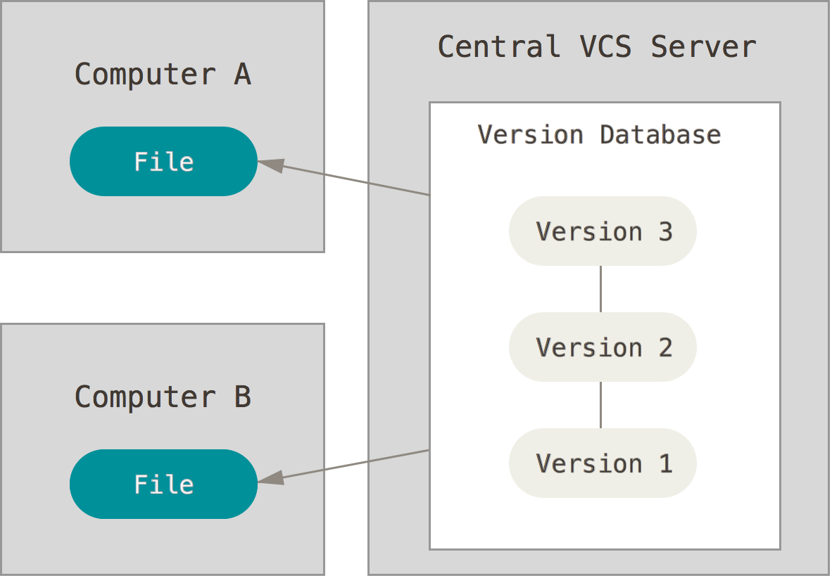
Centralized Version Control Systems
These systems, such as CVS, Subversion, and Perforce, have a single server that contains all the versioned files, and a number of clients that check out files from that central place.
Notes:
<number>

Slide 10
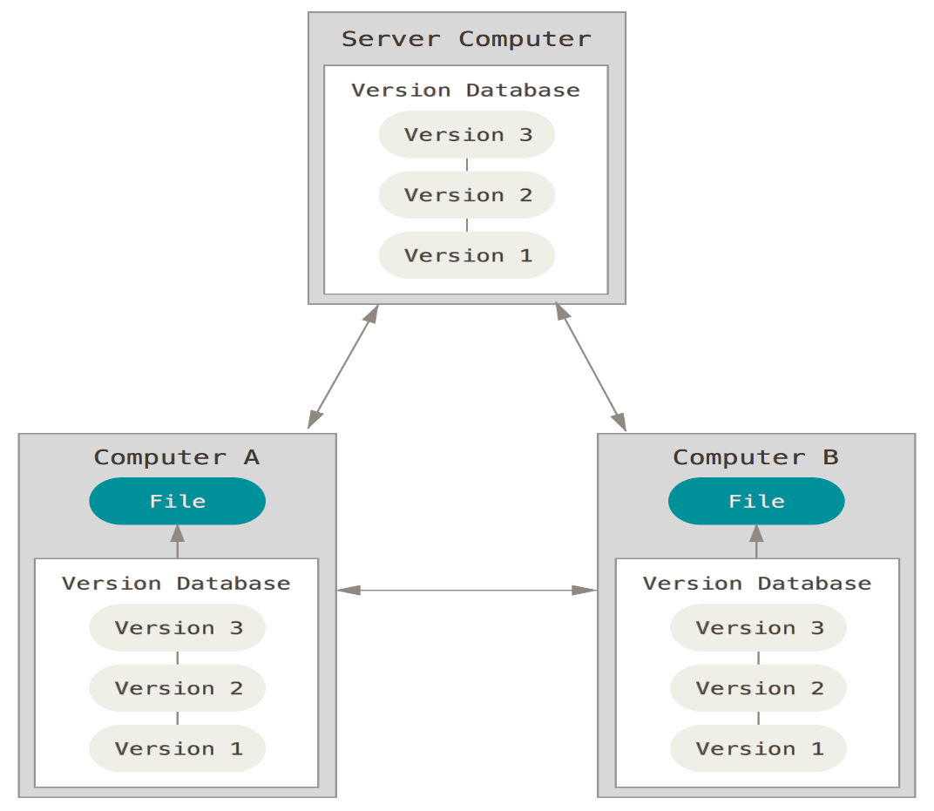
Distributed Version Control Systems
In a DVCS (such as Git, Mercurial, Bazaar or Darcs), clients don’t just check out the latest snapshot of the files: they fully mirror the repository.

Slide 11
History
Git was initially designed and developed in 2005 by Linux kernel developers (including Linus Torvalds) for Linux kernel development.

Slide 12
Some Advantages of Git
Strong support for non-linear development
Nearly every operation in local
You need internet if and only if you want to upload your workspace to server.
Distributed development
Efficient handling of large projects

Slide 13
Live Coding

Slide 14
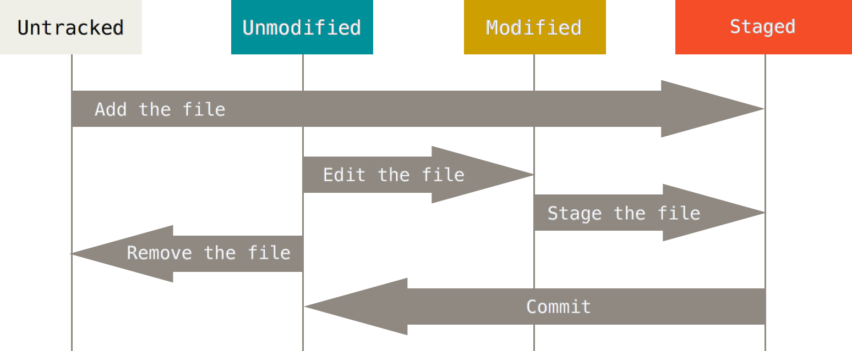

Slide 15



Different web-based Git repository hosting services

Slide 16

Move Further More
English version:
https://progit.org/
Turkish version:
https://git-scm.com/book/tr/v1

