Slide 1
Inventory Management System
Nathaniel Inman Michael Stowe Terry Kleoppel Lucas Gillespie

Slide 2
Terry’s slides are after this slide
Terry covers Purpose, GUI, & How to use it

Slide 3
Design

Slide 4
Mike’s slides go after this one
Mike covers: How it Works, and components

Slide 5
Lucas’s slides go after this
Lucas covers Architecture, predominately UML diagram’s and some descriptions

Slide 6
Structure

Slide 7
Nathan’s slides go after this
Nathan covers architecture p2 and future plans

Slide 8
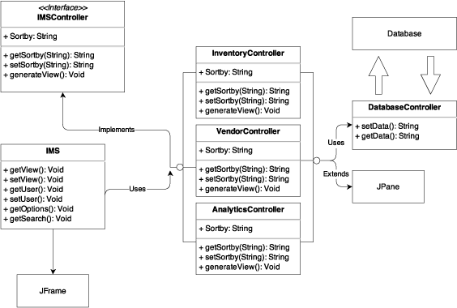
Model View Controller

Slide 9
Debugging

Slide 10
Data

Slide 11
Database Controller

Slide 12
Unit & Integration Testing

Slide 13
References
https://www.draw.io – UML Diagram system used for DD
yWorks Doclet – Auto-documentation system designed for Java
www.gradle.org – Automated Unit Testing Environment
Pegdown Doclet project - Replaces comments with Markdown

