Slide 1
Inventory Management System
Nathaniel Inman Michael Stowe Terry Kleoppel Lucas Gillespie

Slide 2
Terry’s slides are after this slide
Terry covers Purpose, GUI, & How to use it

Slide 3
Design

Slide 4
Mike’s slides go after this one
Mike covers: How it Works, and components

Slide 5
Lucas’s slides go after this
Lucas covers Architecture, predominately UML diagram’s and some descriptions

Slide 6
Structure

Slide 7
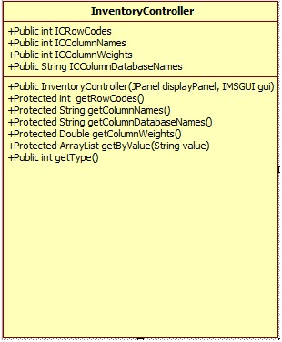
InventoryController
What does it do?
It controls the main aspects of an inventory.
InventoryController gets the ID, Name, Price, Wholesale, Category, Vendor ID, Royalty ID, Description, Picture, and Preferred Stock,

Slide 8
Nathan’s slides go after this
Nathan covers architecture p2 and future plans

Slide 9
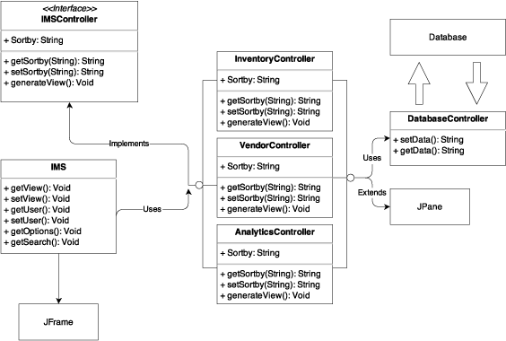
Model View Controller

Slide 10
Debugging

Slide 11
Data

Slide 12
Database Controller

Slide 13
Unit & Integration Testing

Slide 14
References
https://www.draw.io – UML Diagram system used for DD
yWorks Doclet – Auto-documentation system designed for Java
www.gradle.org – Automated Unit Testing Environment
Pegdown Doclet project - Replaces comments with Markdown

