Slide 1
Inventory Management System
Nathaniel Inman Michael Stowe Terry Kleoppel Lucas Gillespie

Slide 2
Terry’s slides are after this slide
Terry covers Purpose, GUI, & How to use it

Slide 3
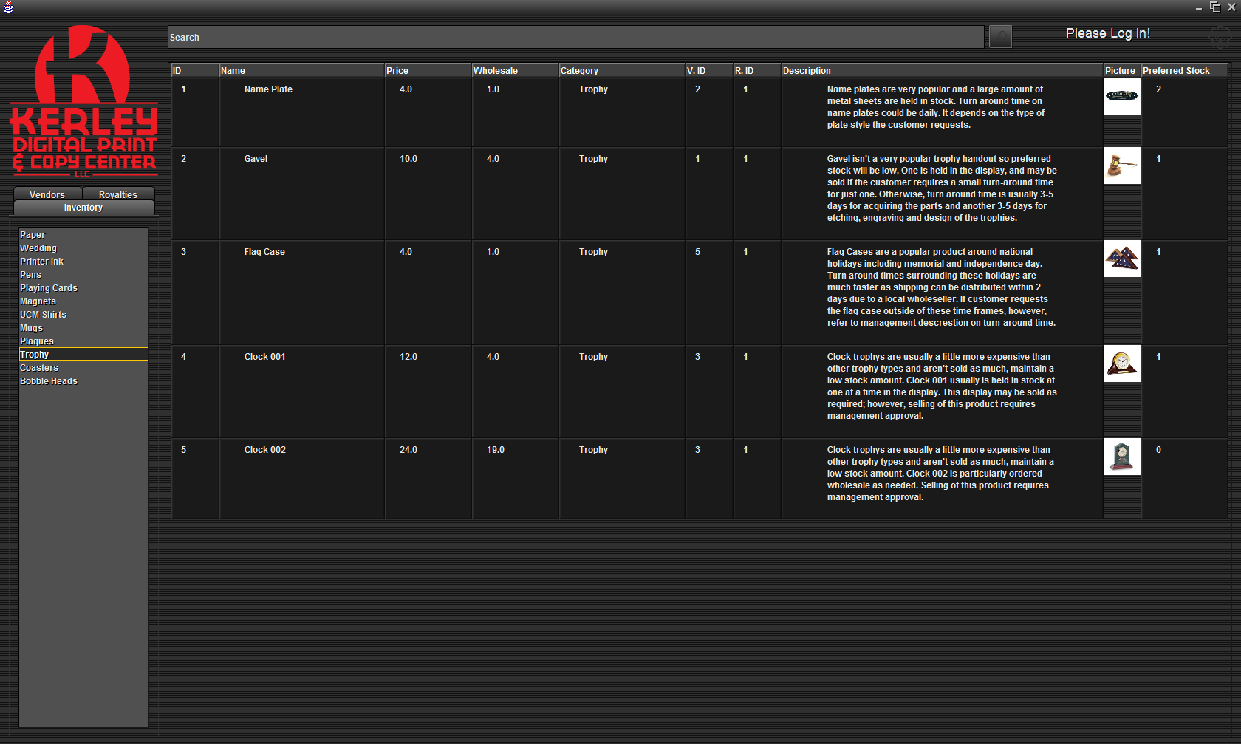
Design

Slide 4
Mike’s slides go after this one
Mike covers: How it Works, and components

Slide 5
Basic Functionality
User sends input to GUI
GUI sends input to database
Database sends output to GUI
GUI sends output to user
Notes:
“In the simplest terms, this is what our software does. We’ll go into more detail later.”

Slide 6
javax.swing
Standard library of lightweight display components
Easily define layouts and add components
Notes:
“You’re all probably familiar with this already.”

Slide 7
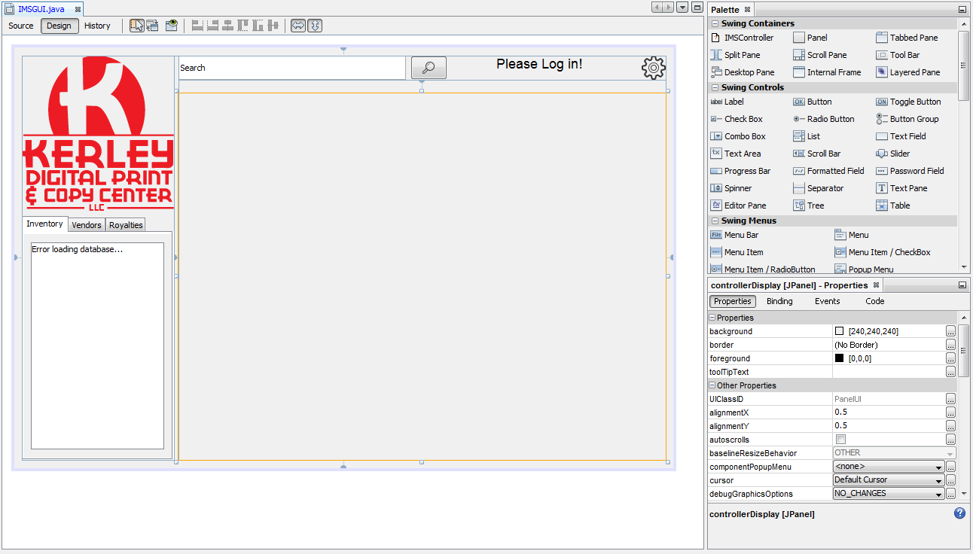
Our Design
Notes:
“This is the NetBeans GUI editor. We were able to design this in a WYSIWYG environment. The highlighted pane is where our main controller class will go, which uses handwritten code.”

Slide 8
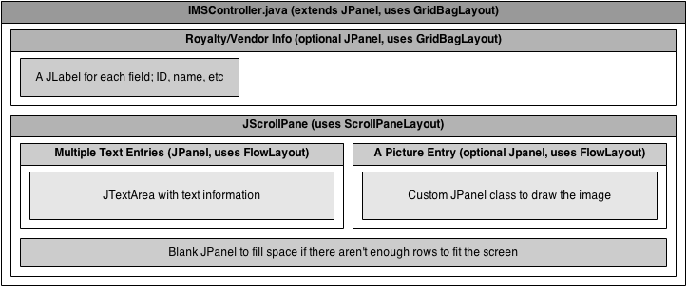
Our Design
Notes:
I’m just going to briefly explain everything here.

Slide 9
Implementation Challenges
We had to write our own text wrapping function
We had to make a custom JPanel class for images
The subtle differences between classes such as JLabel, JTextPane, and JTextArea, as well as between different layout options, caused confusion
Notes:
I’m just going to briefly go over some of the things that gave us (me) the most trouble.

Slide 10
Lucas’s slides go after this
Lucas covers Architecture, predominately UML diagram’s and some descriptions

Slide 11
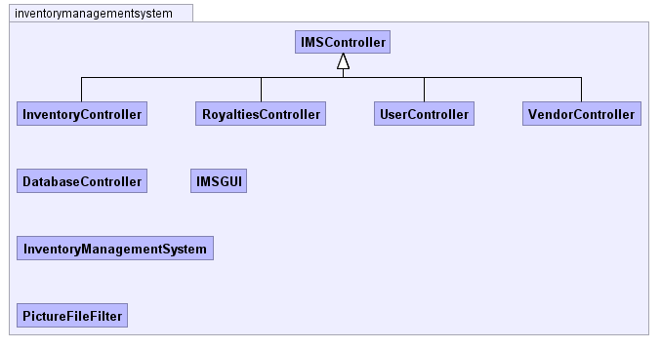
Structure

Slide 12
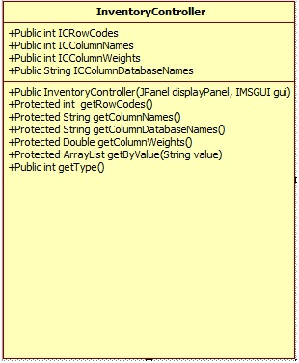
InventoryController
What does it do?
It controls the main aspects of an inventory.
InventoryController gets the ID, Name, Price, Wholesale, Category, Vendor ID, Royalty ID, Description, Picture, and Preferred Stock,

Slide 13
Nathan’s slides go after this
Nathan covers architecture p2 and future plans

Slide 14
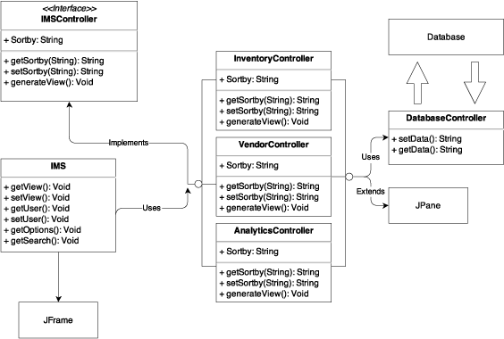
Model View Controller

Slide 15
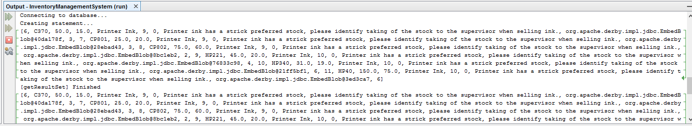
Debugging

Slide 16
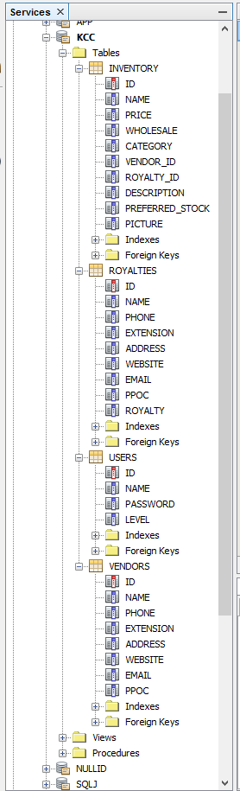
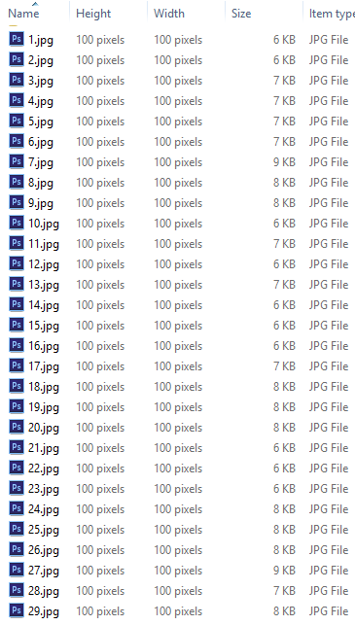
Data

Slide 17
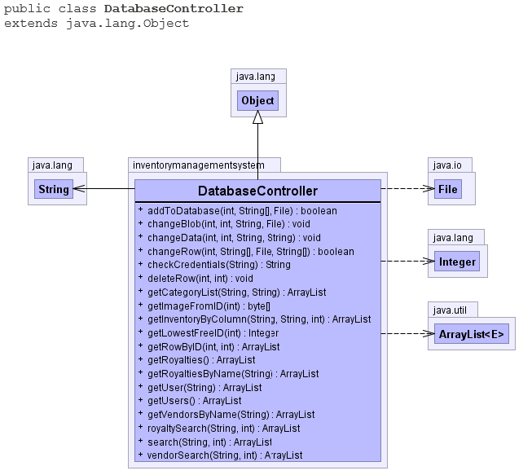
Database Controller

Slide 18
Unit & Integration Testing

Slide 19
References
https://www.draw.io – UML Diagram system used for DD
yWorks Doclet – Auto-documentation system designed for Java
www.gradle.org – Automated Unit Testing Environment
Pegdown Doclet project - Replaces comments with Markdown

