Slide 1
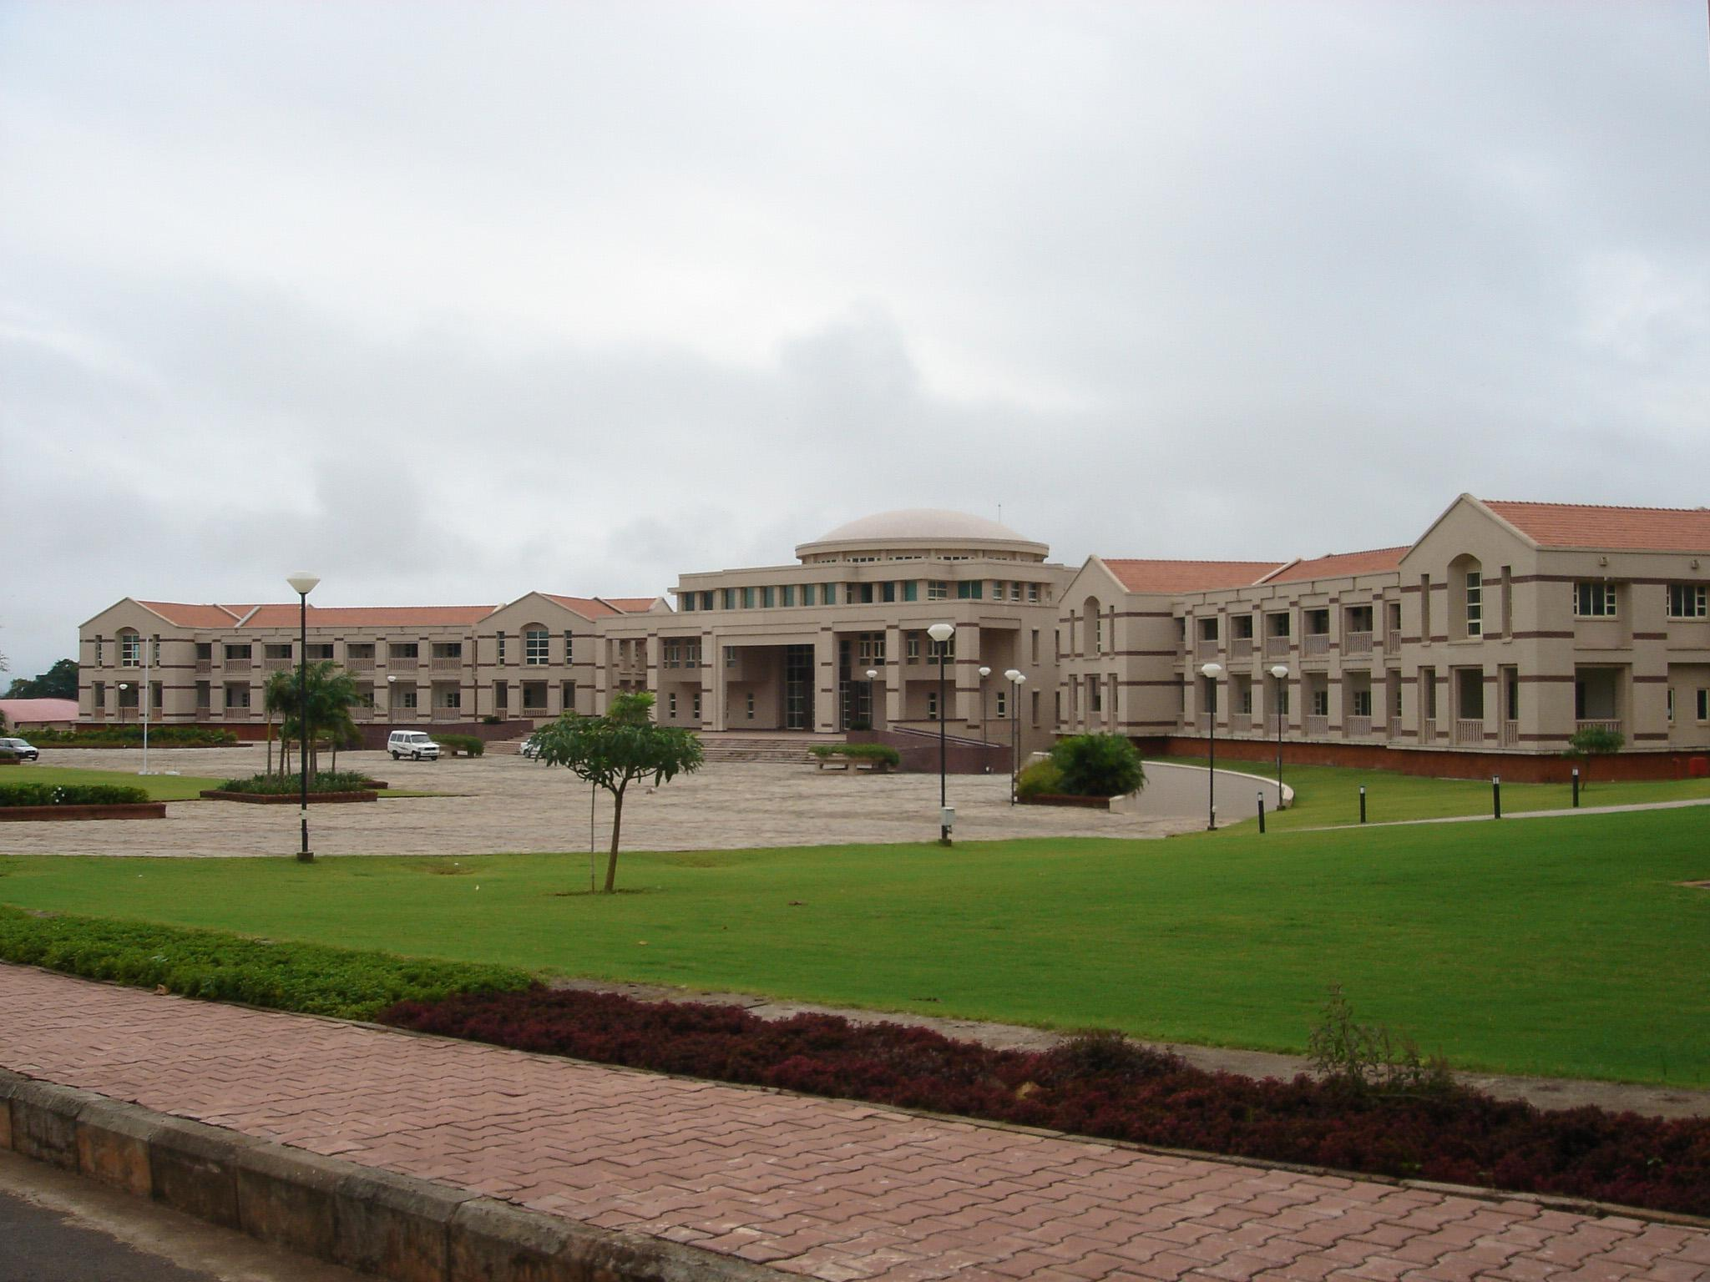


Getting started with ROBOTICS
For the partial fulfillment of:
PS-II internship @ UST-Global, Trivandrum
Presented by:
Prateek Nanhorya 2019A4PS0564G
K.K. Birla, Goa Campus

Slide 2
Getting Started with Robotics
Instantiating AMR Development in Dynamic Environment
Project @ UST
“Path planning in Dynamic environments using more efficient algorithms”
AMR deployment in dynamic environment so that it can adjust in any warehouse environment
Avoid the use of guide lanes/ guide points
Using RRT* path planning algorithm

Slide 3
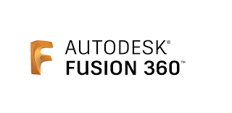
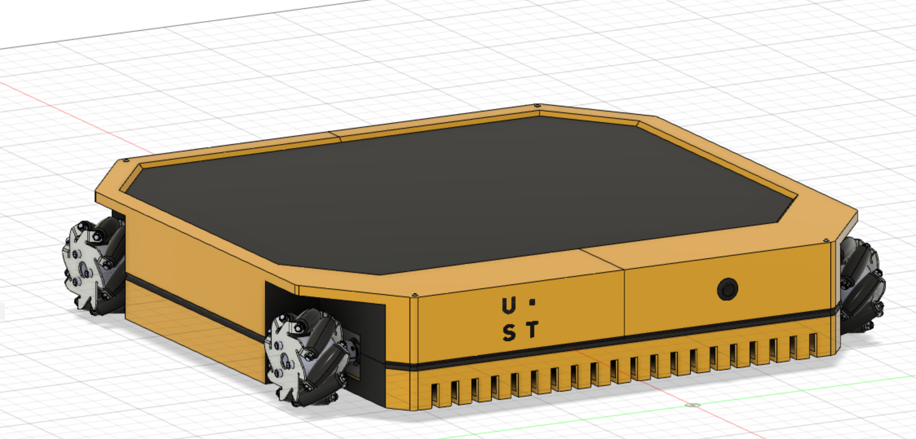
CAD model
Efficient Design
Aesthetic looks
Analysis
  Payload Analysis
  Material Strength

Slide 4
Hardware Interfacing
Software
development

Slide 5
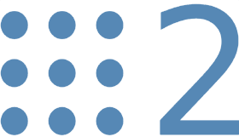

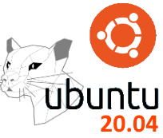
ROS2
Open Source robot software development platform
Availability of proper documentation
Ample amount of examples to refer to
Multiple libraries to develop a robot and simulate it
(Not the latest version)
Requirement
Debian based Linux OS. Ubuntu 20.04 – Focal Fossa

Slide 6
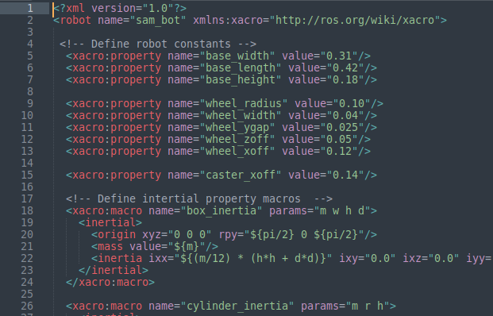
Creating URDF file
<XML> file format
Convert CAD model to .urdf format
Apply
Setting up
Setting up
Transformations
Odometry
Sensors
Software and Hardware

Slide 7
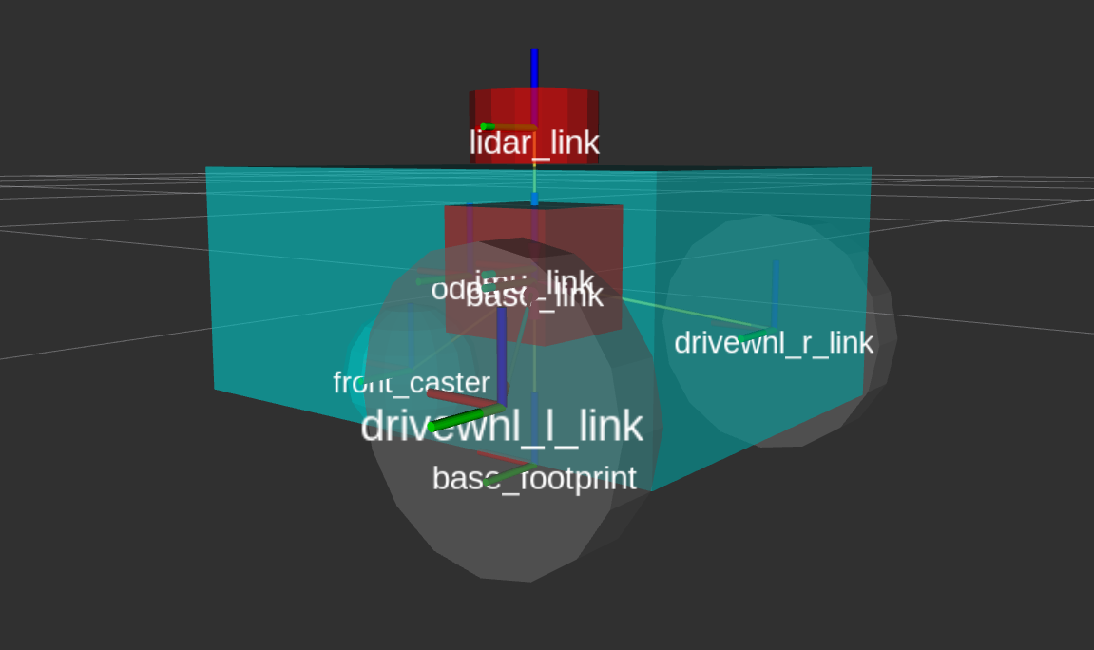
Creating Transformations
What is ?
Coordinate frame for each movable joint
To implement Navigation algorithms, three types off transformations are necessary.
  Map(environment/surroundings) Odom
  Odom(Wheels) Base-Link
  Base-Link(Center) Base-Laser(Sensors)
RViz
URDF

Slide 8
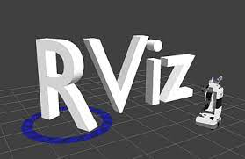
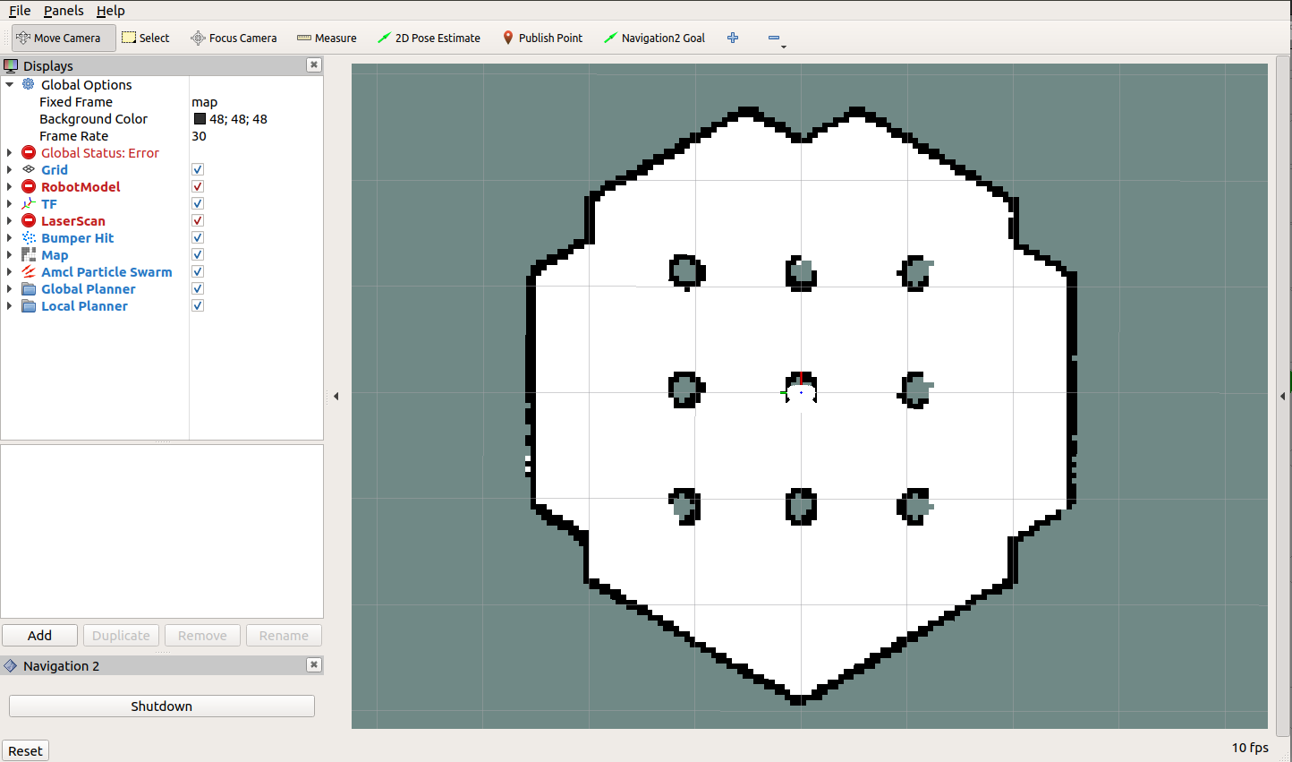
RViz
Rviz is a “Robot state Publisher”, GUI tool used to:
Represent robot transformations
Represent the environment perceived by the robot using sensors
Transformations

Slide 9
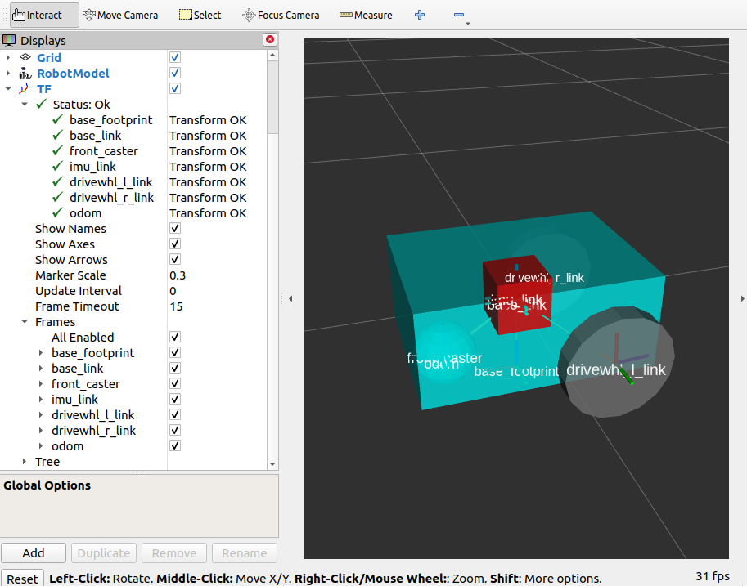
Setting up Odometry
provides a locally accurate estimate of a robot’s pose and velocity based on its motion
IMU, LIDAR, RADAR, VIO, and wheel encoders
URDF

Slide 10
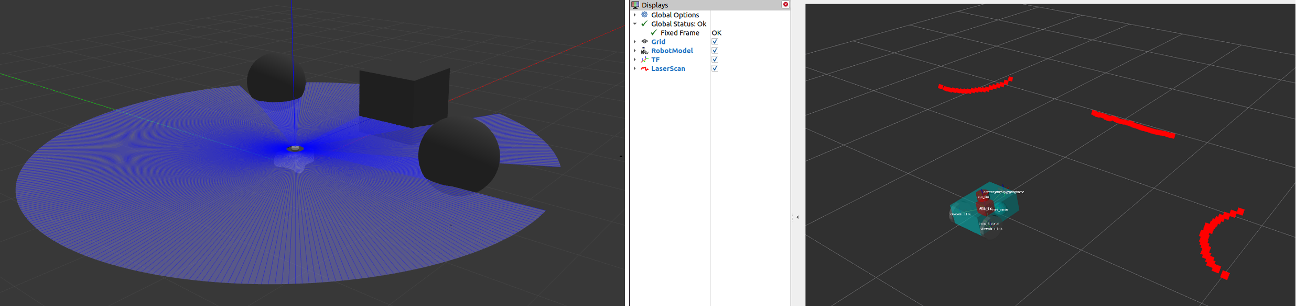
Setting up Sensors
Purpose:
Maintain map of the environment
Localize robot on the map
See the obstacles in the environment
GAZEBO
How to simulate physical environment?
Examples:
Lidar
Radar
RGB camera
Depth camera
IMU
GPS

Slide 11

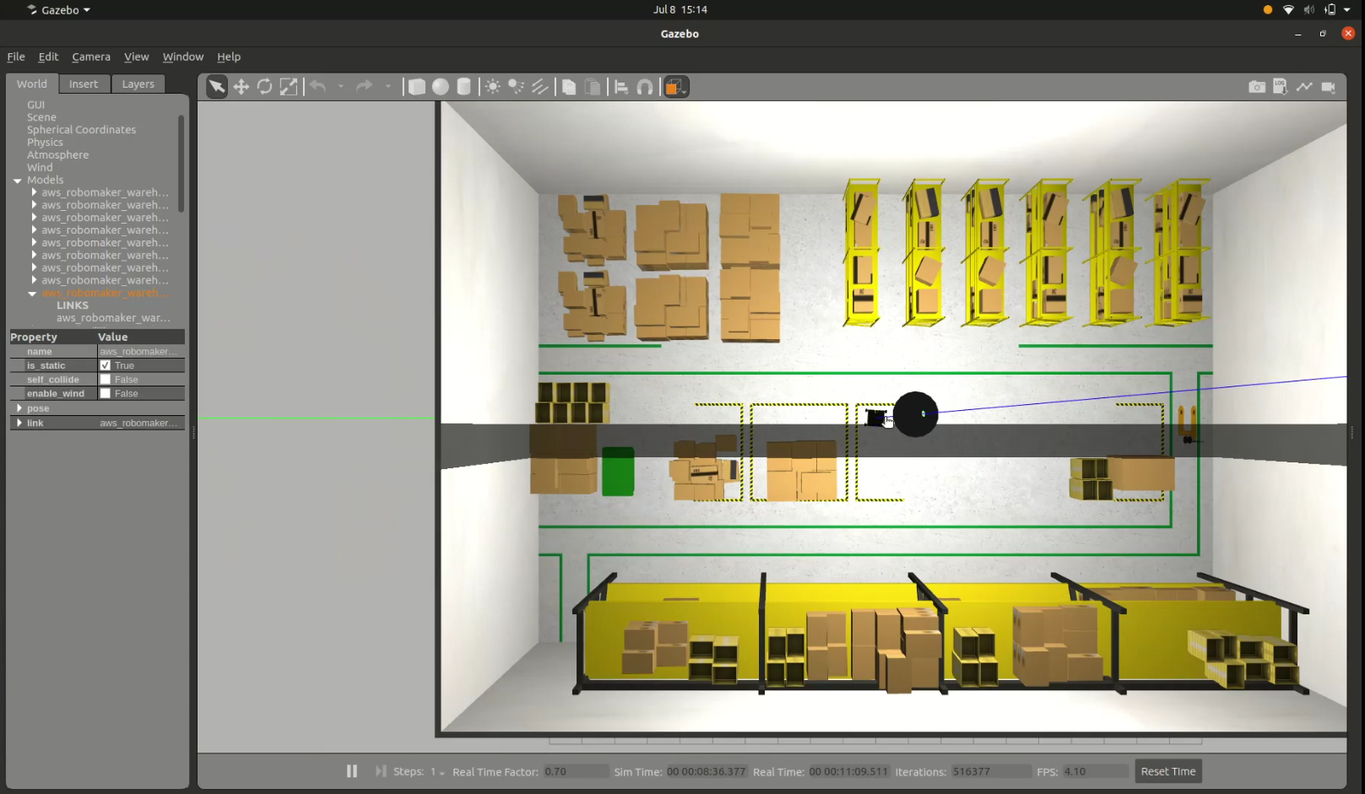
Gazebo
Gazebo is a stand-alone application which can be used independently of ROS 2. The integration of Gazebo with ROS is done through a set of packages called gazebo_ros_pkgs.
warehouse.world
URDF

Slide 12
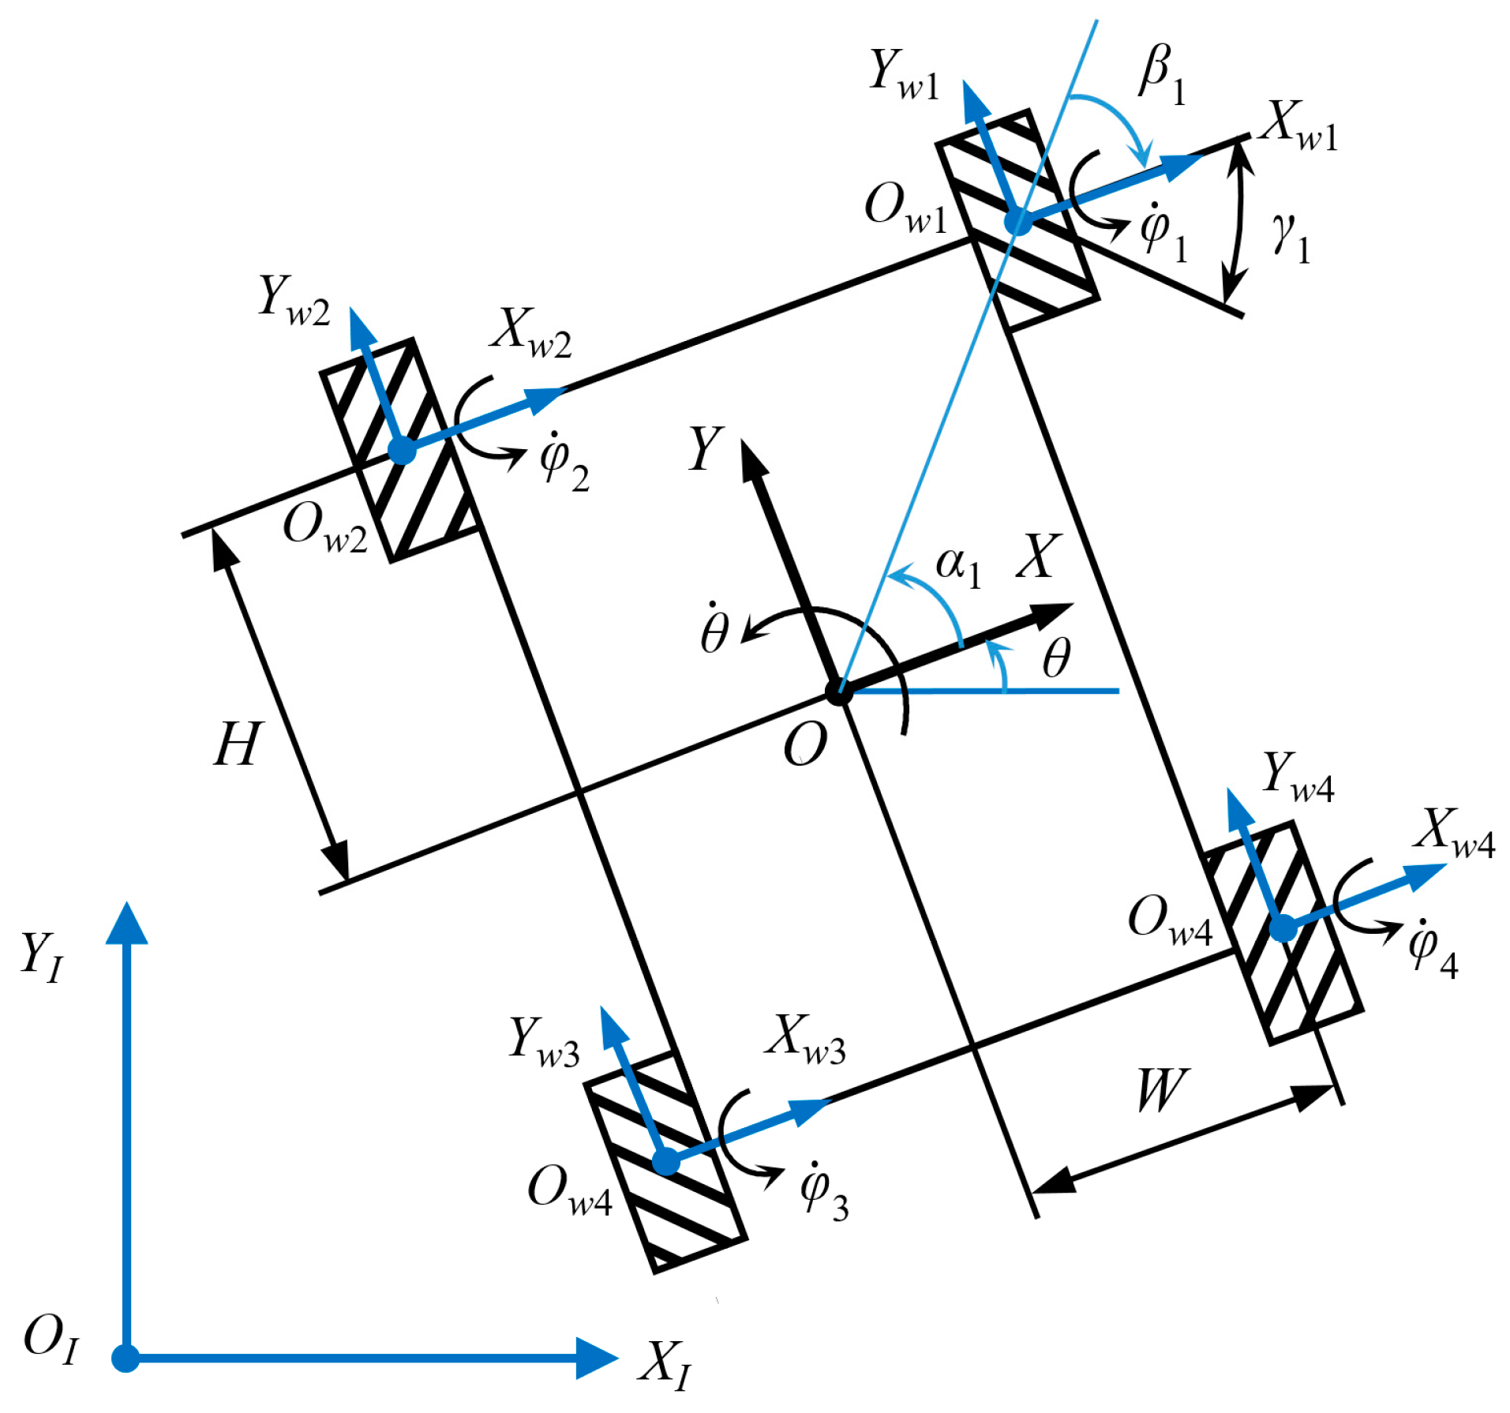
Mecanum Wheel Kinematics
Forward Kinematics:
Given the change in wheels angle, the change in position of the robot and velocity of the robot (including angular velocity) must be calculated
Inverse Kinematics:
Given the velocity of the robot (both linear and angular) the individual wheel velocities which matches the robot velocity must be calculated

Slide 13
Command flow
C1
C2
Convert robot velocity to individual wheel velocity using inverse kinematics
cmd_vel/
Convert wheel velocity to encoder velocity
C4
C3
motors
Move to encoder target using PID control and control motor accordingly
Encoder velocity to encoder target

Slide 14
Feedback Flow
F1
F2
F3
motors
Update current encoder count and change in encoder count
Calculate change in wheel angle using encoder change
Use forward kinematics to get change in robot pose
F5
F4
Convert the calculated values to odometry message
Using the change in pose calculate new pose and velocities
odom/

Slide 15
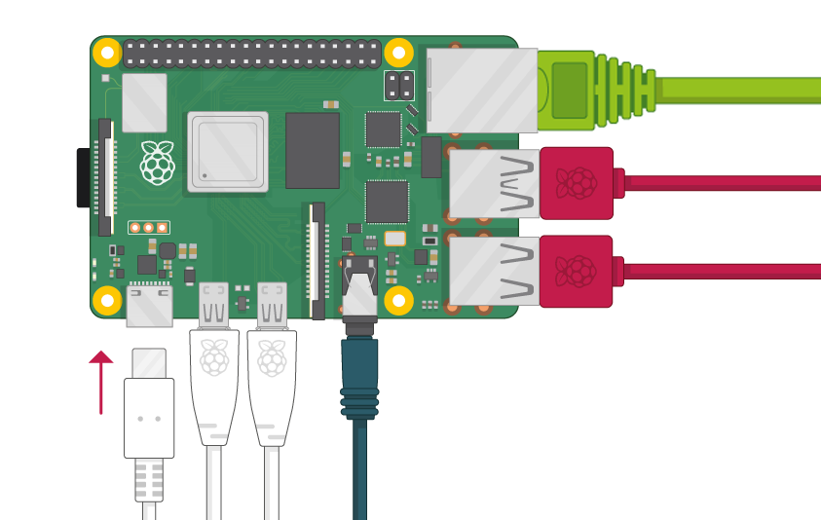
Raspberry pi 3b+
Low cost, credit-card sized computer
Tech specs.
  Cortex-A53 (ARMv8) 64-bit SoC @ 1.4GHz
  1GB LPDDR2 SDRAM
  2.4GHz and 5GHz wireless LAN
  Bluetooth 4.2, BLE
  Gigabit Ethernet over USB 2.0
  Extended 40-pin GPIO header
  Full-size HDMI
  4 USB 2.0 ports
  Micro SD port for loading your operating system and storing data
  CSI camera port
  DSI display port
Capable of running ROS2 utilities in UBUNTU-20.04

Slide 16
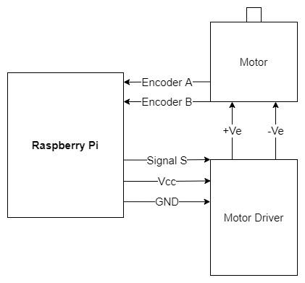
Single Motor Connection

Slide 17
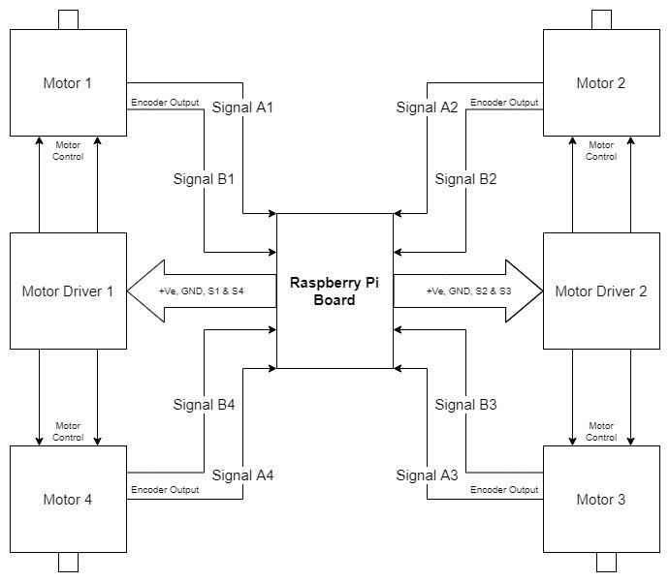
Complete Motor Connection

Slide 18
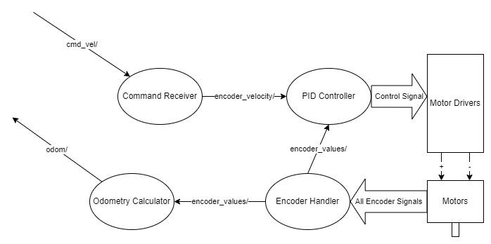
Odometry calculation in a nutshell
Wheel control
Software
Hardware

Slide 19
AMR Simulation

Slide 20
Thank you

