Slide 1
MicroROS on FreeRTOS https://micro.ros.org/docs/tutorials/core/first_application_rtos/freertos/

Slide 2
Accessing GPIO pins in ESP32
FreeRTOS
Peripheral API: Accessing GPIO pins

Slide 3
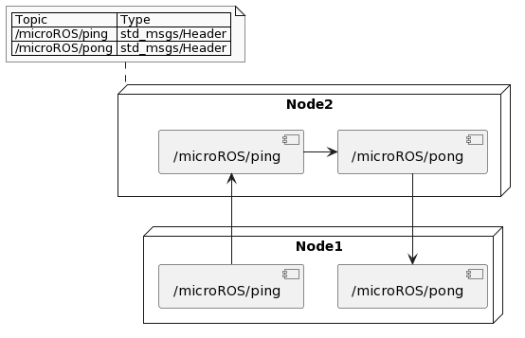
Rough idea of accessing Odom output

Slide 4
Getting familiar with Obsidian
Making Launch files…. Contd..
Getting Familiar with tf2
URDF file creation within ROS2 tutorials
Mecanum wheel kinematics
Control Theory (PID)

Slide 5
Ultimate goal
Make complete setup to be able to run c++ navigation algorithms on hardware using Nav2 lib
Making and implementing custom algorithms
Present a simulation of robot of choice (Deadline 28 Oct)

