Slide 1
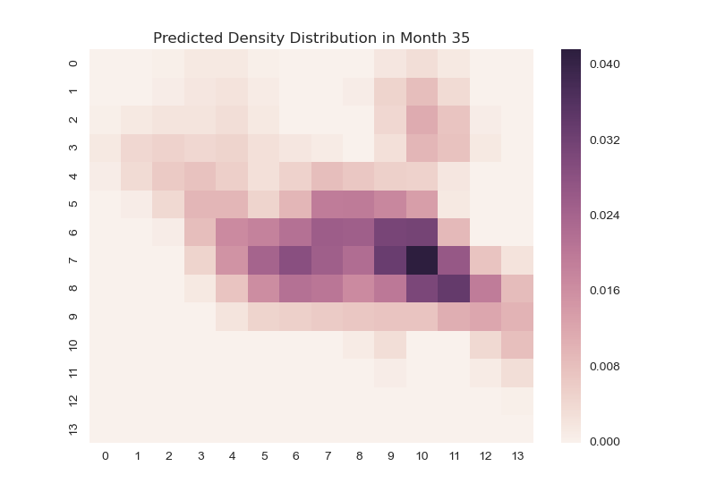
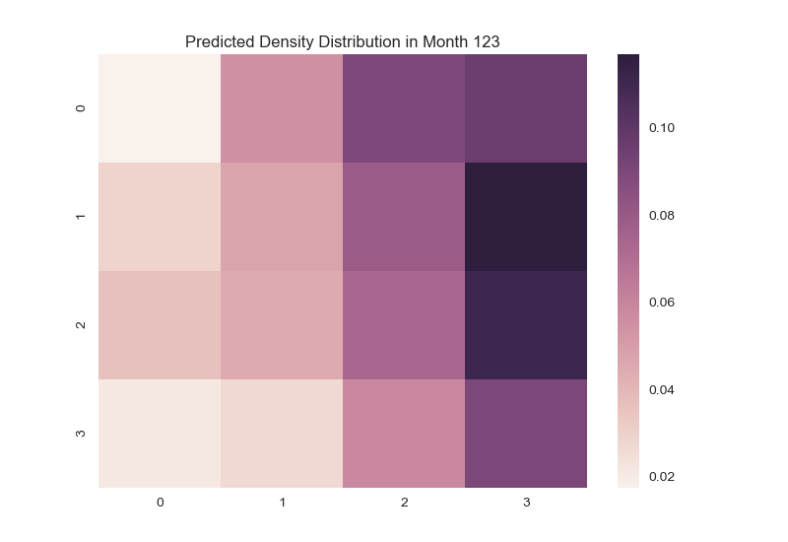
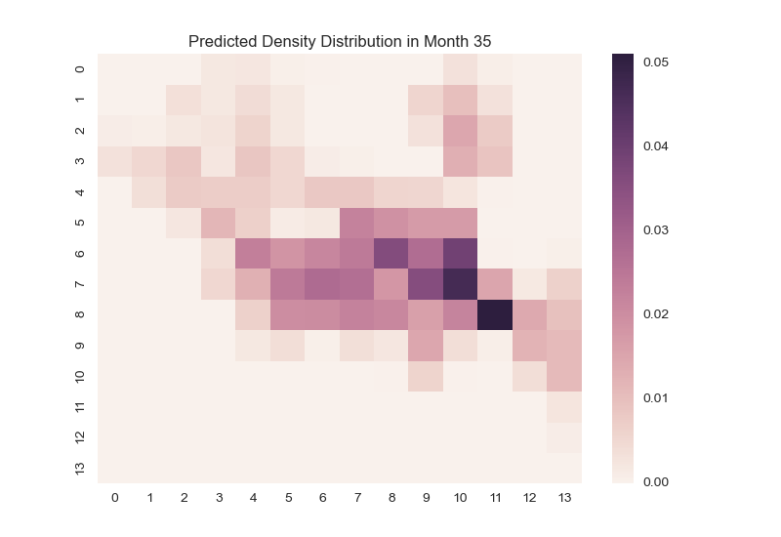
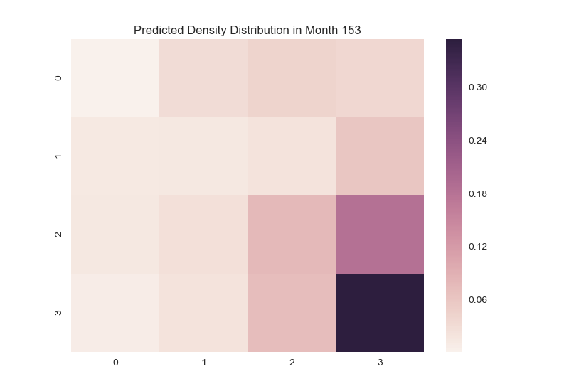
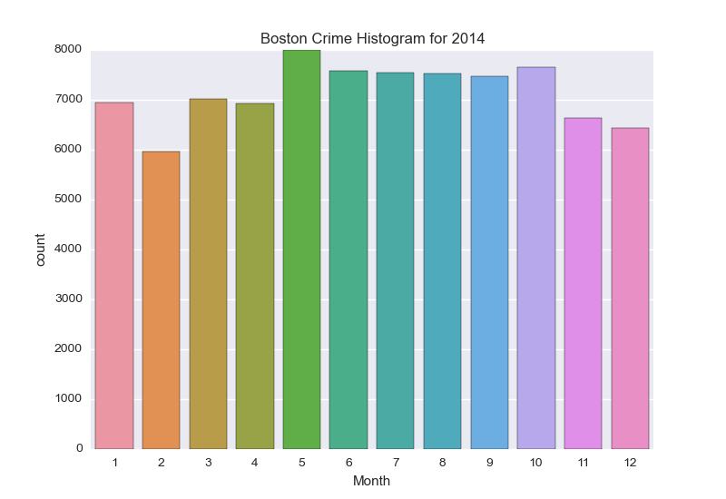
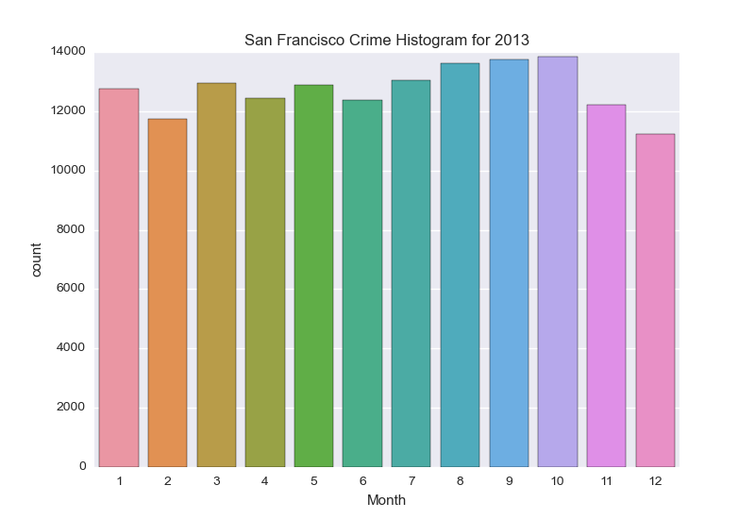
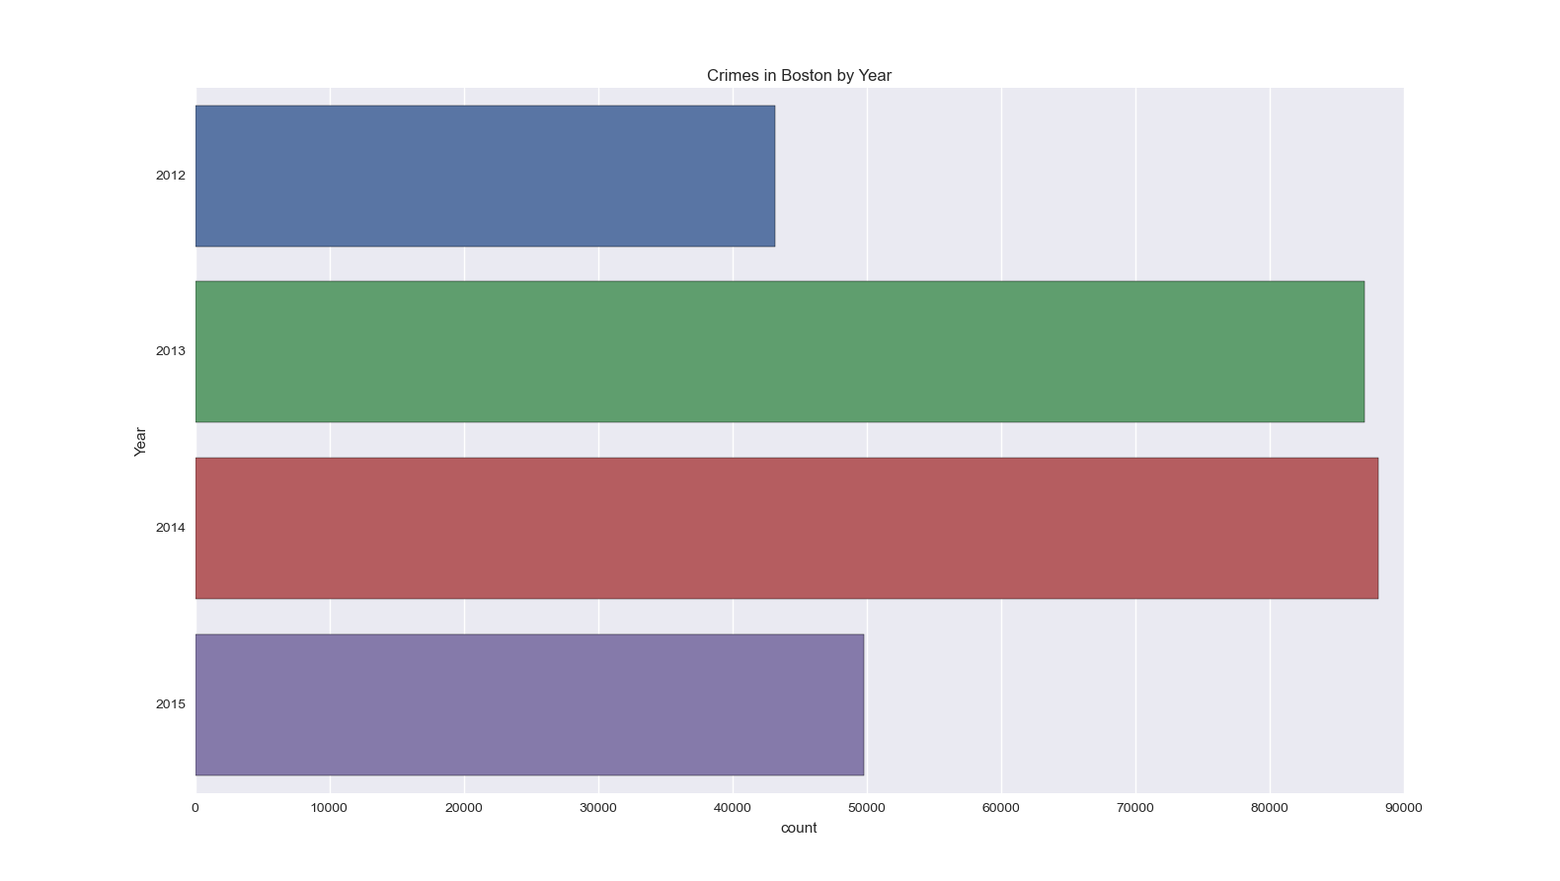
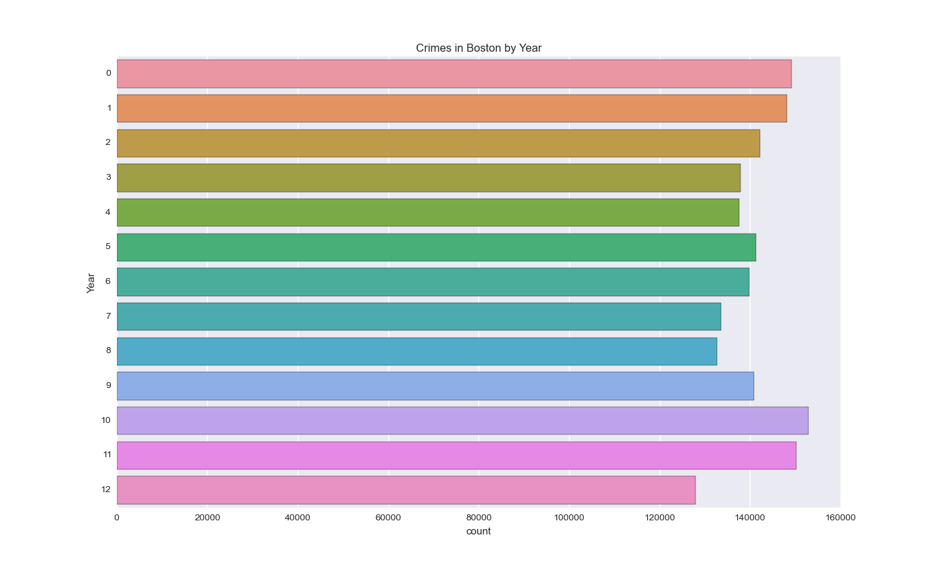
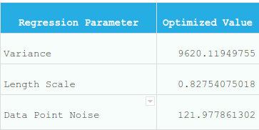
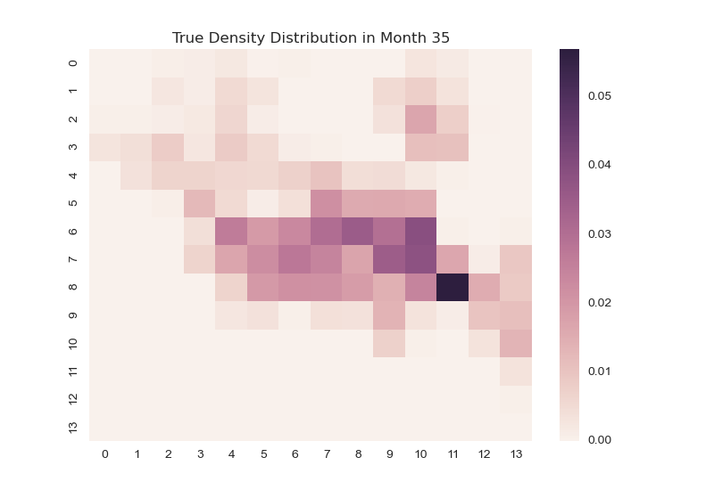

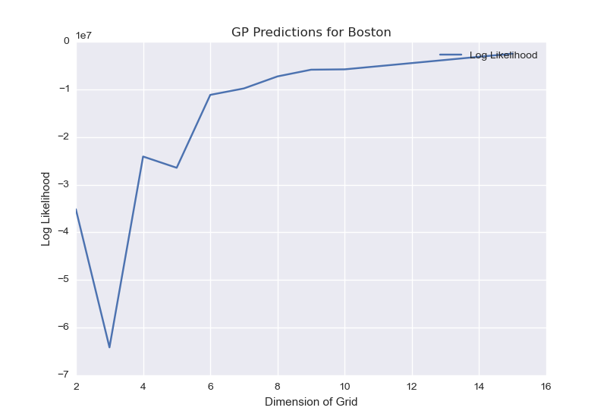
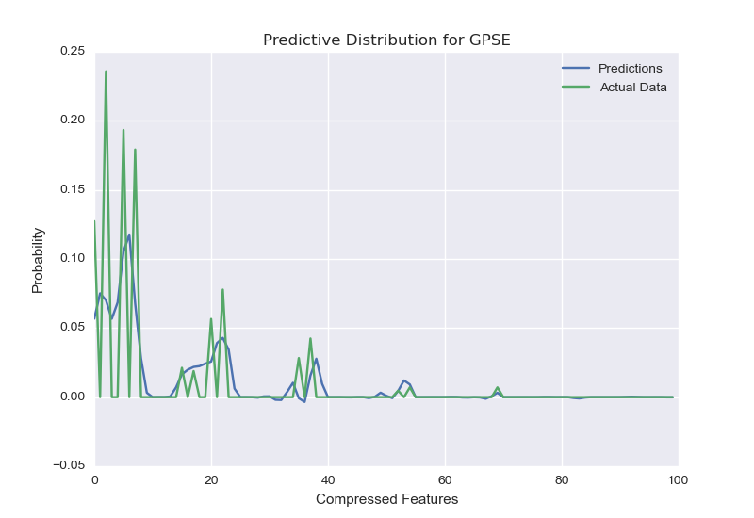
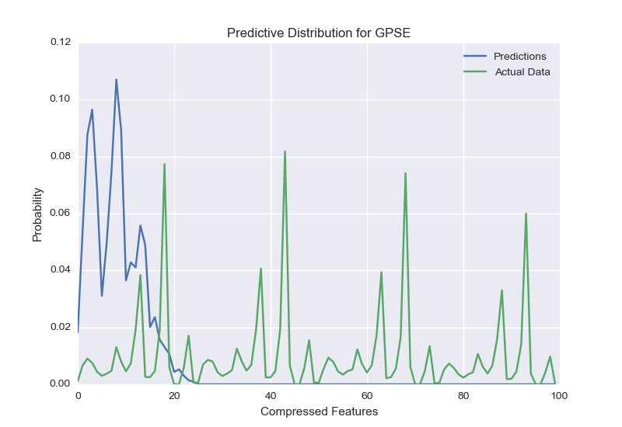
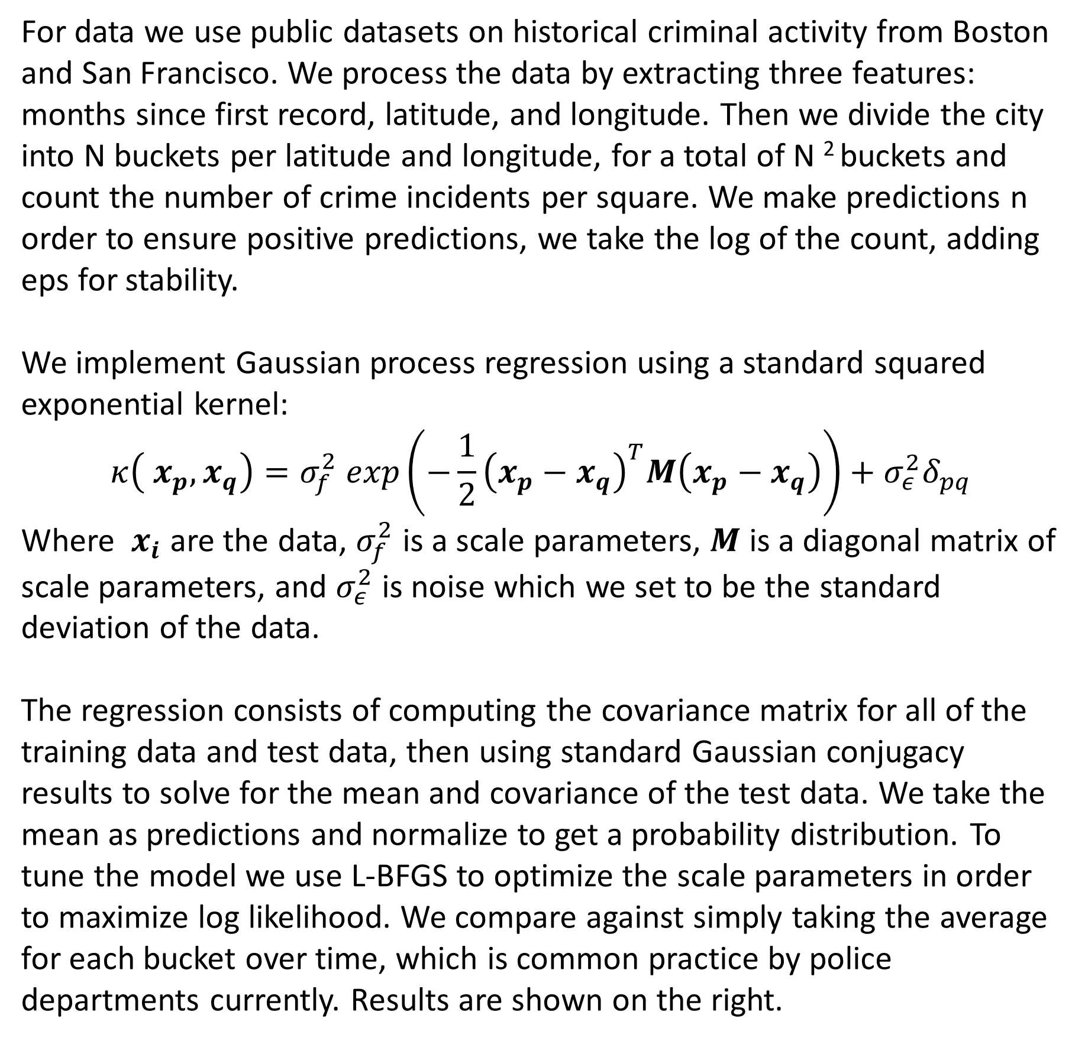
Gaussian Process for Crime Prediction in the Cities of Boston and San Francisco
Luis A. Perez¹, Alex Wang¹
CS281: Advanced Machine Learning, Harvard University
Abstract
Methodology
Results
Gaussian processes are a powerful Bayesian non-parametric model for machine learning that, unlike parametric models, can learn the underlying functions themselves. They have been successful when applied to a variety of tasks, such as inferring CO2 levels or detecting human motion. In this paper, we consider the problem of predicting future crime in a geographic area. Though average crime rates in the United States have been in the decline for the last few years, it is still useful to many groups, such as law enforcement, city officials, home buyers, etc., to be able to predict where and when crime will occur. Using recent data from various cities around the U.S., we explore how Gaussian processes under a variety of different kernels might help with this regression task. We compare these models to current baseline approaches which consists of taking the average over time or using linear regression along with other approaches..
For data we use public datasets on historical criminal activity from Boston and San Francisco. We process the data by extracting three features: months since first record, latitude, and longitude. Then we divide the city into N buckets per latitude and longitude, for a total of N ² buckets and count the number of crime incidents per square. We make predictions n order to ensure positive predictions, we take the log of the count, adding eps for stability.
We implement Gaussian process regression using a standard squared exponential kernel:
$$κ\left( x_{p}, x_{q}\right)=σ_{f}^{2} exp\left(−\frac{1}{2}{\left(x_{p}−x_{q}\right)}^{T}M\left(x_{p}−x_{q}\right)\right)+σ_{ε}^{2}δ_{pq}$$
Where $x_{i}$ are the data, $σ_{f}^{2}$ is a scale parameters, $M$ is a diagonal matrix of scale parameters, and $σ_{ε}^{2}$ is noise which we set to be the standard deviation of the data.
The regression consists of computing the covariance matrix for all of the training data and test data, then using standard Gaussian conjugacy results to solve for the mean and covariance of the test data. We take the mean as predictions and normalize to get a probability distribution. To tune the model we use L-BFGS to optimize the scale parameters in order to maximize log likelihood. We compare against simply taking the average for each bucket over time, which is common practice by police departments currently. Results are shown on the right.
Boston
San Francisco
GP
Analysis
Avg
c1
c2
Patterns in data the city crime data for Boston (left) and San Franscisco (right) for a representative year (top) and over all years (bottom)
f1
f2
Input Vector 1
Input Vector 2
True
Left: Model of GP Likelihood vs. Grid Size for Boston
Above: Optimized Model Hyper parameters for Boston Region discretized into 225 buckets.
X.
Y
T
X.
Y
T
Future Work
Above: Geographic heatmaps of Crime Distributions for Boston (left) and San Francisco (right) for t = 35, 153 months, n=15, 5 respectively, as predicted by a Gaussian process with squared exponential kernel under no transformation (top), the baseline of average over months (middle), and the true hold-out crime distribution (bottom).
Data is learned under partitioning into 225 regions (Boston) and 25 (San Francisco), due to computational limitations.
Explore kernels more suited to the problem domain, specifically periodic kernels that capture the cyclic nature of crime and its variants when combined with linear and squared exponential kernels:
- SE * periodic (locally exponential): periodic functions that
can vary over time
- Linear * periodic: periodic function with varying
amplitude
- Linear + periodic: periodic function with increasing mean
Acquire access to greater computational resources or explore less costly regression in order to explore larger datasets (e.g. Chicago), greater buckets per dimension (i.e. larger N), and/or finer temporal discretization
Determine a realistic noise parameter and explore its effects on the regression
References
Left: Predictive and True Crime
Distributions over Compressed Feature Space for Boston using GP model with RBF Kernel.
Right: Predictive and True Crime Distributions over Compressed Feature Space for San Francisco using GP model with RBF Kernel.
[1] Murphy, Kevin P. Machine Learning: A Probabilistic Perspective. Cambridge, MA: MIT, 2012. Print.
[2] Duvenaud, David. "The Kernel Cookbook:." Kernel Cookbook. Harvard SEAS, n.d. Web. 02 Dec. 2015.
[3] A. G. Wilson and R. Prescott Adams. Gaussian Process Kernels for Pattern Discovery and Extrapolation. ArXiv e-prints, February 2013.
[4] Wang, J.M.; Fleet, D.J.; Hertzmann, A., "Gaussian Process Dynamical Models for Human Motion," in Pattern Analysis and Machine Intelligence, IEEE Transactions on , vol.30, no.2, pp.283-298, Feb. 2008

