Slide 1
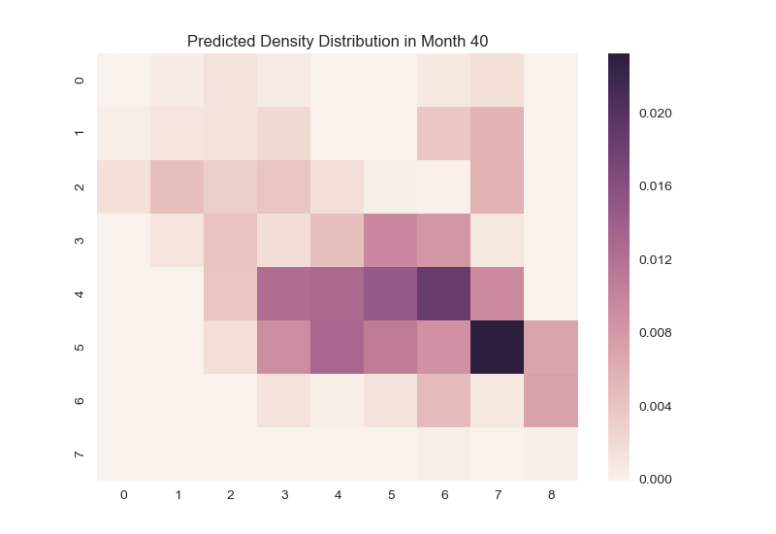
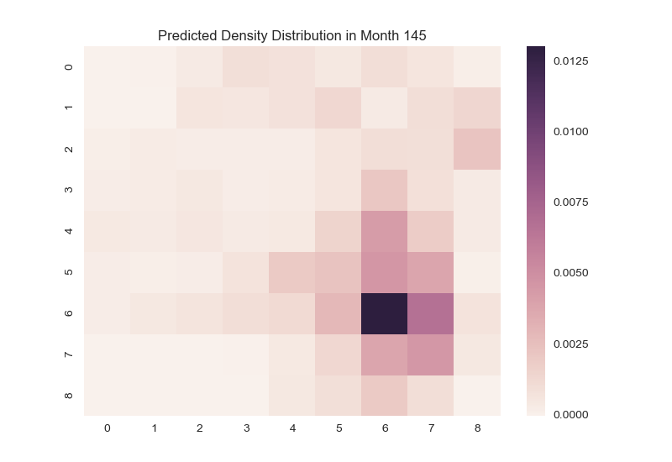
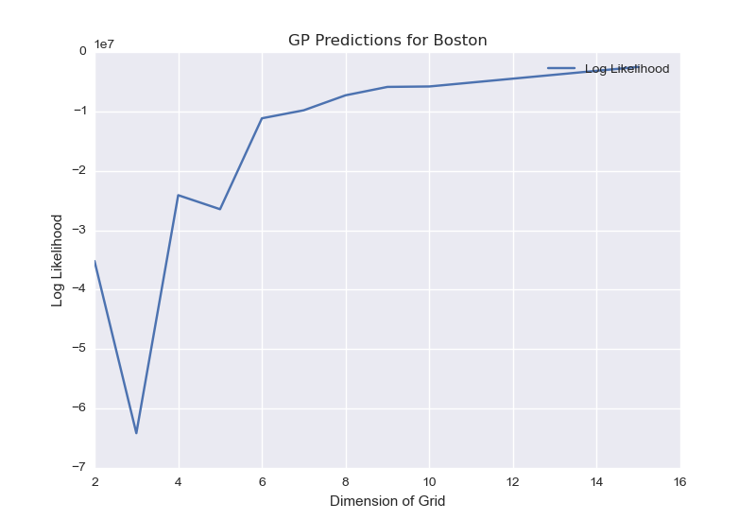
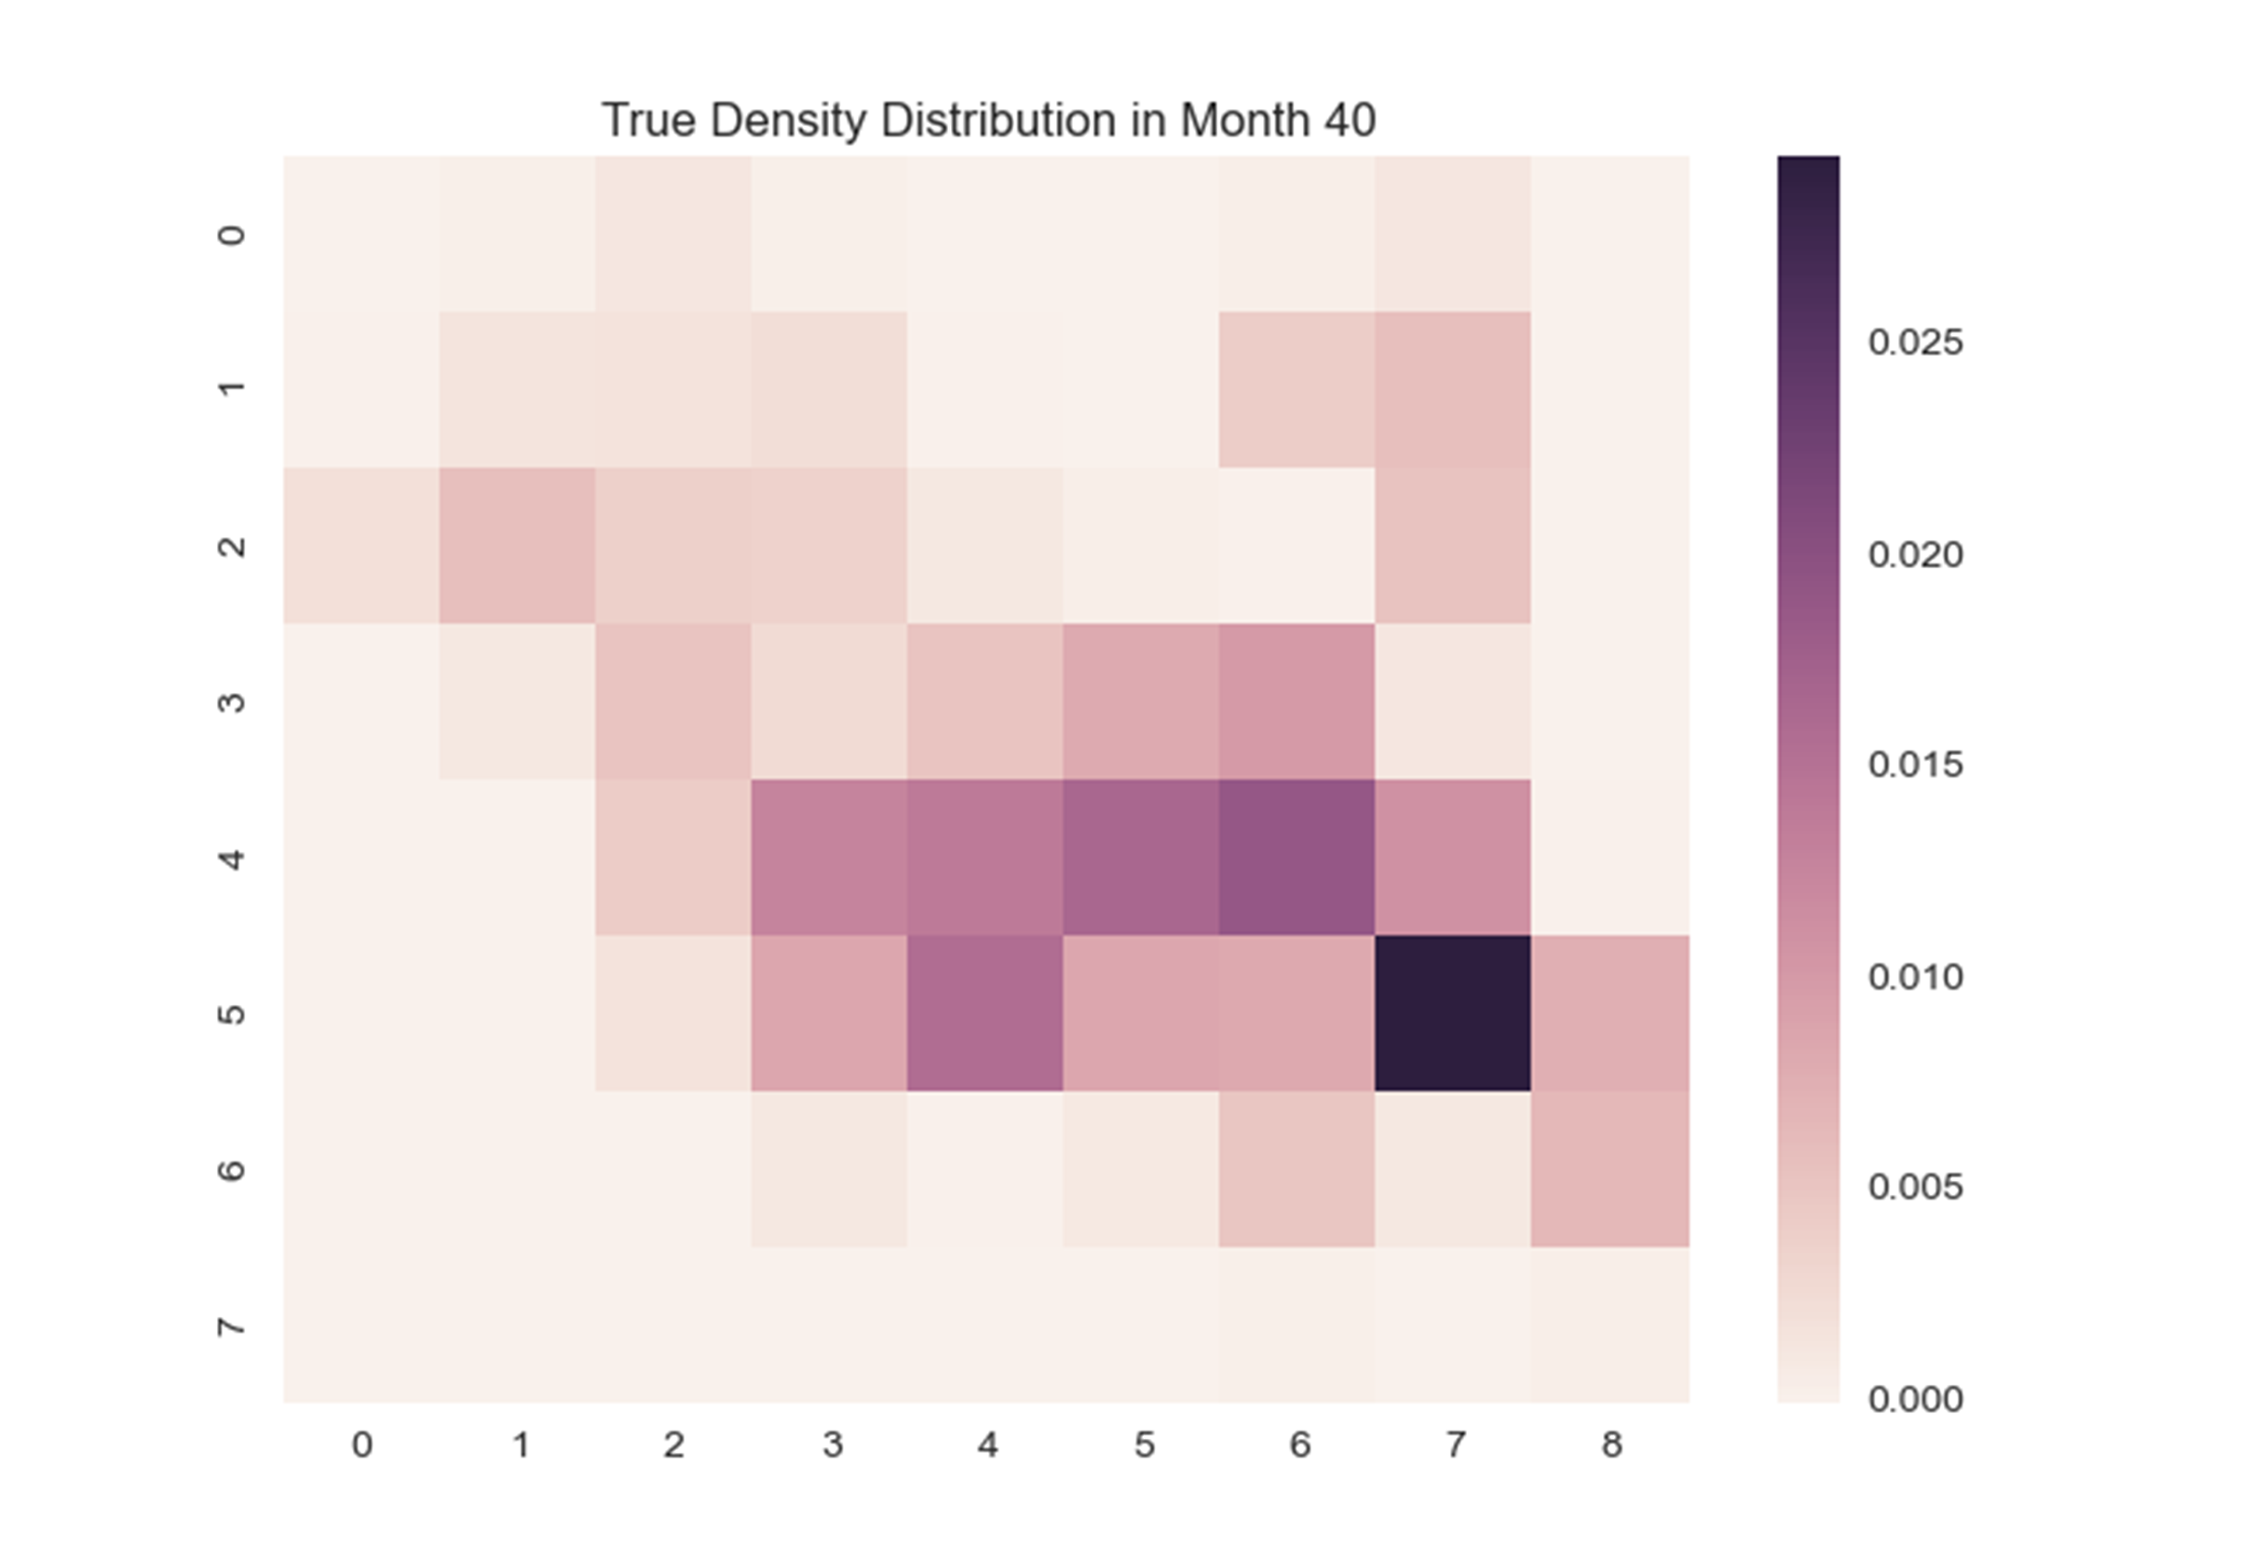
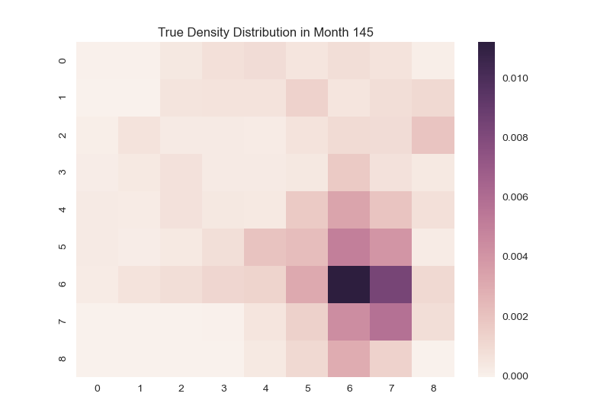
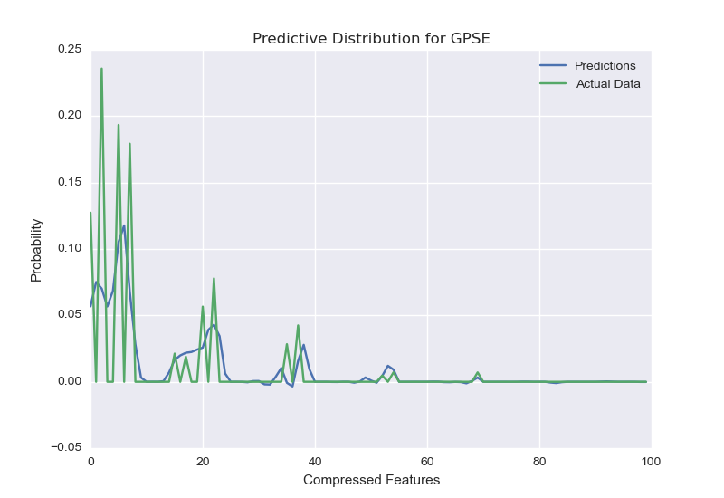
Gaussian Process for Crime Prediction
Luis Perez, Alex Wang
Abstract
Methodology
Results
TODO
We use public datasets from various
TODO
Boston
San Francisco
GP
Avg
Future Work
Explore kernels more suited to the problem domain, specifically periodic kernels that capture the cyclic nature of crime and its variants:
TODO
True
Above: GP marginal likelihood vs grid size Right: Predictive distribution vs true distribution for XXX
Above: heatmaps of crime incidence for Boston (left) and San Francisco (right) as predicted by a Gaussian process with squared exponential kernel (top), average over months (middle), and true (bottom)

