Slide 1
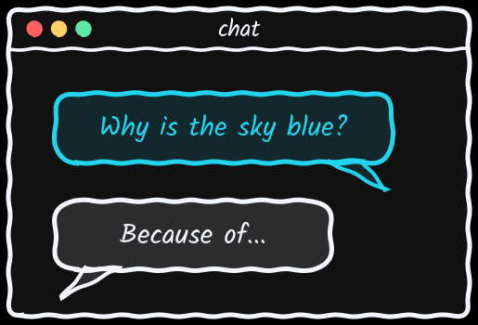
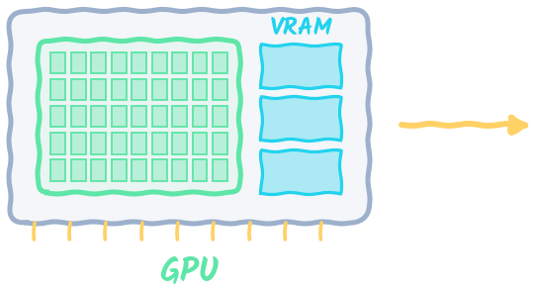
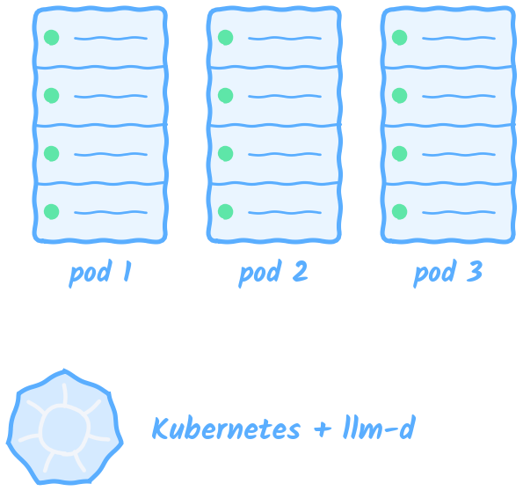

The Infrastructure Behind AI
What really happens after you press Enter — from one GPU to a whole fleet

Slide 2
Agenda
Click any section to jump straight to it — every slide has an Agenda button to come back
00 Introduction
06 Sharding Giant Models
01 What Is a Model?
07 Fleets & Why Load Balancing Breaks
02 Why Not Just Use Your Laptop?
08 llm-d: Smart Routing for LLMs
03 From Script to Model Server
09 Running llm-d on Kubernetes
04 Prefill, Decode & the KV Cache
10 Where You Go From Here
05 Batching: Many Users, One GPU

Slide 3
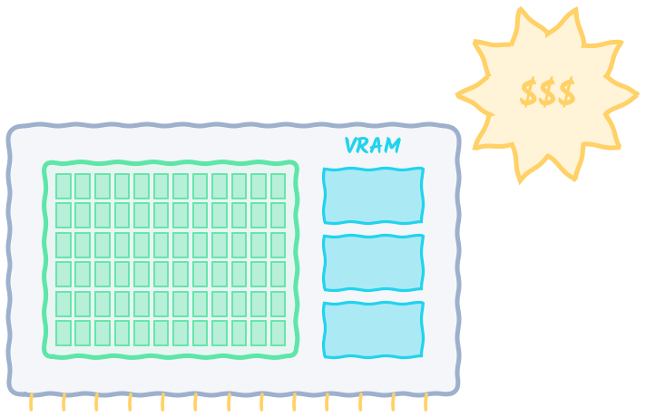
Introduction
00
Why AI infrastructure — and the story we're about to follow
⌂ Agenda

Slide 4

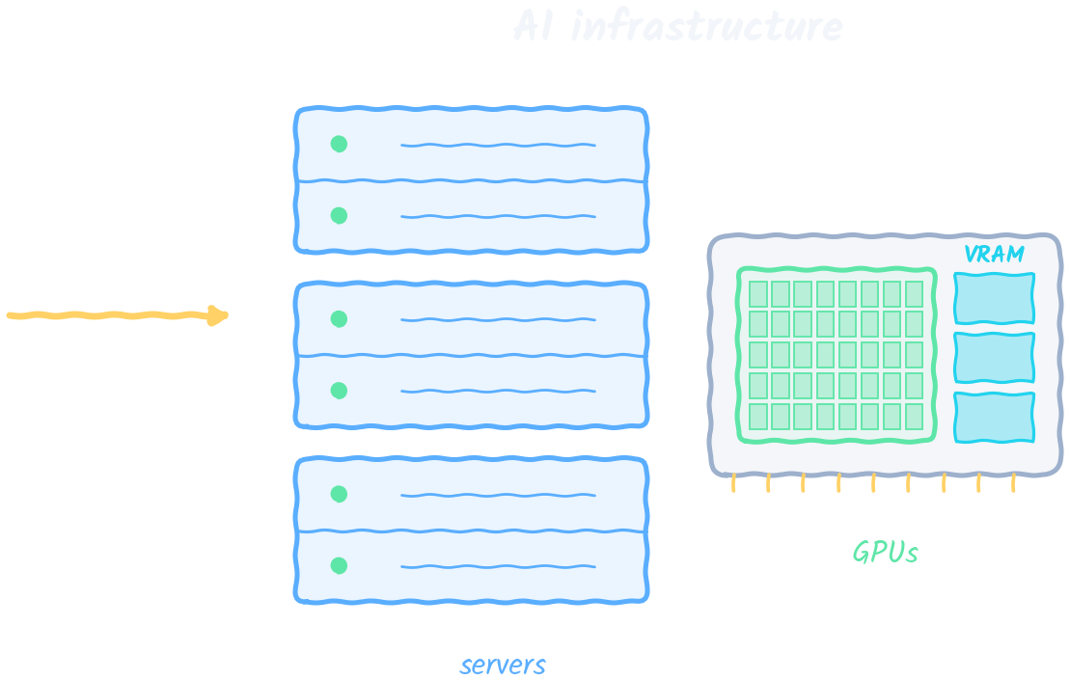
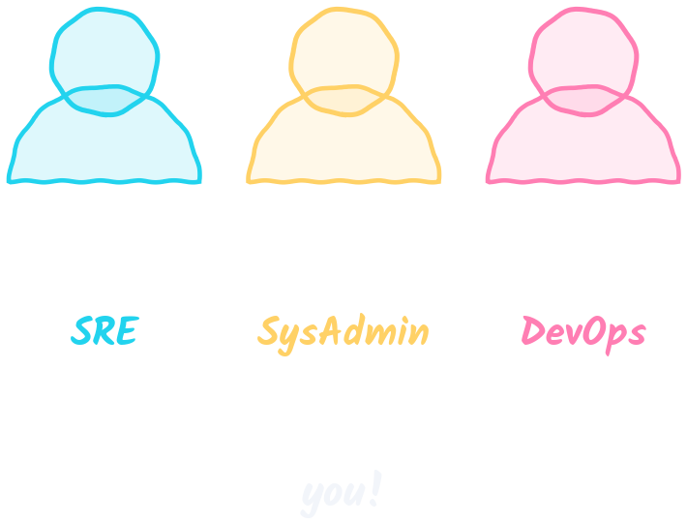
Who This Course Is For
The GPUs, servers and systems behind every AI product
KEY IDEA If you run servers today, you already speak most of this language
This course covers the GPUs, servers and systems behind every AI product. If you're an SRE, sysadmin or DevOps engineer, it's built for you — and there's never been a better time to learn it.
⌂ Menu

Slide 5
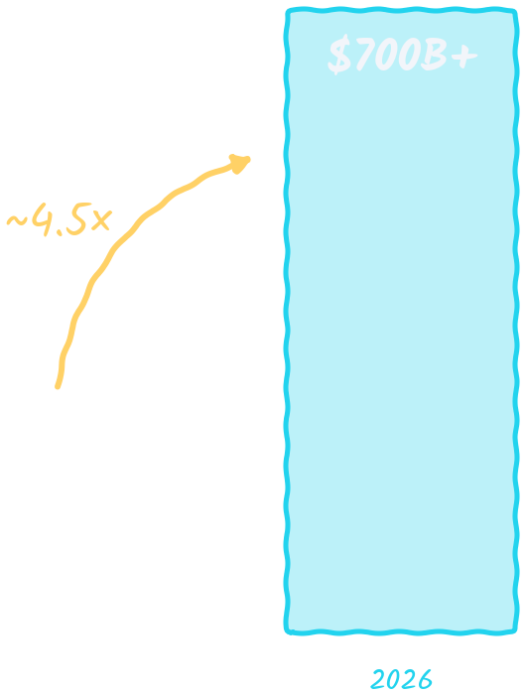
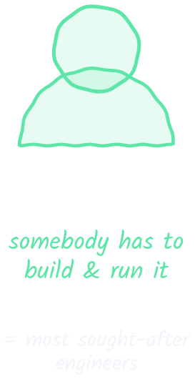
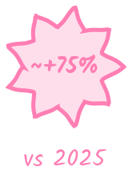
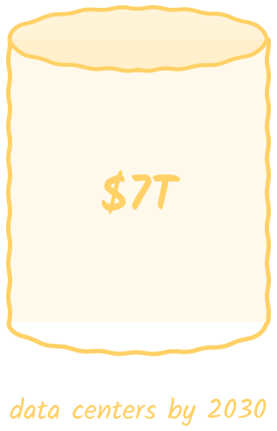
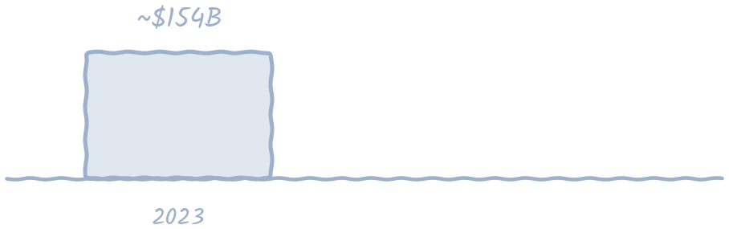
$700 Billion — This Year Alone
Amazon, Google, Microsoft and Meta are all-in on AI infrastructure
KEY IDEA ~4.5× since 2023 · ~+75% vs 2025 · McKinsey: ~$6.7 trillion into data centers by 2030
Big tech now spends about 4.5× what it did in 2023, and ~75% more than in 2025. Someone has to build and run all of that — which is why these engineers are so sought-after.
⌂ Menu

Slide 6
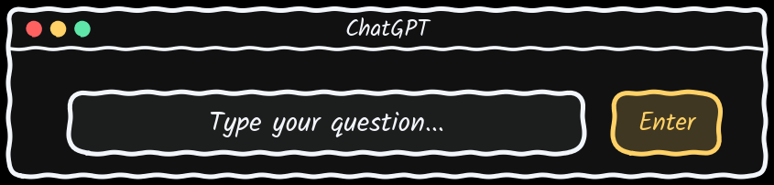
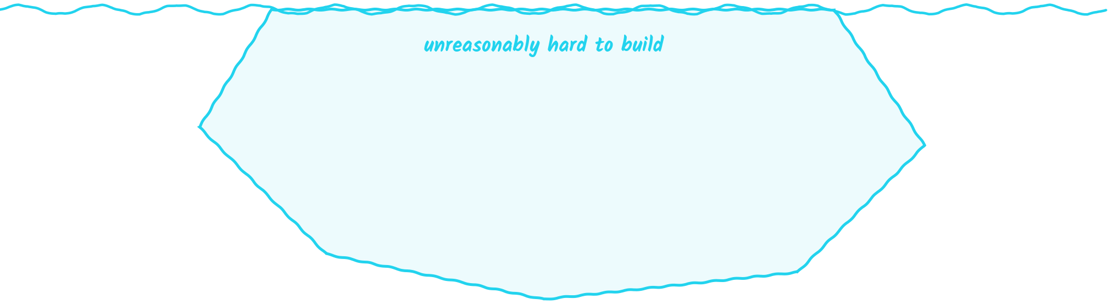
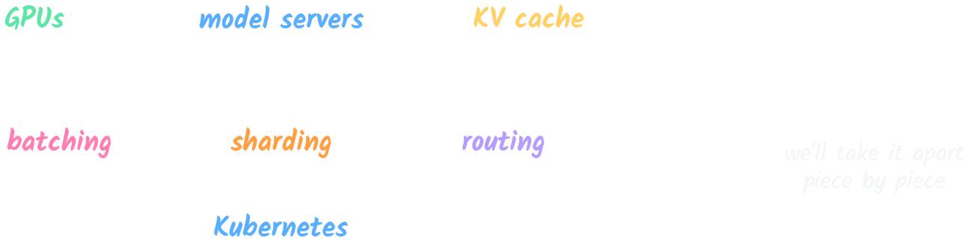
One Simple Question
What actually happens when you type into ChatGPT and press Enter?
KEY IDEA The chat box is the tip of the iceberg — the hard part is hidden underneath
Typing into ChatGPT looks simple, but behind that answer is a system that's unreasonably hard to build. We'll take it apart piece by piece.
⌂ Menu

Slide 7

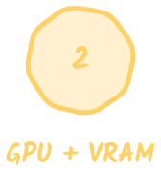
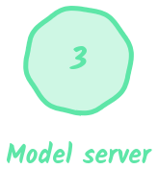





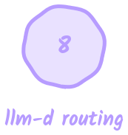


The Story Map
Ten problems, ten solutions — each solution reveals the next problem
KEY IDEA Every chapter solves one problem — and that solution exposes the next one
We'll follow ONE request from a chat box down to a fleet of GPUs. At each stop we hit a wall, fix it, and discover the next wall. This map comes back at the end of every chapter, so you always know where you are.
⌂ Menu

Slide 8
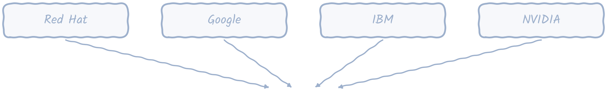
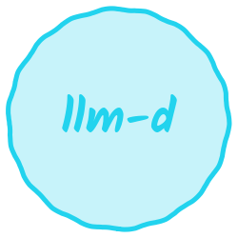
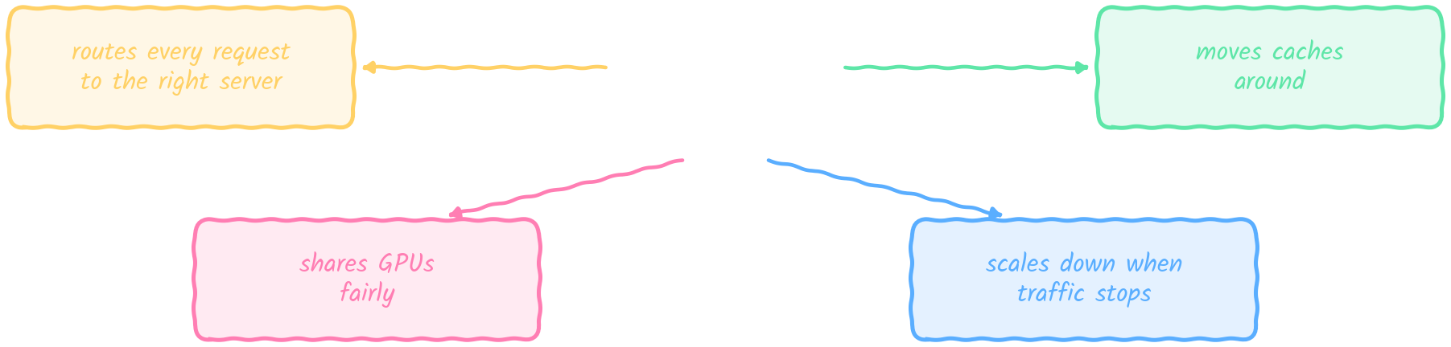
Meet llm-d
Open source, built by Red Hat, Google, IBM and NVIDIA
KEY IDEA llm-d runs the whole fleet: it routes, moves caches, shares GPUs fairly and scales down
llm-d is the open-source project that ties it all together: it decides which server gets each request, moves cached work around, shares GPUs fairly and scales down when traffic stops.
⌂ Menu

Slide 9
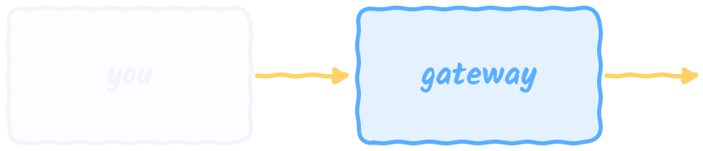

No Machine-Learning Background Needed
If you can follow a request through a system, you can follow this
KEY IDEA Taught by Mumshad Mannambeth · the part of AI nobody shows you
No machine-learning background is needed. If you can trace a request from the user, through a gateway, to a server and back, you can follow every lesson here.
⌂ Menu

Slide 10
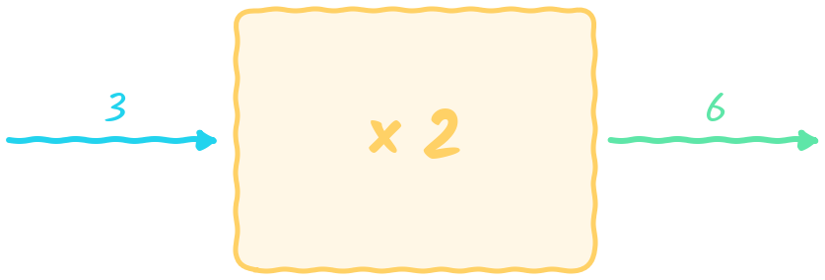
What Is a Model?
01
Before we can serve a model, what IS a model?
⌂ Agenda

Slide 11

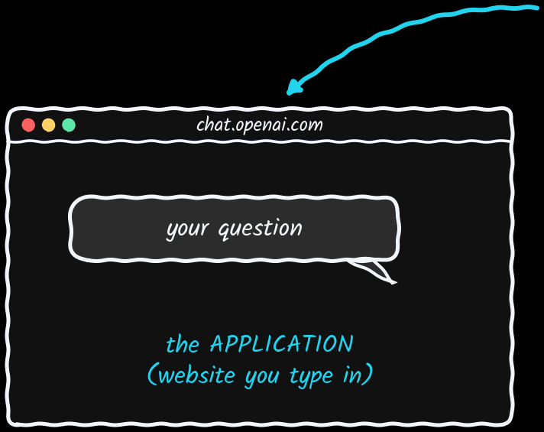
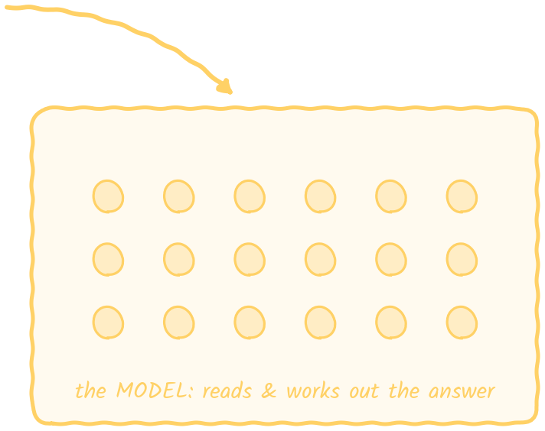
ChatGPT Is Two Things Stuck Together
The application you see + the model doing the thinking
KEY IDEA Chat = the app (the website) · GPT = the model behind the scenes
The name is two things stuck together: 'Chat' is the application you type into, and 'GPT' is the model behind the scenes that reads your question and works out the answer.
⌂ Menu

Slide 12
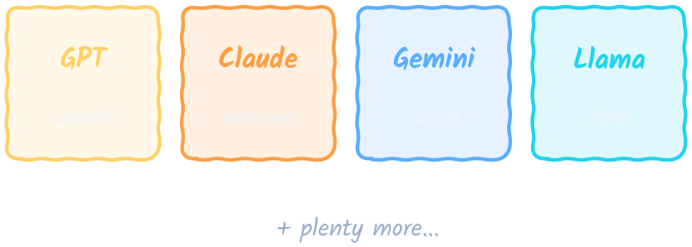
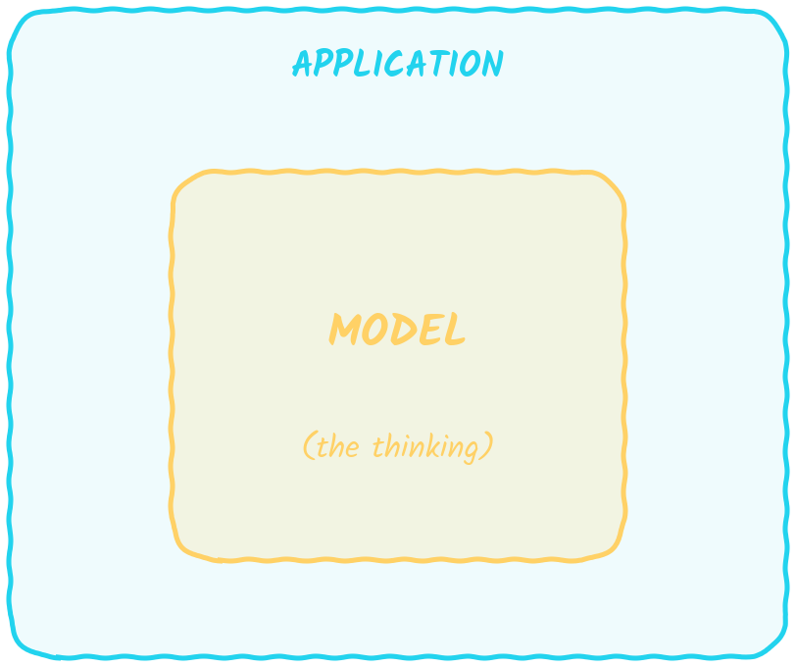

Many Models, One Idea
GPT is just one of them
KEY IDEA Every AI product = a model doing the thinking + an application wrapped around it
GPT, Claude, Gemini and Llama have different names, but underneath they share one idea: a model doing the thinking, wrapped in an application.
⌂ Menu

Slide 13
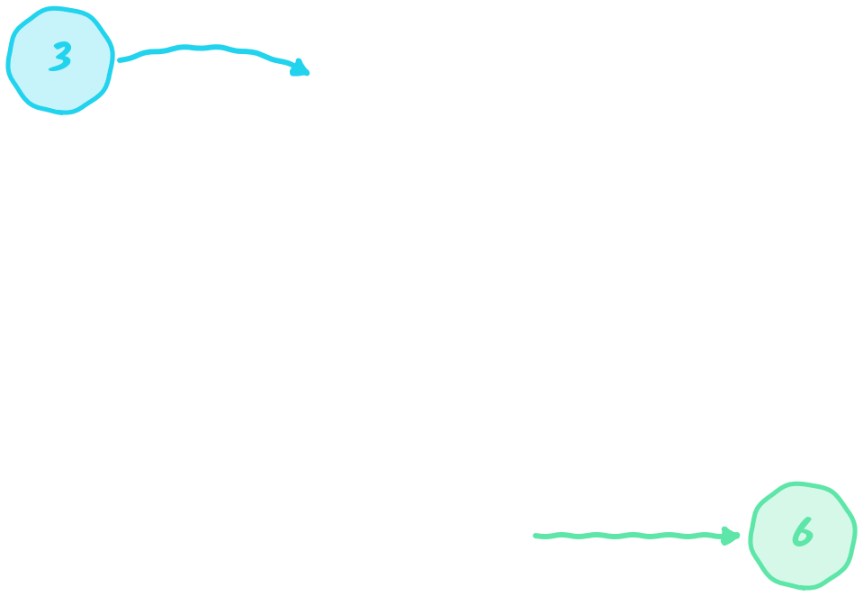

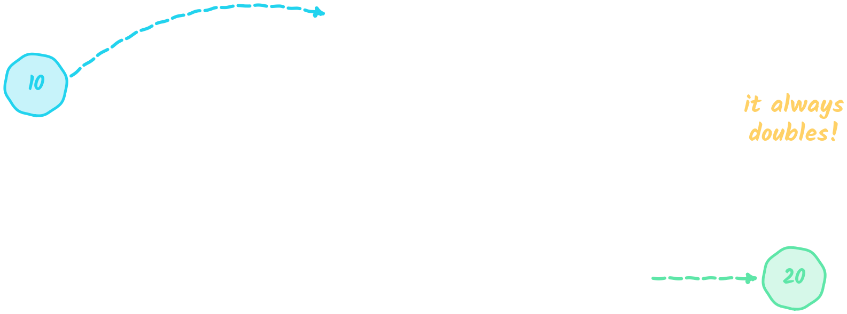
The Simplest Possible Model
Forget AI for a second — picture a tiny machine
KEY IDEA Drop a number in, a different number comes out: it doubles whatever you give it
Drop in 3, get 6. Drop in 10, get 20. This tiny machine always doubles its input — and it's the simplest possible example of what a model is.
⌂ Menu

Slide 14
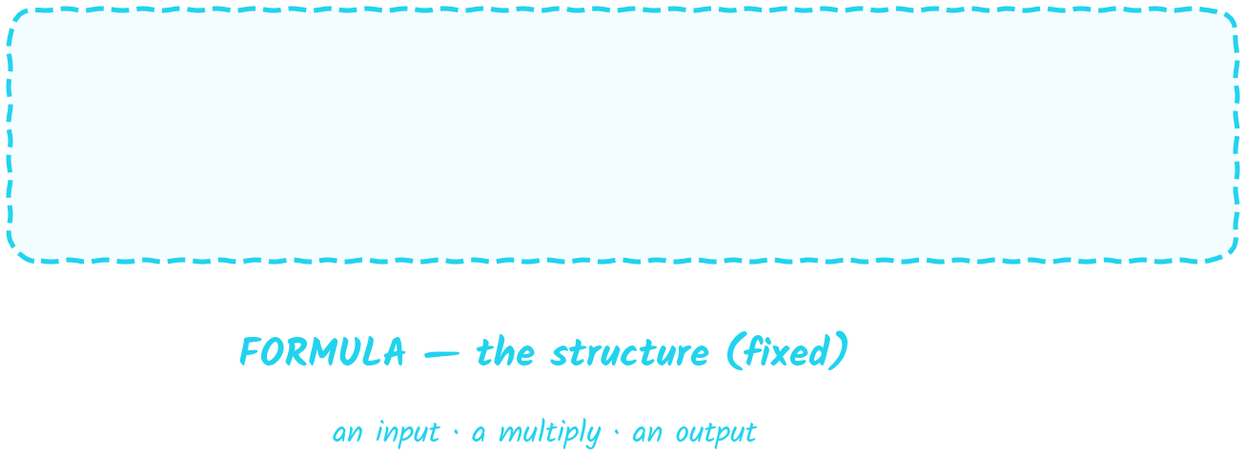
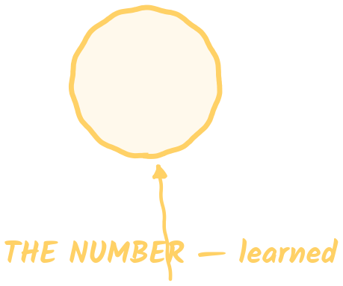

Two Things in One Line
The formula (fixed structure) and the number inside (learned)
KEY IDEA Formula = the shape of the calculation · the number 2 = the part the machine learned
Look closely and the line has two parts: the formula (input, multiply, output), which is fixed, and the number 2, which is what the machine actually learned.
⌂ Menu

Slide 15
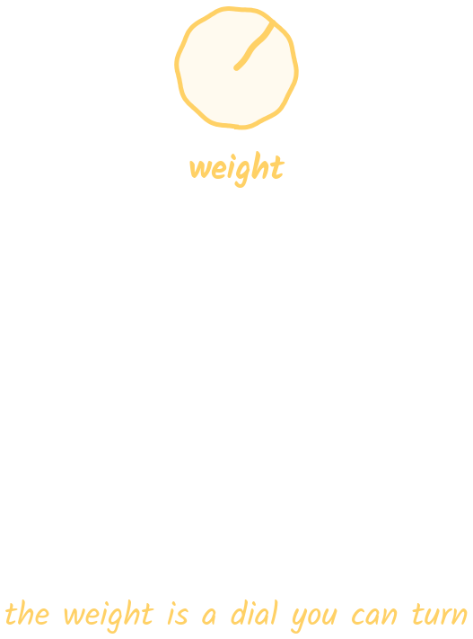
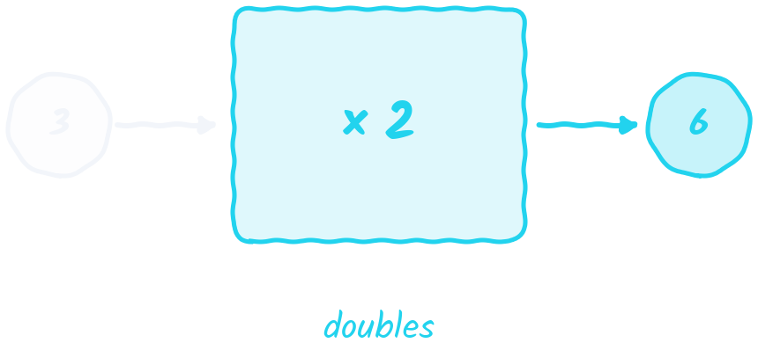
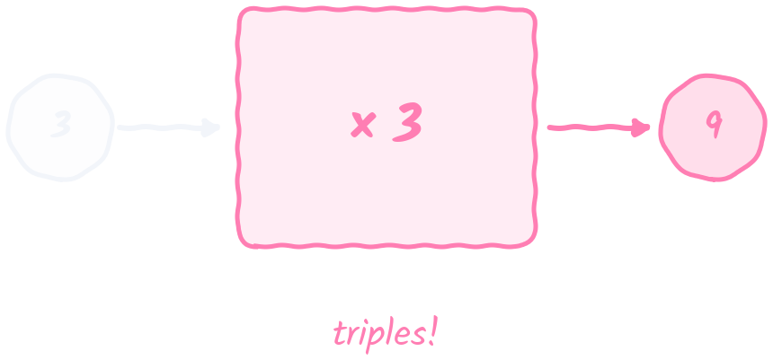
That Number Is Called a Weight
Change the weight, change the behaviour
KEY IDEA Same structure + different weight = completely different behaviour
That learned number is called a weight. Turn it from 2 to 3 and the very same formula triples instead of doubles.
⌂ Menu

Slide 16
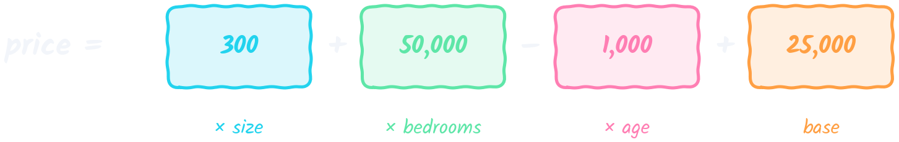
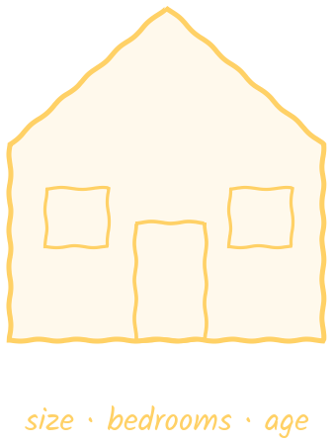
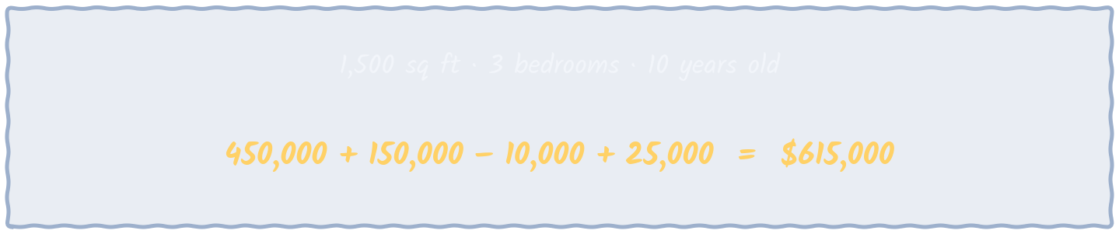
Let's Do Something Real: Price a House
Several things you can measure, each with its own weight
KEY IDEA Still just multiply and add — each weight says how much that one thing matters
To guess a house price, each measurable thing — size, bedrooms, age — gets its own weight, and the formula multiplies and adds them up, exactly like the doubling box.
⌂ Menu

Slide 17
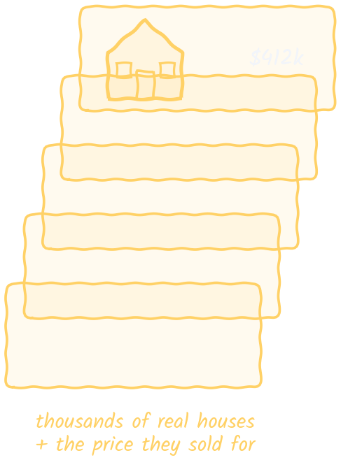
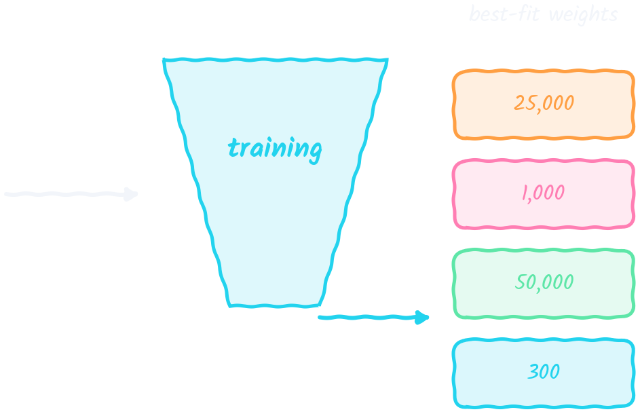
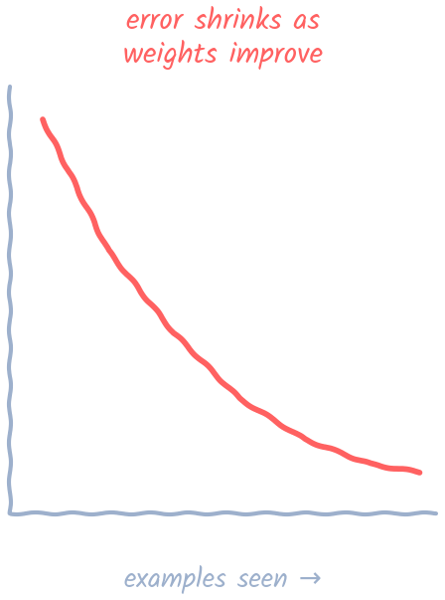
Where Do the Weights Come From? Training
You don't make them up — the formula learns them from examples
KEY IDEA Training = working out the weights from thousands of real examples
Nobody invents the weights. You show the formula thousands of real houses and their sale prices, and it works out the weights that fit best. That process is training.
⌂ Menu

Slide 18
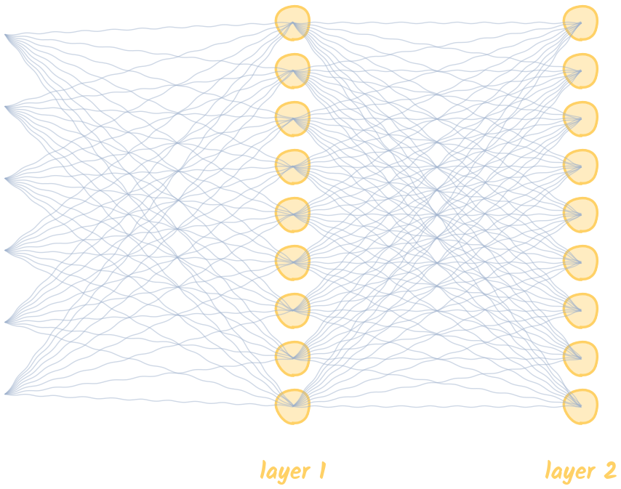
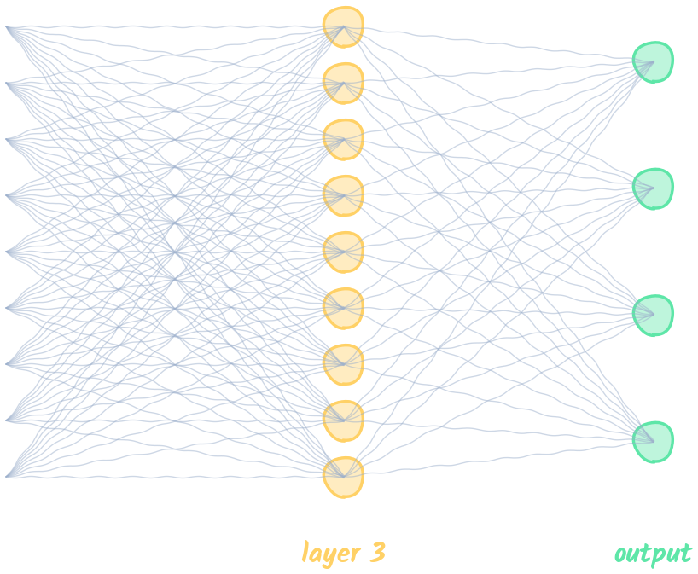

Bigger Problems Need Bigger Formulas
Language is far more tangled than house prices
KEY IDEA More inputs, more multiplications, more weights — stacked in layers, each feeding the next
Understanding language needs far more than a handful of weights, so the formula grows into layers of multiplications, where each layer's output becomes the next layer's input.
⌂ Menu

Slide 19
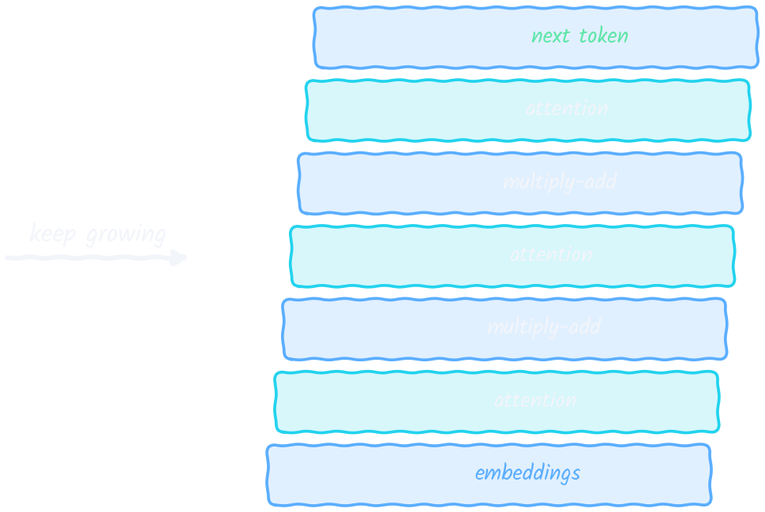
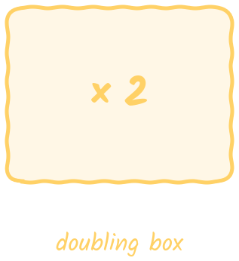
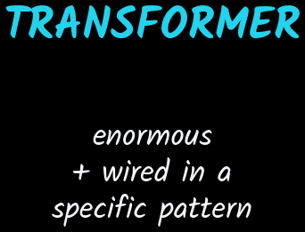
The Transformer
The shape behind every modern language model
KEY IDEA Same idea as the doubling box — inputs, multiplications, weights, output — just enormous and wired a specific way
Keep growing that idea in one particular arrangement and you get the transformer — the shape behind every modern language model. Same math as the doubling box, just enormous.
⌂ Menu

Slide 20
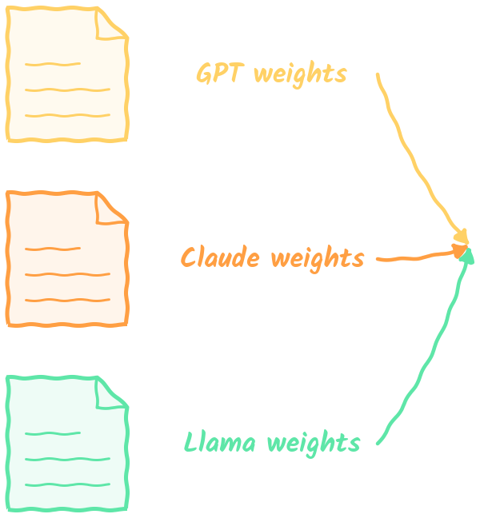
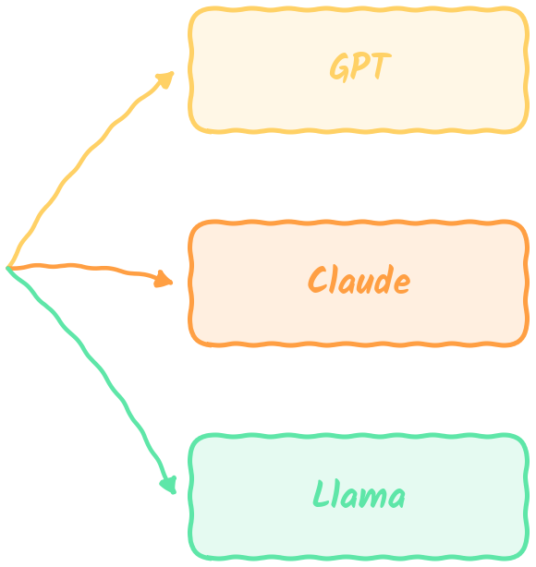
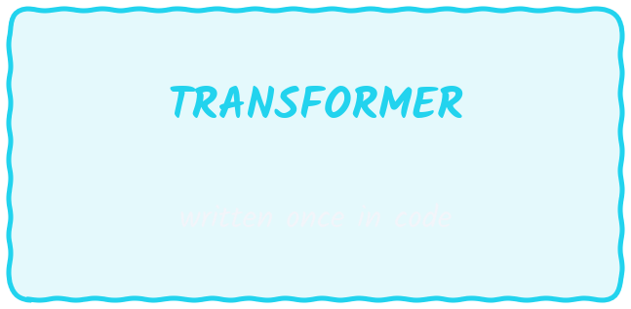
Same Formula, Different Weights
The transformer is broadly the same across GPT, Claude and Llama
KEY IDEA What makes each model different isn't the formula — it's the weights
The transformer is written once in code and is broadly the same in GPT, Claude and Llama. Plug in different weights and you get a different model.
⌂ Menu

Slide 21
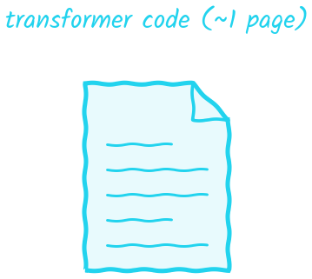
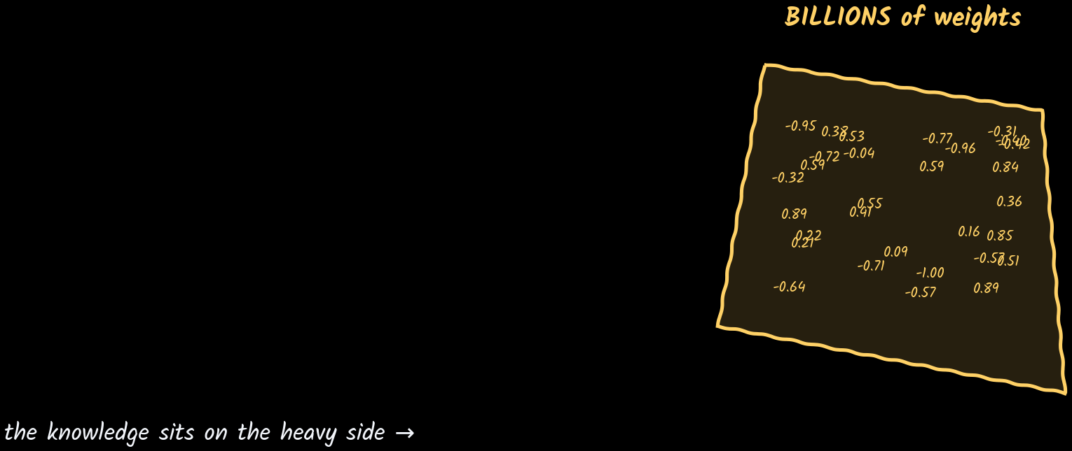

All the Knowledge Lives in the Weights
The formula is only about a page of code
KEY IDEA A real model doesn't have 4 weights or 400 — it has billions
The formula itself is about a page of code. Everything the model 'knows' lives in its weights — and a real model has billions of them.
⌂ Menu

Slide 22
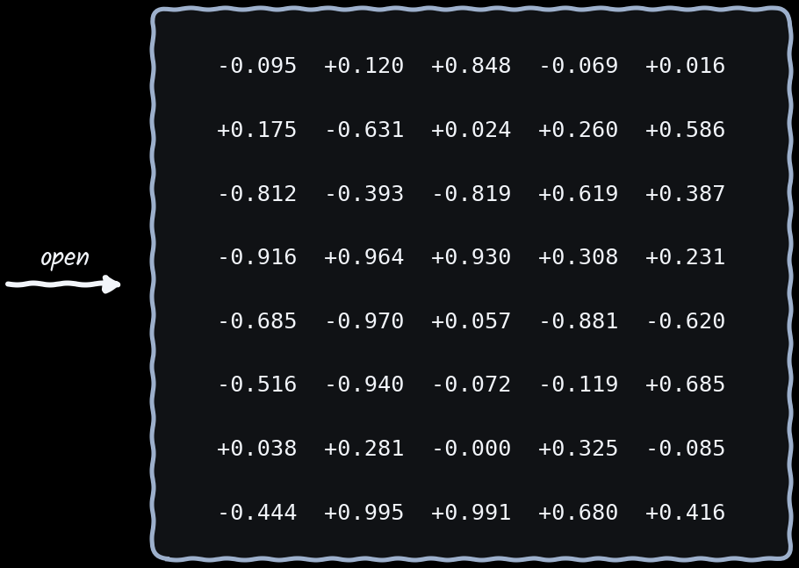


A Model Is Literally a File on Disk
Billions of numbers produced by training, waiting to be poured into the formula
KEY IDEA Open one up and that's genuinely all you'd see: numbers
Those billions of weights are saved as an ordinary file on disk. Open it and you'd see nothing but numbers waiting to be poured into the formula.
⌂ Menu

Slide 23
From Parameters to Gigabytes
Why a 70-billion-parameter model is a 140 GB file
KEY IDEA Each weight is usually stored in 16 bits = 2 bytes, so file size ≈ parameters × 2
'Parameters' is just another word for weights. At 2 bytes each: 1B → ~2 GB, 8B → ~16 GB, 70B → ~140 GB, 500B → ~1,000 GB. This simple rule tells you instantly whether a model can fit in a GPU's memory.
⌂ Menu

Slide 24



Running a Model, at Its Simplest
Load the file → feed it text → get text back
KEY IDEA Load from disk into memory, hand it your question, let the formula run all those numbers
To run a model: load the file into memory, feed in your question as text, let the formula run all those numbers over it, and read the text that comes back.
⌂ Menu

Slide 25



Quick Check: What Is a Model?
Think about each question first — then click to reveal the answer
KEY IDEA Click once per answer
Pause and answer out loud before clicking. If an answer surprises you, jump back to that part of the section using the agenda.
⌂ Menu

Slide 26



Story So Far: What a model is ✓
Solved: formula + billions of weights → next problem: A model is a file. Can a laptop run it?
KEY IDEA Up next — Chapter 2 · Why Not Just Use Your Laptop?
We now know a model is a formula plus billions of learned weights, stored in a file. Running it means billions of multiplications per answer — so next we ask what hardware can actually do that.
⌂ Menu

Slide 27

Why Not Just Use Your Laptop?
02
A model is billions of multiplications — what hardware can run that?
⌂ Agenda

Slide 28


If a Model Is Just a File...
...and running it is just loading it and doing math
KEY IDEA So why can't you just run a small model on the perfectly good laptop in front of you?
If running a model is just loading a file and doing math, and a small model fits in your laptop's memory, why can't you just run it there? Let's look closer.
⌂ Menu

Slide 29


Inside Every Computer: CPU + RAM
Your laptop or a data-center server — the same two parts matter
KEY IDEA CPU does the thinking (calculations, logic) · RAM holds the data and instructions it's working on
Every computer has two key parts: the CPU, which does the calculations and logic, and the RAM, which holds the data and instructions the CPU is working on.
⌂ Menu

Slide 30



They Sit Apart, Connected by a Road
Remember this picture — it comes back later
KEY IDEA The CPU is in one place, the memory in another, joined by a channel (the bus)
The CPU and memory sit in separate places, connected by a bus. Data has to travel along that road every time the processor needs it.
⌂ Menu

Slide 31






Even 6 × 7 Is a Round Trip
Every calculation: memory → CPU → memory
KEY IDEA Processor and memory are always tightly paired — every calculation makes the trip
Even 6 × 7 is a round trip: the numbers land in memory, the CPU reads them, multiplies, and writes 42 back into memory.
⌂ Menu

Slide 32


The CPU: A Brilliant Generalist
A handful of very powerful cores, one complicated task after another
KEY IDEA Extremely fast at sequential work — exactly what your browser, apps and OS need
A CPU has a handful of very powerful cores that race through complicated tasks one after another — perfect for browsers, apps and the operating system.
⌂ Menu

Slide 33



What Is a Model Doing Under the Hood?
Billions of tiny multiplications — and none of them wait for each other
KEY IDEA Every output cell is its own small calculation — so each one can go to a different core
Each output number = one row of weights times the input, added up. Row 1 never waits for row 2, so a GPU can compute all rows at the same time — and real layers have thousands of rows.
⌂ Menu

Slide 34



Problem #1: The CPU Works in Sequence
A few cores chewing through billions of multiplications
KEY IDEA Massively parallel work + a processor built for sequence = a very, very long wait
A CPU works through those billions of multiplications a few at a time. It gets every one right — but you wait a very, very long time.
⌂ Menu

Slide 35


Enter the GPU
Built the exact opposite way
KEY IDEA Instead of a few powerful cores: thousands of small, simple cores, all doing math at once
The GPU is built the opposite way: instead of a few powerful cores it has thousands of small, simple ones, all doing math at the same moment.
⌂ Menu

Slide 36








Watch the Cores Work: CPU vs GPU
The same 16 independent multiplications
KEY IDEA CPU: 4 cores → 4 rounds, one after another · GPU: enough cores for all 16 → 1 round
Each green square is one finished multiplication. The CPU's 4 powerful cores take 16 jobs in 4 rounds. The GPU has a core for every job, so all 16 finish in a single round — and real workloads have billions of jobs, not 16.
⌂ Menu

Slide 37



What Is a FLOP?
How we measure a processor's math speed
KEY IDEA FLOP = one floating-point operation (one multiply or one add of decimal numbers) · FLOPS = how many per second
Model weights are decimal numbers like 0.73 or −1.25, called floating-point numbers. One multiply or one add on them is one FLOP. Count how many a chip can do in one second and you get its FLOPS — its math speed.
⌂ Menu

Slide 38






Giga, Tera, Peta: How Big Are These Numbers?
Each step up the ladder is 1,000× bigger
KEY IDEA GFLOPS = billions per second · TFLOPS = trillions per second · PFLOPS = 1,000 TFLOPS
Giga means billion, tera means trillion, peta means a thousand trillion. A desktop CPU does about 1–3 TFLOPS; an H100 GPU about 990 TFLOPS; a B200 about 2,250 TFLOPS (≈2.25 PFLOPS). For scale: doing 1 trillion sums by hand at one per second would take ~31,700 years.
⌂ Menu

Slide 39

GFLOP of Work ÷ TFLOPS of Speed = Time
Like distance ÷ speed = travel time
KEY IDEA One pass through an 8B model ≈ 16 GFLOP of work: ~0.016 ms on a 990-TFLOPS GPU vs ~8 ms on a 2-TFLOPS desktop
Each weight is used once per pass through the model, for a multiply and an add — 2 FLOPs. So an 8-billion-weight model needs ~16 billion FLOPs (16 GFLOP) per pass. Divide that work by the chip's speed to get the time: this is why GPUs win on raw math.
⌂ Menu

Slide 40



~100× More Math Every Second
Even a modest NVIDIA T4 has ~2,500 cores
KEY IDEA CPU ≈ 1–10 trillion ops/s · data-center GPU ≈ 1,000 trillion ops/s — the GPU solves the math problem
A modest NVIDIA T4 has about 2,500 cores. A CPU manages roughly 1–10 trillion operations per second; a data-center GPU like the H100 gets close to 1,000 trillion — about 100× more math.
⌂ Menu

Slide 41



New Problem: Feeding the GPU
A processor is only as fast as the data that reaches it
KEY IDEA The GPU's food is the model's weights — billions of numbers that must be delivered to the cores
Fast cores create a new problem: they need data to work on. For a model, that data is the weights — billions of numbers that must be delivered to the cores.
⌂ Menu

Slide 42



System RAM Is Too Far Away
A narrow pipe: ~64 GB/s, about 50× slower than the cores can eat
KEY IDEA Fine for a CPU doing a few things — but thousands of GPU cores end up sitting idle
Leave the weights in system RAM and they arrive through a narrow ~64 GB/s pipe — about 50× slower than the cores can use them. So the cores sit idle, waiting.
⌂ Menu

Slide 43


VRAM: Give the GPU Its Own Memory
Built right onto the card, right next to the cores
KEY IDEA Same processor-plus-memory pairing you already know — just packed tightly onto one board
The fix is VRAM: memory built right onto the GPU card, next to the cores. It's the same processor-plus-memory pairing as a CPU and RAM, just packed tightly together.
⌂ Menu

Slide 44


Bandwidth in Numbers: Straw vs Fire Hose
How long does it take to move 16 GB of weights once?
KEY IDEA Reading all 16 GB once: ~0.25 s from system RAM vs ~5 ms from VRAM — about 50× faster
Through a 64 GB/s 'straw', reading a 16 GB model once takes a quarter of a second. Through a ~3,000 GB/s 'fire hose' it takes about 5 milliseconds. Later we'll see the model must be read like this again and again — so this gap matters enormously.
⌂ Menu

Slide 45



The Catch: VRAM Is Fast but Small
A T4 has only 16 GB
KEY IDEA A 70-billion-weight model needs ~140 GB — VRAM space is precious
VRAM is fast but small: a T4 has just 16 GB, while a 70B model needs ~140 GB. Space in VRAM is precious — later we'll split big models across GPUs.
➜ How we'll fix it: Chapter 6 splits giant models across several GPUs (sharding).
⌂ Menu

Slide 46



Three Numbers Size Every AI Workload
Every card you'll ever meet is described by these three
KEY IDEA Each new GPU generation adds more of all three
Compute is how much math a card can do, capacity is how much fits in its memory, and bandwidth is how fast it reads that memory. Every card is described by these three.
⌂ Menu

Slide 47



What Is a Rack Server?
The computers that live in data centers
KEY IDEA A flat, powerful computer that slides into a tall metal rack — no screen, no keyboard, always on
Data centers don't use tower PCs. They use flat servers (1U = 1.75 inches tall) stacked in standard 42U racks. Each has CPUs, lots of RAM, drives, fans and two power supplies, is managed over the network, and runs 24/7 for many users.
⌂ Menu

Slide 48


Desktop vs Rack Server
Same idea (CPU + RAM), built for very different jobs
KEY IDEA Both are CPU machines — a rack server is bigger and always on, but still nowhere near a GPU
A desktop serves one person and does about 1–3 TFLOPS with ~0.09 TB/s of memory bandwidth. A rack server serves many people 24/7, with far more RAM, 5–10 TFLOPS and ~0.5 TB/s. Both are tiny next to data-center GPUs, which we meet next.
⌂ Menu

Slide 49




Data-Center GPUs: A100 → H100 → H200
This is where the numbers jump
KEY IDEA H100 and H200 share ~990 TFLOPS — the H200's big upgrade is memory: 141 GB vs 80 GB
An A100 offers 312 TFLOPS, 80 GB and ~2 TB/s. H100 and H200 both reach ~990 TFLOPS; the H200 mainly adds memory — 141 GB instead of 80 GB.
⌂ Menu

Slide 50


B200 — and the Big Picture
Compute grows ~1,000× from a desktop to a B200
KEY IDEA B200: ~2,250 TFLOPS · ~192 GB VRAM · ~8 TB/s — and a desktop barely registers on this chart
The B200 reaches ~2,250 TFLOPS with ~192 GB of VRAM and ~8 TB/s. On the same chart, a desktop's compute barely shows up.
⌂ Menu

Slide 51



Quick Check: Hardware
Think about each question first — then click to reveal the answer
KEY IDEA Click once per answer
Pause and answer out loud before clicking. If an answer surprises you, jump back to that part of the section using the agenda.
⌂ Menu

Slide 52



Story So Far: GPU + VRAM ✓
Solved: parallel cores fed by fast memory → next problem: A GPU alone isn't a service anyone can call
KEY IDEA Up next — Chapter 3 · From Script to Model Server
GPUs give us thousands of parallel cores, and VRAM keeps them fed. But a GPU running a script serves one person, once. Next we turn it into an always-on service — and meet tokens.
⌂ Menu

Slide 53

From Script to Model Server
03
A GPU alone serves nobody — turn it into a service
⌂ Agenda

Slide 54



PyTorch: The Software That Drives the Chip
A chip on its own does nothing at all
KEY IDEA PyTorch loads the model onto the GPU and puts all of those cores to work
Hardware alone does nothing. PyTorch is the software layer that loads a model onto the GPU and puts all of its cores to work.
⌂ Menu

Slide 55



A Model in About Seven Lines
Try this on your laptop with a really small model
KEY IDEA Import torch · load the model · generate · read the generated text
With a few lines of code you import torch, load a model such as Llama, and call generate. The generated text is the model's answer. Small models even run on a laptop.
⌂ Menu

Slide 56



A Script Isn't a Service
It runs once, for one person, then it's done
KEY IDEA Real users are on the internet — thousands at once — so you need something always on
A script runs once for one person and exits. Real users arrive by the thousands over the internet, so you need something always on, listening for requests.
⌂ Menu

Slide 57



vLLM: A Model Server
Built right on top of PyTorch, wrapping the model in a normal web API
KEY IDEA Now it's a real product — so what does the server do each time a request comes in?
vLLM is that always-on model server. Built on PyTorch, it wraps the model in a normal web API. Next question: what does it do with each request?
⌂ Menu

Slide 58



Serving a Model Takes One Command
vLLM reads the weights off disk and loads them into GPU memory
KEY IDEA ~16 GB to move, so a minute or two — then the server stays up, waiting for requests
'vllm serve <model>' reads the weights off disk and loads them into GPU memory. Moving ~16 GB takes a minute or two; then the server stays up, waiting for requests.
⌂ Menu

Slide 59



It Speaks OpenAI's Language
A normal web request, in the exact format the OpenAI API uses
KEY IDEA Any tool or script that talks to OpenAI can talk to your own server — no code changes
You talk to vLLM with ordinary web requests in the same format the OpenAI API uses, so existing OpenAI tools and scripts work against your own server unchanged.
⌂ Menu

Slide 60



A Model Server Is a Heavy Beast
It holds the entire model in GPU memory the whole time it runs
KEY IDEA Need a second server? That's another full copy of the model on another expensive GPU
The server holds the entire model in GPU memory the whole time it runs. A second server means a second full copy on another expensive GPU — costly to run, slow to start, costly to copy.
➜ How we'll fix it: Chapter 5 squeezes many users onto one server (batching); Chapter 7 handles fleets of servers.
⌂ Menu

Slide 61


Tokens: How Models Read and Write
Not whole words — little pieces, roughly ¾ of a word each
KEY IDEA "Serving LLMs is not like serving web apps" = 8 words but ~9 tokens
Models read and write tokens — pieces of roughly ¾ of a word. Sometimes a token is a whole word, sometimes only part of one.
⌂ Menu

Slide 62



More Tokenizer Examples
How words actually get chopped up (illustrative splits)
KEY IDEA Rule of thumb: ~1,000 tokens ≈ 750 words ≈ 1.5 pages of text
Common words are usually one token; rare or long words, names, numbers and code get split into several pieces. Exact splits vary by model, but the ¾-word rule of thumb works for estimating cost and speed.
⌂ Menu

Slide 63



Everything Is Counted in Tokens
The universal unit of LLM serving
KEY IDEA What a model can read, what you pay, how fast it goes — all measured in tokens
How much a model can read, how much you pay and how fast it responds are all measured in tokens. Tokens are the unit of everything in LLM serving.
⌂ Menu

Slide 64



The Model Has Exactly One Trick
Given all the text so far, predict the next token
KEY IDEA Append the new token and go again — a 100-token answer is 100 laps of this loop
A model only ever predicts the next token. It appends that token to the text and predicts again — so a 100-token answer is the same loop run 100 times.
⌂ Menu

Slide 65



How the Next Token Is Chosen
The model scores every possible next token
KEY IDEA The output is a probability for each token in the vocabulary — the server picks one and loops
For 'The capital of France is', the model gives ' Paris' a very high probability and everything else tiny ones. The server samples or picks the top token, appends it, and runs the model again.
⌂ Menu

Slide 66




Why Answers Stream Word by Word
You're watching each lap of the loop finish
KEY IDEA Streaming isn't a feature someone built on top — it falls out of the loop for free
Each lap of the loop finishes one token, so you see the answer type itself out word by word. Streaming comes for free.
⌂ Menu

Slide 67


Consequence #1: LLM Requests Are Slow
A web request finishes in milliseconds
KEY IDEA A few hundred tokens = a few hundred laps of the loop
A normal web request finishes in milliseconds. An LLM answer of a few hundred tokens needs a few hundred laps of the loop, so it takes seconds.
➜ How we'll fix it: Chapter 4 shows exactly where the time goes — and the cache that removes the waste.
⌂ Menu

Slide 68



Consequence #2: No Two Requests Are Alike
Same server, same API — wildly different amounts of work
KEY IDEA "Capital of France?" ≈ 7 tokens · "Summarize this 100-page contract" = tens of thousands
'Capital of France?' is a few tokens in and one or two out. 'Summarize this 100-page contract' is tens of thousands. Both hit the same API, but one is ~1,000× the work.
➜ How we'll fix it: Chapter 8: llm-d routes by size, cache and load instead of treating every request the same.
⌂ Menu

Slide 69



Quick Check: Model Server & Tokens
Think about each question first — then click to reveal the answer
KEY IDEA Click once per answer
Pause and answer out loud before clicking. If an answer surprises you, jump back to that part of the section using the agenda.
⌂ Menu

Slide 70



Story So Far: Model server ✓
Solved: vLLM + the token-by-token loop → next problem: Requests are slow and wildly unequal. Why?
KEY IDEA Up next — Chapter 4 · Prefill, Decode & the KV Cache
vLLM serves the model over a normal API, writing answers one token per lap. That loop makes requests slow and very unequal in size. Next we open the loop to see where the time goes — and how to stop wasting it.
⌂ Menu

Slide 71

Prefill, Decode & the KV Cache
04
Why is every request slow — and how do we stop wasting work?
⌂ Agenda

Slide 72


Every Answer Has Two Halves
First a pause... then a steady stream
KEY IDEA Paste a big chunk of text: nothing for a second or two, then words flow out steadily
Paste in a big chunk of text and you'll notice two phases: a pause of a second or two where nothing happens, then a steady stream of words.
⌂ Menu

Slide 73



The Pause: Reading Everything at Once
Your whole prompt goes through the model in one big burst
KEY IDEA Weights loaded from VRAM once, thousands of cores fire together — and out pops the first token
During the pause, the model reads your whole prompt at once: every token goes through in one big burst, thousands of cores fire together, and the first answer token pops out.
⌂ Menu

Slide 74


Pause Length = How Much You Gave It
One tiny pass vs one giant burst
KEY IDEA ~7 tokens: no noticeable pause · a 100-page contract: tens of thousands of tokens = a real wait
The length of the pause depends on how much text you gave it. Seven tokens is one tiny pass; a 100-page contract is a single huge burst and a real wait.
⌂ Menu

Slide 75



Its Real Name: Prefill → TTFT
The pause is called PREFILL; the wait it causes is Time To First Token
KEY IDEA TTFT = how long until the first token of the response appears
This first phase is called prefill. The wait it causes is called time to first token (TTFT): how long until the first word of the answer appears.
⌂ Menu

Slide 76





Decode: One Full Model Read per Token
The token-by-token loop has a completely different bottleneck
KEY IDEA 200-token answer = read the entire model 200 times — each read buys exactly ONE token
The second phase, decode, writes the answer one token at a time. Each token requires reading the entire model out of memory, so a 200-token answer means 200 full reads.
⌂ Menu

Slide 77



Do the Math
A high-end GPU reads its own memory at ~3 TB/s
KEY IDEA 3 TB/s ÷ 16 GB ≈ 200 full reads per second ≈ 200 tokens/s max ≈ one token every 5 ms
A high-end GPU reads ~3 TB/s. Divide by a 16 GB model and you get ~200 full reads per second: ~200 tokens per second at most, or one token every 5 milliseconds.
⌂ Menu

Slide 78

Where Does the Time Go During Decode?
One token for an 8B model on a ~990 TFLOPS / ~3 TB/s GPU
KEY IDEA Reading weights ≈ 5 ms · doing the math ≈ 0.02 ms — the cores are idle 99%+ of the time
An 8B model needs about 16 billion operations per token: ~0.02 ms of math for this GPU. But reading 16 GB of weights takes ~5 ms. Decode is memory-bound — which is exactly why batching works so well.
➜ How we'll fix it: The cores are idle — so Chapter 5 uses each read for many users at once (batching).
⌂ Menu

Slide 79



The Two Numbers Every Benchmark Uses
TTFT for the pause, TPOT for the stream
KEY IDEA TTFT = time to first token · TPOT = time per output token (the gap between tokens)
TTFT measures the initial pause; TPOT (time per output token) measures the gap between streamed tokens. Every serving benchmark is built on these two numbers.
⌂ Menu

Slide 80



Two Phases, Two Very Different Jobs
Prefill is compute-heavy · decode is memory-bandwidth-heavy
KEY IDEA Right now both run on the same GPU, taking turns
Prefill is a one-time, compute-heavy calculation. Decode is a long, memory-bandwidth-heavy grind. Today both run on the same GPU, taking turns.
➜ How we'll fix it: Chapter 8 gives each phase its own pool of GPUs (disaggregation).
⌂ Menu

Slide 81


What If Every Word Needed a Fresh Prefill?
Re-read everything before each new token...
KEY IDEA A fresh pause before every single word — the chat would be far too slow to use
If the model redid the whole prefill before every new word, each word would come after a fresh pause and chat would be unusably slow. That's not what happens.
⌂ Menu

Slide 82



The Secret: the KV Cache
Prefill's expensive work is saved right there in GPU memory
KEY IDEA Prefill runs once; every new token reuses the cache and adds just one token on top
Prefill's expensive work is kept in GPU memory as the KV cache. Each new token reuses everything already computed and adds just one token on top — the pause is paid only once.
⌂ Menu

Slide 83



Then You Send a Second Message...
Models remember nothing between messages
KEY IDEA The app resends the whole thread; last time's cache is gone, so everything is re-read from scratch
Once your reply finishes, its cache is cleared. Models remember nothing between messages, so the app resends the entire conversation and the server re-reads all of it.
⌂ Menu

Slide 84


Prefix Caching: Just Keep It
Hang on to the saved blocks, labelled by the exact text that produced them
KEY IDEA Only the newest message needs prefill — turn 10 costs about what turn 2 cost
Prefix caching keeps the saved blocks, labelled by the text that produced them. On the next turn only your newest message needs prefill, so the pause stays small.
⌂ Menu

Slide 85



Prompt Caching Saves Real Money
Providers expose it too — e.g. prompt caching in the Anthropic API
KEY IDEA A cached input token costs roughly a tenth of a fresh one
Providers expose this too — the Anthropic API calls it prompt caching. Cached input tokens cost about a tenth of fresh ones, which adds up to big savings.
⌂ Menu

Slide 86



Shared Prefixes: One System Prompt, Many Users
Saved work depends only on the text before it — not whose chat it is
KEY IDEA A long system prompt is computed once and reused for everyone who talks to the assistant
Cached work depends only on the text before it, not on whose conversation it is. A shared system prompt is computed once and reused for every user.
⌂ Menu

Slide 87


Prefix Caching Needs an Exact Match From the Start
Saved work is labelled by the exact text that produced it
KEY IDEA Same beginning → cache hit · change even the first word → everything after it must be recomputed
Because the work for each token depends on all the text before it, the cache can only be reused for an identical beginning. Practical tip: put stable text (system prompt, documents) first and changing text (dates, user questions) last.
⌂ Menu

Slide 88



Quick Check: Prefill, Decode & Caching
Think about each question first — then click to reveal the answer
KEY IDEA Click once per answer
Pause and answer out loud before clicking. If an answer surprises you, jump back to that part of the section using the agenda.
⌂ Menu

Slide 89



Story So Far: KV cache ✓
Solved: prefill once, reuse saved work → next problem: Each model read still serves just ONE user
KEY IDEA Up next — Chapter 5 · Batching
Prefill reads the prompt once, decode streams tokens, and the KV cache plus prefix caching stop us redoing work. But every model read still serves just one user. Next: batching.
⌂ Menu

Slide 90

Batching: Many Users, One GPU
05
Each model read serves one user — can it serve fifty?
⌂ Agenda

Slide 91


How Many Users Can One GPU Serve?
Remember the expensive part: every token = one full read of the model
KEY IDEA If you're reading the whole model anyway... why serve only one user with that read?
Each output token requires reading the whole model from memory — that read is the real cost. So why spend it on just one user?
⌂ Menu

Slide 92


Batching: One Read, Fifty Tokens
Pack many people's requests together and run them as one group
KEY IDEA One read of the model → 1 token for 1 user, or 50 tokens for 50 users: same single read
Batching packs many users' requests into one group. One read of the model then produces the next token for all of them: 1 token for 1 user, or 50 tokens for 50 users.
⌂ Menu

Slide 93



Throughput Shoots Up
Each person's answer streams at roughly the same speed — but add up everyone's tokens...
KEY IDEA Serve 50 people for close to the cost of one — without batching, nobody could afford the hardware
Each user's answer streams at about the same speed as before, but the server's total output — its throughput — shoots up. Without batching, the hardware would be unaffordable.
⌂ Menu

Slide 94



The Ceiling Is Memory
Every user in the batch needs their own scratchpad (KV cache) in VRAM
KEY IDEA Weights are fixed and take most of the room — only what's left over holds everyone's scratchpads
Every user in the batch needs their own KV cache in VRAM for as long as they're being served. The weights already take most of the memory; only what's left holds those caches.
⌂ Menu

Slide 95




Worked Example: How Many Chats Fit on One GPU?
Llama-3-8B on an 80 GB H100, 16-bit weights
KEY IDEA Weights ~16 GB · KV cache ≈ 128 KB per token · 4,000-token chat ≈ 0.5 GB → roughly 120 chats
KV per token = 32 layers × 8 KV heads × 128 dims × 2 (K and V) × 2 bytes ≈ 128 KB. A 4,000-token conversation needs ~0.5 GB. With ~60 GB left after weights and overhead, about 120 chats fit at once.
⌂ Menu

Slide 96




When the Scratchpad Space Fills Up
The server is full
KEY IDEA New users wait in line, or someone's cache gets evicted — that's ChatGPT's "at capacity"
When that leftover space fills up, the server is full. New users wait in a queue or someone's cache is evicted — which is exactly when ChatGPT says it's at capacity.
➜ Coming up: Next slides: why memory is the real limit — and the plan to fight it.
⌂ Menu

Slide 97


Memory, Not Math, Decides How Many Fit
Plenty of compute left idle — memory runs out first
KEY IDEA Teams buy far more GPUs than the math calls for, and they sit half idle
It's memory, not compute, that runs out first: the cores still have plenty of math to spare. Teams often buy more GPUs than the math needs, and those GPUs sit half idle.
➜ Coming up: Next slide: the four-part plan to fight the memory ceiling.
⌂ Menu

Slide 98





Fighting the Memory Ceiling: The Plan
Memory is the limit — so every tool we add from here helps use it better
KEY IDEA Four ways to fit more users into the same GPU memory — one done, three coming up
Share identical prefixes so many users reuse one cache (done, Chapter 4). Split giant weights across GPUs so each holds less (Chapter 6). Route each request to a server that still has free KV memory (Chapter 8). Spill old caches to CPU RAM or NVMe instead of throwing them away (llm-d's tiered cache).
⌂ Menu

Slide 99



Quick Check: Batching
Think about each question first — then click to reveal the answer
KEY IDEA Click once per answer
Pause and answer out loud before clicking. If an answer surprises you, jump back to that part of the section using the agenda.
⌂ Menu

Slide 100



Story So Far: Batching ✓
Solved: one read → many users' tokens → next problem: Giant models don't fit on ONE GPU at all
KEY IDEA Up next — Chapter 6 · Sharding Giant Models
Batching turns one model read into tokens for many users — until KV-cache memory runs out. And some models don't fit on one GPU at all. Next: sharding.
⌂ Menu

Slide 101

Sharding Giant Models
06
Some models don't fit on ANY single GPU — so we split them
⌂ Agenda

Slide 102



Too Big for a Single GPU
Large models ~140 GB · giants with 500B+ parameters = several hundred GB
KEY IDEA A GPU holding ~80 GB simply can't take them — so what now?
A large model is ~140 GB and the 500B+ giants are several hundred GB, while a typical data-center GPU holds about 80 GB. It just doesn't fit.
⌂ Menu

Slide 103




Slice the Giant Across Several GPUs
No single GPU holds it all — together they hold the entire model
KEY IDEA vLLM can do this itself: point it at the model, tell it how many GPUs, it handles the rest
The answer is to slice the model into pieces and put one piece on each of several GPUs. vLLM can do this itself — just tell it how many GPUs to use.
⌂ Menu

Slide 104



Worked Example: Sharding a 70B Model
140 GB of weights, 80 GB GPUs
KEY IDEA Split across 4 GPUs: ~35 GB of weights each, leaving ~45 GB per GPU for KV cache
A 70B model in 16-bit needs ~140 GB — it can't fit on one 80 GB card. Sharded 4 ways, each GPU holds ~35 GB of weights and still has plenty of room left for users' KV caches.
⌂ Menu

Slide 105



What We're Cutting: A Stack of Layers
Each layer is a formula — in practice, a big sum of numbers
KEY IDEA Your prompt enters at the top, flows down layer by layer, and the last layer produces the token
A model is a stack of layers, and each layer is a big sum of numbers. Your prompt enters at the top and flows down until the last layer produces the token.
⌂ Menu

Slide 106



Two Ways to Split
By layer (whole layers per GPU) or within each layer (split the sum)
KEY IDEA By layer: GPU 1 gets the first layers, GPU 2 the next · within a layer: each GPU adds half the terms
You can split by layer (GPU 1 gets the first layers, GPU 2 the rest) or within each layer (each GPU adds half of every sum, and the halves are combined).
⌂ Menu

Slide 107



The Wire Decides: NVLink Inside a Box
Inside one machine, GPUs are joined by ultra-fast NVLink
KEY IDEA The chatty within-layer split works here — 8 GPUs in one box acting as one is how most large models run today
Inside one machine, GPUs are linked by ultra-fast NVLink, so the chatty within-layer split works well. Eight GPUs in one box acting as one is how most big models run today.
⌂ Menu

Slide 108



Across Machines: Use the Light Method
Between boxes there's only the ordinary (much slower) network
KEY IDEA Rule: chatty talk inside a box, light talk between boxes
Between machines there's only the slower regular network, so you hand out whole stretches of layers and pass just one small result from machine to machine.
➜ Coming up: Next: the official names for these two methods — you'll see them in every config.
⌂ Menu

Slide 109


The Official Names: Tensor and Pipeline Parallelism
The two sharding methods, as you'll see them in docs and configs
KEY IDEA Within each layer = tensor parallelism (inside a box) · by layer = pipeline parallelism (between boxes)
What we called 'splitting within each layer' is tensor parallelism; 'handing out whole stretches of layers' is pipeline parallelism. A common setup: tensor-parallel 8 across the GPUs in each box, pipeline-parallel 2 across two boxes = 16 GPUs serving one model.
➜ Coming up: Together they make one giant model act as ONE logical server — next.
⌂ Menu

Slide 110


This Is Called Sharding
It solves the fitting problem
KEY IDEA A giant model runs across one machine's GPUs or several machines' — acting as ONE logical server
Splitting a model across GPUs is called sharding. It lets a giant model run as one logical server — but one server still can't serve the whole world.
➜ Coming up: But one server can't serve the world — Chapter 7 builds a fleet of them.
⌂ Menu

Slide 111



Quick Check: Sharding
Think about each question first — then click to reveal the answer
KEY IDEA Click once per answer
Pause and answer out loud before clicking. If an answer surprises you, jump back to that part of the section using the agenda.
⌂ Menu

Slide 112



Story So Far: Sharding ✓
Solved: one model across many GPUs → next problem: One server can't serve the whole world
KEY IDEA Up next — Chapter 7 · Fleets & Load Balancing
Sharding lets a giant model run across many GPUs as one logical server. But one server — however big — can't serve the whole world. Next: fleets of servers, and how to route between them.
⌂ Menu

Slide 113

Fleets & Why Load Balancing Breaks
07
One server can't serve the world — how do we route across many?
⌂ Agenda

Slide 114



A Real Service Runs a Whole Fleet
Each server: its own expensive GPU, its own copy of the model
KEY IDEA So how does my request get to one of these servers?
A real service runs a whole fleet of servers, each with its own expensive GPU and its own copy of the model. So how does each request reach a server?
⌂ Menu

Slide 115



The Classic Fix: A Load Balancer
Spread requests evenly — round and round, one to each in turn
KEY IDEA We've balanced web traffic like this for decades — but for LLMs it's wrong, for two reasons
The classic infrastructure answer is a load balancer that sends requests to servers in turn, round and round. It has worked for web traffic for decades — but not for LLMs.
⌂ Menu

Slide 116




Problem #1: It Throws Away the Cache
Message 1 → server 2 (cache saved) · Message 2 → server 5 (never seen you)
KEY IDEA Servers are NOT interchangeable — round-robin wastes perfectly good work on your most expensive hardware
Your first message lands on server 2, which caches your conversation. Your second goes to server 5, which has never seen you and must redo the prefill — wasted work on costly hardware.
➜ How we'll fix it: llm-d Signal 1 — cache-aware routing (Chapter 8).
⌂ Menu

Slide 117



Analogy: Seeing the Same Doctor
Why cache-aware routing matters
KEY IDEA Your doctor already has your file — a random doctor must take your whole history again
Round-robin is like being sent to a random doctor at every visit: each one re-takes your full history (a fresh prefill). Cache-aware routing sends you back to the doctor who already has your file.
⌂ Menu

Slide 118



Problem #2: Requests Aren't Equal
A quick "hello" and a 50-page summary look identical to a load balancer
KEY IDEA The big one lands on a server already streaming to 30 people — all 30 slow down
A load balancer assumes requests are similar in size. It might send a 50-page summary to a server already streaming to 30 people, slowing all of them down.
➜ How we'll fix it: llm-d Signal 2 — load-aware routing (Chapter 8).
⌂ Menu

Slide 119


The Load Balancer Is Blind
Everything it would need to know is inside the servers
KEY IDEA How full is each server's memory? Whose saved work is where? How long is each queue?
The information needed to route well — memory use, where each user's cache lives, queue length — is inside the servers, where a load balancer can't see it.
➜ How we'll fix it: A router that CAN see inside every server — coming up: llm-d.
⌂ Menu

Slide 120



Why Serving LLMs Is So Hard
Everything we've learned, in one place
KEY IDEA Get the routing wrong on top of all this and you waste your most expensive asset: GPU cycles
The model barely fits, every token re-reads it, cached work is stuck on one server, and memory limits users per server. Bad routing on top of that wastes GPU cycles.
➜ How we'll fix it: The industry built one open solution together — next slide.
⌂ Menu

Slide 121


The Industry Teams Up
The same wall stopped everyone — so they solved it together, in the open
KEY IDEA Red Hat + Google + IBM + NVIDIA → llm-d
Everyone in the industry hit the same wall, so Red Hat, Google, IBM and NVIDIA built the solution together in the open: llm-d.
⌂ Menu

Slide 122



Quick Check: Fleets & Routing
Think about each question first — then click to reveal the answer
KEY IDEA Click once per answer
Pause and answer out loud before clicking. If an answer surprises you, jump back to that part of the section using the agenda.
⌂ Menu

Slide 123



Story So Far: Fleets ✓
Solved: many servers, many copies → next problem: Round-robin wastes caches, overloads servers
KEY IDEA Up next — Chapter 8 · llm-d Smart Routing
A fleet gives us capacity, but round-robin throws away caches and overloads busy servers because it can't see inside them. Next: llm-d, a router that can.
⌂ Menu

Slide 124

llm-d: Smart Routing for LLMs
08
A router that can see inside every server
⌂ Agenda

Slide 125



llm-d: A Smart Router in Front of the Fleet
It doesn't just pick whichever server is free — it thinks first
KEY IDEA Three signals decide where each request goes: saved work, free memory, queue length
llm-d is a smart router in front of the fleet. Before sending a request anywhere, it checks each server's cached work, free memory and queue length.
⌂ Menu

Slide 126




Signal 1: Cache-Aware Routing
llm-d tracks which server holds which saved work
KEY IDEA Back to the server that has your conversation — llm-d benchmark: ~3× throughput, ~2× faster TTFT vs round-robin
llm-d remembers which server holds which conversation and sends your next message back there, skipping the re-read. In an llm-d benchmark (Llama 3.1 70B, vs round-robin) that gave ~3× throughput and a ~2× faster first token.
⌂ Menu

Slide 127


Signal 2: Load-Aware Routing
Look inside each server — at what a plain load balancer never checks
KEY IDEA Send the request to a server that genuinely has room, not one that's already full
llm-d also looks inside each server at memory use and queue length, and sends work to one with real room instead of one that's already full.
⌂ Menu

Slide 128



How the Scheduler Picks a Server (Illustrative)
A worked scoring example with three servers
KEY IDEA Each server gets a score from cache hits, free memory and queue — the highest score wins
Here we weight cache hit 50%, free memory 30% and short queue 20% (illustrative; in llm-d these weights are tunable). Server A has your cache but is full; B is empty but has no cache; C has both — C wins.
⌂ Menu

Slide 129



Signal 3: Two Halves Fighting Over One GPU
Prefill (compute) and decode (memory) take turns on a shared GPU
KEY IDEA Someone pastes 50 pages → one giant prefill → everyone's answer stalls mid-stream
Prefill and decode take turns on a shared GPU, so one huge 50-page prefill pauses every other user's stream mid-answer.
➜ Coming up: Next slide: split the two phases onto separate pools.
⌂ Menu

Slide 130





Disaggregation: Split Prefill and Decode
One pool only reads prompts, another only writes answers
KEY IDEA Prefill pool (compute, e.g. H100) → KV cache over a fast link → decode pool (memory, e.g. H200): up to 70% more tokens/s at high load
llm-d can split them: a prefill pool on compute-strong GPUs (e.g. H100) hands the KV cache over a fast link to a decode pool on memory-rich GPUs (e.g. H200) — up to 70% more tokens/s under heavy load with long prompts.
⌂ Menu

Slide 131



GPU Timelines: Before vs After Disaggregation
What each GPU is doing over time
KEY IDEA Shared GPU: long prefills interrupt everyone's stream · split pools: decode never stops
On a shared GPU, every big prefill block pauses all running streams. After disaggregation, the prefill GPU just processes prompts back to back, while the decode GPU produces tokens steadily without interruption.
⌂ Menu

Slide 132


Load Balancer vs llm-d, Side by Side
Same fleet, very different decisions
KEY IDEA A load balancer counts requests · llm-d looks at tokens, caches, memory and queues
A classic load balancer spreads requests evenly and sees nothing inside the servers. llm-d knows where each conversation's cached tokens live, how full each server's memory is, how long its queue is, and can route prefill and decode to different pools.
⌂ Menu

Slide 133



Sharing the GPUs Fairly
One heavy user shouldn't starve everyone else
KEY IDEA Requests from different users are interleaved, so a flood from one client can't block the rest
If one client suddenly sends hundreds of long prompts, a simple first-come queue makes everyone else wait behind them. Fair sharing takes turns between users (or teams), so each still gets GPU time — part of llm-d's job of sharing the GPUs fairly.
⌂ Menu

Slide 134



Story So Far: llm-d routing ✓
Solved: cache-, load- & phase-aware → next problem: How do we deploy and operate all this?
KEY IDEA Up next — Chapter 9 · Running llm-d on Kubernetes
llm-d routes by cache, by load and by phase, and can split prefill from decode. Now all of this has to be deployed, scaled and kept alive. Next: llm-d on Kubernetes.
⌂ Menu

Slide 135

Running llm-d on Kubernetes
09
Deploy it, scale it, keep it alive
⌂ Agenda

Slide 136



It Runs on Kubernetes
The platform your ops team already runs — now the de facto standard for inference
KEY IDEA CNCF survey (Jan 2026): 66% of organizations hosting GenAI use Kubernetes for some or all inference
llm-d runs on Kubernetes, the platform most ops teams already use. About two out of three organizations running GenAI in production use it for inference.
⌂ Menu

Slide 137




The Hard Part: So Many Knobs
Every concept so far has a real tuning knob behind it
KEY IDEA The right setting depends on your model, hardware and traffic — by hand, that's weeks of work
Every concept has a knob: cache vs load preference, whether to split prefill and decode, how many of each, GPUs per model copy, batch size. Tuning them by hand takes weeks.
➜ Coming up: Next: llm-d's pre-tuned recipes, the 'well-lit paths'.
⌂ Menu

Slide 138



llm-d's "Well-Lit Paths"
Ready-made recipes: every knob pre-set and measured on real hardware
KEY IDEA Many paths exist — three of them carry almost the whole story
llm-d ships 'well-lit paths': ready-made recipes with every knob already set and measured on real hardware, so you don't start from scratch.
⌂ Menu

Slide 139



Three Paths, One Router
Only the shape of the fleet behind the router changes
KEY IDEA Most teams start with path 1: the smallest change for the biggest payoff
Path 1: identical servers with cache-aware routing. Path 2: separate prefill and decode pools for long prompts. Path 3 (wide expert-parallelism): giant Mixture-of-Experts models spread across many GPUs. The router stays the same.
⌂ Menu

Slide 140



Setup: Two Helm Commands
One installs the router + vLLM servers, the other installs the model
KEY IDEA Let's see what those two commands actually build
Setup is two Helm commands: one installs the llm-d router and the vLLM servers, the other installs the model itself.
⌂ Menu

Slide 141



What Gets Built: Nodes, Pods, Deployments
Each vLLM server is a pod, scheduled onto whichever node has room
KEY IDEA A group of identical pods is a Deployment: one for the prefill pool, one for the decode pool
Starting from an empty cluster, each vLLM server becomes a pod on whichever node has room. Identical pods form Deployments: one for the prefill pool, one for the decode pool.
⌂ Menu

Slide 142



Out Front: Gateway + Scheduler
One address for the whole fleet, and a small brain behind it
KEY IDEA The gateway takes the request; the llm-d scheduler (cache- and load-aware) picks the pod
In front sits a gateway that gives the fleet one address. Behind it, the llm-d scheduler — the cache- and load-aware brain — picks which pod handles each request.
⌂ Menu

Slide 143


Giant Models Span Several Machines
Kubernetes must treat that whole group of pods as ONE unit
KEY IDEA First instinct: a StatefulSet? Let's check whether that fits
A model too big for one machine must span several, so Kubernetes needs to treat that group of pods as one unit. Is a StatefulSet the right tool?
➜ Coming up: Next: why a StatefulSet doesn't fit — and what does.
⌂ Menu

Slide 144



StatefulSet vs LeaderWorkerSet
Separate ordered replicas vs one group that lives and dies together
KEY IDEA LeaderWorkerSet: a leader pod + its workers, scaled and healed as a single unit
A StatefulSet treats each pod as a separate replica — fine for MySQL. A LeaderWorkerSet groups a leader and its workers into one unit that scales and restarts together.
⌂ Menu

Slide 145


values.yaml Describes the Whole Fleet
The file you pass to Helm when you deploy the model
KEY IDEA Swap the file, get a completely different fleet — llm-d creates the pods, gateway and scheduler and wires it up
The values.yaml you pass to Helm sets the model location and how many prefill and decode pods to run. Apply it, and a minute later the whole stack is up and running.
⌂ Menu

Slide 146



The Kubernetes Objects in This Stack
Quick reference: what each piece is for
KEY IDEA Everything llm-d deploys is a standard Kubernetes object your team already knows how to operate
Pods run vLLM. Deployments keep N identical pods alive (one per pool). The Gateway is the single entry point. The llm-d scheduler (endpoint picker) chooses the pod. LeaderWorkerSet groups shards of a giant model. values.yaml describes it all for Helm.
⌂ Menu

Slide 147



Kubernetes Keeps It Alive, llm-d Keeps It Smart
Every server is just a pod — the loop your ops team already trusts
KEY IDEA Pod crashes → restarted · node dies → pods move · scale prefill and decode pools independently
Every server is just a pod, so Kubernetes restarts crashed pods and moves pods off dead nodes. You can grow the prefill and decode pools independently.
⌂ Menu

Slide 148




Scaling With Traffic
Grow the pools when tokens pile up, shrink them when traffic stops
KEY IDEA GPUs are the most expensive thing you run — idle replicas at 3 a.m. are money burned
Traffic is uneven through the day. Watching queue length and KV-cache usage, the fleet adds decode or prefill pods during busy hours and scales back down when traffic stops, so you only pay for GPUs that are producing tokens.
⌂ Menu

Slide 149


One Endpoint for Everything
llm-d hands you a single address: the inference gateway
KEY IDEA Never call a pod directly — send every request to the gateway URL, just like a web app
Your applications only ever call the inference gateway's single address. Behind it sit every prefill pod, every decode pod and even sharded giant models.
⌂ Menu

Slide 150





Sequence Diagram: One Request, Step by Step
Who talks to whom, in order
KEY IDEA Gateway → scheduler → prefill pod → KV handoff → decode pod → tokens stream back to the client
1) Client sends the prompt to the gateway. 2) Gateway asks the scheduler which pod to use. 3) Prefill pod reads the prompt and builds the KV cache. 4) It hands the cache to a decode pod. 5) Decode streams tokens back to the client.
⌂ Menu

Slide 151



Quick Check: llm-d on Kubernetes
Think about each question first — then click to reveal the answer
KEY IDEA Click once per answer
Pause and answer out loud before clicking. If an answer surprises you, jump back to that part of the section using the agenda.
⌂ Menu

Slide 152



Story So Far: Kubernetes ✓
Solved: pods, LWS, autoscaling → next problem: What does this mean for YOUR career?
KEY IDEA Up next — Chapter 10 · Where You Go From Here
Helm, pods, Deployments, LeaderWorkerSets and autoscaling turn llm-d into a production platform your ops team already understands. Last chapter: what this means for you.
⌂ Menu

Slide 153

Where You Go From Here
10
The models are new — the discipline is one you already have
⌂ Agenda

Slide 154



It Was Infrastructure All Along
Look back at what we just covered
KEY IDEA Almost none of it was machine learning — it was infrastructure from the first lesson to the last
Look back: pods, routing, load balancing, caching, autoscaling, memory and networking. Almost none of it was machine learning — it was infrastructure work throughout.
⌂ Menu

Slide 155


You're Closer Than You Think
SysAdmins, SREs and DevOps engineers: this is your foundation
KEY IDEA Keep the GPUs busy, keep latency down, keep the bill under control — that person looks a lot like you
Linux, containers, Kubernetes and monitoring are the foundation of every AI platform. Companies need people who keep GPUs busy, latency low and costs under control.
⌂ Menu

Slide 156


What to Monitor as an SRE
The dashboard for an LLM fleet speaks in tokens
KEY IDEA TTFT, TPOT, tokens/sec, KV-cache usage, queue length and GPU utilization tell you almost everything
High TTFT means prompts wait too long (add prefill capacity or fix routing). Rising TPOT means decode is overloaded. KV-cache near 100% means memory is the limit. Long queues mean add pods. Low GPU utilization means you're paying for idle hardware.
⌂ Menu

Slide 157



The Demand Is Real
Trillions are pouring into data centers — every one needs people to build and run it
KEY IDEA WEF: AI & big data are the fastest-growing skills · LinkedIn Jobs on the Rise: AI engineer is #1 in the US
Trillions are going into data centers, and each one needs people to build and run it. You don't need to train models — just point your existing skills at a new workload.
⌂ Menu

Slide 158



Add the AI Layer on Top
Keep your foundation — stack GPUs, vLLM and llm-d on it
KEY IDEA Learning path (KodeKloud): from the foundations all the way to serving models at scale
Keep your foundation and add the AI layer on top: how GPUs work, model servers like vLLM, and orchestration with llm-d. A step-by-step learning path takes you to serving at scale.
⌂ Menu

Slide 159
Recap: The Whole Course in Tokens
Follow one request's tokens from your prompt to the answer
KEY IDEA Everything you learned is about how tokens go in, get processed, and come out
Your prompt is split into tokens; prefill reads them all at once (TTFT); their work is saved in the KV cache; decode then produces one token per lap (TPOT). Batching, sharding and llm-d all exist to make more tokens flow, faster and cheaper.
⌂ Menu

Slide 160
The Whole Stack in One Picture
Everything from this course, bottom to top
KEY IDEA GPU + VRAM → vLLM (prefill, decode, KV cache, batching, sharding) → llm-d routing → Kubernetes → one endpoint
Every layer here solved a problem the layer below created. A request travels from the gateway, through llm-d and Kubernetes, into vLLM, and finally onto the GPU.
⌂ Menu

Slide 161
Cheat Sheet: Every Term in One Place
Keep this slide handy
KEY IDEA If you can explain these twelve terms, you understand how LLMs are served
⌂ Menu

