Slide 1

PLAYLIST 02 · AI-NATIVE DEV SETUP · 6-MONTH FDE CHALLENGE
LEARN · CREATE · AUTOMATE · GROW
GIT & GITHUB
FROM SCRATCH,
2
IN VS CODE
One small Python repo, taken from an empty folder to a merged pull request.
Build A Smarter Tomorrow
TRACK & COMMIT
BRANCH & MERGE
PUSH & REVIEW
STASH & RECOVER
Playlist 02 — AI-Native Dev Setup
youtube.com/playlist?list=PLJm7qkO8_m7o
youtube.com/@AIWithVK12
Notes:
Cold open on the finished GitHub repo — branches, a merged pull request, a commit history — then cut back to an empty folder. Everything happens in one project: expense-tracker.

Slide 2



THE PROJECT
One repo: expense-tracker
Every command in this video runs against the same small Python repo.
Repository layout
Six things we do to it
6-month-fde-challenge/expense-tracker
app.py
summary.py
export.py
config.py
.gitignore
README.md
1
Track it init → stage → commit → log
2
Hide it .gitignore keeps the API key out
3
Branch it feature/add-summary off dev
4
Ship it push → pull request → review → merge
config.py holds a fake API key on purpose — that is what makes the .gitignore lesson land.
5
Break it two branches, one line → conflict
6
Rescue it stash the WIP, hotfix main, pop it back
AI-Native Dev Setup
02
Notes:
Say out loud: we never switch projects. Every new command lands on expense-tracker so viewers can follow along in one folder.

Slide 3






WHAT THIS COVERS
Six modules, start to finish
Nothing in a module needs anything from a later one.
01
02
03
Setup & first commit
Ignore & undo
Branching
install · git config · git init · status letters · add · commit · log
.gitignore · git rm --cached · restore --staged · discard · revert
why branches · env vs feature · branch · checkout -b · VS Code picker
04
05
06
Going remote
Merge, rebase & conflicts
Stash, cherry-pick & clone
create repo · remote add origin · push -u · auth · pull request · review · merge
merge · rebase · deliberate conflict · accept current / incoming
stash · list · pop · apply · cherry-pick · clone
AI-Native Dev Setup
03
Notes:
This is the playlist index. Put these six titles in the video description as timestamps.

Slide 4

MODULE 01 · FOUNDATION
The four places your code lives
Every Git command is just moving a file from one of these boxes to the next.
Working
Directory
Staging Area
(Index)
Local
Repository
Remote
(GitHub)
git add
git commit
git push
Your editor.
Files you just typed.
The shortlist for
your next commit.
Committed history
on your machine.
The shared copy
your team sees.
Where you see each box inside VS Code
Changes
Staged Changes
Commit button
Sync / ↑ push
maps to Working Directory
maps to Staging Area
maps to Local Repository
maps to Remote on GitHub
Undo is just the same arrows reversed: git restore --staged pulls a file back left.
AI-Native Dev Setup
04
Notes:
Draw this on screen before touching a single command. Viewers who understand these four boxes stop memorising commands and start reasoning about them.

Slide 5


MODULE 01 · STEP 1
Install once, configure once
Git does not know who you are until you tell it — every commit carries this name and email.
Identity — run this before your first commit
VS Code checklist
git config --global user.name "Veeru K"
git config --global user.email "you@example.com"
git config --list
git --version
1
Source Control icon
third icon in the Activity Bar, or Ctrl + Shift + G
2
Integrated terminal
Ctrl + ` — keep it open beside the UI all series
--global sets it for every repo on this machine; drop it to override inside one repo.
Use the same email as your GitHub account so commits link to your profile.
Skip this and Git refuses the first commit with "Please tell me who you are".
3
GitLens (optional)
inline blame and a richer history graph
4
Auto-fetch on
Settings → git.autofetch, so remote changes show up
AI-Native Dev Setup
05
Notes:
On camera: run git config --list first so viewers see the before state, then set name and email and run it again.

Slide 6
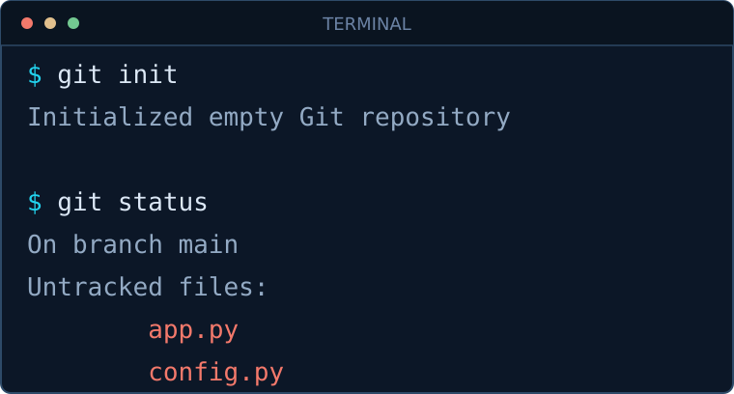
MODULE 01 · STEP 2
git init — and the letters VS Code shows you
The moment a folder is tracked, every file gets a one-letter status in the Source Control panel.
Start tracking this folder
Status letters — decode the gutter
U
Untracked Git has never seen this file
A
Added Staged for the next commit (git add)
M
Modified Tracked file changed since last commit
D
Deleted Tracked file removed from disk
R
Renamed Moved or renamed, content kept
What just happened
C
Conflict Merge needs your decision
A hidden .git folder appears — that is the whole repository.
Files light up under "Changes" in the Source Control panel.
Nothing is saved yet. Tracking ≠ committing.
Right-click any changed file: Open Changes (side-by-side diff) · Discard Changes (throw the edit away).
AI-Native Dev Setup
06
Notes:
Create app.py live so viewers watch U appear. Then add a line and show M. Letters first, commands second — the UI teaches the concept faster.

Slide 7
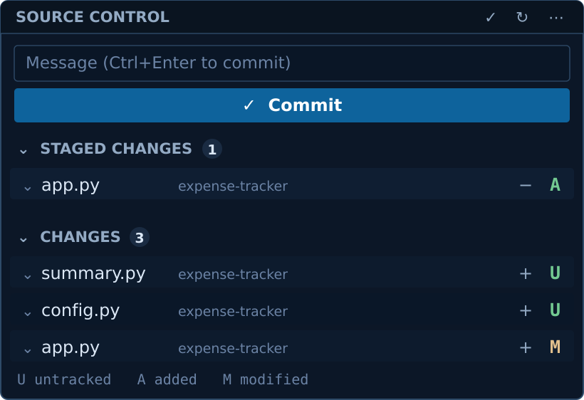
MODULE 01 · STEP 3
Stage and commit — the same act, two ways
Do it in the terminal, undo it, then repeat it with the mouse. remember the pairing.
In the terminal
In the VS Code UI
# stage one file, or everything
git add app.py
git add .
# take the snapshot
git commit -m "feat: add expense entry"
# see what you have built
git log --oneline
Status flips U → A the moment you add, and A → committed the moment you commit.
+ stages a file, − unstages it, and the box on top is your -m "..." text.
The ⋯ menu has Discard Changes — that one has no undo.
AI-Native Dev Setup
07
Notes:
Good commit messages: imperative mood, one logical change. Show a bad one ("changes") and a good one ("feat: add expense entry") back to back.

Slide 8

MODULE 01 · STEP 4
Reading your own history
Once there are three or four commits, history becomes the most useful thing in the repo.
Commands worth muscle memory
The same history, three more places
git log
git log --oneline
git log --oneline --graph --all
git show d13bf26
d13bf26 added git ignore
^^^^^^^ the short SHA — your handle
on any single commit
VS Code → Source Control → Graph: branches and merges drawn for you.
Right-click a file → Open Timeline: every commit that touched just that file.
GitHub → Commits tab, and the same list filtered per branch.
GitLens inline blame: who wrote this line, in which commit, and why.
Why it matters: the SHA you read here is the argument to almost everything that comes later — git revert, git cherry-pick, git stash apply, git checkout.
AI-Native Dev Setup
08
Notes:
Make four small commits before this slide so the log is not empty on screen.

Slide 9

MODULE 02 · IGNORE
.gitignore — the file that keeps you employed
Secrets pushed to GitHub are public the instant they land. The fix is one file, written on day one.
Create .gitignore in the repo root
The trap: it only works going forward
.gitignore is ignored for files Git already tracks. If you committed the secret once, untrack it first — and treat that key as burned.
# secrets — never commit these
.env
config.py
*.key
# python noise
__pycache__/
venv/
*.log
# local editor settings
.vscode/
git rm --cached config.py
Rules of thumb
Commit .gitignore itself — the team needs it.
Ignore generated things: builds, caches, virtual envs.
Never ignore source code to "hide" work in progress — branch instead.
Ignored files turn grey in the Explorer and vanish from Changes.
AI-Native Dev Setup
09
Notes:
Demo the trap for real: commit config.py first, then add it to .gitignore and show it still tracked. That surprise is the memorable moment.

Slide 10
MODULE 02 · UNDO
The undo toolkit — four situations, four answers
Pick the command by asking one question: how far has the change already travelled?
I staged the wrong file
I want my edit gone
Bad commit, not pushed
Bad commit, already pushed
Still local, not committed
Still local, not committed
Local history only
Everyone has it
git restore --staged config.py
git restore app.py
git reset --soft HEAD~1
git log --oneline
git revert d13bf26
Give Esc , type :wq
VS Code: click the − beside the staged file
VS Code: ⋯ → Discard Changes (destructive)
Keeps the edits, drops the commit
Adds an opposite commit — safe for teams
The one question that decides it: has anyone else pulled this commit? If no, reset is fine. If yes, use revert — rewriting shared history is what breaks your teammates.
AI-Native Dev Setup
10
Notes:
Do all four on camera in sequence. End with git revert so the last thing they see is the safe option.

Slide 11

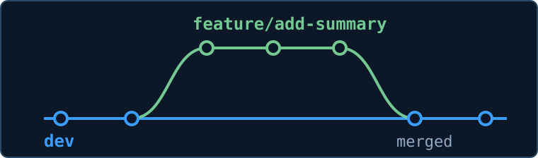
MODULE 03 · BRANCHING
Why branches exist — and the two ways teams use them
A branch is a movable label on a commit. Creating one is instant and costs nothing.
Feature branches — one per task
Environment branches — one per stage
feature/add-summary
main / prod
what customers actually run
feature/add-export
staging
production rehearsal
bugfix/wrong-total
All three branch off dev, get reviewed, and merge back into dev. Broken code on a branch harms nobody, and two people can work the same file at once.
test
QA runs against this
dev
everything merges here first
Code flows upward only: feature → dev → test → staging → main. Nobody commits directly to main.
AI-Native Dev Setup
11
Notes:
Explain that small teams often use only main + feature branches; the four-environment model shows up in enterprise work like Virtusa projects.

Slide 12
MODULE 03 · HANDS ON
Creating and switching branches
Three commands cover 95% of daily branch work — plus one click in the bottom-left corner.
Terminal
VS Code, bottom-left corner
git branch
# list branches, * marks where you are
git branch test
# create test, but stay where you are
git checkout test
# move onto test
git checkout -b feature/add-summary
# create AND switch — the one you will use
git switch feature/add-summary
git branch -d test
Click the branch name in the status bar.
Pick "Create new branch…" and type the name.
The same menu switches branches — the file tree updates instantly.
Before you switch
Commit or stash your work first. Switching with uncommitted edits either drags them along or is refused outright — and that confusion is where beginners lose files.
AI-Native Dev Setup
12
Notes:
Switch branches on camera with a file open so viewers watch the editor content change — that is the moment branching clicks.

Slide 13

MODULE 04 · GOING REMOTE
From local folder to GitHub repository
GitHub hands you these seven lines when you create an empty repo. Here is what each one does.
Paste these once, in the repo folder
git branch -M main
Force-renames the current branch to main — GitHub's default name.
echo "# expense-tracker" >> README.md
git init
git add README.md
git commit -m "first commit"
git branch -M main
git remote add origin \
https://github.com/6-month-fde-challenge/
expense-tracker.git
git push -u origin main
git remote -v # check what is wired up
origin
Just a nickname for the remote URL. Nothing magic about the word.
push -u
Sets the upstream, so from now on plain "git push" is enough.
Already have commits?
Skip init/add/commit — run only the last three lines.
AI-Native Dev Setup
13
Notes:
Create the GitHub repo on screen with no README and no licence, so the seven lines match exactly what GitHub prints.

Slide 14

MODULE 04 · AUTHENTICATION
Signing in, and fixing it when it breaks
The single most common beginner blocker: a stale credential that keeps rejecting your push.
The easy path — GitHub CLI
Push rejected? Clear the stale login
gh auth login
gh auth status
1
Windows
Control Panel → Credential Manager → Windows Credentials → delete the git:https://github.com entry
Browser opens, you approve once, Git stops asking.
2
macOS
Keychain Access → search "github" → delete the internet password
HTTPS vs SSH
3
Any OS
HTTPS + Personal Access Token — easiest on Windows, works behind most firewalls.
SSH key — no prompts ever, best on a machine you own. Password is never your token.
git config --global --unset credential.helper, then push again and re-enter
4
Then
Push once more — Git asks fresh and stores the new token
AI-Native Dev Setup
14
Notes:
Use a throwaway account or blur the token field while recording. Never show a real PAT on screen.

Slide 15


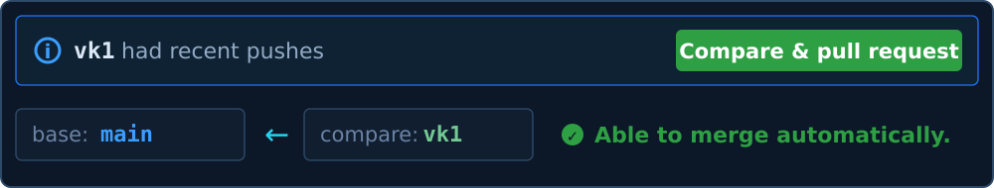
MODULE 04 · COLLABORATION
Push a branch, open a pull request, merge it
This is the loop you will repeat every working day of your career.
01
02
03
04
05
Push the branch
Compare & PR
Set base ← compare
Review
Confirm merge
git push -u origin
feature/add-summary
GitHub shows a yellow banner
the moment the branch lands
base: dev
compare: feature/add-summary
Add a reviewer (assign yourself
while learning) · Files changed tab
Merge pull request → Confirm
→ Delete branch
After the merge, three tabs
Commits — every commit in order · Insights → Network — the branch graph · the branch dropdown, which swaps the files exactly like VS Code does.
AI-Native Dev Setup
15
Notes:
Assign the PR to yourself and approve it so viewers see the full review UI. Mention that on real teams you cannot approve your own.

Slide 16
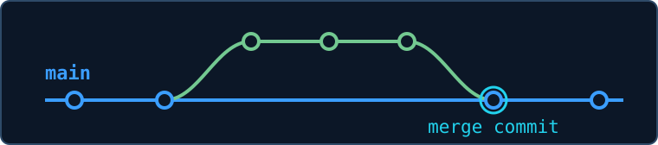
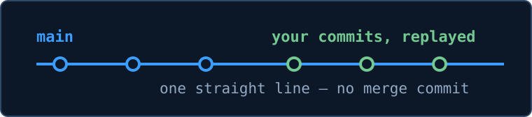
MODULE 05 · INTEGRATING
merge vs rebase — same destination, different history
Both end with the same files. Rebase your own branch; merge anything other people have already pulled.
git merge — keeps the true story
git rebase — replays for a straight line
git checkout main
git pull
git merge feature/add-summary
git checkout feature/add-summary
git rebase main
git rebase --continue # after fixing
A merge commit joins both lines — the history keeps the branch in it.
Nothing is rewritten, so it is safe on branches others have pulled.
This is what GitHub does when you merge a pull request.
Your commits are lifted off and laid back down on top of main.
No merge commit, so the log reads as one straight line.
Commit IDs change — never rebase a branch others have pulled.
AI-Native Dev Setup
16
Notes:
Run git log --oneline --graph --all after each so the difference in shape is visible, not just described.

Slide 17
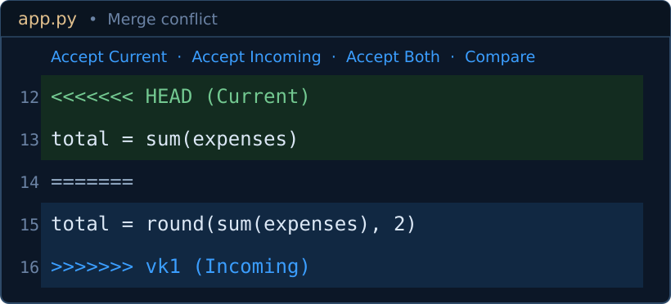
MODULE 05 · CONFLICTS
Solve a conflict
Git only asks for help when two branches change the same line. So change the same line deliberately.
The setup — 60 seconds
What the markers mean
git checkout -b vk1
# edit line 1 of app.py → commit
git checkout main
# edit the SAME line differently → commit
git merge vk1
CONFLICT (content): Merge conflict in app.py
VS Code jumps straight into the merge editor and marks the file C in the Source Control panel.
Resolve it, then close the merge
Click one of the four links, or edit the line by hand. Delete all three markers, then run git add app.py and git commit.
AI-Native Dev Setup
17
Notes:
"Current" is the branch you are standing on, "Incoming" is the one you are pulling in. Say that twice — it is the number one point of confusion.

Slide 18
MODULE 06 · STASH
git stash — the pause button for half-finished work
A production bug lands while your feature is mid-sentence. You cannot commit junk, and you cannot lose it.
1
2
3
4
5
On newdev,
half done
git stash
Fix main
Back to newdev
git stash pop
Files are dirty.
Too messy to commit.
Working tree goes clean.
Edits parked safely.
checkout main → patch
→ commit → push
git checkout newdev
Edits return exactly
as you left them.
Managing multiple stashes
pop vs apply
git stash list
stash@{0}: WIP on newdev: d13bf26 added gitignore
stash@{1}: WIP on newdev: d13bf26 added gitignore
git stash pop restores the newest stash and deletes it from the list.
git stash apply stash@{1} restores a chosen stash and keeps it, so you can reuse it.
AI-Native Dev Setup
18
Notes:
Tell the story before typing anything. The hotfix scenario is what makes stash memorable; the commands are trivial once the story lands.

Slide 19


MODULE 06 · FINISHERS
Stash across branches, cherry-pick, and clone
Three questions that always come up in the comments — answered before they are asked.
Can I move a stash to another branch?
I want one commit, not the whole branch
How do I get someone else's repo?
Yes — a stash is not tied to a branch.
That is cherry-pick.
Clone it — init is only for brand-new folders.
git stash
git checkout other-branch
git stash pop
git log --oneline vk1
git checkout main
git cherry-pick d13bf26
git clone <repo-url>
cd expense-tracker
git branch -a
Handy when you started work on the wrong branch — which happens to everyone.
Copies that single commit onto your current branch. Classic use: a hotfix made on the wrong branch.
Clone brings history, branches and the origin remote already wired up. In VS Code: Ctrl+Shift+P → Git: Clone.
AI-Native Dev Setup
19
Notes:
Close the loop: delete the local folder on camera and clone it back from GitHub. Proves the remote really holds everything.

Slide 20
REFERENCE
Every command in one place
Screenshot this one and keep it beside the terminal.
SETUP
DAILY
BRANCHING
git config --global user.name "…"
git config --global user.email "…"
git init
git clone <url>
git status
git add . | git add file
git commit -m "msg"
git log --oneline --graph
git branch
git checkout -b feature/x
git switch main
git branch -d feature/x
REMOTE
INTEGRATE
UNDO & PARK
git remote add origin <url>
git push -u origin main
git pull
gh auth login
git merge feature/x
git rebase main
git rebase --continue
git cherry-pick <sha>
git fetch origin pull/1/head:pr-1
git switch pr-1
git restore --staged file
git revert <sha>
git stash | git stash list
git stash pop | apply <id>
git stash apply “<id>” in powershell
AI-Native Dev Setup
20
Notes:
Export this single slide as a PNG and drop it in the description and community post.

Slide 21
PRACTICE
Fourteen steps, one repo
Work through these against expense-tracker, watching both the terminal and the Source Control panel.
Local
Remote & recovery
1
Create the folder, open it in VS Code, run git init.
8
Create the GitHub repo, run the seven lines, push main.
2
Add app.py — watch U appear. git status confirms it.
9
git checkout -b feature/add-summary, change a line, push.
3
git add .\app.py → status flips to A. Commit it.
10
Open the PR, assign yourself, review, merge, delete branch.
4
Edit app.py → M appears. Open Changes to see the diff.
11
Create vk1 and main edits on the same line → merge conflict.
5
Add config.py with a fake key. Commit it by mistake.
12
Resolve with Accept Current / Incoming, commit the merge.
6
Write .gitignore, notice it is still tracked, git rm --cached.
13
Start new work, git stash, hotfix main, come back, stash pop.
7
git restore --staged, then Discard Changes — both undos.
14
Delete the local folder and git clone it back. Full circle.
AI-Native Dev Setup
21
Notes:
Fourteen beats, roughly 6-8 minutes each if split into six videos. Reset the folder between takes with a shell script so every run is identical.

Slide 22

COMING UP IN PART 2
Git, beyond the basics
Clone the repo, break it on purpose, and fix it. That is the only way this sticks.
Secrets & scanning
Tags & releases
Forks & open source
GitHub Actions
GitHub secret scanning, push protection, rotating a leaked key
git tag, semantic versioning, release notes from commits
fork → upstream remote → PR into someone else's repo
run tests on every push, straight from .github/workflows
This video sits in Playlist 02, AI-Native Dev Setup — the rest of the setup is in there too.
START HERE
Playlist 02 — AI-Native Dev Setup
youtube.com/playlist?list=PLJm7qkO8_m7o
Make your first commit before the next video.
Notes:
Ask for one comment naming the Git command that used to scare them. Point at the rest of the AI-Native Dev Setup playlist as the next watch.

