Slide 1
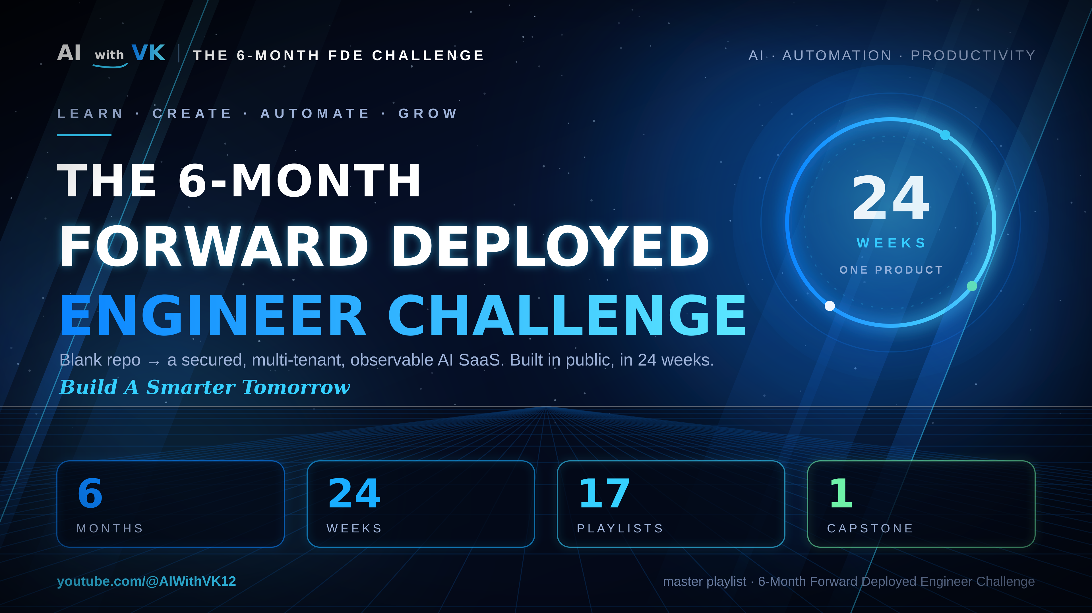
Notes:
Hero. Channel: youtube.com/@AIWithVK12. Master playlist: 6-Month Forward Deployed Engineer Challenge (PLeA0lzogo6eA). 17 playlists, 24 weeks. Python Zero to Hero (PLIQrs29V6Vgw) is pre-work, already live.

Slide 2
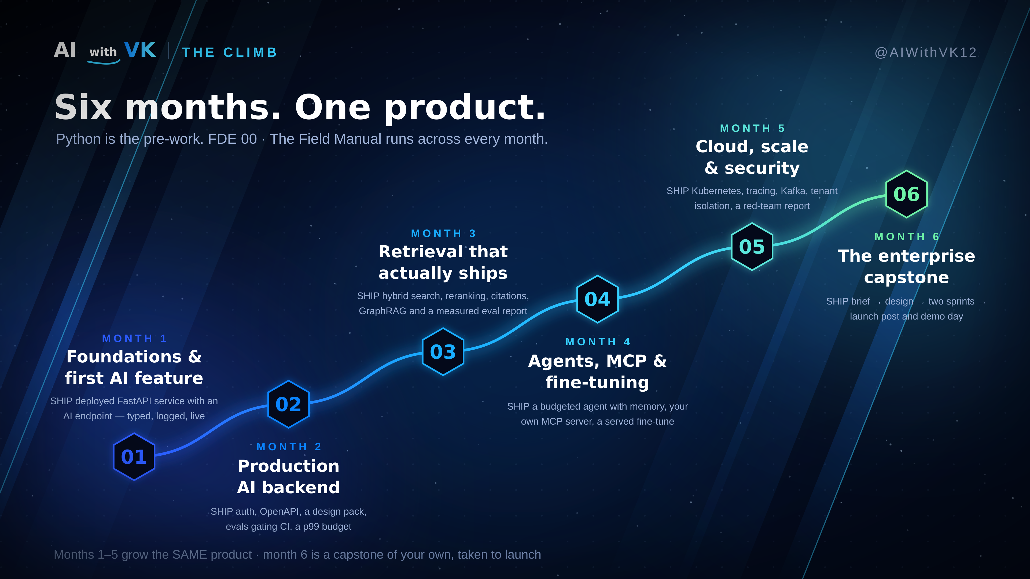
Notes:
The climb. M1 foundations and first AI feature · M2 production backend · M3 retrieval · M4 agents, MCP and fine-tuning · M5 cloud, scale and security · M6 the capstone alone.

Slide 3
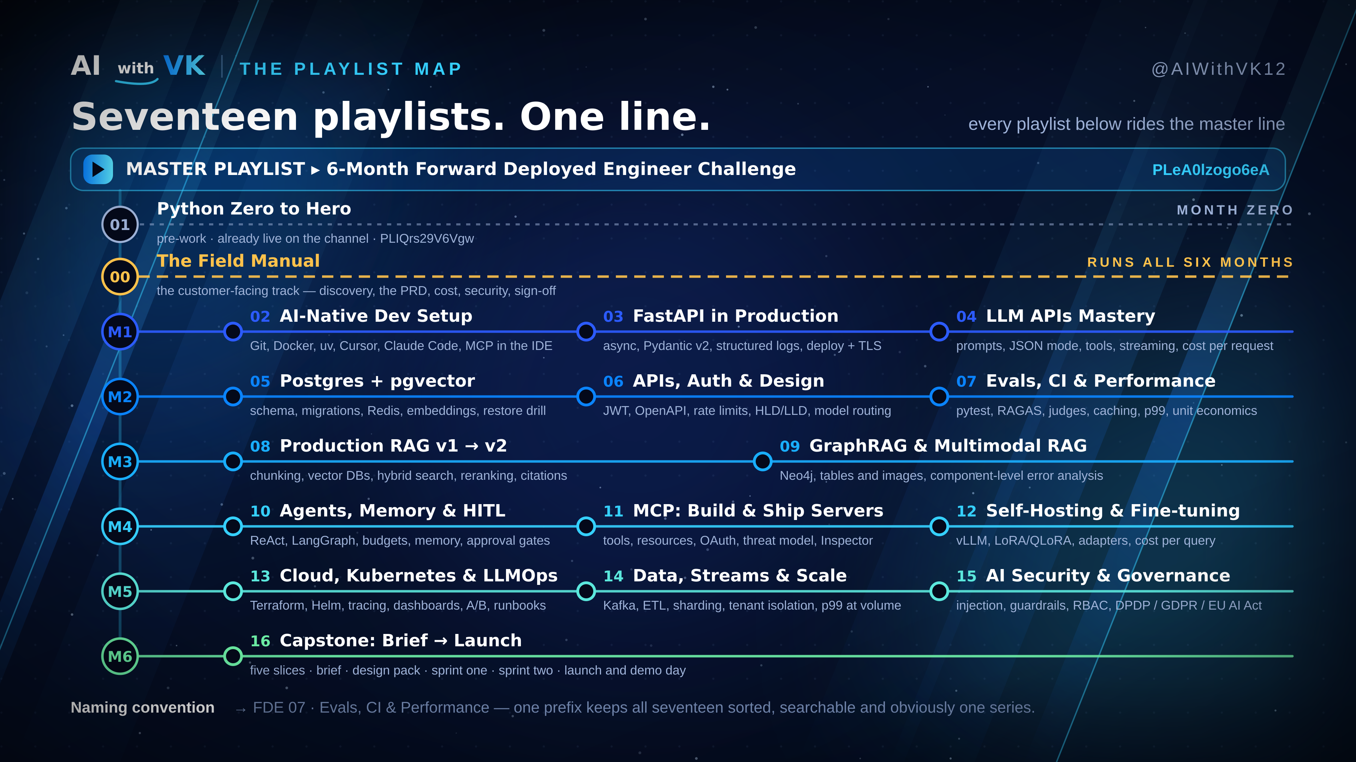
Notes:
The playlist map. Spine is the master playlist. Grey dashed line is Python as month-zero pre-work; gold dashed line is FDE 00. Then M1-M6 routes with 16 numbered playlists.

Slide 4
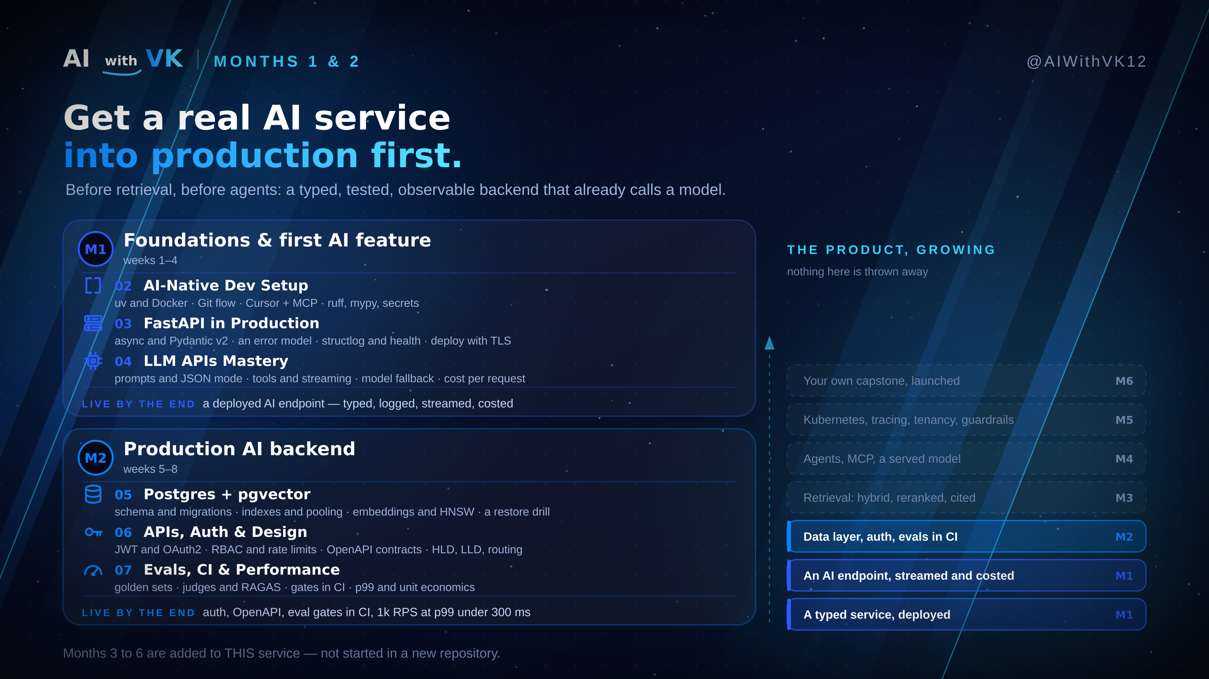
Notes:
Months 1 & 2 in detail. M1: dev setup, FastAPI in production, LLM APIs. M2: Postgres + pgvector, APIs/auth/design, evals + CI + performance. Emphasise that months 3-6 are added to THIS service, not started fresh. Ships: a deployed AI endpoint; then auth, OpenAPI, eval gates and 1k RPS at p99 under 300ms.

Slide 5
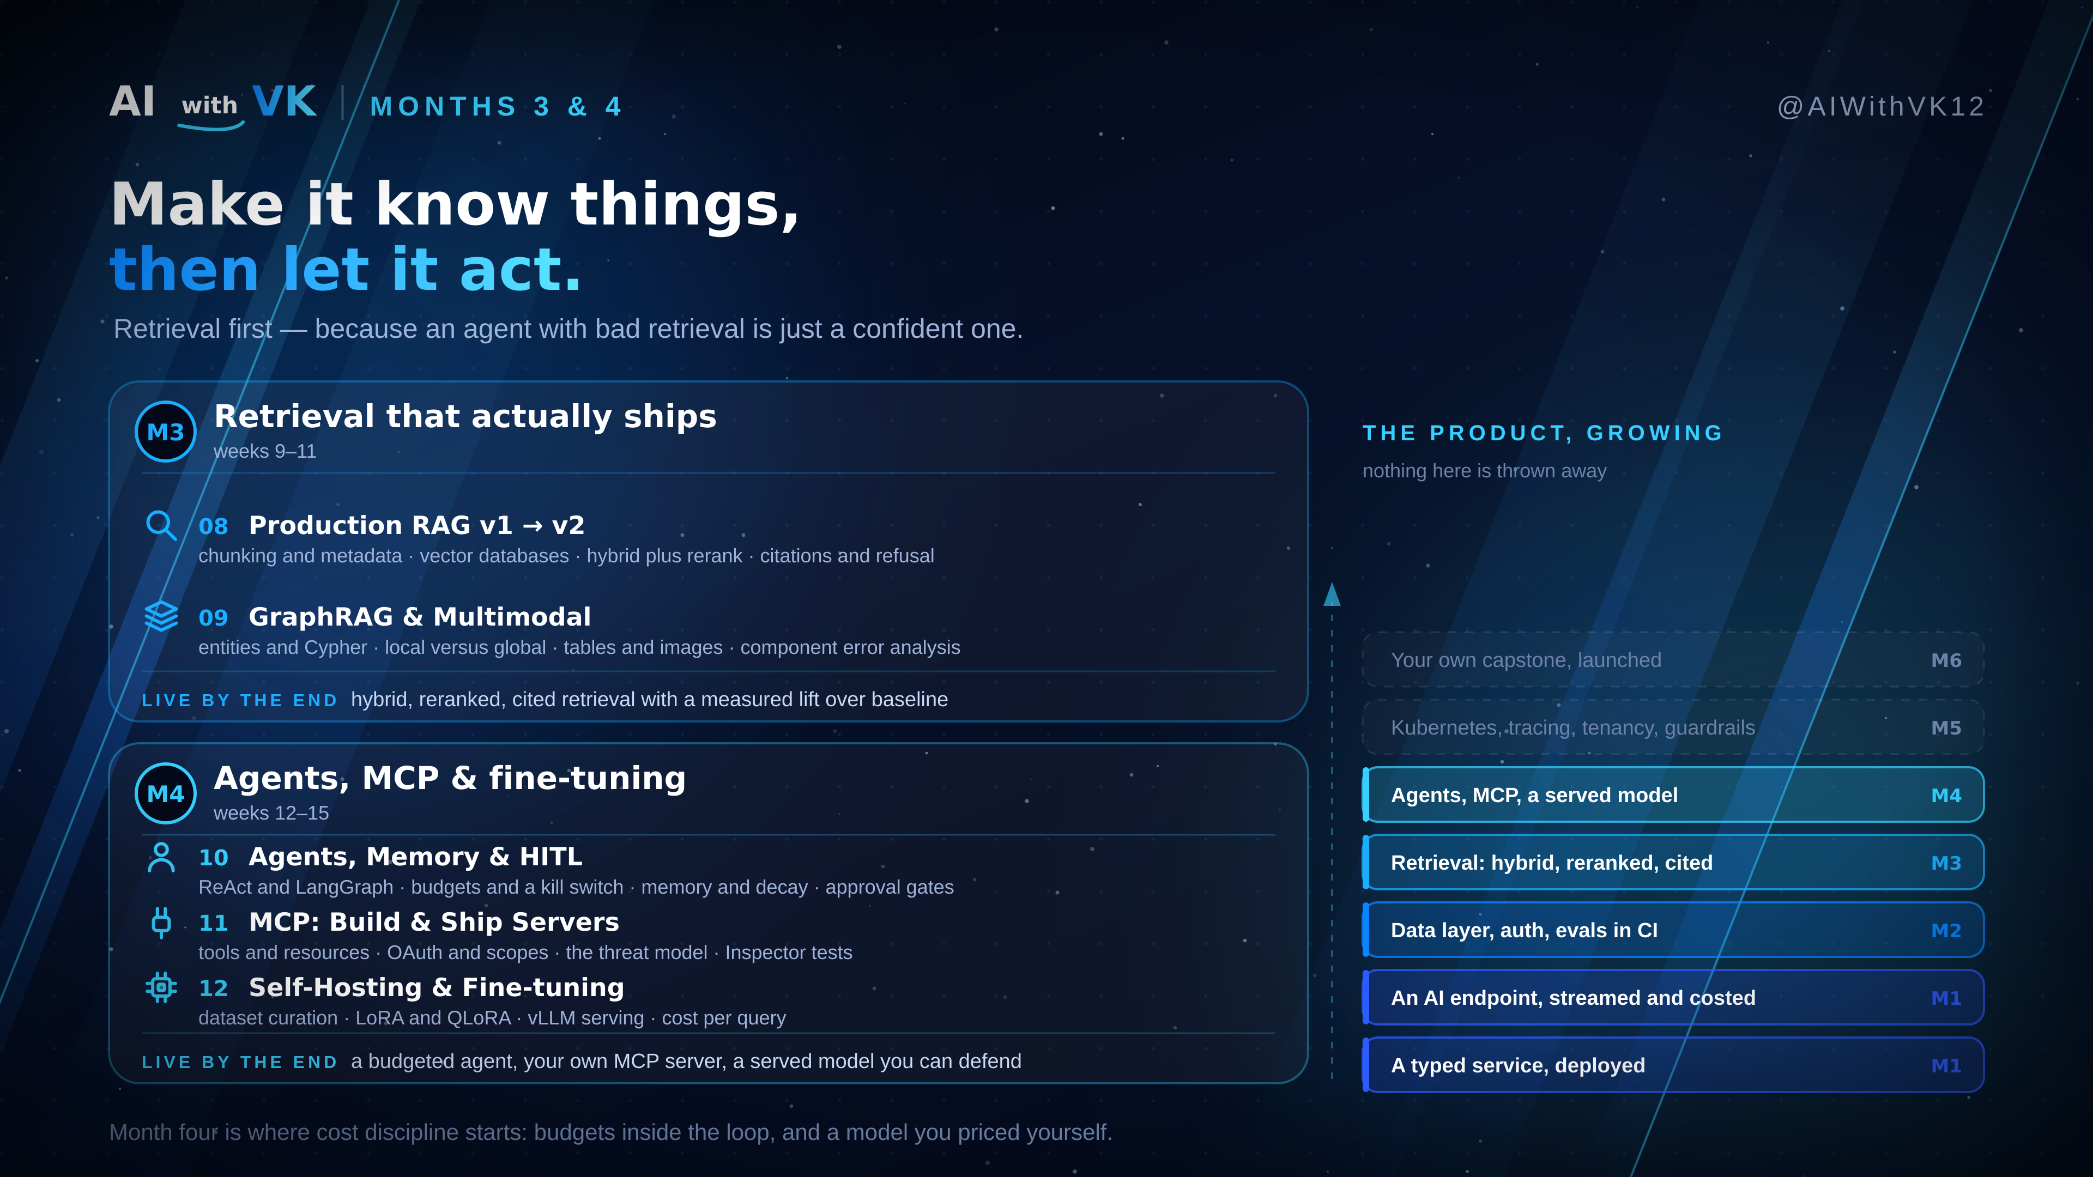
Notes:
Months 3 & 4 in detail. M3: production RAG v1 to v2, then GraphRAG and multimodal with component-level error analysis. M4: agents with memory and human-in-the-loop, your own MCP server, self-hosting and fine-tuning. The line to land: retrieval before agents, because an agent with bad retrieval is just a confident one.

Slide 6
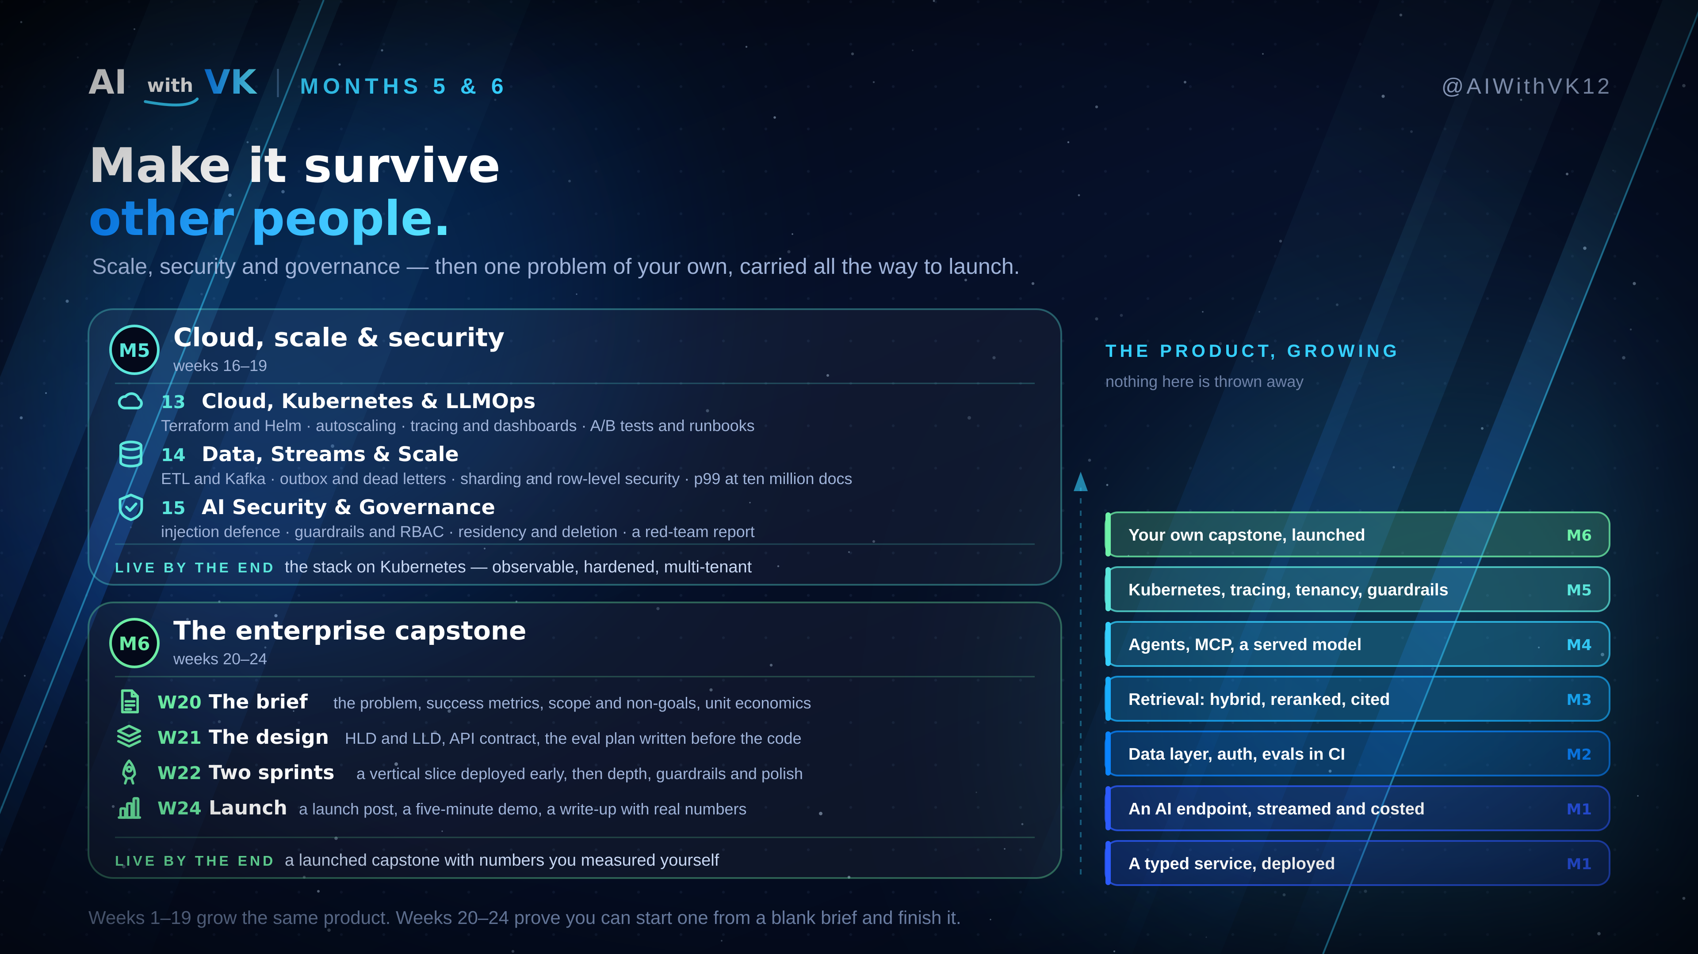
Notes:
Months 5 & 6 in detail. M5: cloud/Kubernetes/LLMOps, data + streams + multi-tenant scale, security and governance (DPDP, GDPR, EU AI Act, NIST AI RMF). M6: the capstone across five weekly slices — brief, design, two sprints, launch. Ships: the stack on Kubernetes hardened and multi-tenant; then a launched capstone with real numbers.

Slide 7
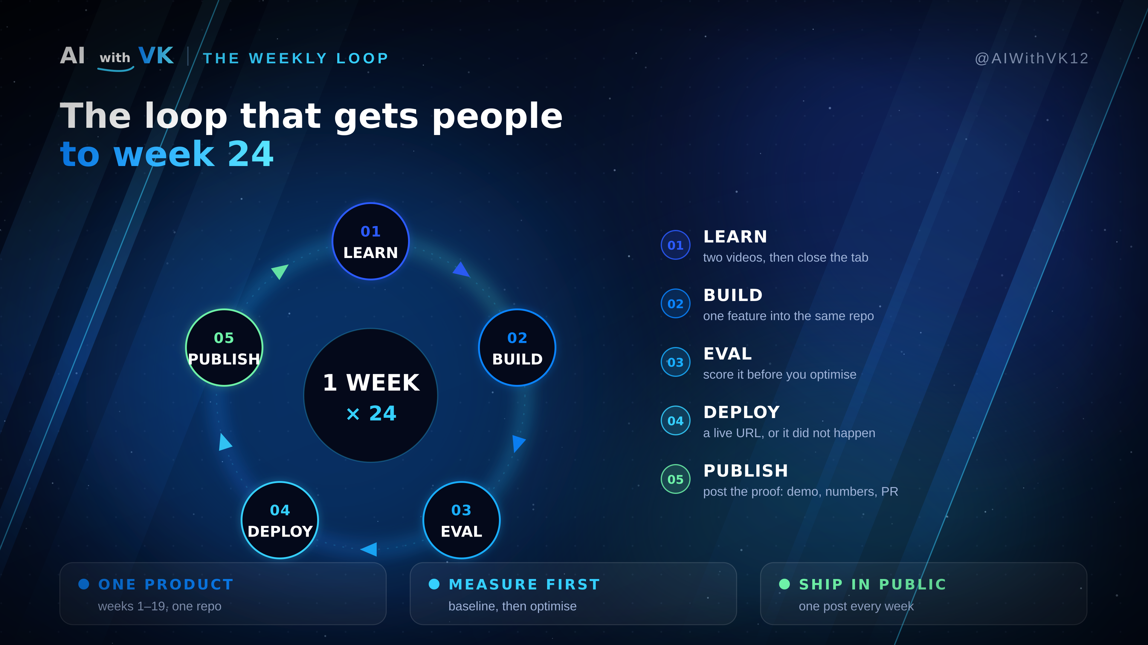
Notes:
The weekly loop: learn, build, eval, deploy, publish. Rules: one product carried up, measure before optimising, ship in public.

Slide 8
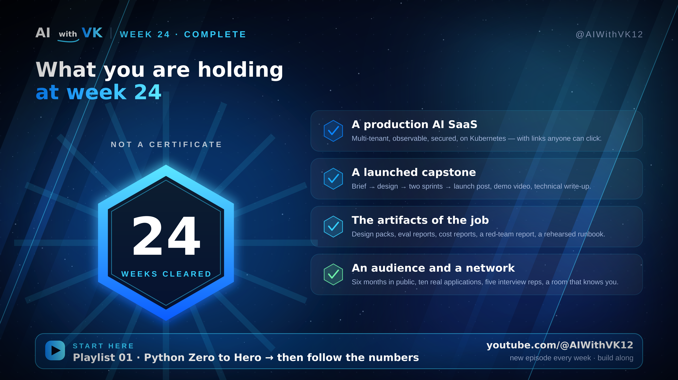
Notes:
The payoff and CTA. Start at Python Zero to Hero, then follow the numbers.

