Slide 1
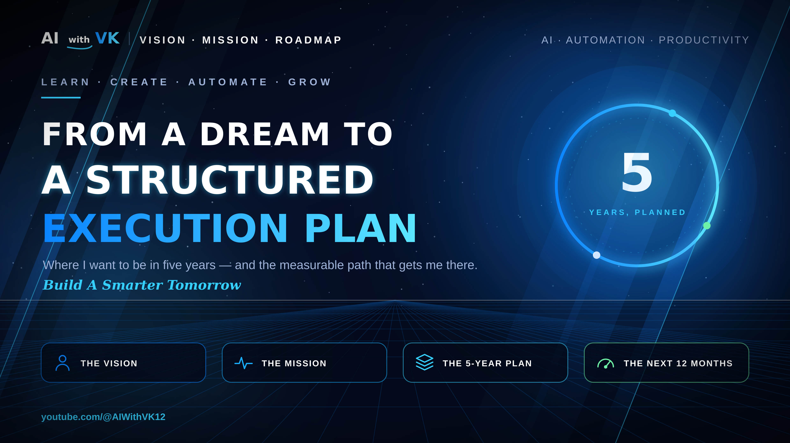
Notes:
1 · Title. Three parts: vision (where), mission (what I do consistently), roadmap (when, with numbers).

Slide 2
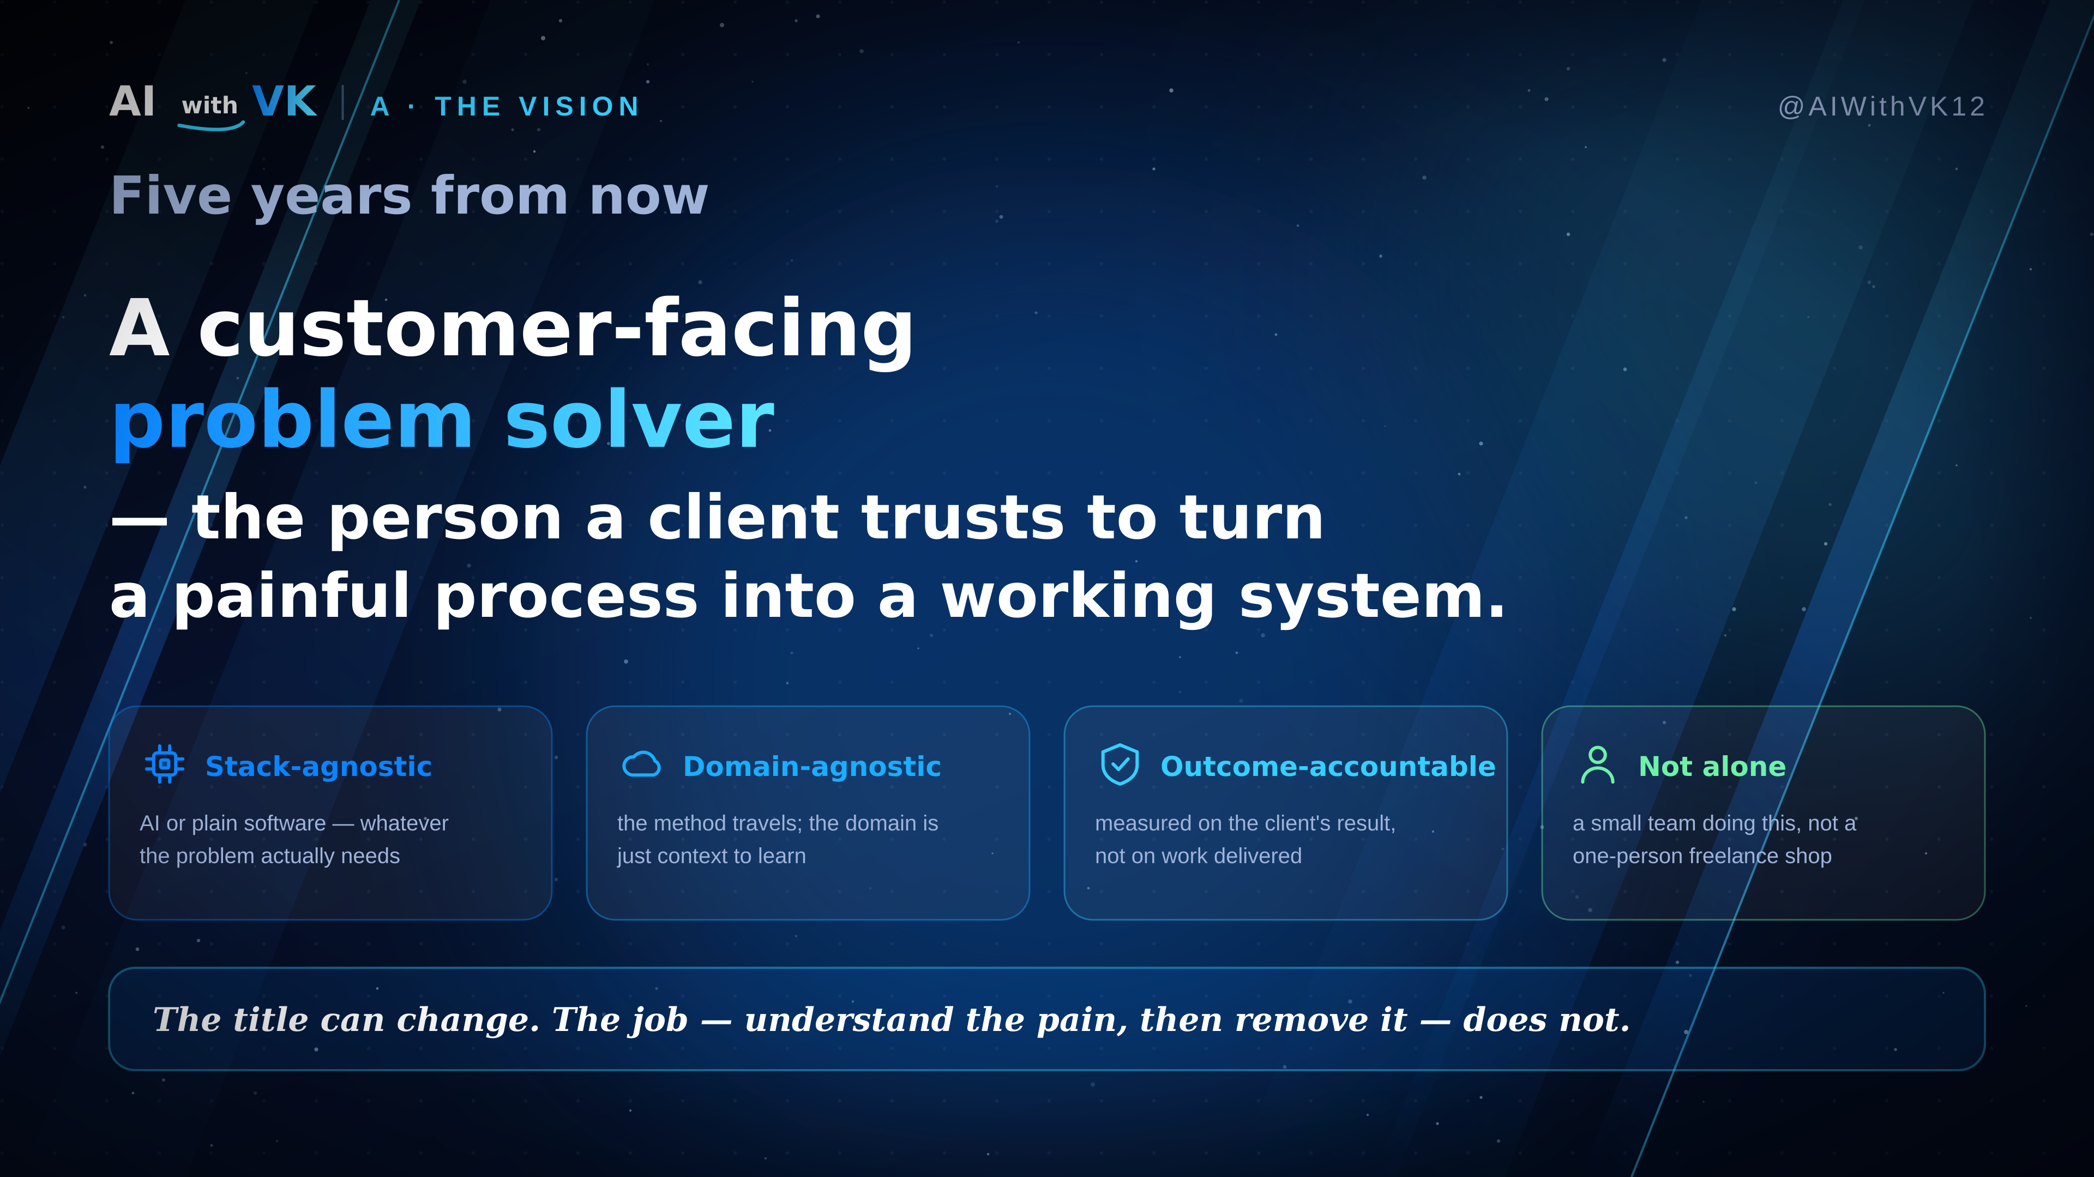
Notes:
2 · A · The vision. Five-year destination: a customer-facing problem solver — stack-agnostic, domain-agnostic, accountable for the client's outcome, working with a small team rather than alone.

Slide 3
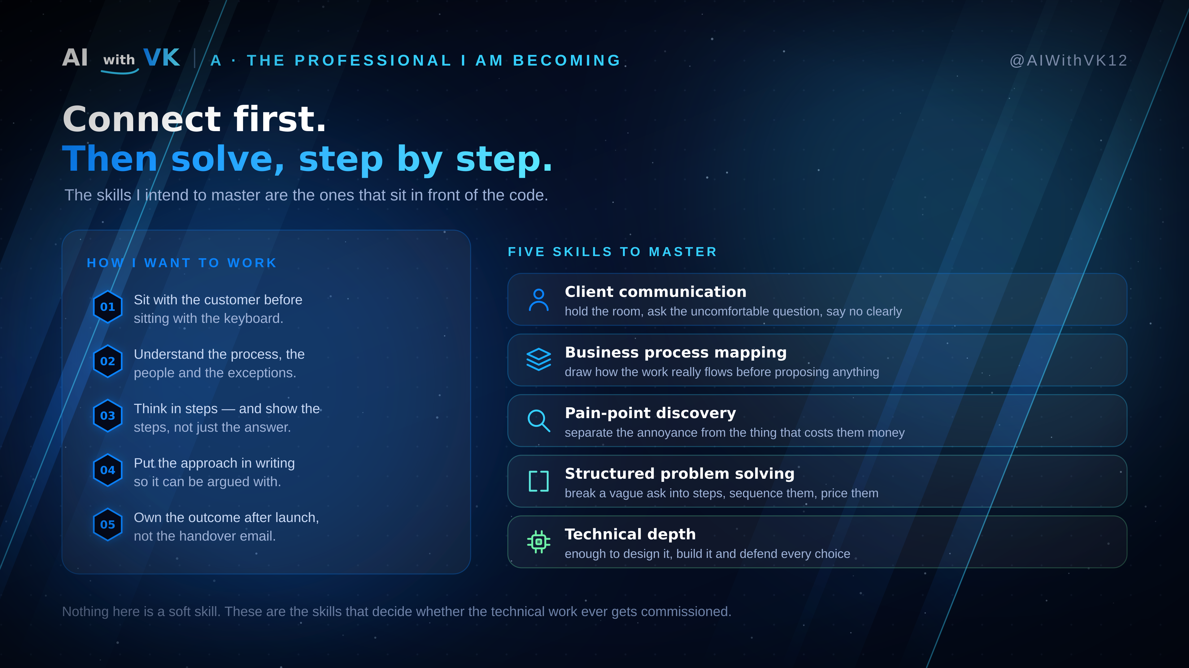
Notes:
3 · A · The professional and the skills. How I want to work, plus the five customer-facing skills to master: client communication, business process mapping, pain-point discovery, structured problem solving, technical depth.

Slide 4
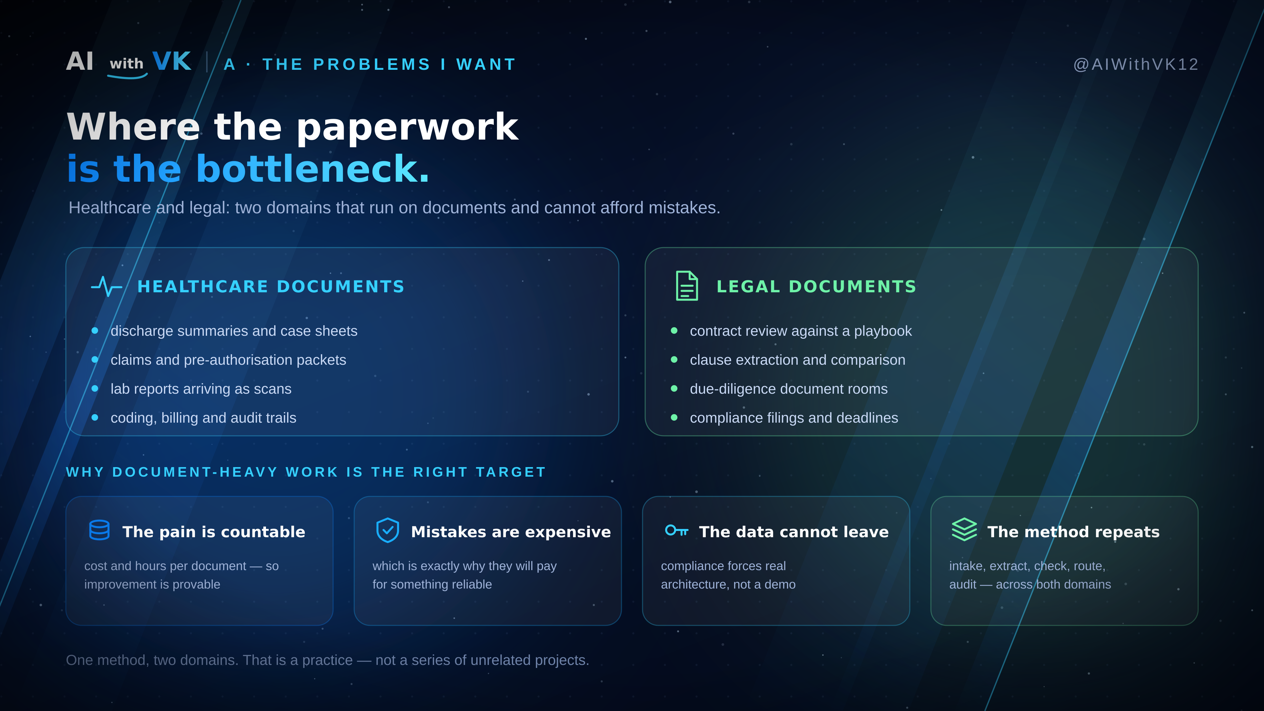
Notes:
4 · A · The problems. Healthcare documents and legal documents. Four reasons the choice is deliberate: the pain is countable, mistakes are expensive, the data cannot leave, the method repeats across both.

Slide 5
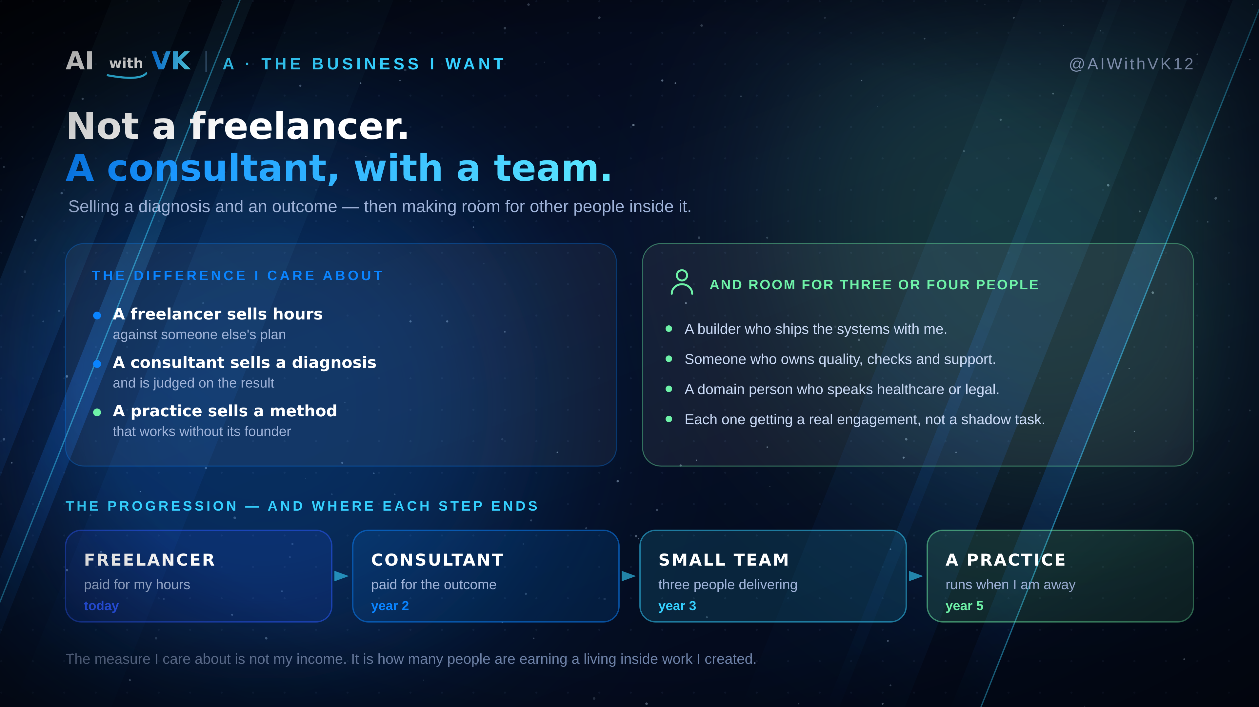
Notes:
5 · A · The business. Not a freelancer — a consultant, then a small team, then a practice. Freelancer sells hours, consultant sells a diagnosis and owns the result, a practice sells a method that works without its founder. Room for three or four people, each on a real engagement. Progression: today → year 2 → year 3 → year 5.

Slide 6
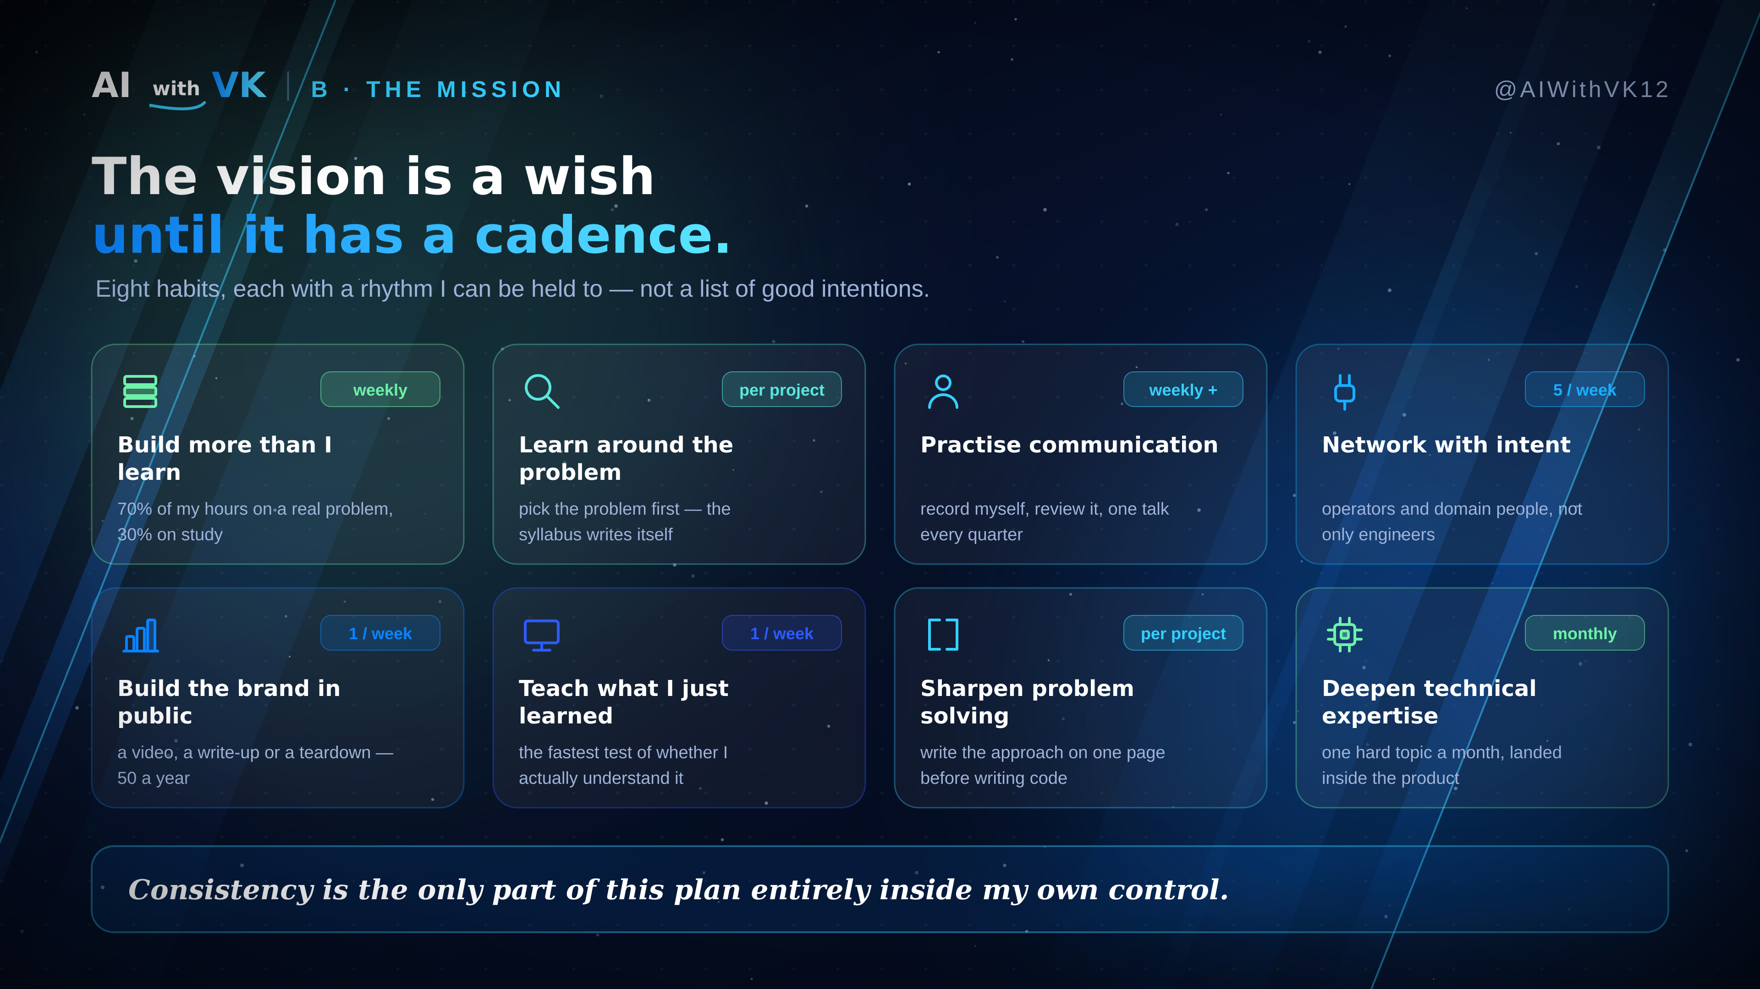
Notes:
6 · B · The mission. Eight habits with a cadence: build 70 / learn 30, learn around the problem, practise communication, network with intent, build the brand in public, teach weekly, write the approach before code, one hard technical topic a month.

Slide 7
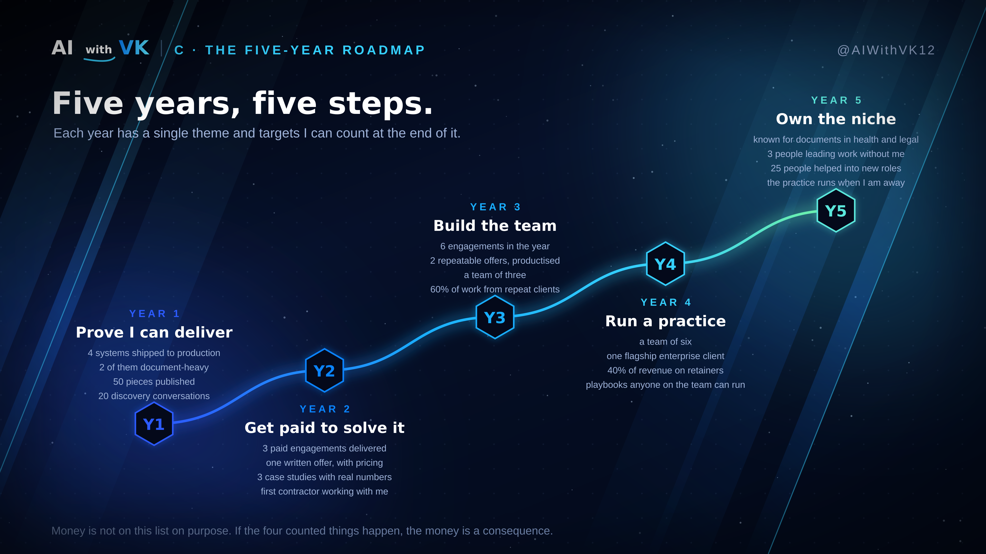
Notes:
7 · C · The five-year roadmap. Y1 prove I can deliver. Y2 get paid to solve it. Y3 build the team. Y4 run a practice. Y5 own the niche. Four countable targets per year; revenue deliberately excluded as a target.

Slide 8
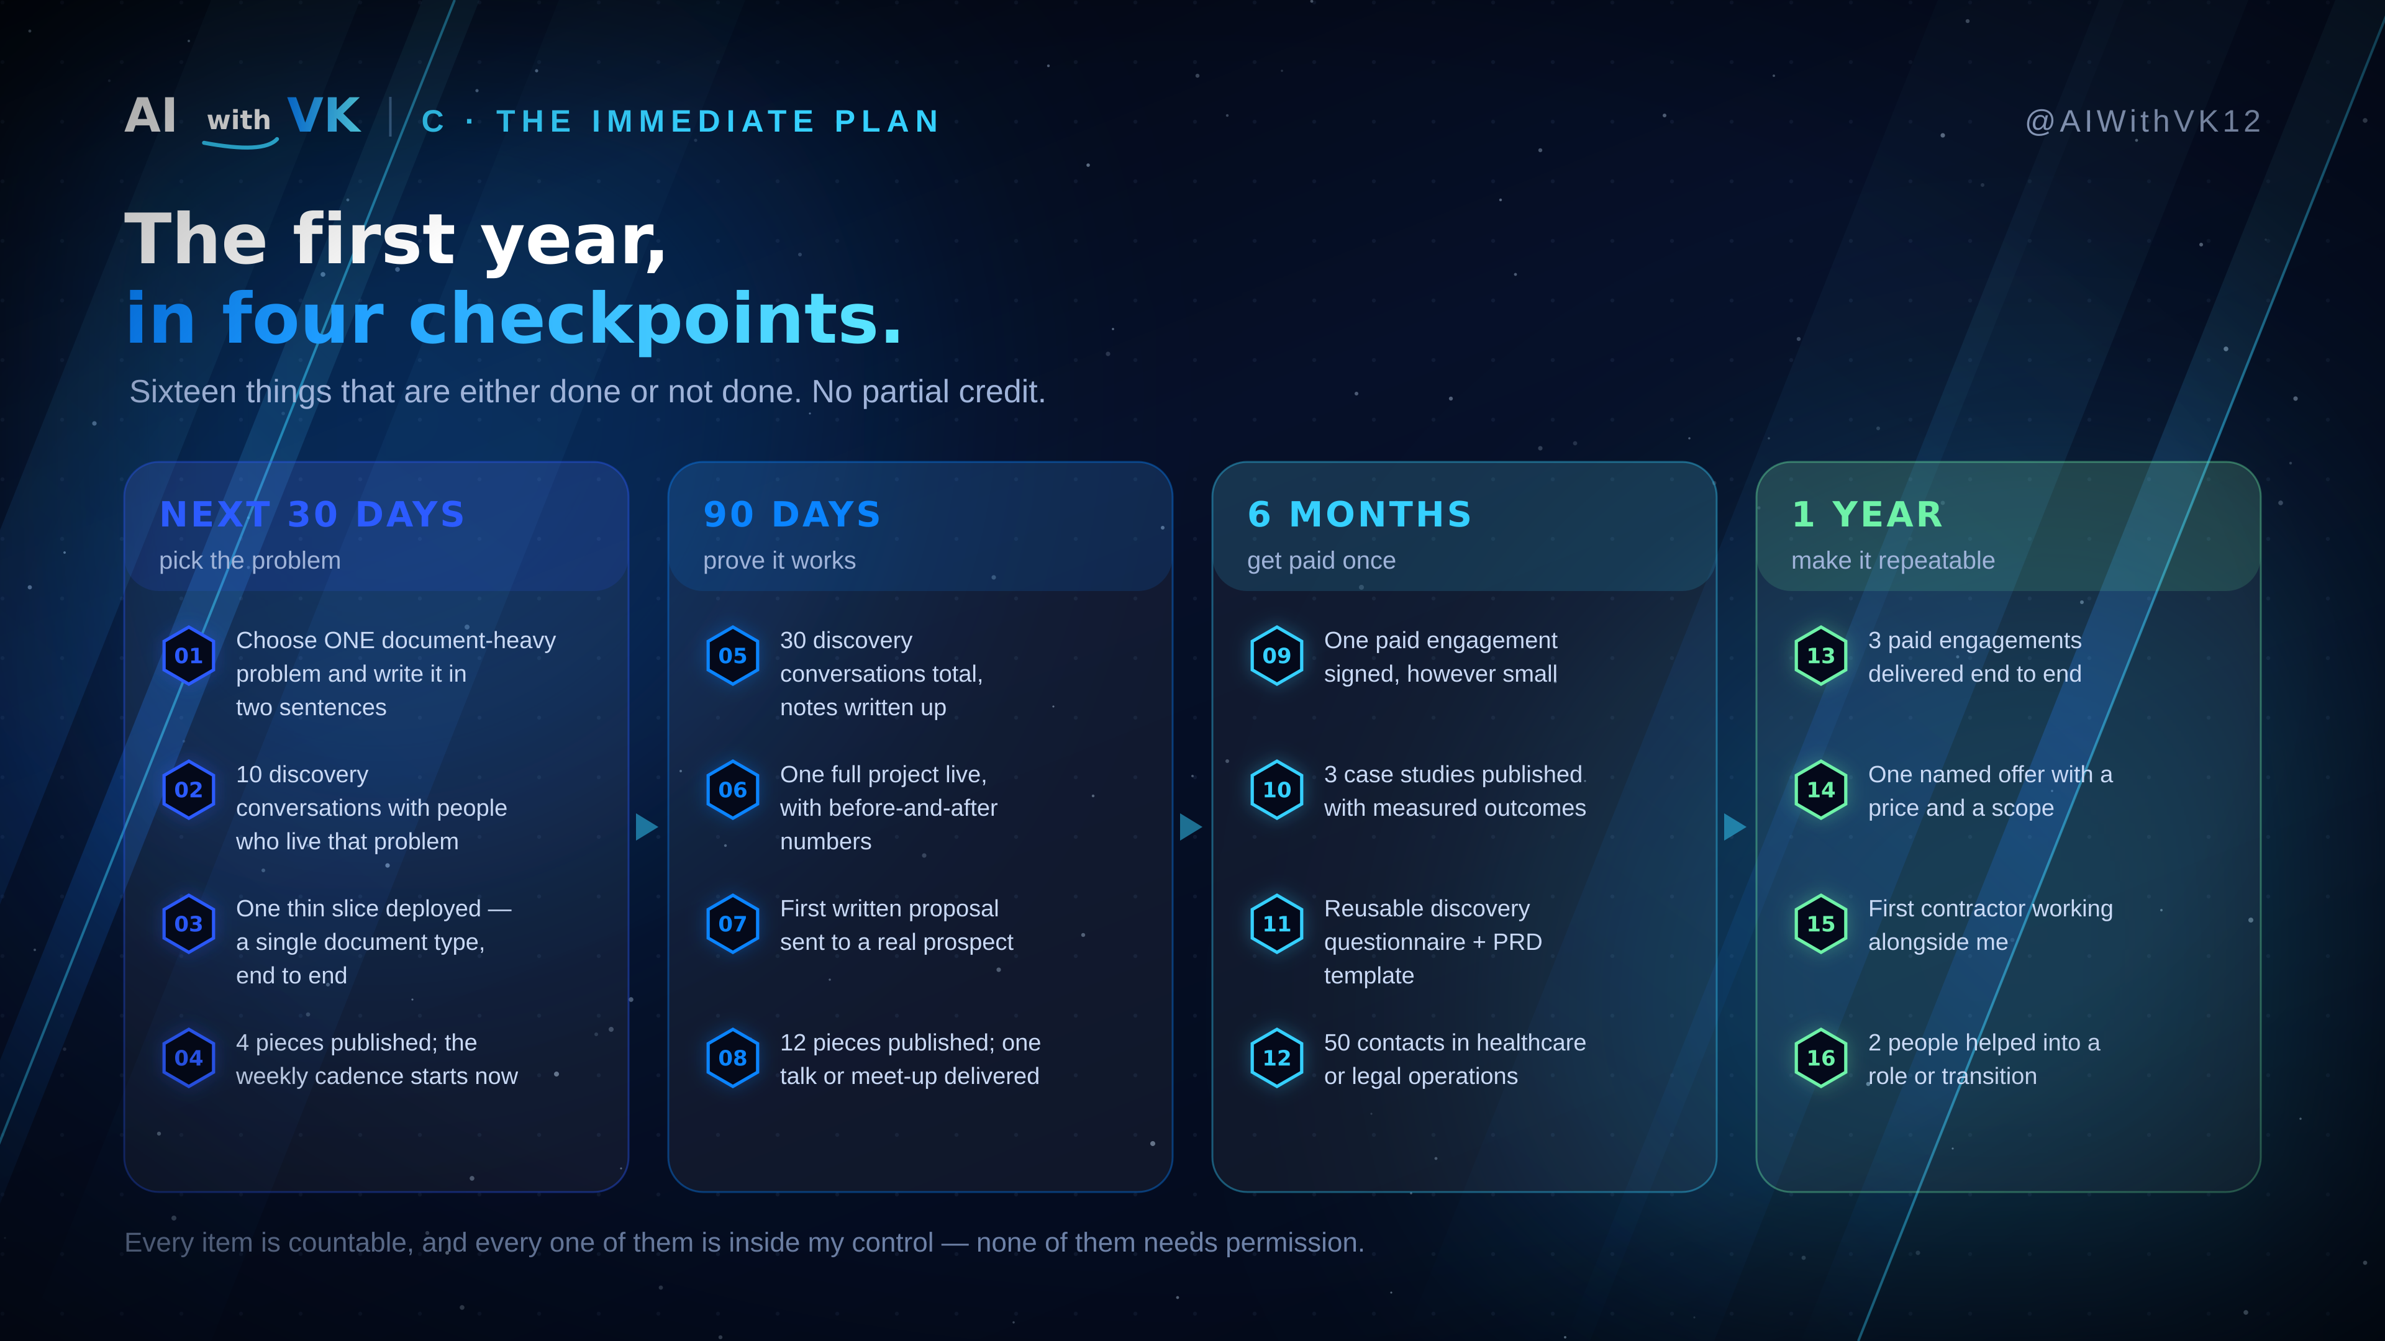
Notes:
8 · C · The immediate plan. 30 days, 90 days, 6 months, 1 year — sixteen binary items, all inside my own control.

Slide 9
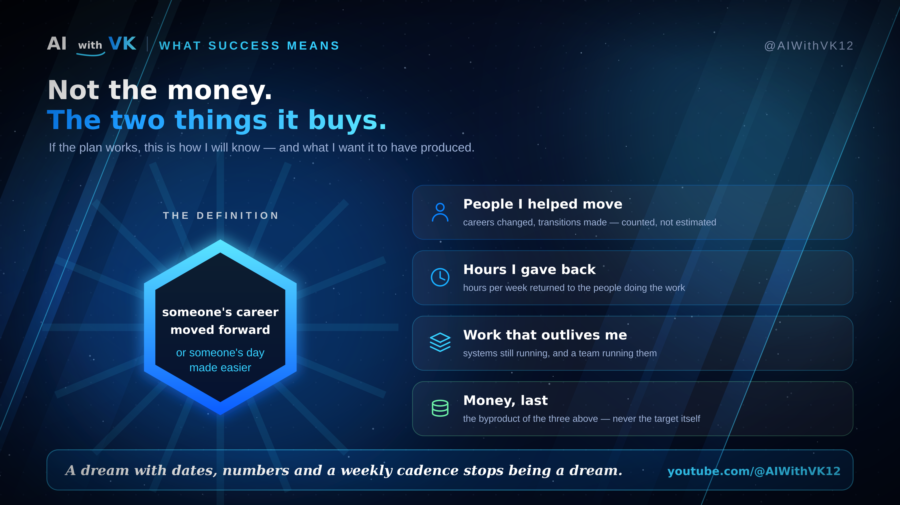
Notes:
9 · What success means. A career moved forward or a day made easier. Scoreboards: people helped, hours given back, work that outlives me, money last.

