Slide 1
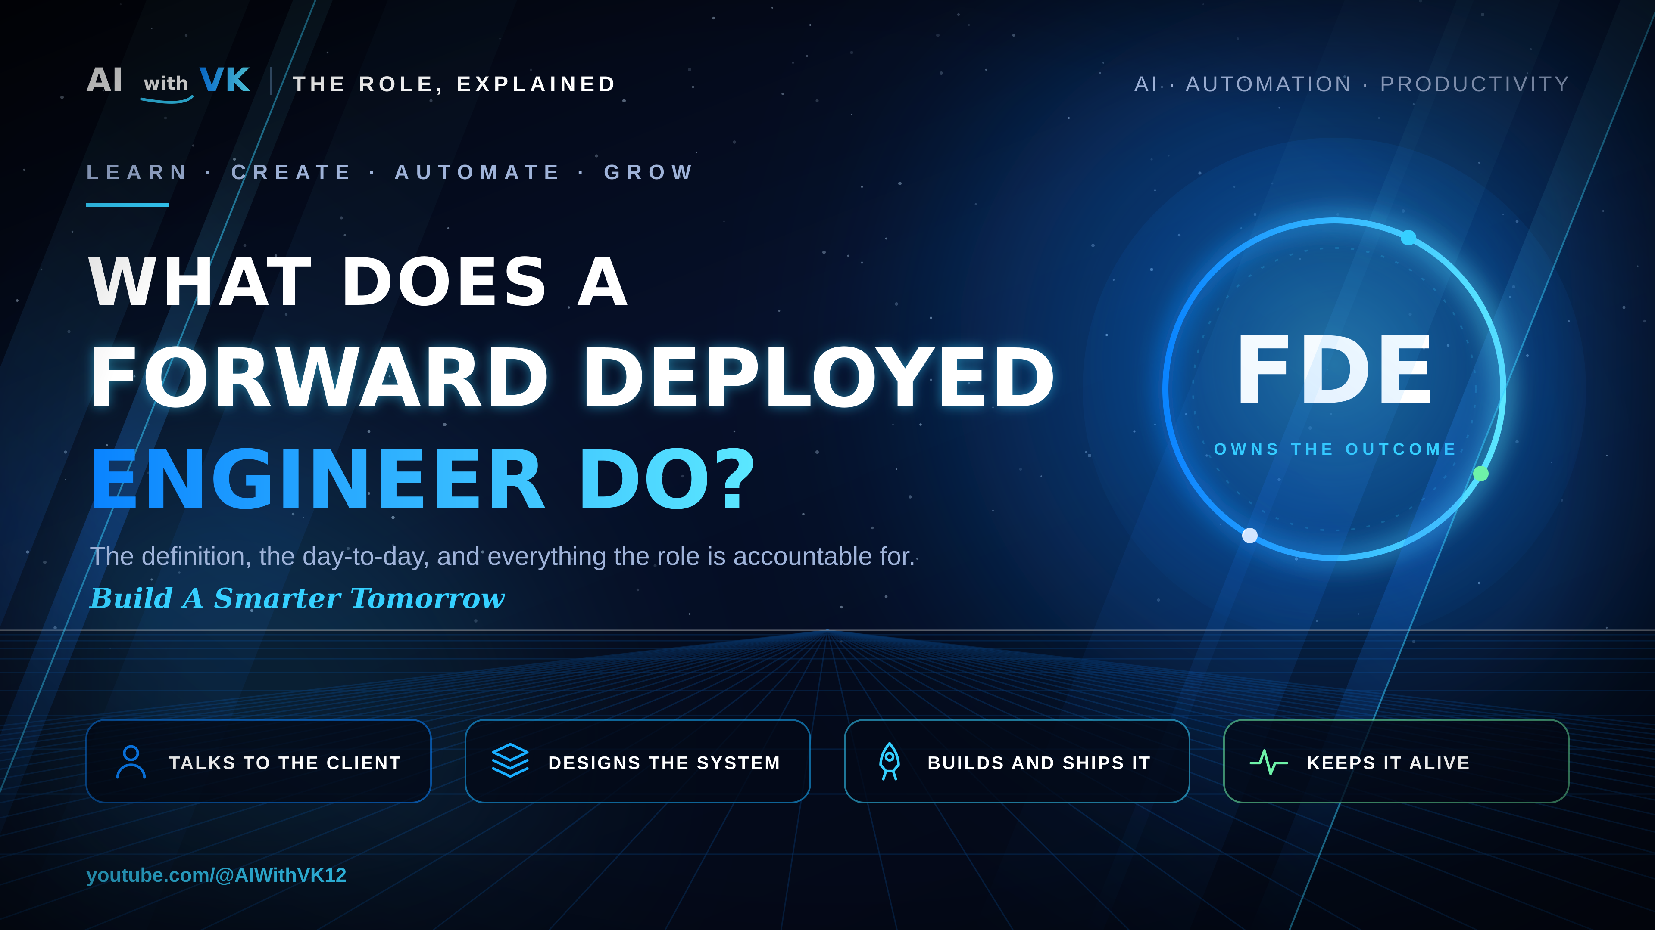
Notes:
1 · HOOK (0:00-0:50). The title is appearing at AI labs and AI-native companies. Most explanations are one vague line. Promise: the definition, the day-to-day, and everything the role is accountable for.

Slide 2
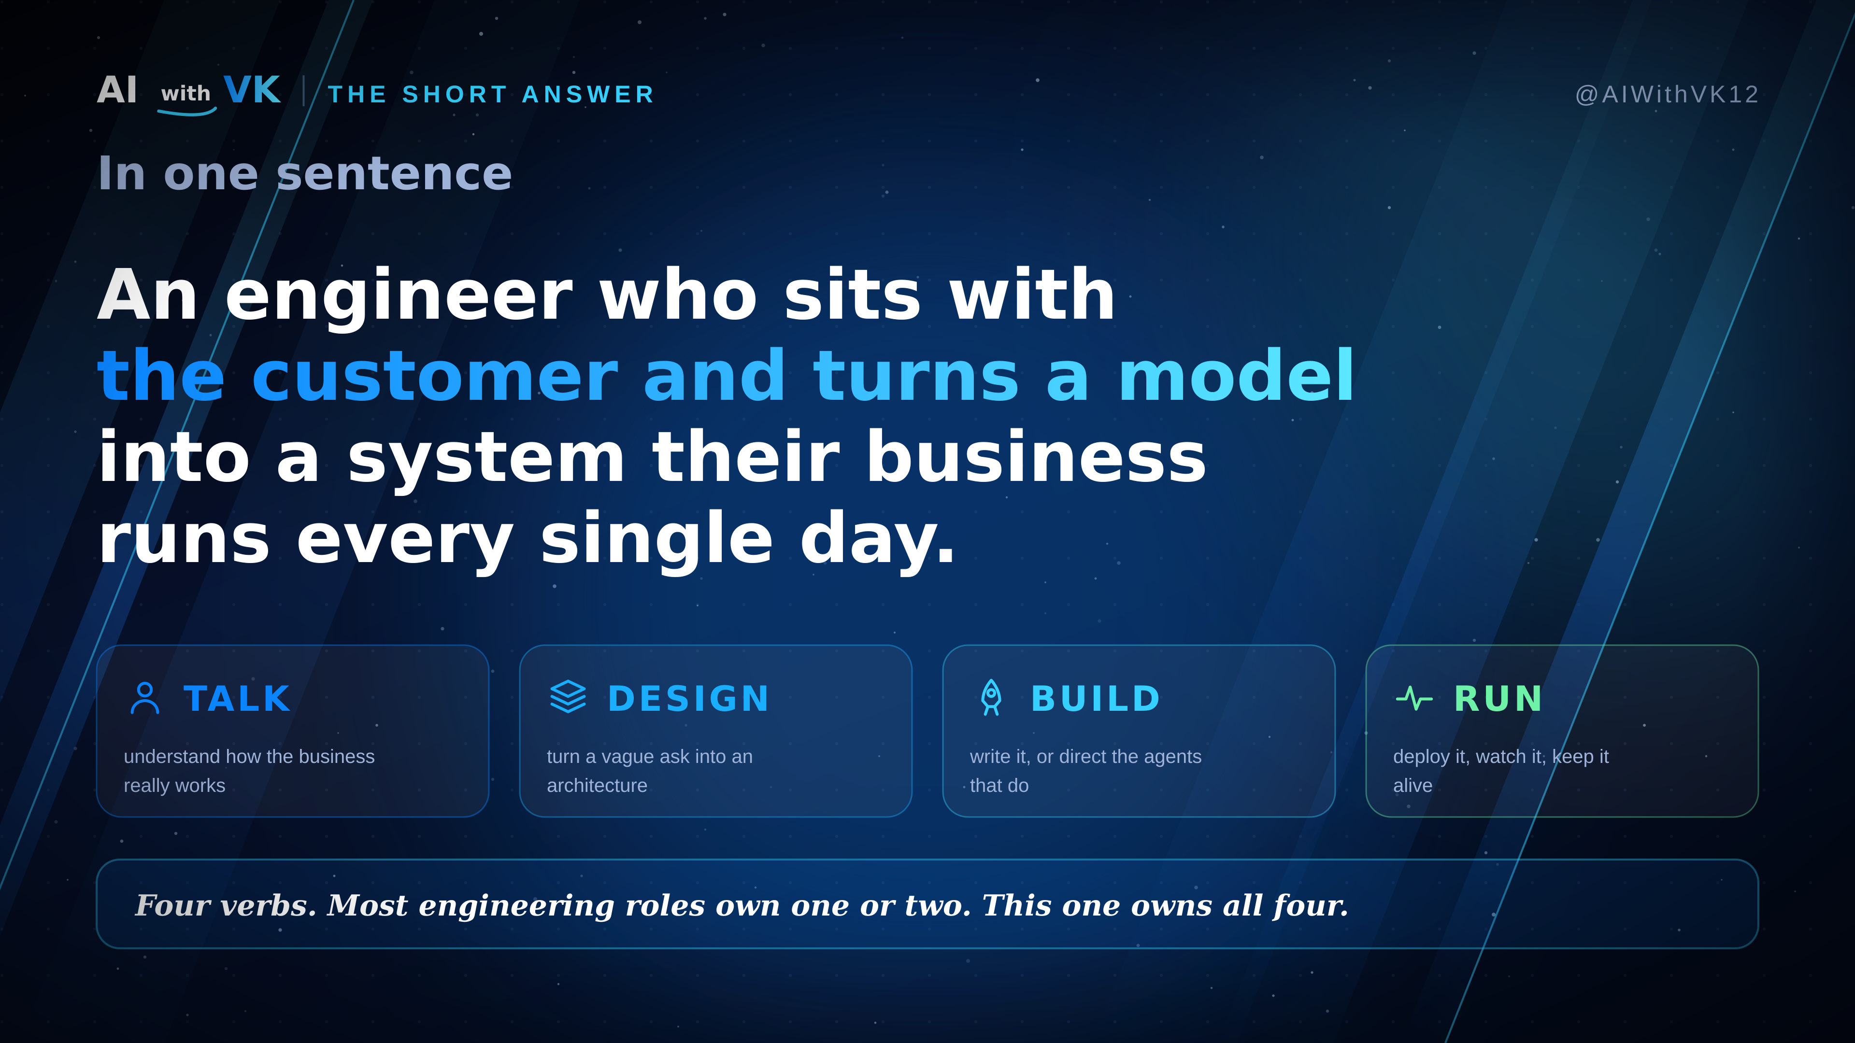
Notes:
2 · DEFINITION (0:50-2:30). An engineer who sits with the customer and turns a model into a system their business runs every day. Four verbs: talk, design, build, run.

Slide 3
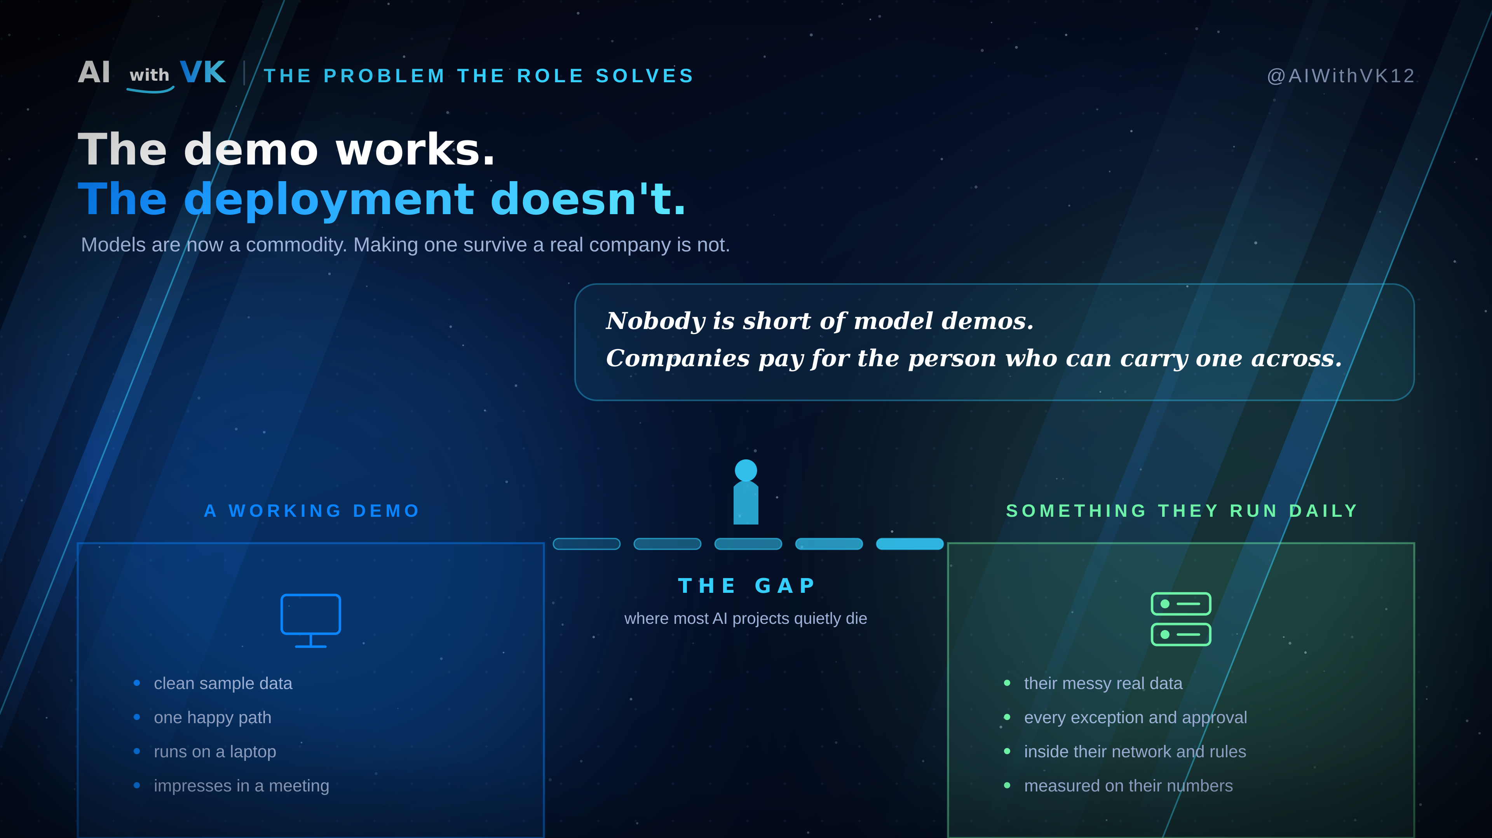
Notes:
3 · THE GAP (2:30-5:00). The market reason the role exists. Models are commoditised; a demo on clean data and a system a company runs daily are separated by a gap — messy data, exceptions, approvals, their network and rules. Companies pay for whoever can carry a demo across it.

Slide 4
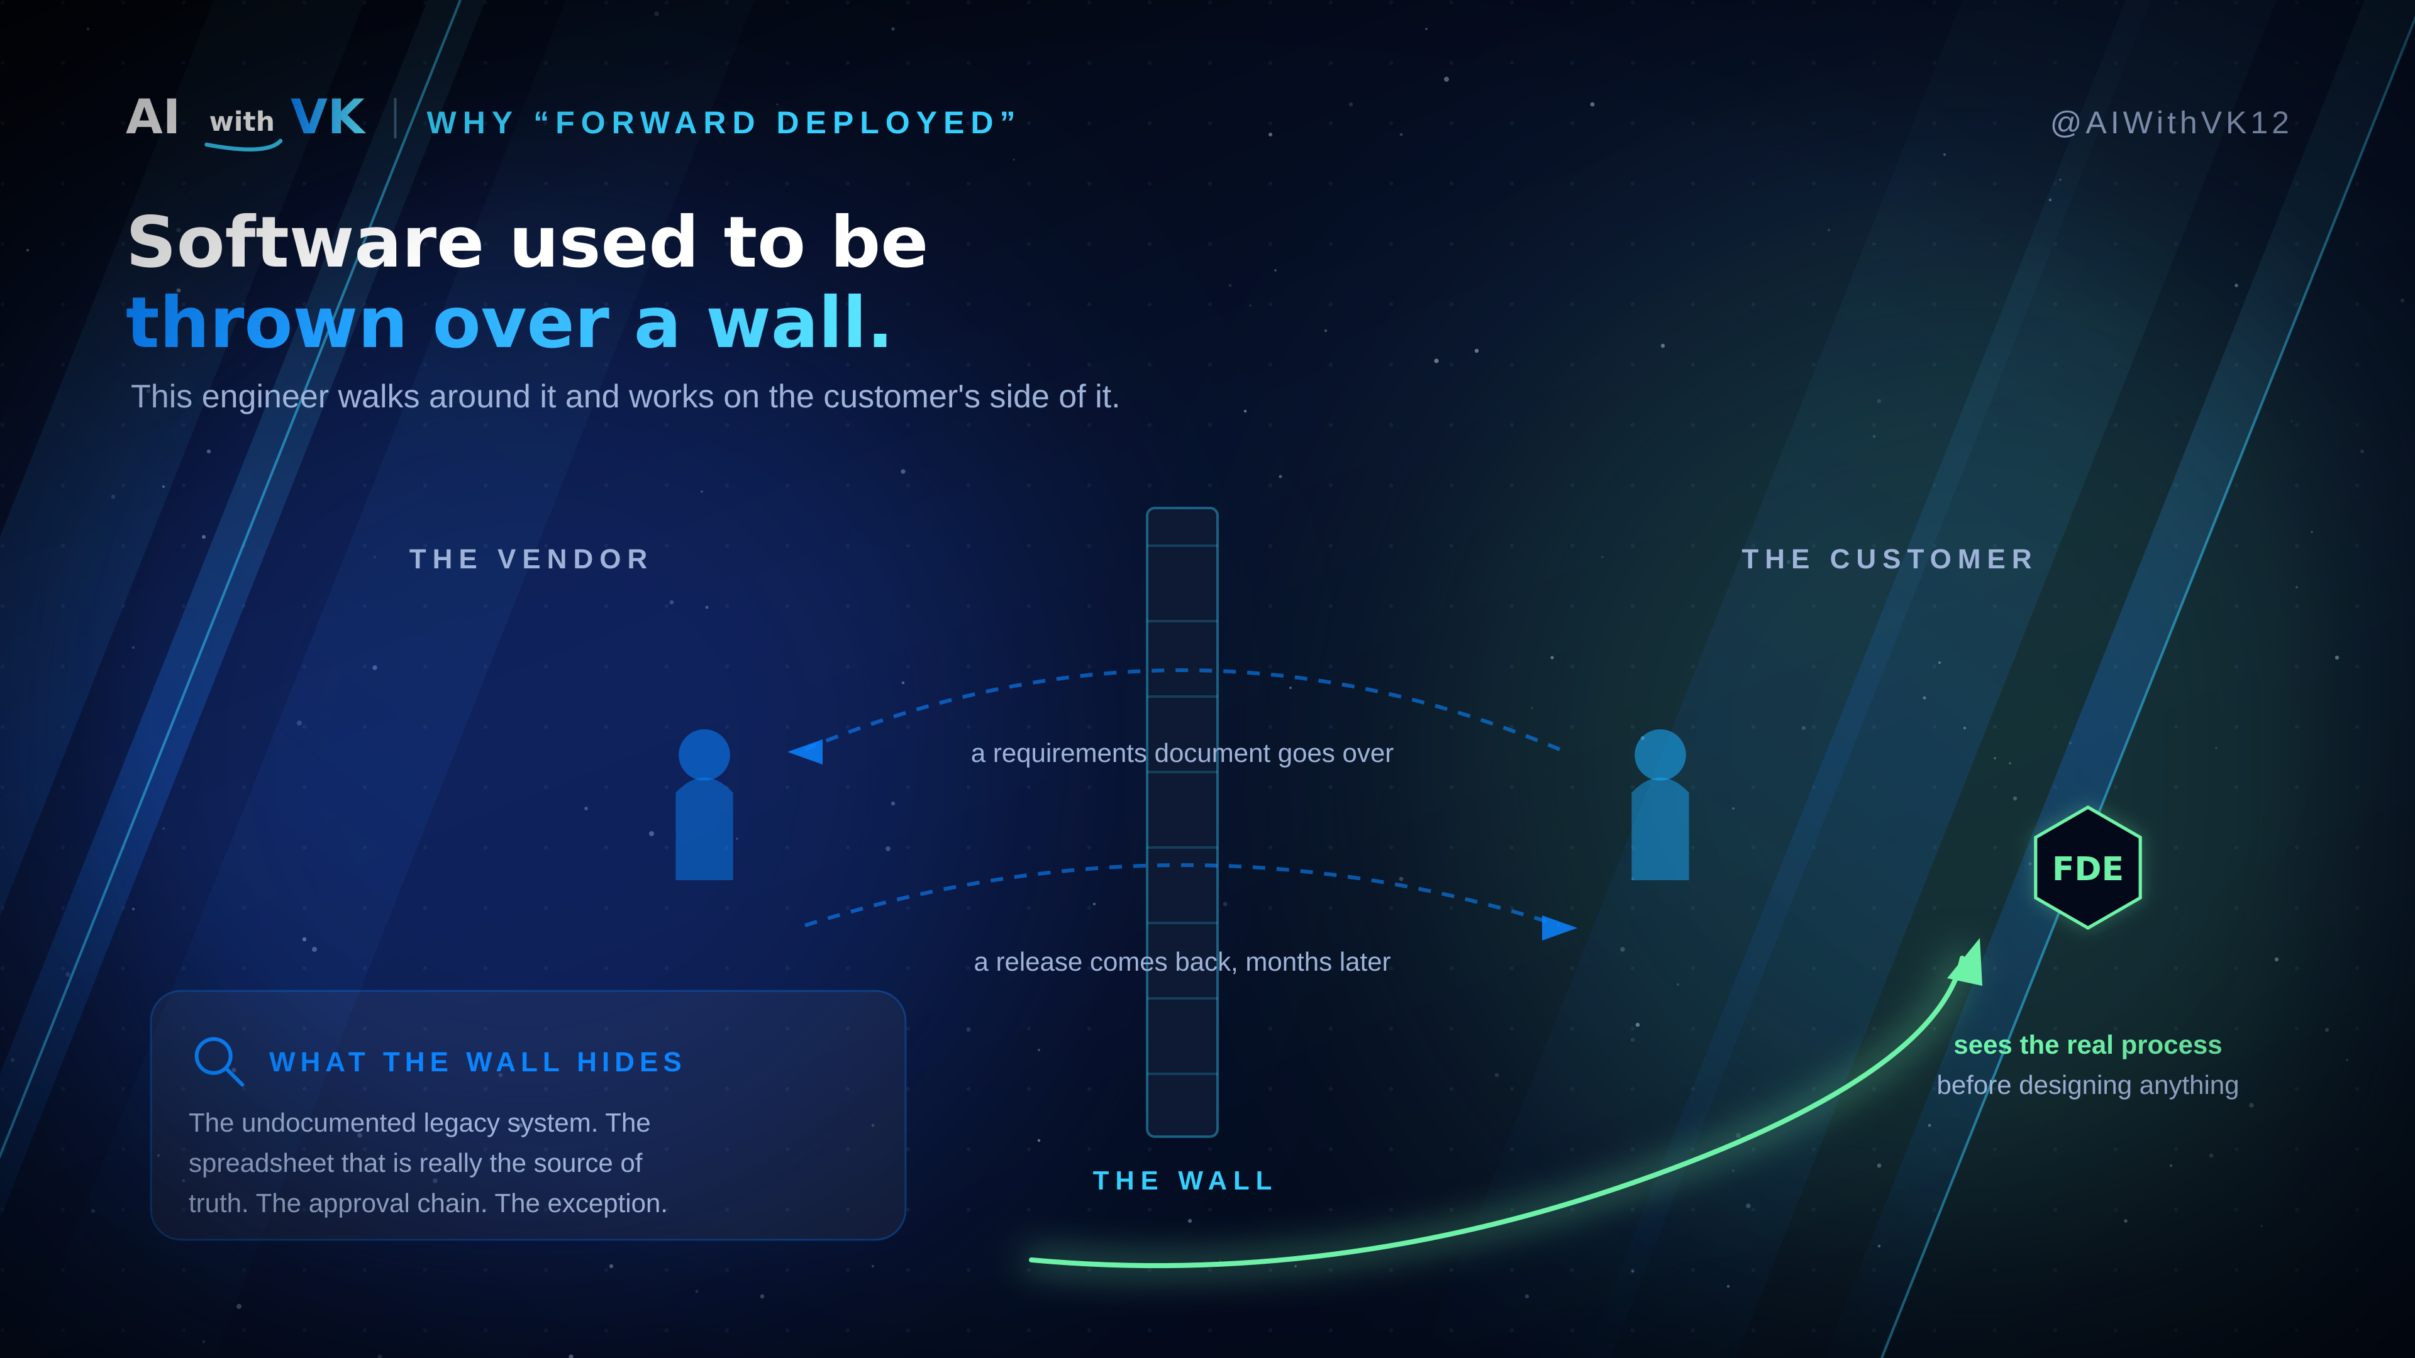
Notes:
4 · THE WALL (5:00-7:00). Why the name. Requirements over the wall, release back months later, builders never see the legacy system, the spreadsheet that is really the source of truth, or the approval chain. This engineer works on the customer's side.

Slide 5
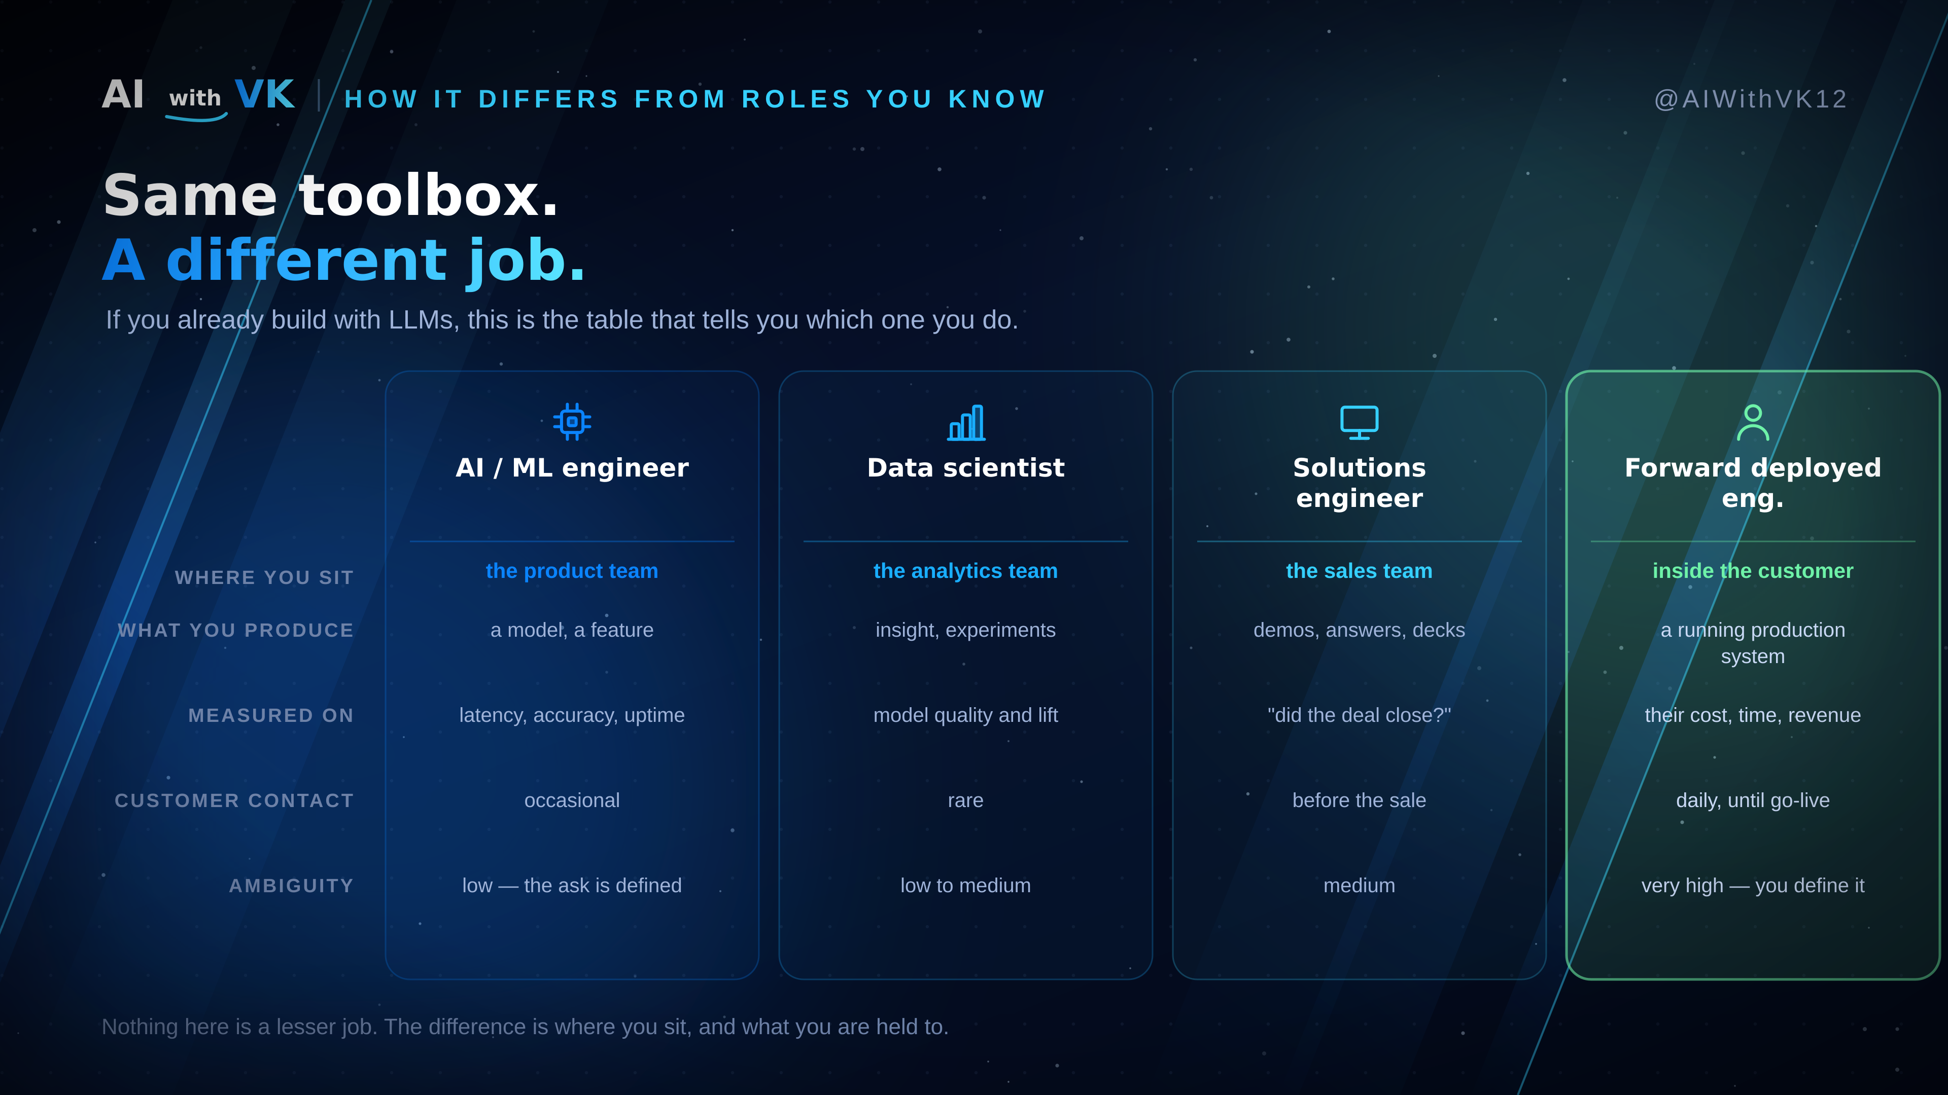
Notes:
5 · WHERE YOU SIT (7:00-10:00). Comparison with AI/ML engineer, data scientist and solutions engineer across five rows: where you sit, what you produce, what you are measured on, customer contact, ambiguity. Say clearly that none of the others is a lesser job.

Slide 6
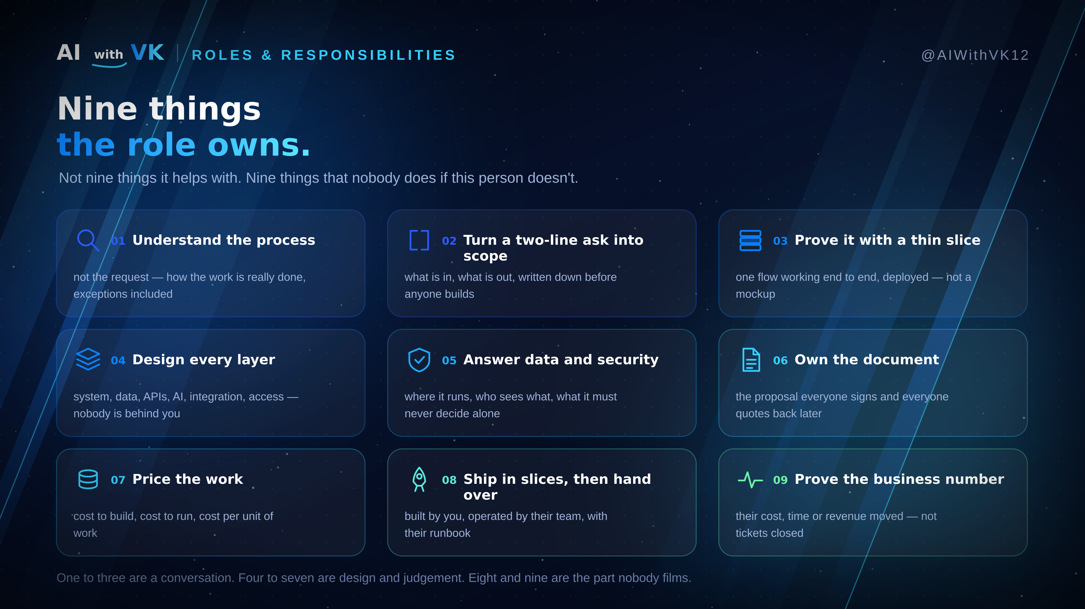
Notes:
6 · RESPONSIBILITIES (10:00-14:00). The spine. Nine things nobody else does: understand the process, scope it, prove with a slice, design every layer, answer data and security, own the document, price it, ship and hand over, prove the business number. Group them: 1-3 conversation, 4-7 design, 8-9 the part nobody films.

Slide 7
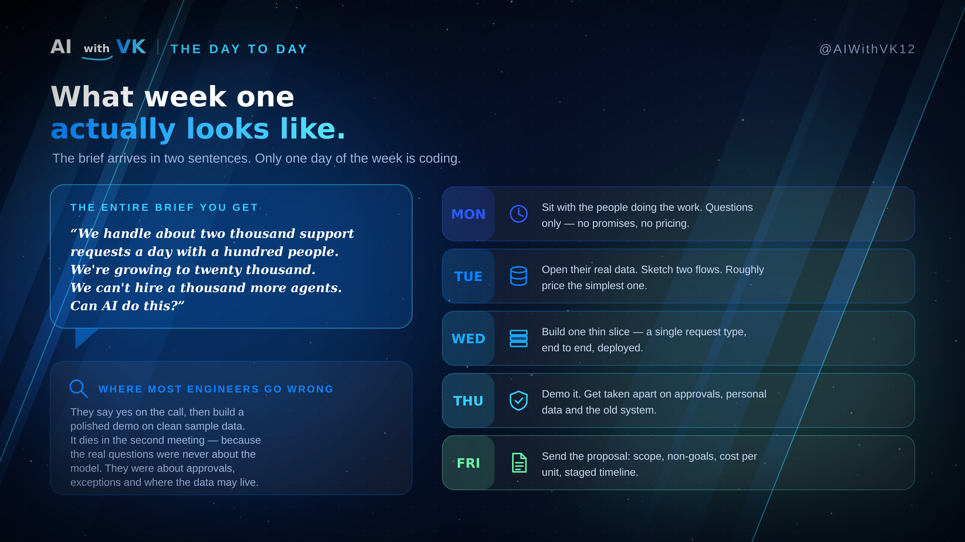
Notes:
7 · THE DAY TO DAY (14:00-17:30). Two-sentence brief, then Mon to Fri. Land the point: one coding day out of five, and that day is one slice.

Slide 8
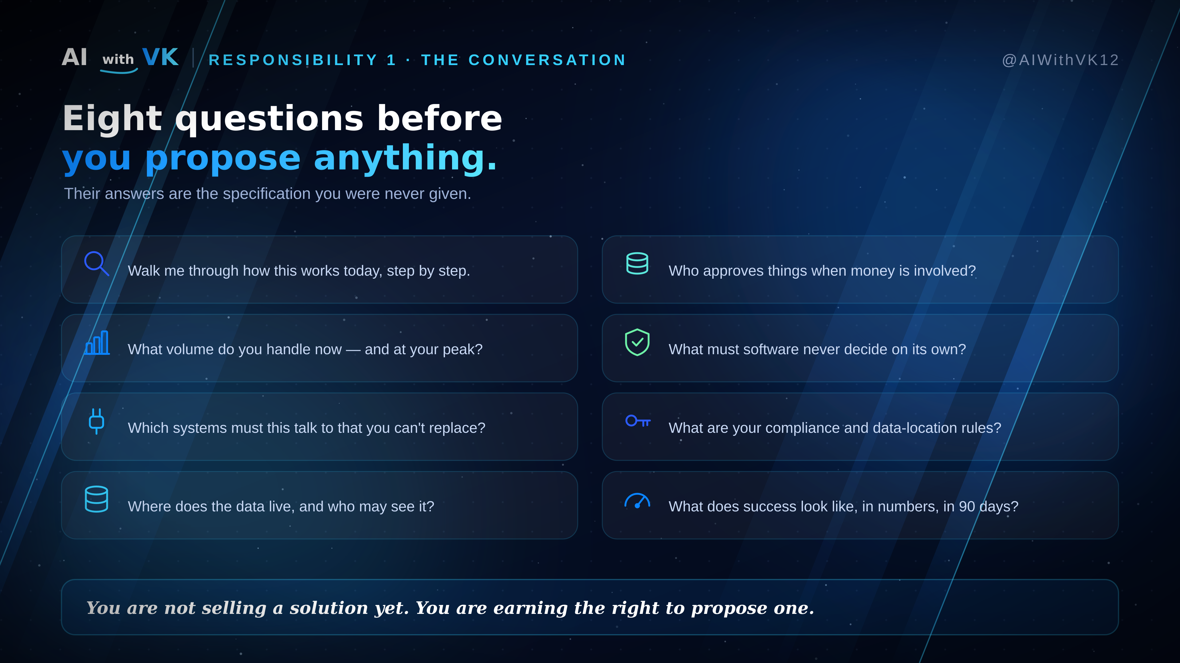
Notes:
8 · THE CONVERSATION (17:30-20:30). Eight questions, one line of why each. Their answers are the specification you were never given.

Slide 9
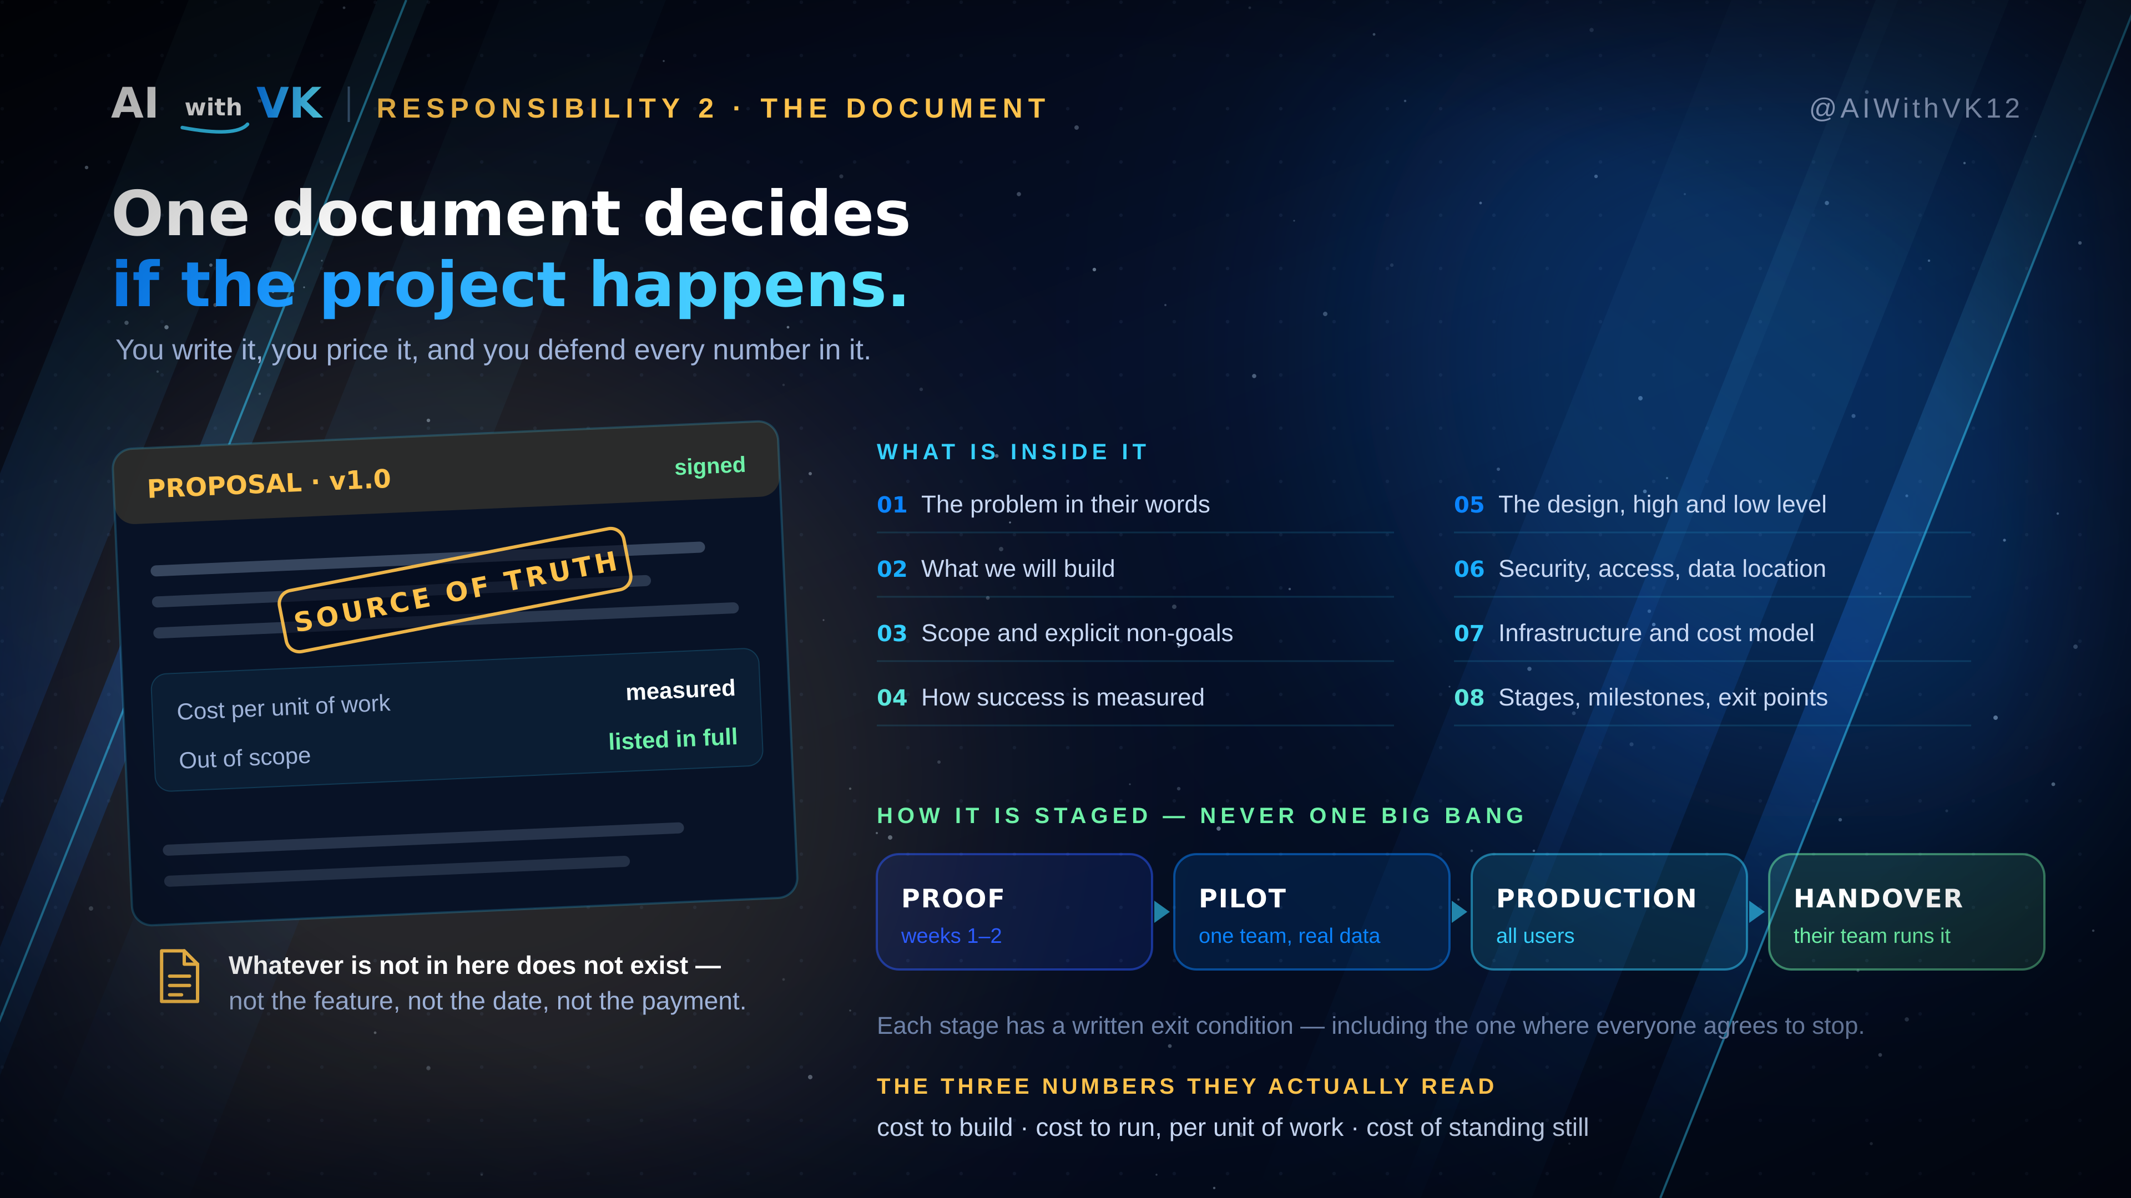
Notes:
9 · THE DOCUMENT (20:30-24:00). Eight sections; staged as proof, pilot, production, handover with written exit conditions including stopping; the three numbers — cost to build, cost to run per unit, cost of standing still. Rule: whatever is not in it does not exist.

Slide 10
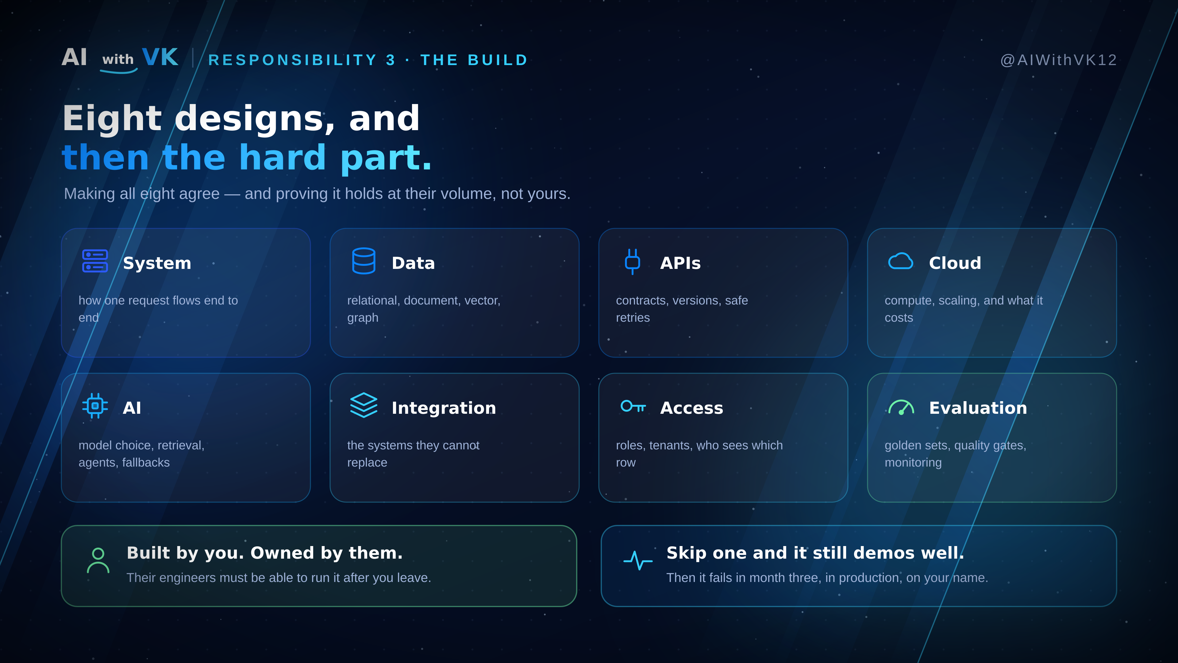
Notes:
10 · THE BUILD (24:00-27:00). Eight designs, and making them agree at their volume. Two callouts: built by you but owned by them, and the cost of skipping one design.

Slide 11
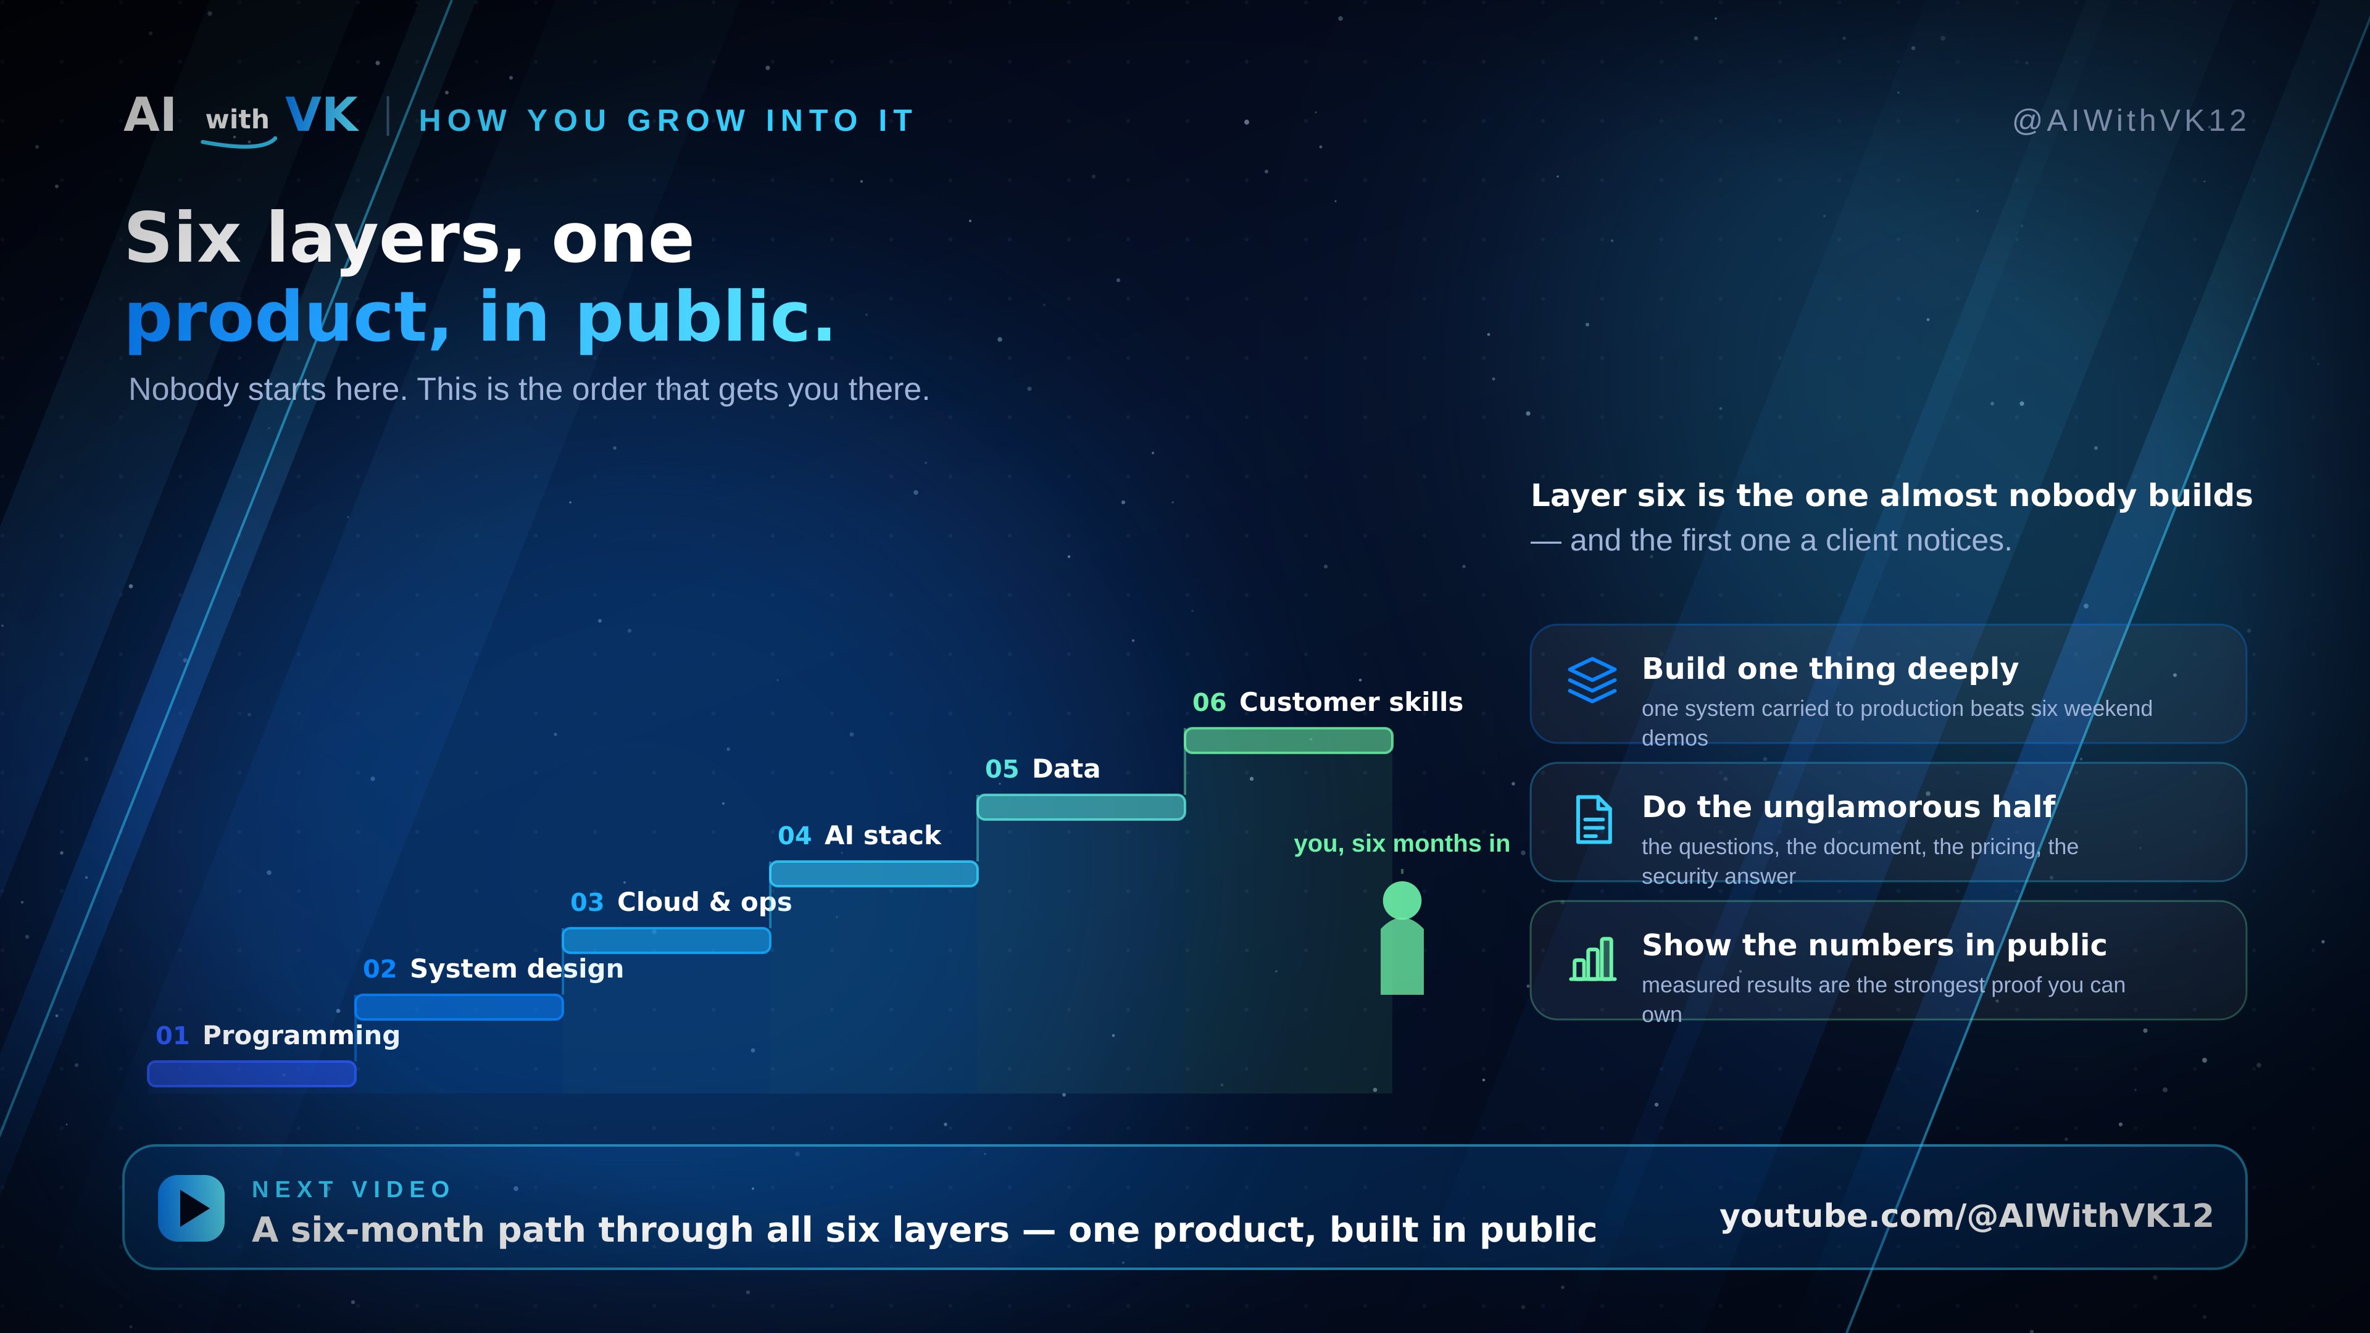
Notes:
11 · HOW YOU GROW INTO IT (27:00-29:00). Six layers as a staircase, layer six being customer skills. Three habits. Point at the six-month roadmap video and the channel.

