Slide 1
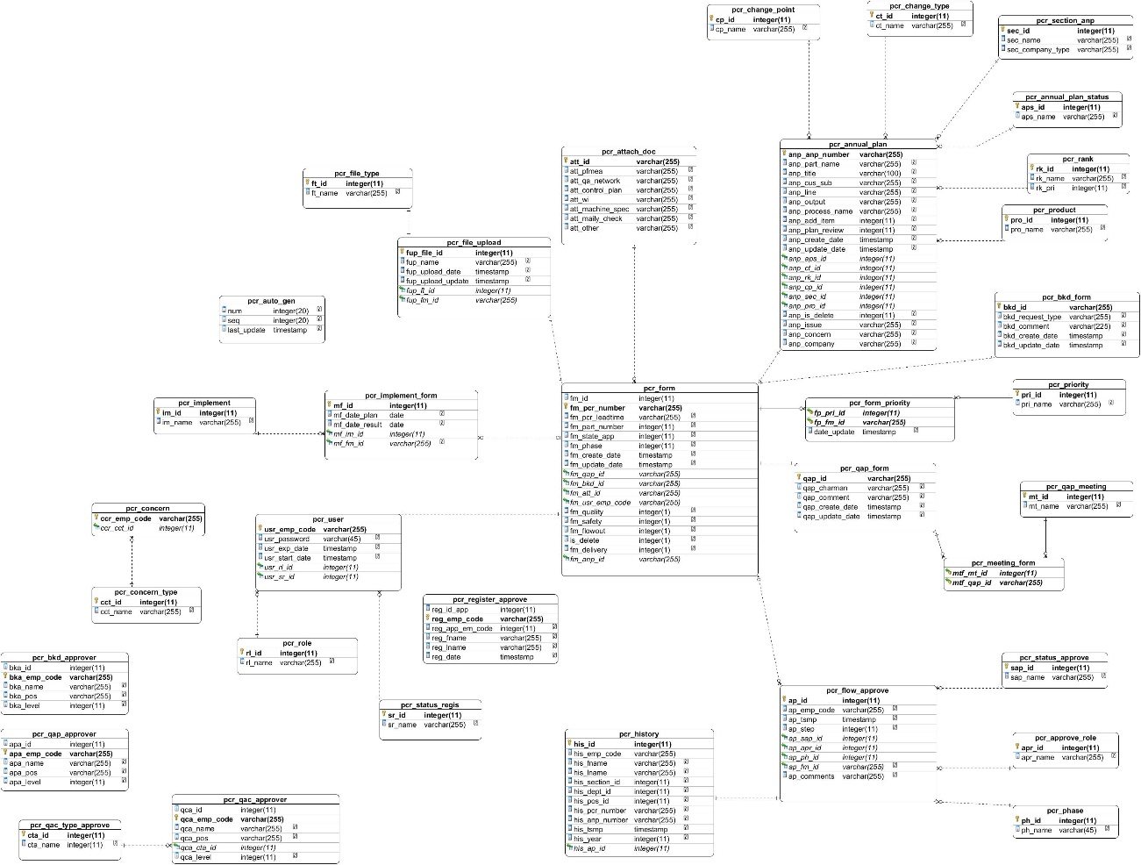
Database (ใส่ไว้หน้าหลังก็แล้วแต่)

Slide 2
Co-operative Education Action Plan
Plan.
Actual.
PIC.
Jul
Aug
Sep
Oct
Oct
Project identification
Get requirement
System analysis
System design
Kittiya
Code programming
Software testing
Training & Trial
Document

Slide 3
Access and storage

Slide 4

Responsibility
Kit
Responsible for
1. Access and storage
2. Database & Data dictionary
3. Add permission system
(PE admin module)
4. Setting system role
(System Admin)
5. Setting password

Slide 5





Responsibility
1. Permission for use PCR system
PE admin approve every register
Send register result by email
To be a PCR user
Reset password

Slide 6

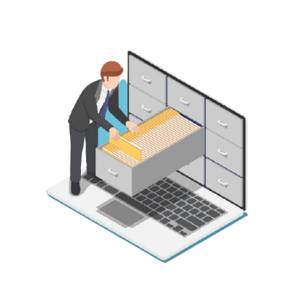

Responsibility
2. File upload storage
1. Every files upload are kept neat in server.
2. Easy for find or reuse.
3. Restrict access to download file by role.

Slide 7

Responsibility
3. Storage detail of PCR
1. Information of each PCR and annual plan kept neat database.
2. Easy for find or reuse.
3. Data it’s easy to Manage

Slide 8

Responsibility
4. Manage system role
For To make it easier to restrict access data and usage each user.
So can divide role it as follows.
1. Creator.
2. Acknowledge Approver.
3. BKD Approver.
4. QAC Approver.
5. QAP Approver.
6. PE admin.
7. QA admin.
8. System admin.

Slide 9
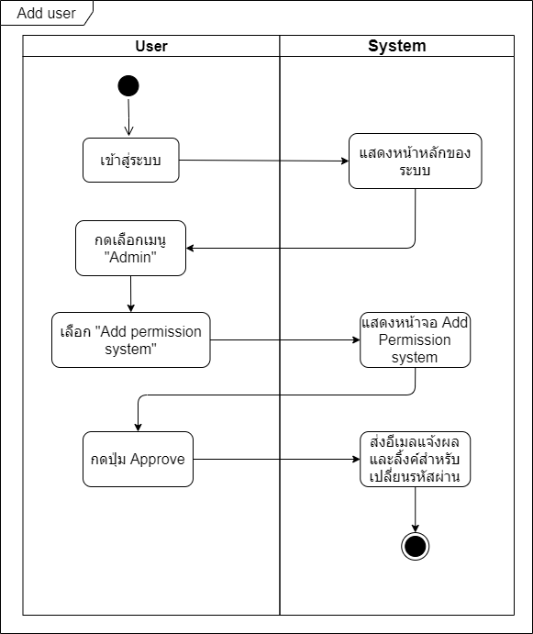
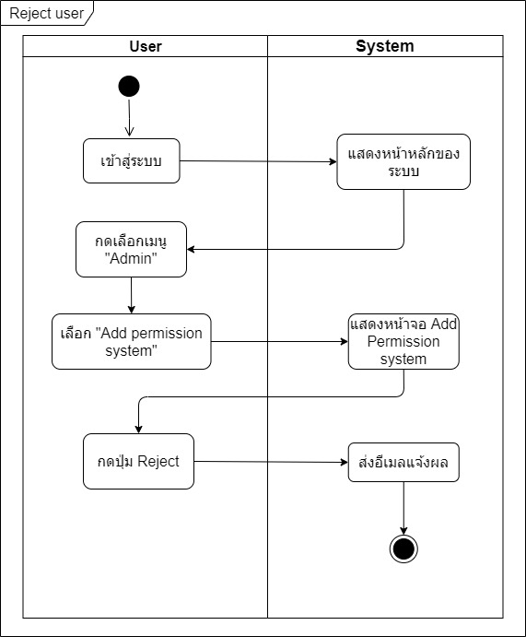
Diagram
Activity diagram

Slide 10
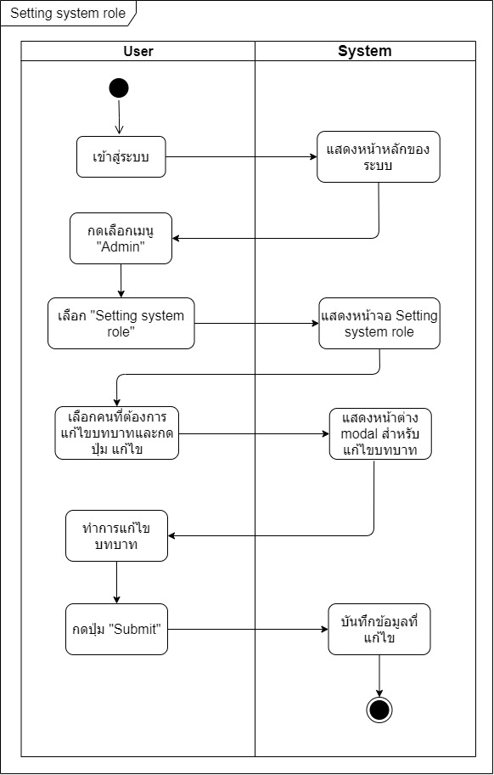
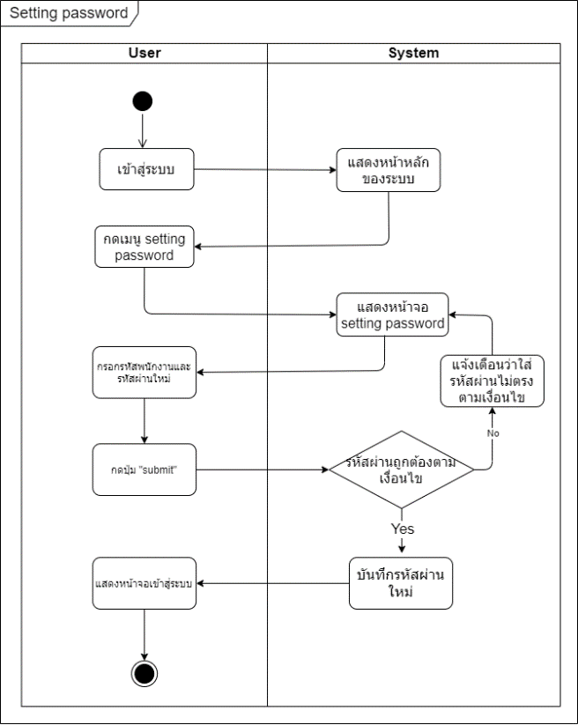
Diagram
Activity diagram

Slide 11
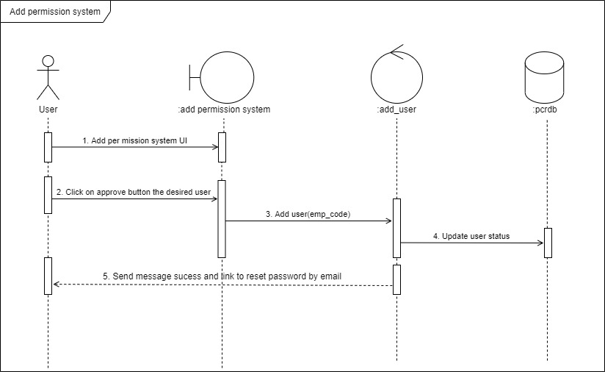
Diagram
Sequence diagram

Slide 12
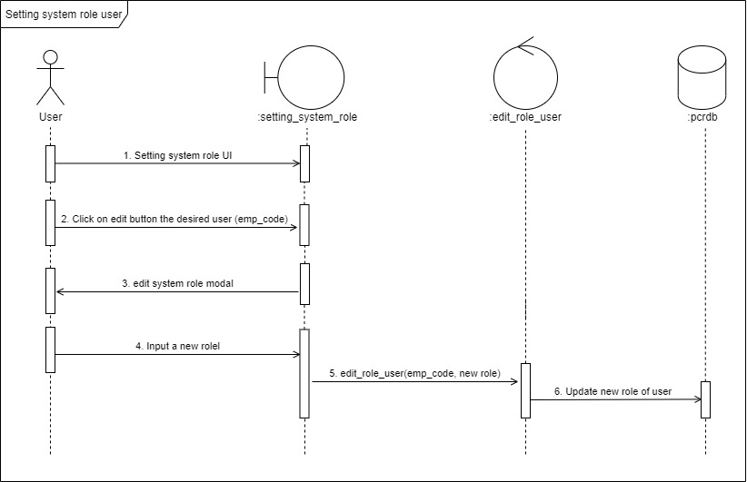
Diagram
Sequence diagram

Slide 13
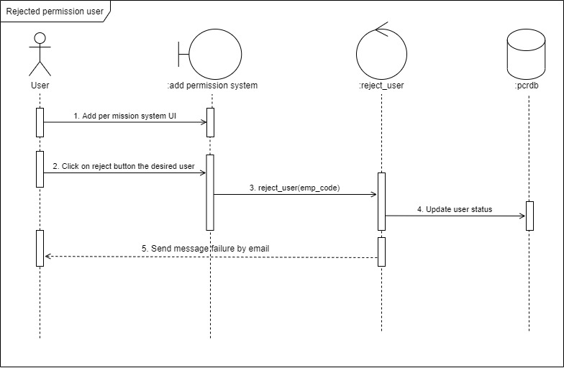
Diagram
Sequence diagram

Slide 14
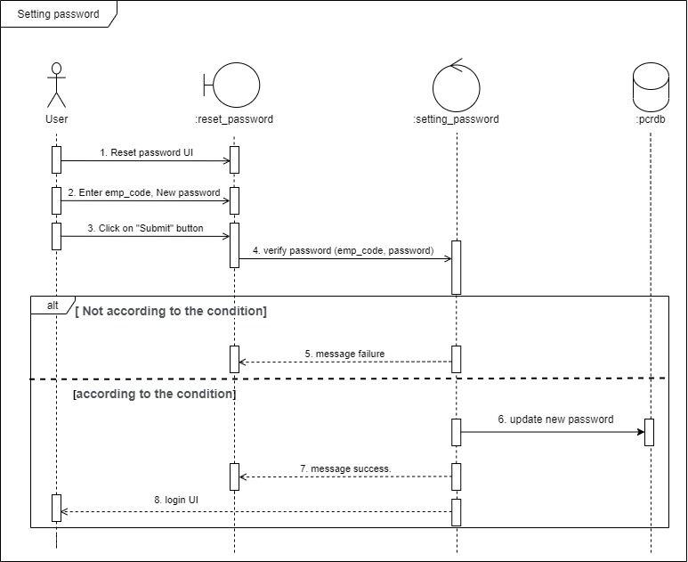
Diagram
Diagram
Sequence diagram

Slide 15
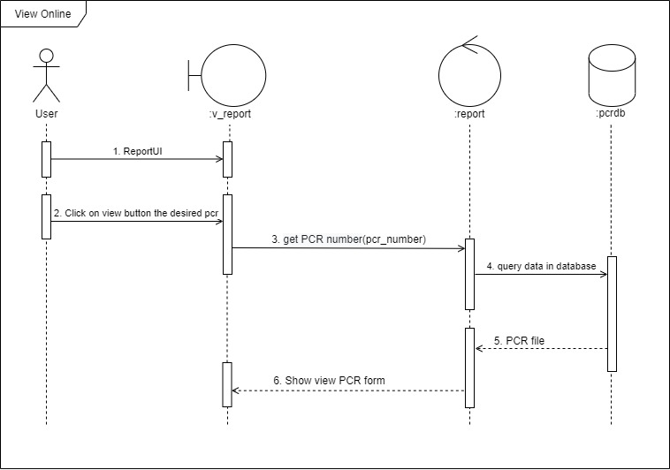
Diagram
Sequence diagram

Slide 16
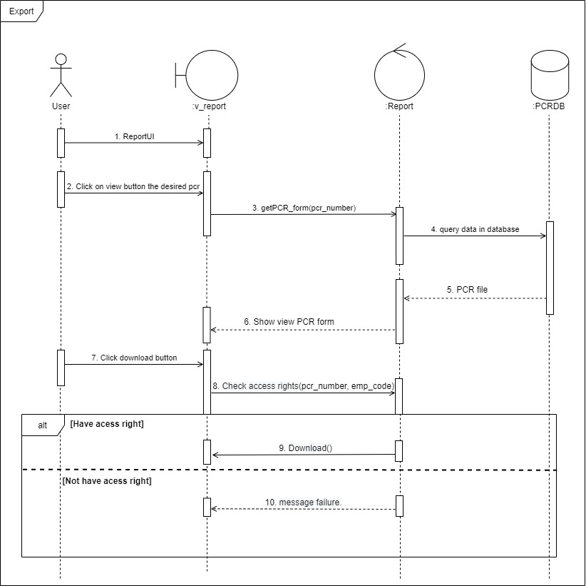
Diagram
Sequence diagram

Slide 17
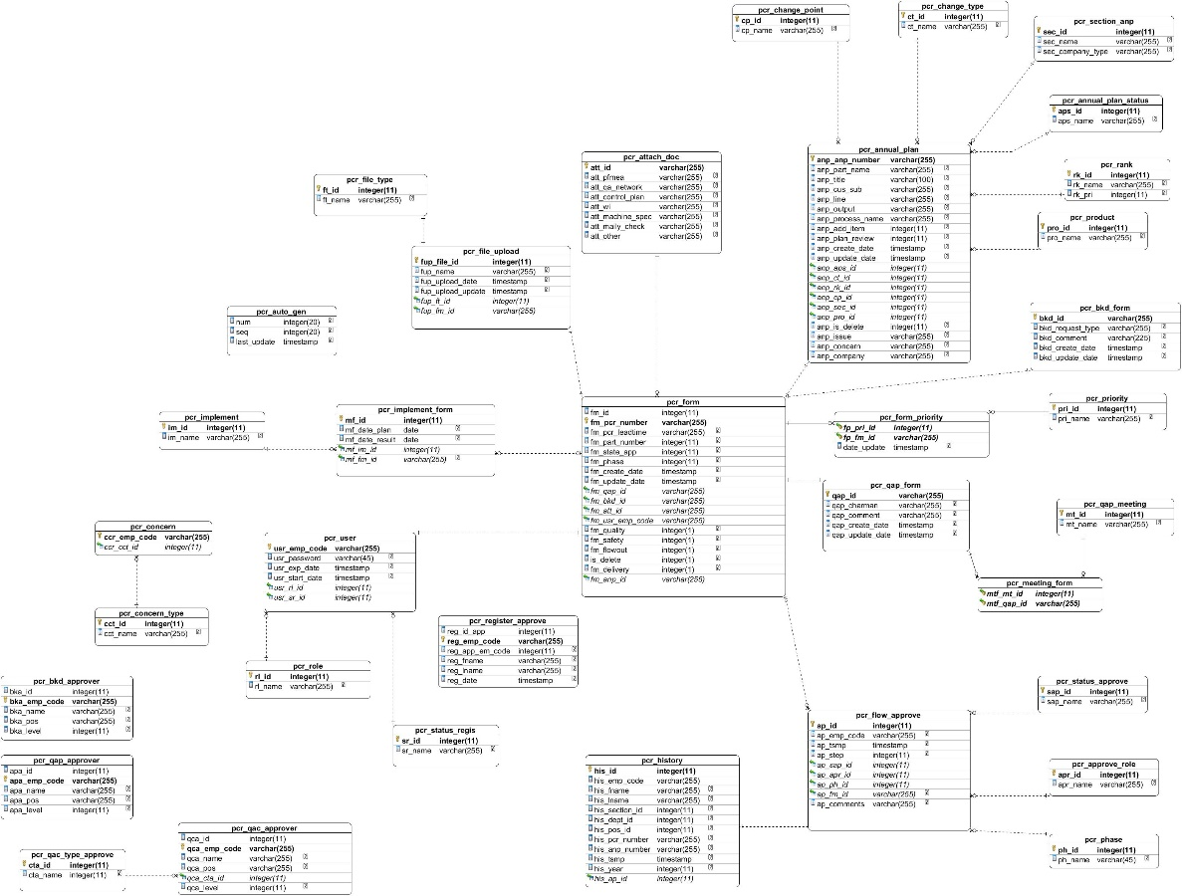
Diagram
ER diagram

Slide 18
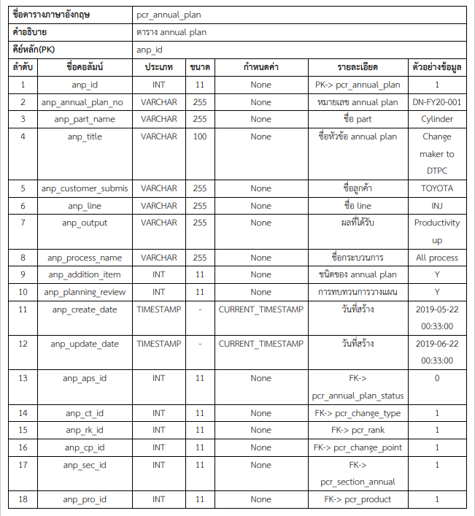
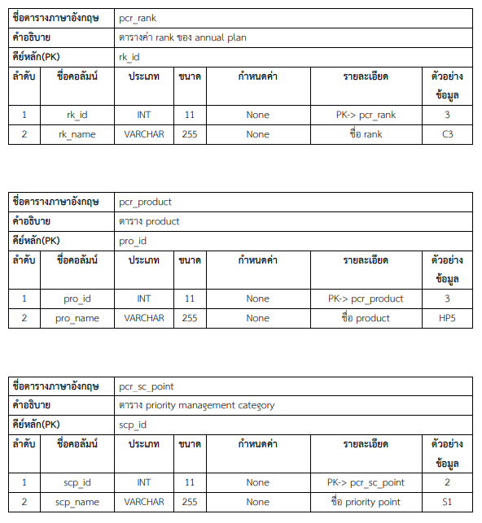
Data dictionary

Slide 19
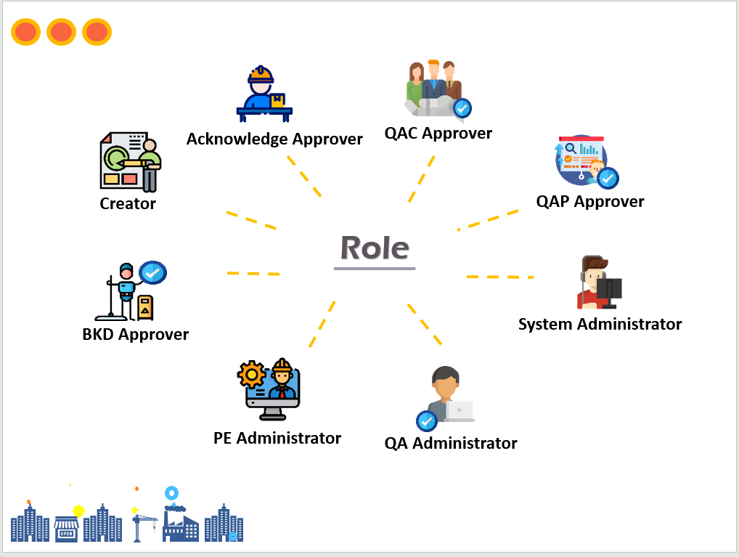
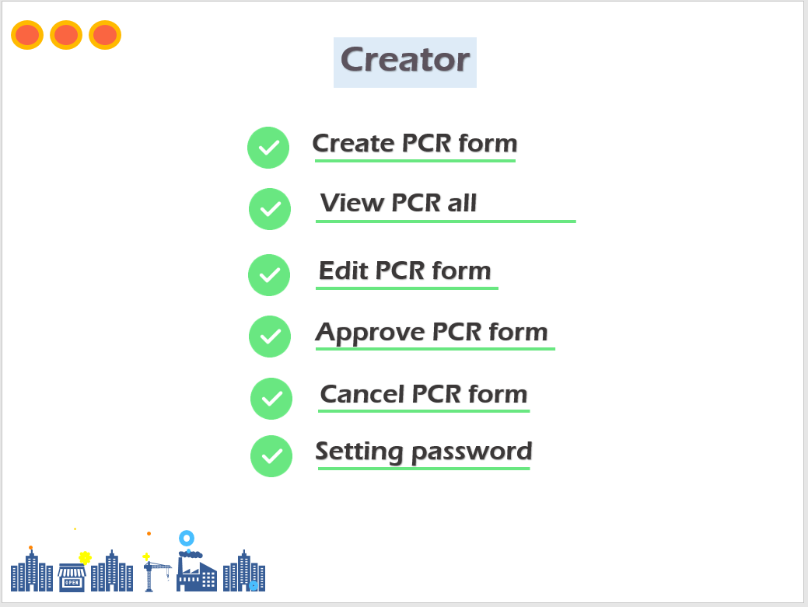
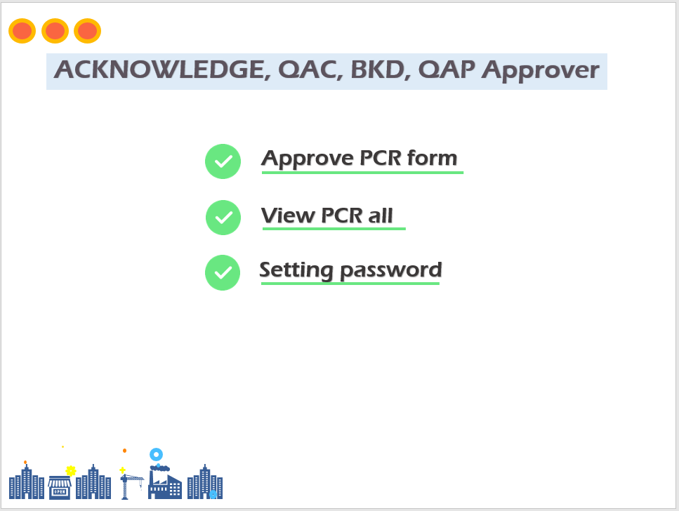
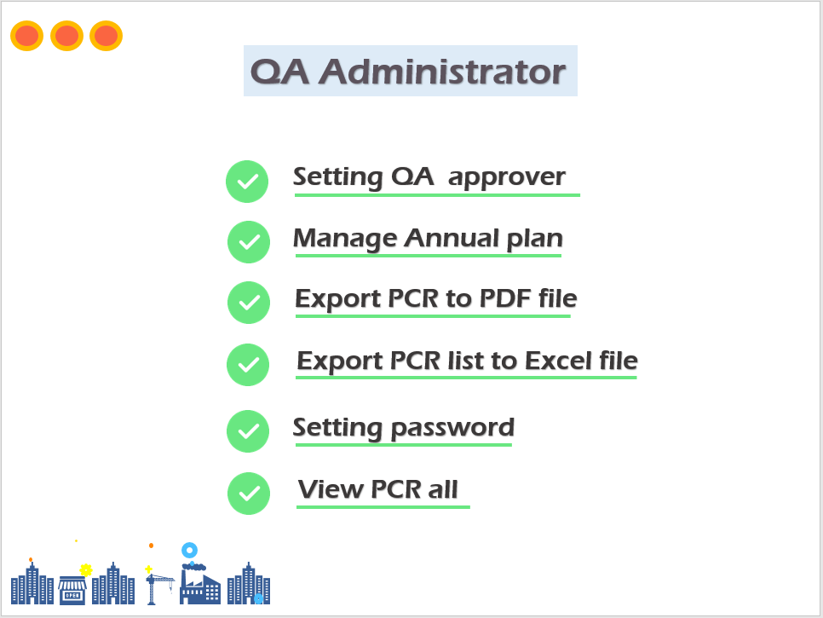
Analyze System
ROLE SYSTEM

Slide 20
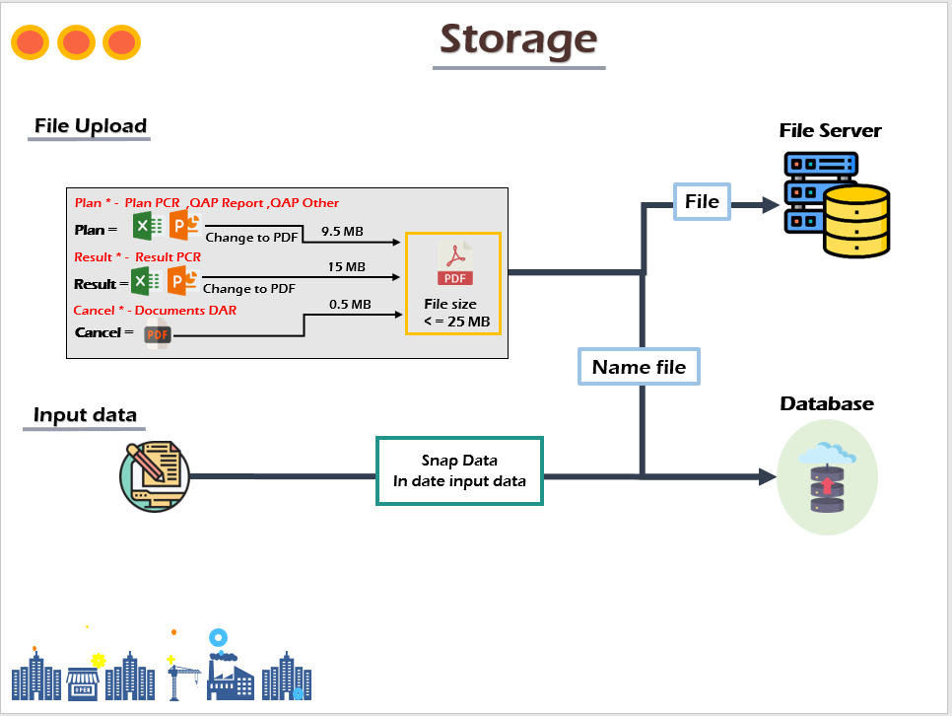
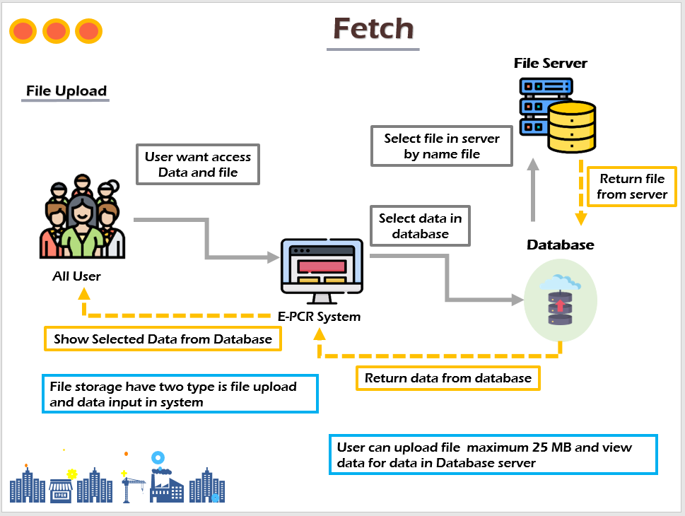
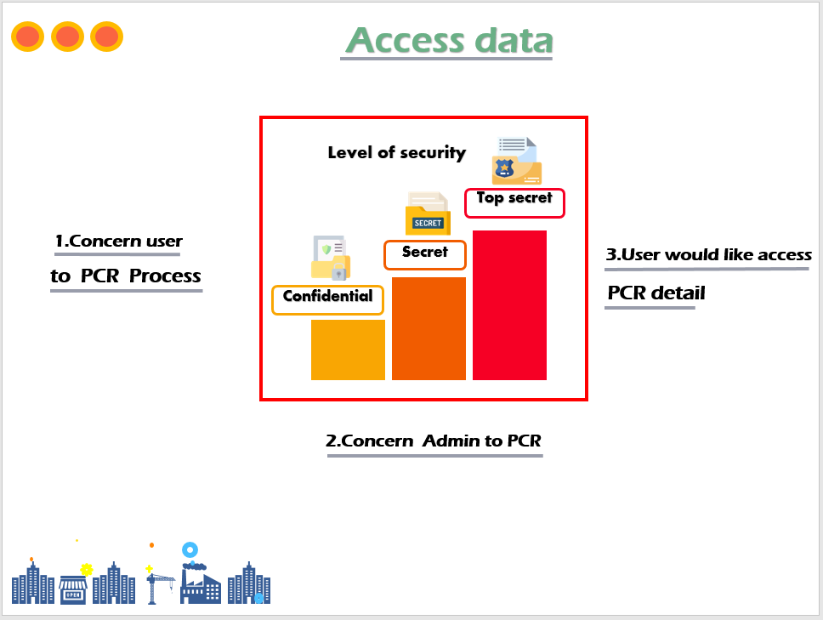
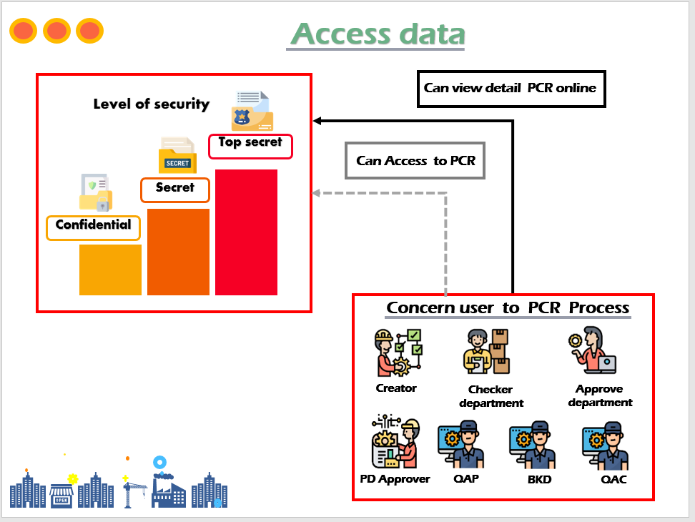
Analyze System
STORAGE & ACCESS

Slide 21
Conclusion

Slide 22


Benefits
organization
Internship
Convenient for dealing
with information or reuse the data
1. Improves analytical potential
design and development skill
2. Reduce resources
(Time, Staff, Cost, Paper)
2. Team work
3. Work is more comfortable.

Slide 23

Problem
1. Limited time
2. Search information on the internet
it’s difficult (Some useful websites are blocked.)
3. Poor communication
skills of their own

Slide 24
Skill & Experience

Slide 25

Skill & Experience
Technical Skill
Soft Skill
A:Analyze skill
B:Design skill
C:Programming skill
D:Testing skill
A:Teamwork
B:Communication
C:Problem-solving
D:Presentation skill
Kittiya Yangso
NickName : Kit

Slide 26
Skill & Experience
Technical Skill
Soft Skill
A:Analyze skill
B:Design skill
C:Programming skill
D:Testing skill
A:Teamwork
B:Communication
C:Problem-solving
D:Presentation skill
Kanyarat Rodtong
NickName : Mint

Slide 27
Skill & Experience
Technical Skill
Soft Skill
A:Analyze skill
B:Design skill
C:Programming skill
D:Testing skill
A:Teamwork
B:Communication
C:Problem-solving
D:Presentation skill
Supatchai Kamaporn
NickName : Pond

Slide 28

Thank you

Slide 29
Q&A

