Slide 1
Mini Quiz 6

Slide 2

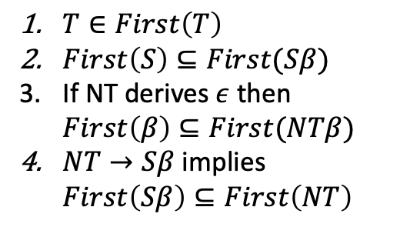
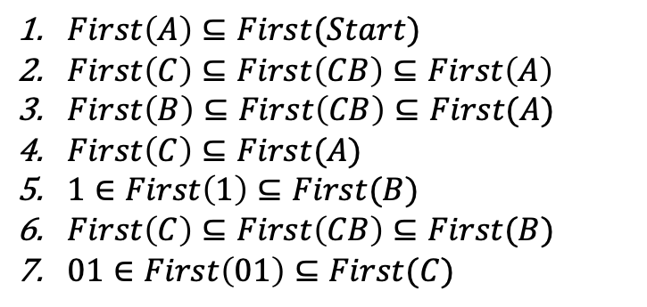
$First\left(A\right)⊆First(Start)$
$First\left(C\right)⊆First\left(CB\right)⊆First\left(A\right)$
$First\left(B\right)⊆First\left(CB\right)⊆First(A)$
$First\left(C\right)⊆First(A)$
$1∈First\left(1\right)⊆First(B)$
$First\left(C\right)⊆First\left(CB\right)⊆First(B)$
$01∈First\left(01\right)⊆First(C)$
$T∈First\left(T\right)$
$First\left(S\right)⊆First(Sβ)$
If NT derives $ε$ then $First\left(β\right)⊆First(NTβ)$
$NT→Sβ$ implies $First\left(Sβ\right)⊆First\left(NT\right)$
$Start→A$
$A→CB$
$A→C$
$B→1$
$B→CB$
$C→01$
$C→ε$

Slide 3
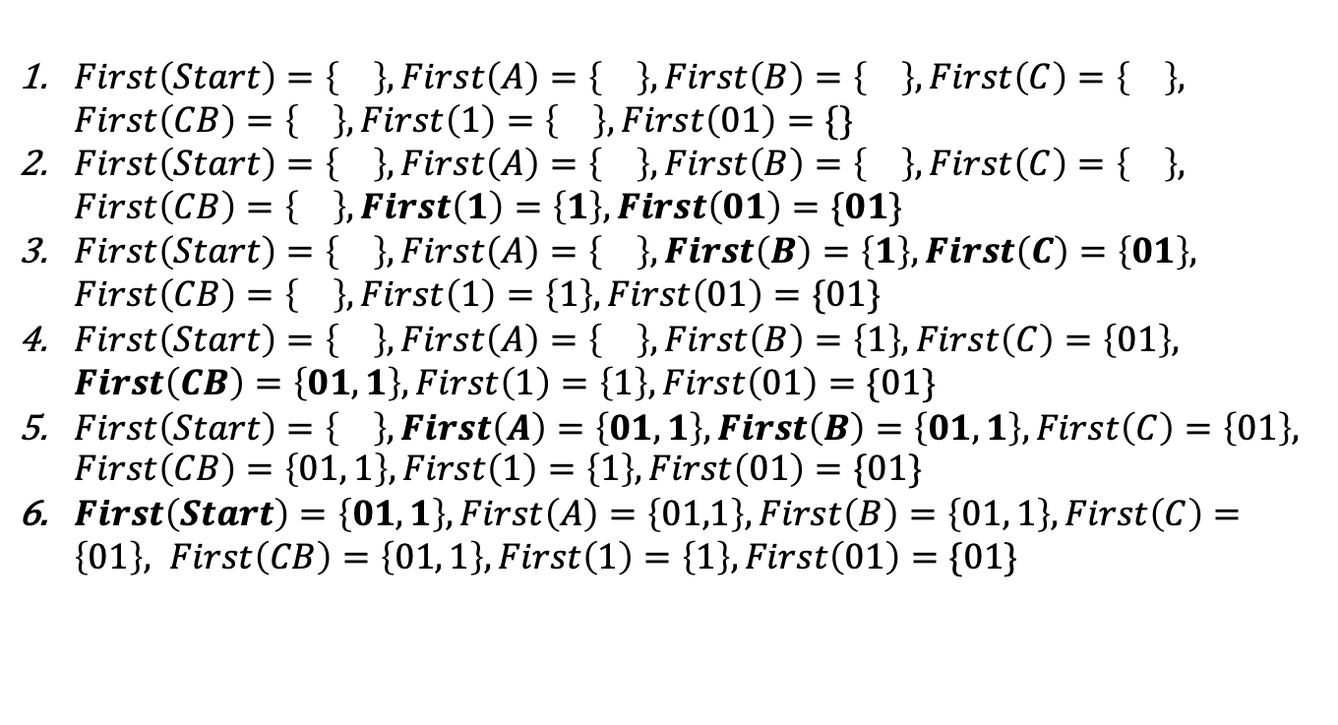
$First\left(A\right)⊆First(Start)$
$First\left(C\right)⊆First\left(CB\right)⊆First\left(A\right)$
$First\left(B\right)⊆First\left(CB\right)⊆First(A)$
$First\left(C\right)⊆First(A)$
$1∈First\left(1\right)⊆First(B)$
$First\left(C\right)⊆First\left(CB\right)⊆First(B)$
$01∈First\left(01\right)⊆First(C)$
$T∈First\left(T\right)$
$First\left(S\right)⊆First(Sβ)$
If NT derives $ε$ then $First\left(β\right)⊆First(NTβ)$
$NT→Sβ$ implies $First\left(Sβ\right)⊆First\left(NT\right)$
$First\left(Start\right)=\left\{\right\}, First\left(A\right)=\left\{\right\}, First\left(B\right)=\left\{\right\}, First\left(C\right)=\left\{\right\}, First\left(CB\right)=\left\{\right\}, First\left(1\right)=\left\{\right\}, First\left(01\right)=\{\}$
$First\left(Start\right)=\left\{\right\}, First\left(A\right)=\left\{\right\}, First\left(B\right)=\left\{\right\}, First\left(C\right)=\left\{\right\}, First\left(CB\right)=\left\{\right\}, First\left(1\right)=\left\{1\right\}, First\left(01\right)=\{01\}$
$First\left(Start\right)=\left\{\right\}, First\left(A\right)=\left\{\right\}, First\left(B\right)=\left\{1\right\}, First\left(C\right)=\left\{01\right\}, First\left(CB\right)=\left\{\right\}, First\left(1\right)=\left\{1\right\}, First\left(01\right)=\{01\}$
$First\left(Start\right)=\left\{\right\}, First\left(A\right)=\left\{\right\}, First\left(B\right)=\left\{1\right\}, First\left(C\right)=\left\{01\right\}, First\left(CB\right)=\left\{01, 1\right\}, First\left(1\right)=\left\{1\right\}, First\left(01\right)=\{01\}$
$First\left(Start\right)=\left\{\right\}, First\left(A\right)=\left\{01,1\right\}, First\left(B\right)=\left\{01, 1\right\}, First\left(C\right)=\left\{01\right\}, First\left(CB\right)=\left\{01, 1\right\}, First\left(1\right)=\left\{1\right\}, First\left(01\right)=\{01\}$
$First\left(Start\right)=\left\{01,1\right\}, First\left(A\right)=\left\{01,1\right\}, First\left(B\right)=\left\{01, 1\right\}, First\left(C\right)=\left\{01\right\}, First\left(CB\right)=\left\{01, 1\right\}, First\left(1\right)=\left\{1\right\}, First\left(01\right)=\{01\}$
$Start→A$
$A→CB$
$A→C$
$B→1$
$B→CB$
$C→01$
$C→ε$

