Slide 1
Mini Quiz 8

Slide 2
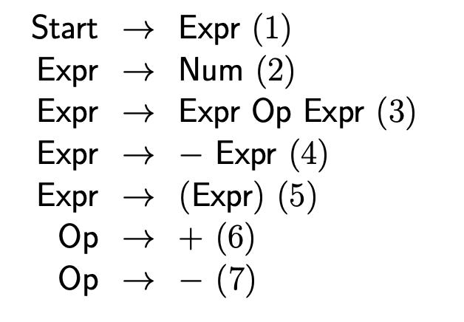

$$−\left(Num+Num\right)$$

Slide 3


-
$$\left(Num+Num\right)$$
$ε$,Shift

Slide 4
(
-
Num + Num)
-, Shift

Slide 5
Num
(
-
+ Num)
(, Shift

Slide 6
Expr
Num
(
-
+ Num)
Num, Reduce 2

Slide 7
+
Expr
Num
(
-
Num)
Expr, Shift

Slide 8
Op
+
Expr
Num
(
-
Num)
+, Reduce 6

Slide 9
Num
Op
+
Expr
Num
(
-
)
Op, Shift

Slide 10
Expr
Num
Op
+
Expr
Num
(
-
)
Num, Reduce 2

Slide 11
Expr
Num
Expr
Op
+
(
Expr
Num
-
)
Expr, Reduce 3

Slide 12
)
Expr
Num
Expr
Op
+
(
Expr
Num
-
Expr, Shift

Slide 13
)
Expr
Num
Expr
Expr
Op
+
-
(
Expr
Num
(, Reduce 3

Slide 14
)
Expr
Num
Expr
Expr
Expr
Op
+
-
(
Expr
Num
Expr, Reduce 4

Slide 15
)
Expr
Num
Expr
Expr
Expr
Op
+
-
(
Expr
Num
Expr, Accept

