Slide 1
Mini Quiz 13

Slide 2
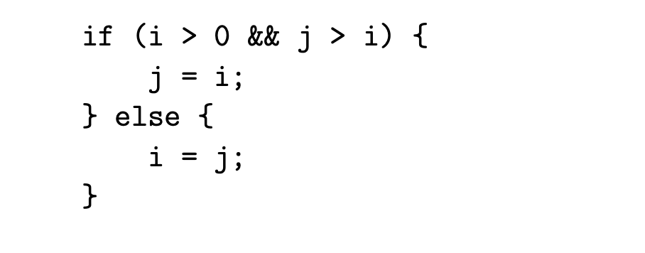

Slide 3
j>i
j = i
i = j

Slide 4
i>0
j>i
j = i
i = j

Slide 5
i>0
j>i
j = i
i = j

Slide 6
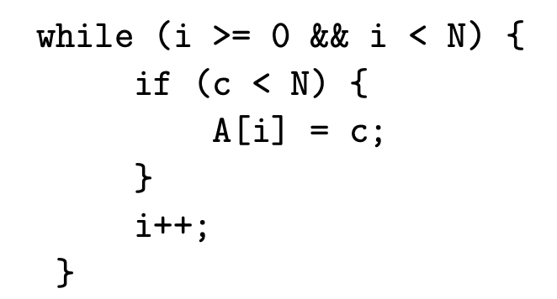
c<N
A[i]=c
i++

Slide 7
i<N
c<N
A[i]=c
i++

Slide 8
i>=0
i<N
c<N
A[i]=c
i++

Slide 9
i>=0
i<N
c<N
A[i]=c
i++

Slide 10
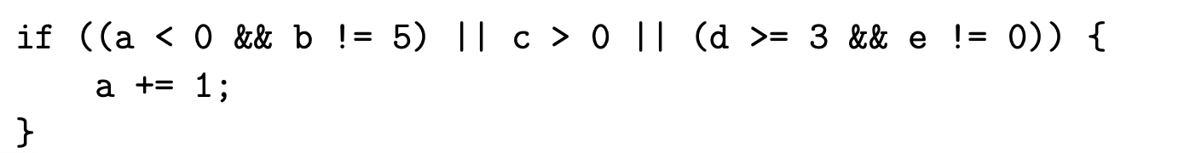
a+=1

Slide 11
e!=0
a+=1

Slide 12
d>=3
e!=0
a+=1

Slide 13
c > 0
d>=3
e!=0
a+=1

Slide 14
c > 0
b != 5
d>=3
e!=0
a+=1

Slide 15
a < 0
c > 0
b != 5
d>=3
e!=0
a+=1

