Slide 1
Mini Quiz 14

Slide 2
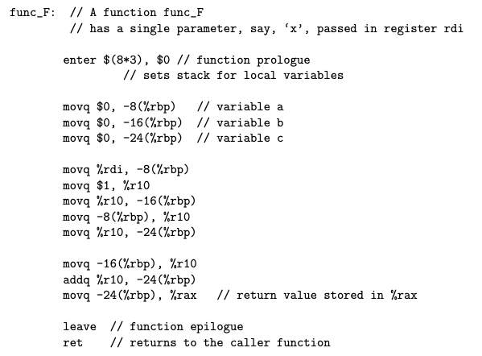

Slide 3
int func_F(int x)
{
int a = 0;
int b = 0;
int c = 0;
}

Slide 4
int func_F(int x)
{
int a = 0;
int b = 0;
int c = 0;
a = x;
b = 1;
}

Slide 5
int func_F(int x)
{
int a = 0;
int b = 0;
int c = 0;
a = x;
b = 1;
c=a;
}

Slide 6
int func_F(int x)
{
int a = 0;
int b = 0;
int c = 0;
a = x;
b = 1;
c=a;
c = b + c;
}

Slide 7
int func_F(int x)
{
int a = 0;
int b = 0;
int c = 0;
a = x;
b = 1;
c=a;
c = b + c;
return c;
}

