Slide 1
BINARY ADDITION
Conceptually similar to decimal addition
Example: Add the binary numbers 1010 and 11
(carry)
1
1 0 1 0
+ 1 1
1
1
0
1

Slide 2

TEST
Add the Binary numbers 11010 and 1100
(carry)
1
(carry)
1
1 1 0 1 0
+ 1 1 0 0
1
0
0
1
1
0

Slide 3
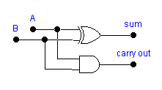
HALF ADDER
Logic device that adds two binary numbers
Only adds Least Significant Digit (LSD) column (1s column) in binary addition
Input Output
Logic Symbol:
A
Half
Adder
Σ (sum)
B
C₀ (carry out)
Logic Diagram:

Slide 4
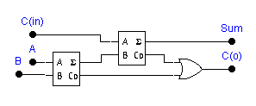
FULL ADDER
Used for adding binary place values other than the 1s place
Input Output
Logic Symbol:
C_{in}
Full
Adder
Σ (sum)
A
B
C₀ (carry out)
Logic Diagram:

Slide 5
BINARY SUBTRACTION
Example: Subtract binary number 101 from 1011
(borrow)
0
1
1 0 1 1
- 1 0 1
0
1
1
0

Slide 6
TEST
Subtract binary number 11 from 1010
01
0
10
1
0
1
1 0 1 0
- 1 1
0
1
1
1

Slide 7
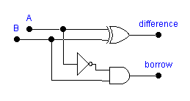
HALF SUBTRACTOR
Subtracts LSD column in binary subtraction
Input Output
Logic Symbol:
A
Half
Subtractor
D_{i} (difference)
B
B₀ (borrow out)
Logic Diagram:

Slide 8
FULL SUBTRACTOR
Used for subtracting binary place values other than the 1s place
Input Output
Logic Symbol:
B_{in}
D_{i} (difference)
Full
Subtractor
A
B
B₀ (borrow out)
Logic Diagram:
B_{in}
D_{i}
H. S.
A
B₀
H. S.
B

Slide 9
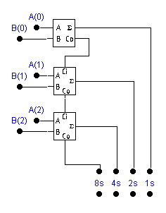
PARALLEL ADDING
Use half adder for LSD
Use full adder for other digits
A₂ A₁ A₀
+ B₂ B₁ B₀

Slide 10
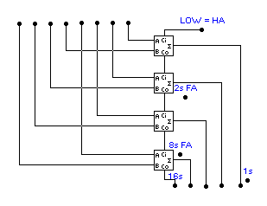
PARALLEL ADDER
Enter binary numbers
to be added here
0 0 1 1 + 1 0 0 0
1 1 1 0 + 0 1 1 0
1 1 0 0 + 1 1 1 1
1 1 0 1 1
1 0 1 0 0
0 1 0 1 1
SUM appears here
1s place uses half-adder
2s, 4s, 8s places use full adders
Parallel adders are available in IC form.

Slide 11
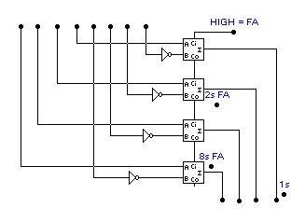
PARALLEL SUBTRACTOR USING FULL ADDERS
HIGH at Carry in input acts like adding +1 to a 1s C number to form the 2s complement.
1sC is formed by four inverters.
HIGH at Carry in input makes this perform as a full adder circuit
Binary numbers to be subtracted are input here
1 0 0 1 - 0 1 1 1
1 1 1 1 - 0 0 1 1
Note the use of four full adder circuits
Also notice the addition of four inverters on the B inputs to the FAs
1 1 0 0
0 0 1 0
Inverters
The result (difference) of the subtraction problem will appear here.

Slide 12
BINARY MULTIPLICATION
Example: Multiply the binary numbers 111 and 101.
1 1 1
x 1 0 1
Multiplicand
Multiplier
1
1
1
1st partial product
0
0
0
2nd partial product
1
1
1
3rd partial product
1
0
0
0
1
1
Product
111 x 101 can also be calculated: 111 + 111 + 111 + 111 + 111

Slide 13
TEST
Multiply the binary numbers 101 and 100.
1 0 1
x 1 0 0
0
0
0
0
0
0
1
0
1
1
0
1
0
0

Slide 14
BINARY MULTIPLIERS
Binary multiplier circuits - utilize repeated addition.
Block Diagram:
Multiplicand
register
Adder
Multiplier
down counter
Product
register

Slide 15
2s COMPLEMENT NOTATION
2s complement representation - widely used in microprocessors.
Represents sign and magnitude
MSB
LSB
Sign bit (0 = + ; 1 = -)
Decimal: +7 +4 +1 0 -1 -4 -7
2s Complement: 0111 0100 0001 0000 1111 1100 1001

Slide 16
2s COMPLEMENT - CONVERSIONS
Converting positive numbers to 2s complement:
  Same as converting to binary
Converting negative numbers to 2s complement:
Decimal to 2s Complement
2s Complement to
Binary
- 4 (decimal)
1 1 0 0 (2s C)
Convert decimal
to binary
1s complement
0 1 0 0
1s complement
0 0 1 1
1 0 1 1
Add 1
Add 1
- 4 = 1 1 0 0 (2s Complement)
0 1 0 0 (Binary)

Slide 17
ADDING/SUBTRACTING IN 2s COMPLEMENT
2s complement notation makes it possible to add and subtract signed numbers
(Decimal)
2s Complement
(- 1)
+ (- 2)
1 1 1 1
+ 1 1 1 0
(- 3)
1
1
1
0
1
2s complement
Discard
(+1)
+ (- 3)
0 0 0 1
+ 1 1 0 1
(- 2)
1
1
1
0
2s complement

Slide 18
TEST
Add the following 2s complement numbers:
(+5)
+ (- 4)
0 1 0 1
+ 1 1 0 0
(+1)
1
0
0
0
1
Discard

Slide 19
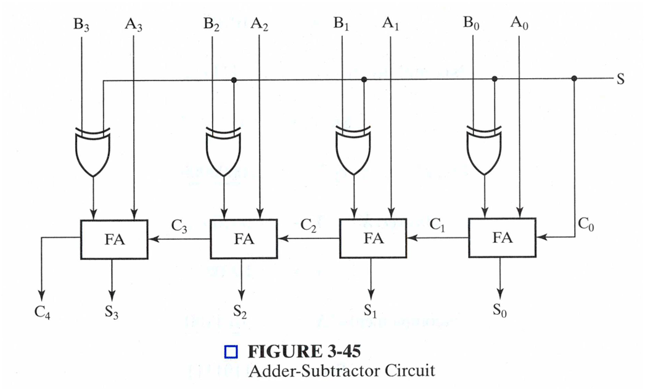
Binary Adder-Subtractors
This circuit requires prerequisite knowledge of Ex-OR Gate, and Binary Subtraction using 2’s complement. The circuit also consists of 4 full adders (FA) since we are performing operations on 4-bit numbers. There is a control line M that holds a binary value of either 0 or 1 which determines that the operation is carried out in addition or subtraction.

Slide 20
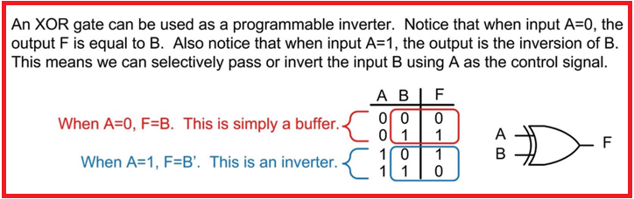
The Concept of Exclusive-OR Gate (XOR)
Figure 2: XOR Gate

Slide 21
Overflow Detection
Overflow
Overflow occurs if n + 1 bits are required to contain the result from an n-bit addition or subtraction
Overflow can occur for:
  Addition of two operands with the same sign
  Subtraction of operands with different signs
Signed number overflow cases with correct result sign
0 0 1 1
+ 0 − 1 − 0 + 1
0 0 1 1
Detection can be performed by examining the result signs which should match the signs of the top operand

Slide 22
Overflow Detection
Overflow
Signed number cases with carries C_{n} and C_{n−1} shown for correct result signs:
0 0 0 0 1 1 1 1
0 0 1 1
+ 0 − 1 − 0 + 1
0 0 1 1
Signed number cases with carries shown for erroneous result signs (indicating overflow):
0 1 0 1 1 0 1 0
0 0 1 1
+ 0 − 1 −0 + 1
1 1 0 0
Simplest way to implement overflow V = C_{n} + C_{n − 1}
Chapter 3 - Part 3 <number>

Slide 23
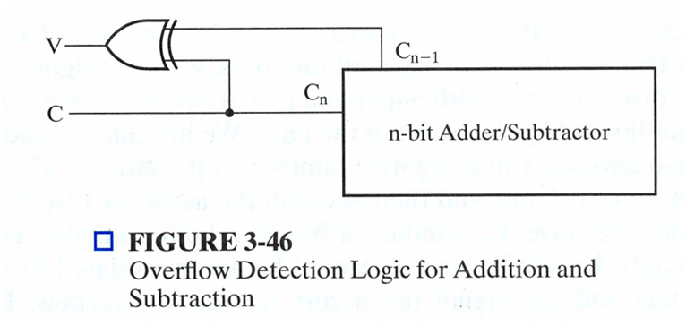
Overflow Detection
Chapter 3 - Part 3 <number>

