Slide 1
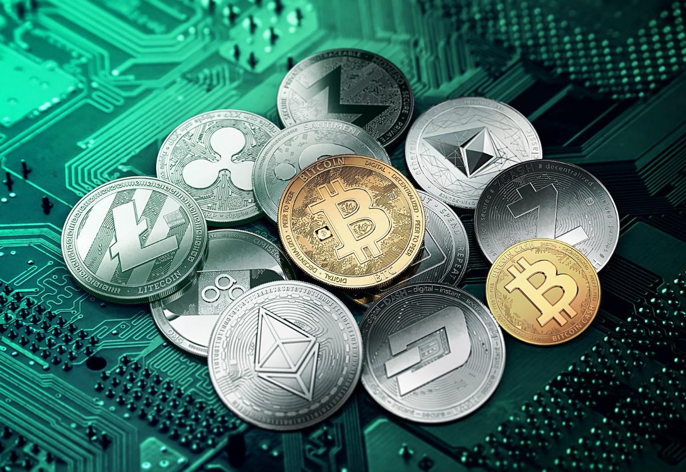
CRYPTOCURRENCY

Slide 2
Contents
1 ) What is cryptocurrency?
2) Difference between digital currency and cryptocurrency
3) Why use cryptocurrency?
4) Blockchain
5) Working of blockchain
6) Conclusion

Slide 3
Cryptocurrency
A cryptocurrency or crypto, is a virtual or digital currency.
Highly secured by cryptography.
Individual ownership records are stored in computerised database.
The records of cryptocurrencies are stored securely in blockchain.
Bitcoin is the first famous cryptocurrency developed by Satoshi Nakamoto in 2009.
Nakamoto’s solution was based on a well-known encryption arrangement known as public-private key encryption.

Slide 4
Difference b/w digital currency & cryptocurrency
Digital Currency
Cryptocurrency
Digital currencies are fully centralised(regulated by central authority i.e. RBI)
Digital currencies are only known to the sender, receiver and the bank.
Digital currencies needs strong password to protect digital wallets, banking apps, credit &debit cards.
Its is globally accepted.
Cryptocurrencies are decentralised.
Cryptocurrency transactions are publicly available on decentralised ledger.
Cryptocurrencies are secured by encryption.
Cryptocurrency rates are highly volatile, and are not widely accepted yet.

Slide 5
Why use cryptocurrency?
Fast and safe .
Transparent and neutral.
Decentralized nature.
Active involvement of users.
Freedom to transact.
You are the owner.

Slide 6

Blockchain
Blockchain is a peer-to-peer decentralized distributed ledger technology.
Makes the records of any digital asset transparent and unchangeable.
Works without involving any third-party intermediary.

Slide 7
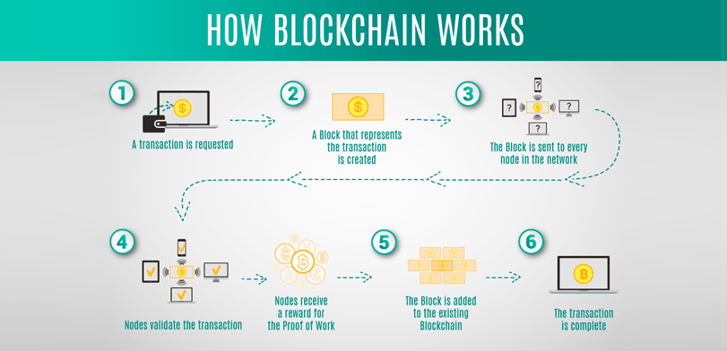

Slide 8
Conclusion
. As we can see, any cryptocurrency until now is not perfect.
. It has many advantages however, it also has its disadvantages.
. This is mostly due to the fact that it is still relatively young and new currency.
. In order to have more acceptance of cryptocurrency to suceed, more people need to understand what it is.

Slide 9
Thank you

