Slide 1

KIET GROUP OF INSTITUTION
IDEATHON 2K23
HELPING HAND MONITORING SYSTEM
TEAM MEMBERS
ANSHIKA VARSHNEY
PRERNA BHARDWAJ
MANMEET CHAUHAN
PRIYANKA PANDEY
DIVYAM RASTOGI

Slide 2
ABSTRACT
To Seeing a doctor, the treatment of patient will sometime require an assistant or proper online booking system for maintenance of patient reservation.
Our system is designed to accommodate such requirement and is able to coordinate these factors at the same time.
This is the web based application that overcomes the issue of managing and booking appointments.

Slide 3
PROBLEM STATEMENT
DEADLINE TO BOOK AN APPOINTMENT
HAVE TO WAIT EVEN AFTER APPOINTMENT
EMERGENCY ISSUES
REGULAR MONITORING IS NOT POSSIBLE

Slide 4

NECESSITY IS THE MOTHER OF INVENTION

Slide 5
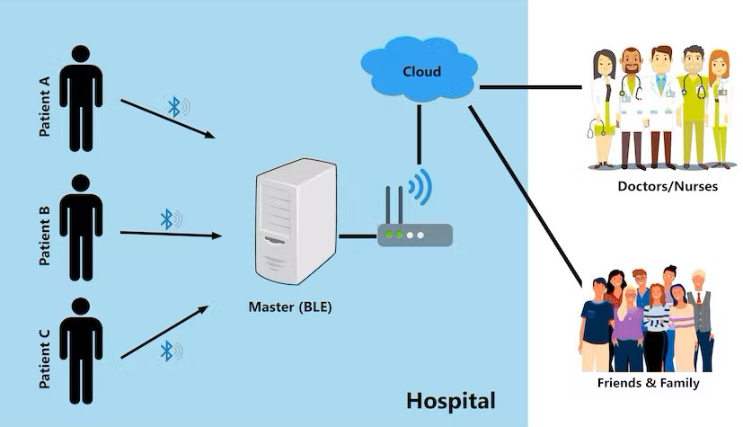
IMPLEMENTATION
USING WEB APPLICATION
(HTML,CSS,Django)
Database connectivity
using (JAVA, MySQL)
Machine learning or IoT

Slide 6
WORKING OF HHMS
Collection of data
Transmission of data
Evaluation
Notification
Action

Slide 7

ADDITIONAL FEATURES OF OUR WEB APPLICATION
DIET PLAN
YOGA POSTURES
MEDICAL CAMP NOTIFICATION
SYNCHRONIZE DATA STREAMS
APPROPRIATE COUNSELLING
SHARED DECISION-MAKING

Slide 8
BENEFITS
IMPROVES ACCESS TO CARE
DOUBTS SOLVING SESSIONS
HELPS PATIENTS IMPROVE SELF MANAGEMENT AND CARE PLAN
REDUCES PATIENT’S EXPENSES AND IMPROVES WORK PRODUCTIVITY
PREVENTS THE SPREAD OF INFECTIOUS DISEASE
IMPROVES PATITENT EXPERIENCE AND SATISFACTION

Slide 9

THANK YOU…
“An invention can not be called an invention if it is not progress monitored.
An invention without progress monitoring is just an activity.”

