Slide 2
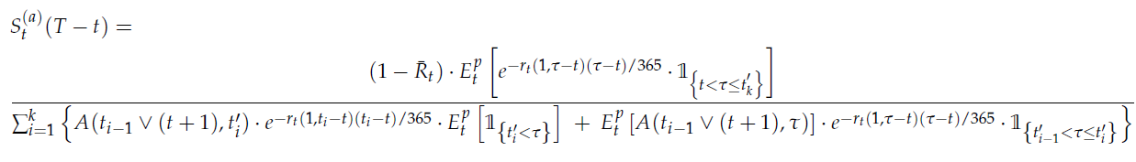

Slide 3

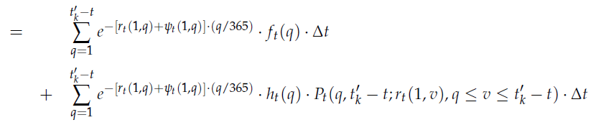

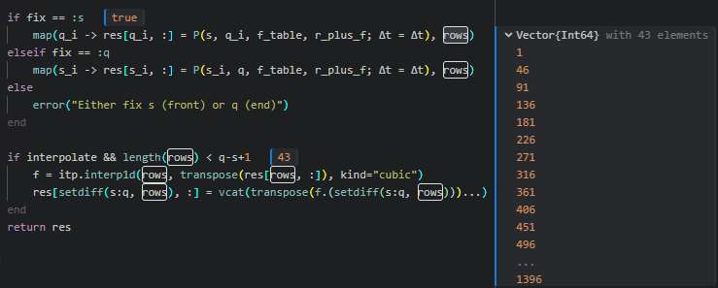
1. E_discount
E_discount =
interpolate_P =
Actually, interpolate_P is just P, but in the computation, we calculate some point of P and then interpolate it to simplify and stablize the computation.

Slide 4

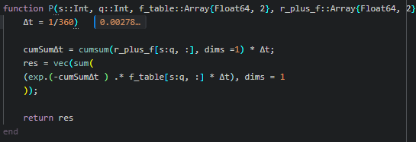


P =
cumSumΔt =
= cumsum(r_plus_f[s:q, :], dims =1) * Δt
= discountCurve.LocalAvgRate[1:daysToAccrualEnd]

Slide 5
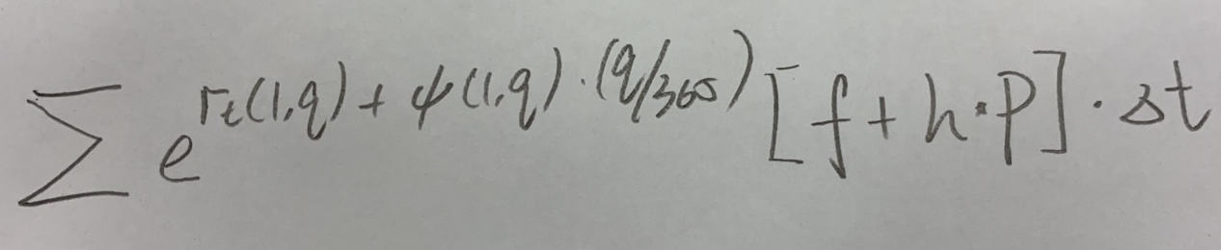
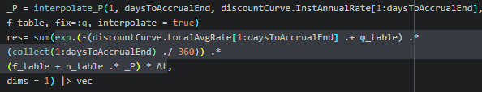
=
=

Slide 6
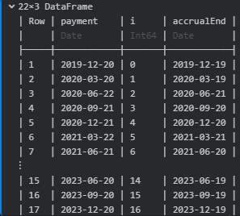

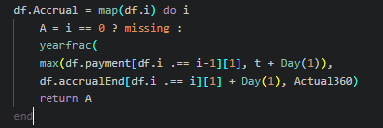
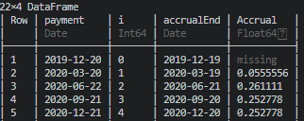
2. Accrual_discount_E
Accrual_discount_E =
get_t_k : get the previous payment date to calculate the 1st payment
df.Accrual:

Slide 7

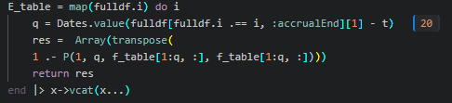
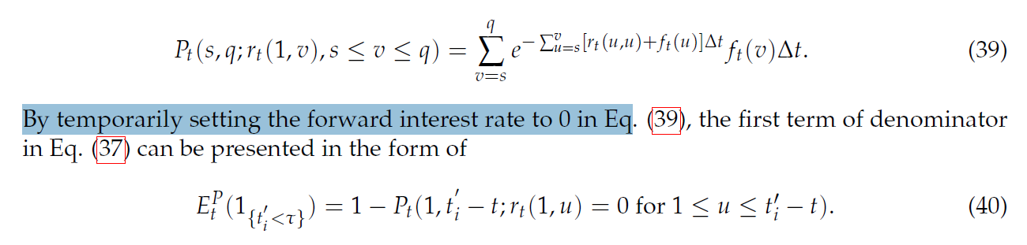
E_table :
=
Here we input f_table as r_plus_f to set r to 0
A notable point is: When calculating Accrual Period, it’s the start date -> payment date – 1 (Accrual End). But when discounting, we use the discount factor for start date -> payment date. It’s because payment is calculated on Accrual Period, but paid one day later.

Slide 8
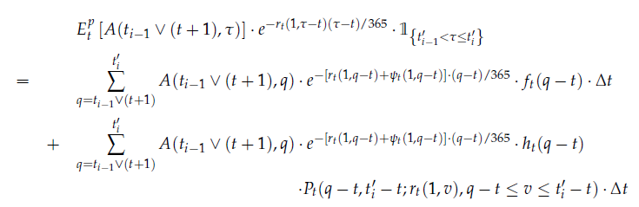
3. E_Accrual_discount
E_Accrual_discount =

