Slide 1
Resumo Visão Geral Onda 3
Horacio Vasconcellos

Slide 2



Visão Geral
PROBLEMA
BBTS e Hitachi Consulting
IMPACTO
SOLUÇÕES

Slide 3
Reuniões
Agenda de reuniões
Data | Agenda | Participantes Numero
23/08/2017 | eRat e GAC | 8
25/08/2017 | Mapeamento Alto Nível | 15
 | Mapeamento Alto Nível | 9

Slide 4






Customer/Prod Info, Knowledge Base
Secure Access
Intelligence
Channels
Rapid Resolution
Proactive Service
Users
Delivery Options
Self-Service
Field Service
Self-Service
Agent Assisted
Depot Repair
Service Parts Logistics
CSRs
Email
Identify & Verify
Analyze
Prioritize
Plan & Schedule
Repair / Resolve
Debrief
Close & Bill
Analysts
Workflow Automation
Phone
Contract Entitlements / Warranties
Customers
In Person
Shipping / Receiving
Orders & Cases
Marketing Offers
Inventory
Invoices & Payments
Mobile
BBTS Integrator
(eRat)
PeopleSf

Slide 5
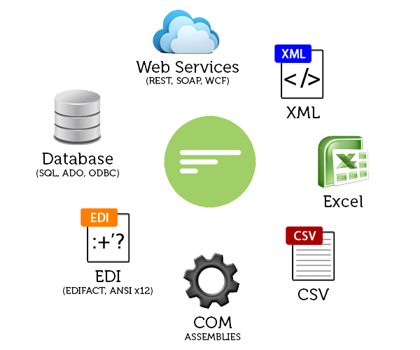
BBTS Integrator
RECEPCIONAR ORIGENS DISTINTAS EM FORMATOS DISTINTOS
INPUT
RECEPCIONAR DIVERSAS ORIGENS DE DADOS;
RECEPCIONAR TEMPLATES PRÉ-FORMATADOS;
RECEPCIONAR FLAT FILES FORMATADOS;
TRANSFORM
TRANSFORMAÇÃO INPUT EM FORMATO PADRÃO
ENTREGA
ENTREGA PARA O PROCESSO DE VALIDAÇÃO, PERSISTIR OU ENRIQUECER
COMPARTILHA/DEVOLUÇÃO
FORNECER STATUS OU VALIDAÇÕES
BBTS GATEWAY

Slide 6
Customer/Prod Info, Knowledge Base
Secure Access
Intelligence
Channels
Rapid Resolution
Proactive Service
Users
Delivery Options
Self-Service
Field Service
Self-Service
Agent Assisted
Depot Repair
Service Parts Logistics
CSRs
Email
Identify & Verify
Analyze
Prioritize
Plan & Schedule
Repair / Resolve
Debrief
Close & Bill
Analysts
Workflow Automation
Phone
Contract Entitlements / Warranties
Customers
In Person
Shipping / Receiving
Orders & Cases
Marketing Offers
Inventory
Invoices & Payments
Mobile
BBTS Integrator
(eRat)
PeopleSf

Slide 7



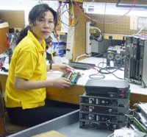

DEPÓSITO DE REPARO
Service Channels
Customer Repair
No Repair
Internal Repair
Long Customer Repair Cycle
Short Customer Repair Cycle
Repair and Return
✓
✓
Self-Service
Receive and Inspect
Estimate and Approve
Plan and Schedule
Repair and Debrief
Ship and Bill
Loaner, Repair and Return
✓
Assign
✓
Manage Resources
Agent Assisted
Exchanges
✓
✓
Replacement
Customer & Product Data
✓
Field Service
Installed Base
Common Data
Repository
Reports
Refurbishment
✓
Depot Walk-In

Slide 8



REPARO – LOANER, REPAIR AND RETURN
Track Promise Date, Manage Issues
Ship Loaner
Receive Defective Product
Inspect & Repair
Ship Product
Receive Loaner

Slide 9
Mudanças/Dúvidas Identificadas
Alguns pontos
eRat
Atual
Receptor de uma única forma
Possui Lógica
Entre sistemas (Valida, Encaminha, Transforma)
Entregador
eRat
Proposto
Receptor de múltiplos
Transformar em representacao alternativa
Entregador
Integração com OTL
Payroll
Time
Expenses
Integração People e Payables
Time
Expenses

Slide 10
Mudanças/Dúvidas Identificadas
Alguns pontos
OKS
Digitação de Fatura
OKS
Regras de SLA
Regras/Calculo de Faturamento
Reconciliação
OKS com o OKC
Transporte
TOA
GAC
Integração não nativa
Serviço de Integração ORACLE
Transporte
Mobile Field Service
Licenciamento

Slide 11
Obrigado

