Slide 1
Introduction to Azure Pipelines
Part 1 of 3 in the Build end-to-end CI/CD capabilities with Azure Pipelines series

Slide 2
About the presenter
Presenter Name
☁️ Presenter Title
For questions or help with this series: msusdev@microsoft.com
All demos and source code available on GitHub:
github.com/msusdev/end-to-end-ci-cd

Slide 3
Series road map
Session 1:
↪️ Introduction to Azure Pipelines
Session 2:
Automatically build and test your code with Azure Pipelines
Session 3:
Deploy your code to Azure with Azure Pipelines

Slide 4
Today’s agenda
What are Azure Pipelines?
Learn the YAML syntax
Building a simple project
Notes:
Learn how Azure Pipelines enable you to automate your software development cycle for code hosted in GitHub. We’ll walk you through using everyday actions in your first pipeline. You’ll learn how to:
Create a pipeline
Add actions to a pipeline
Trigger the pipeline

Slide 5
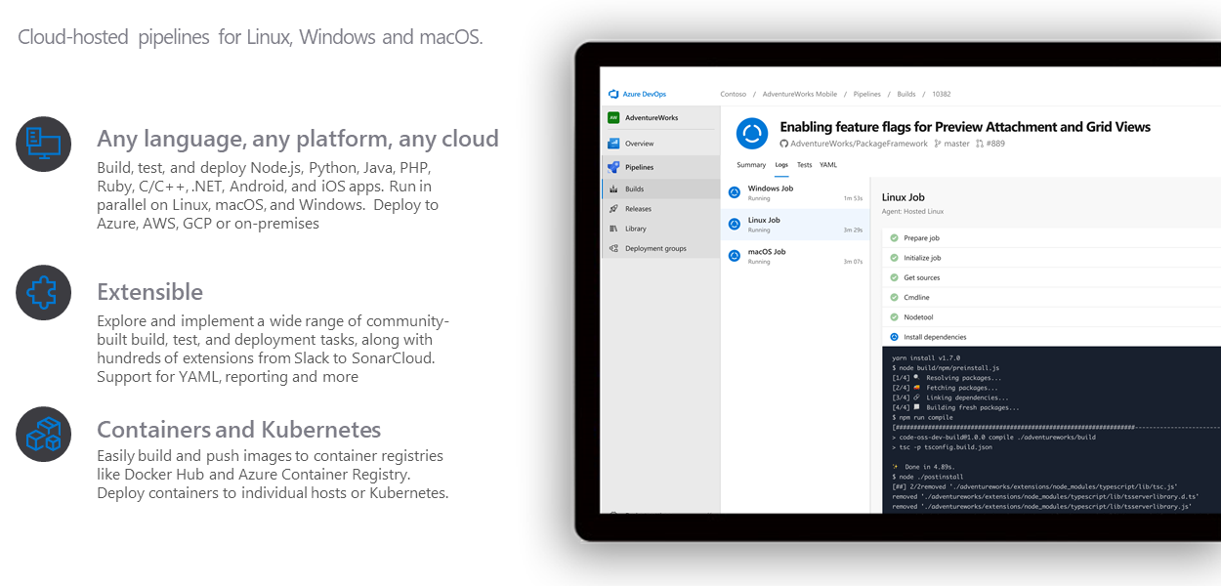
Azure Pipelines

Slide 6
What are Azure Pipelines?
Packaged pipelines
Automates common build, test, and deployment actions
Highly configurable and extendable
Supports an open marketplace of free and paid tools
Includes a rich user interface system native in Azure DevOps

Slide 7
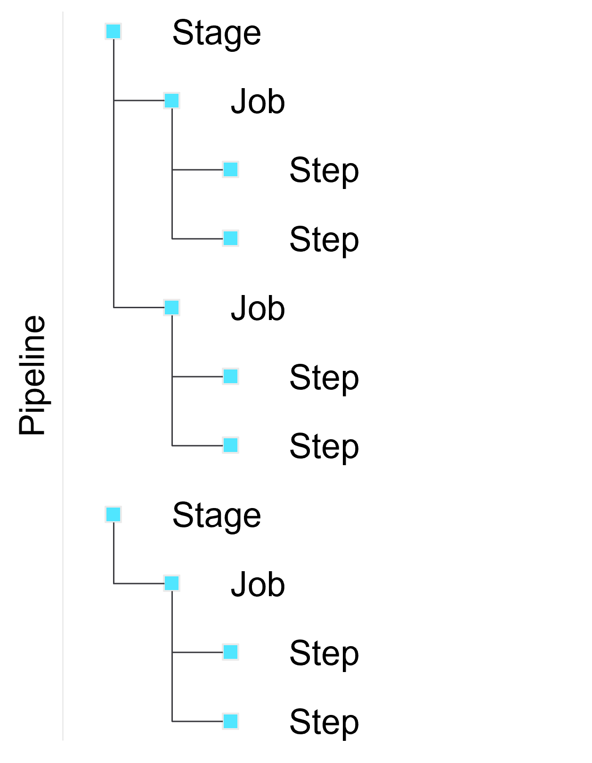
Anatomy of a pipeline

Slide 8
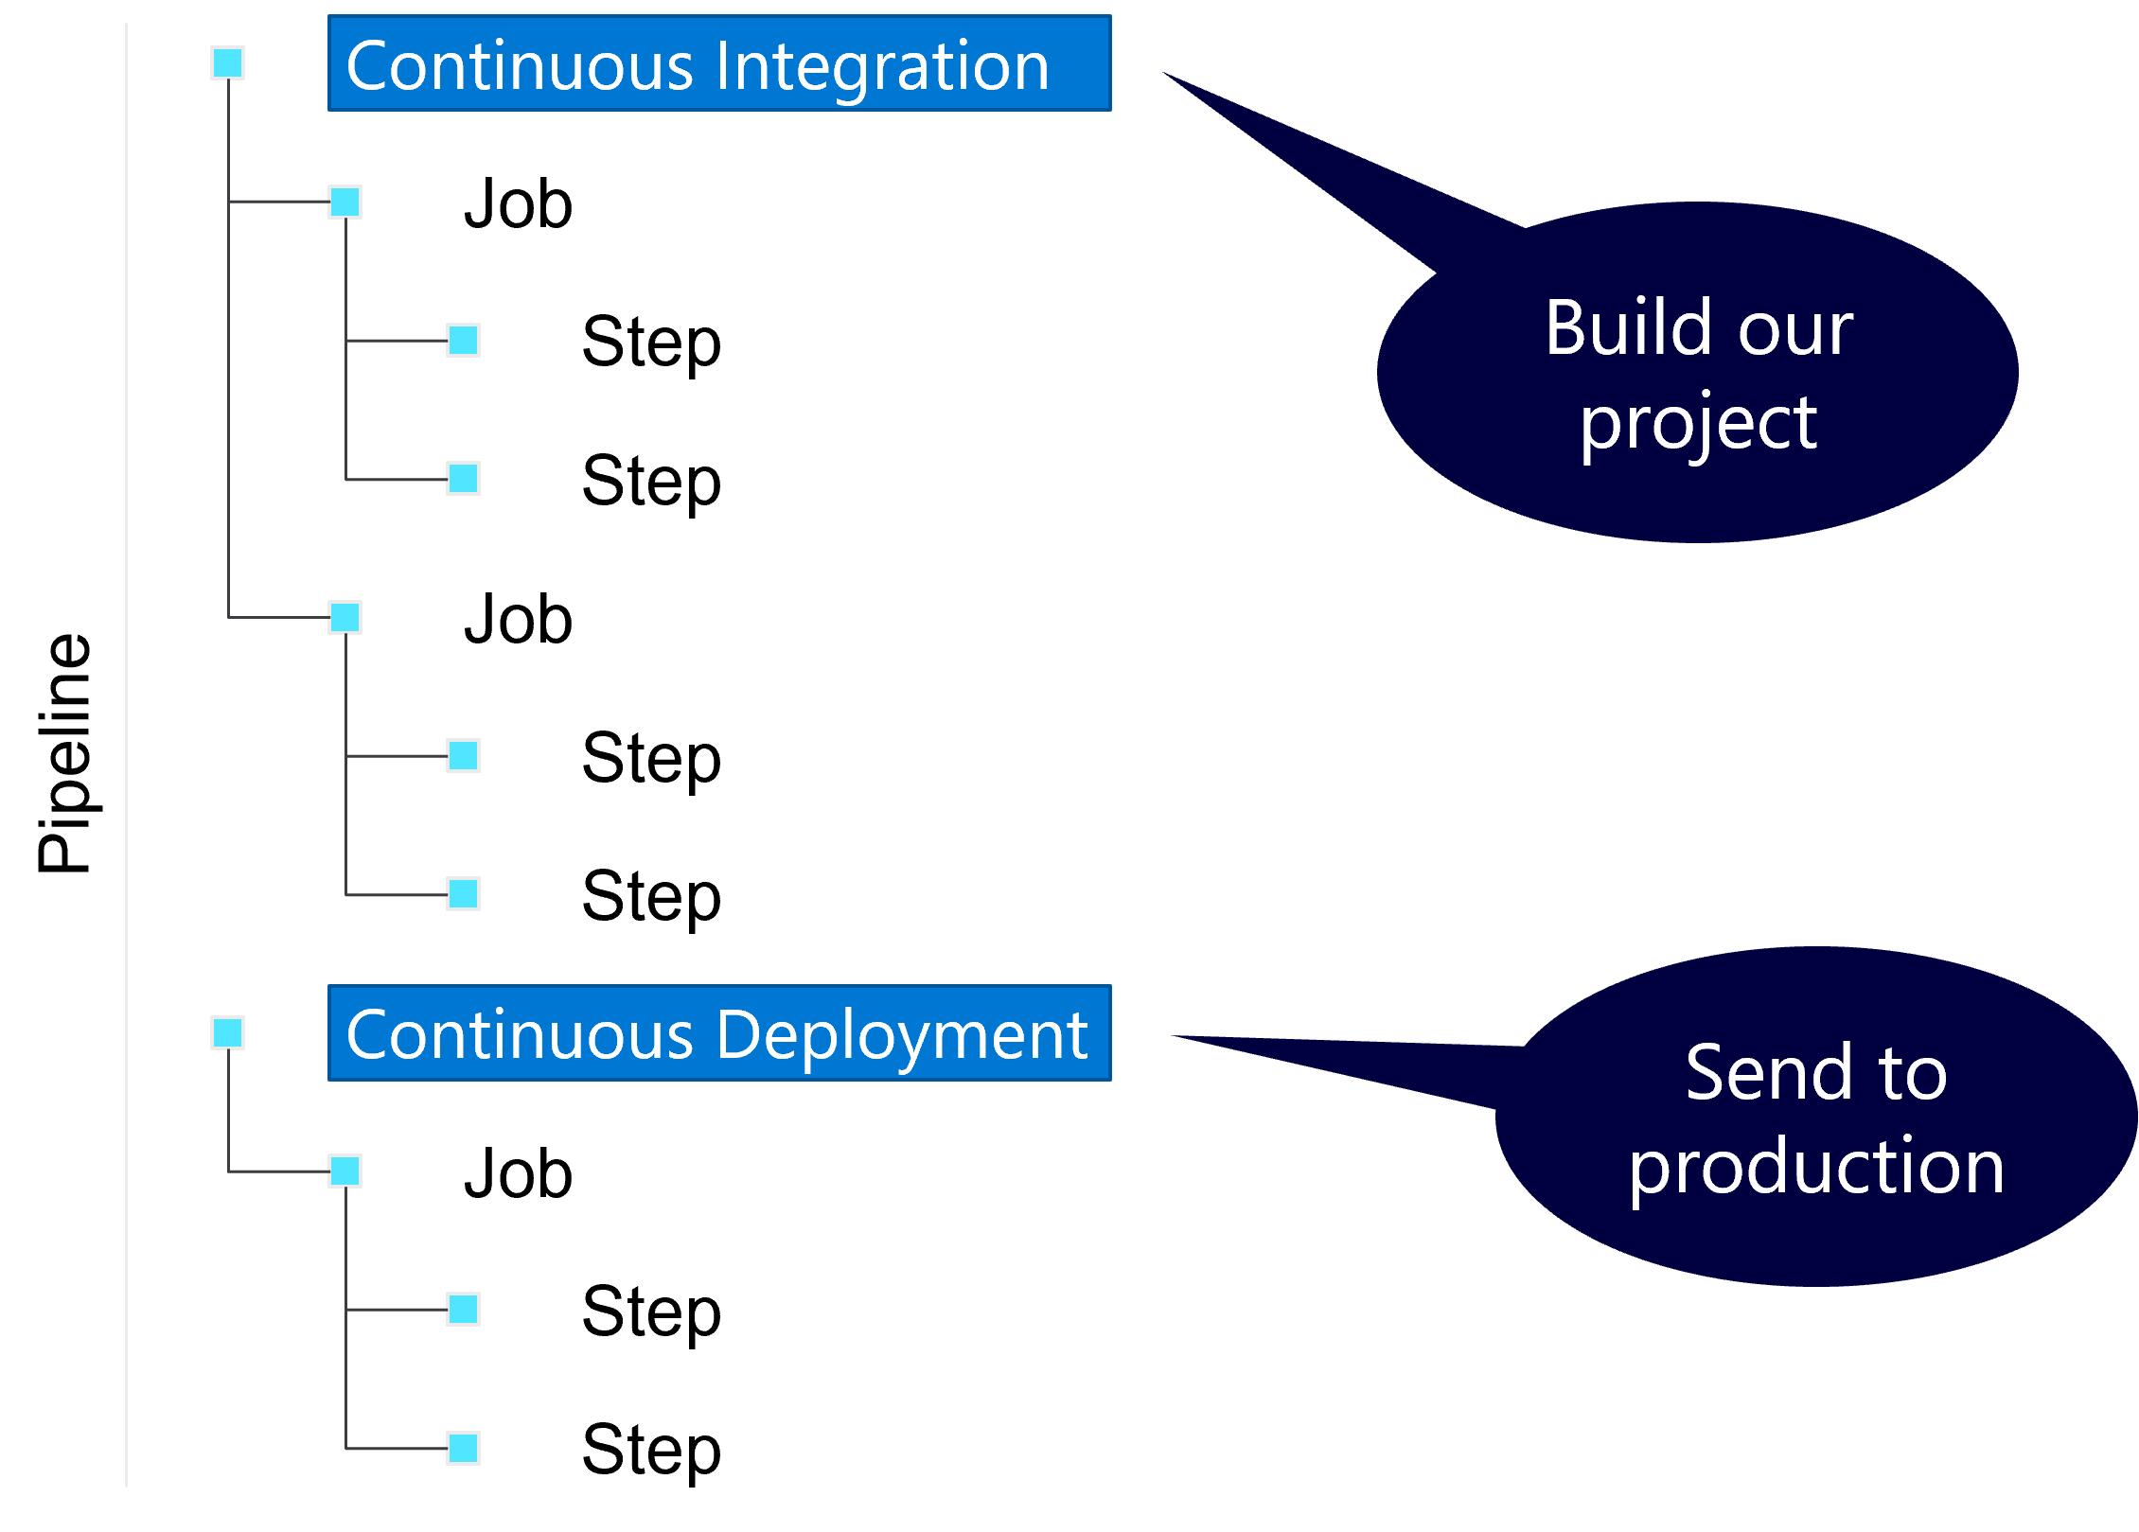
Stages

Slide 9
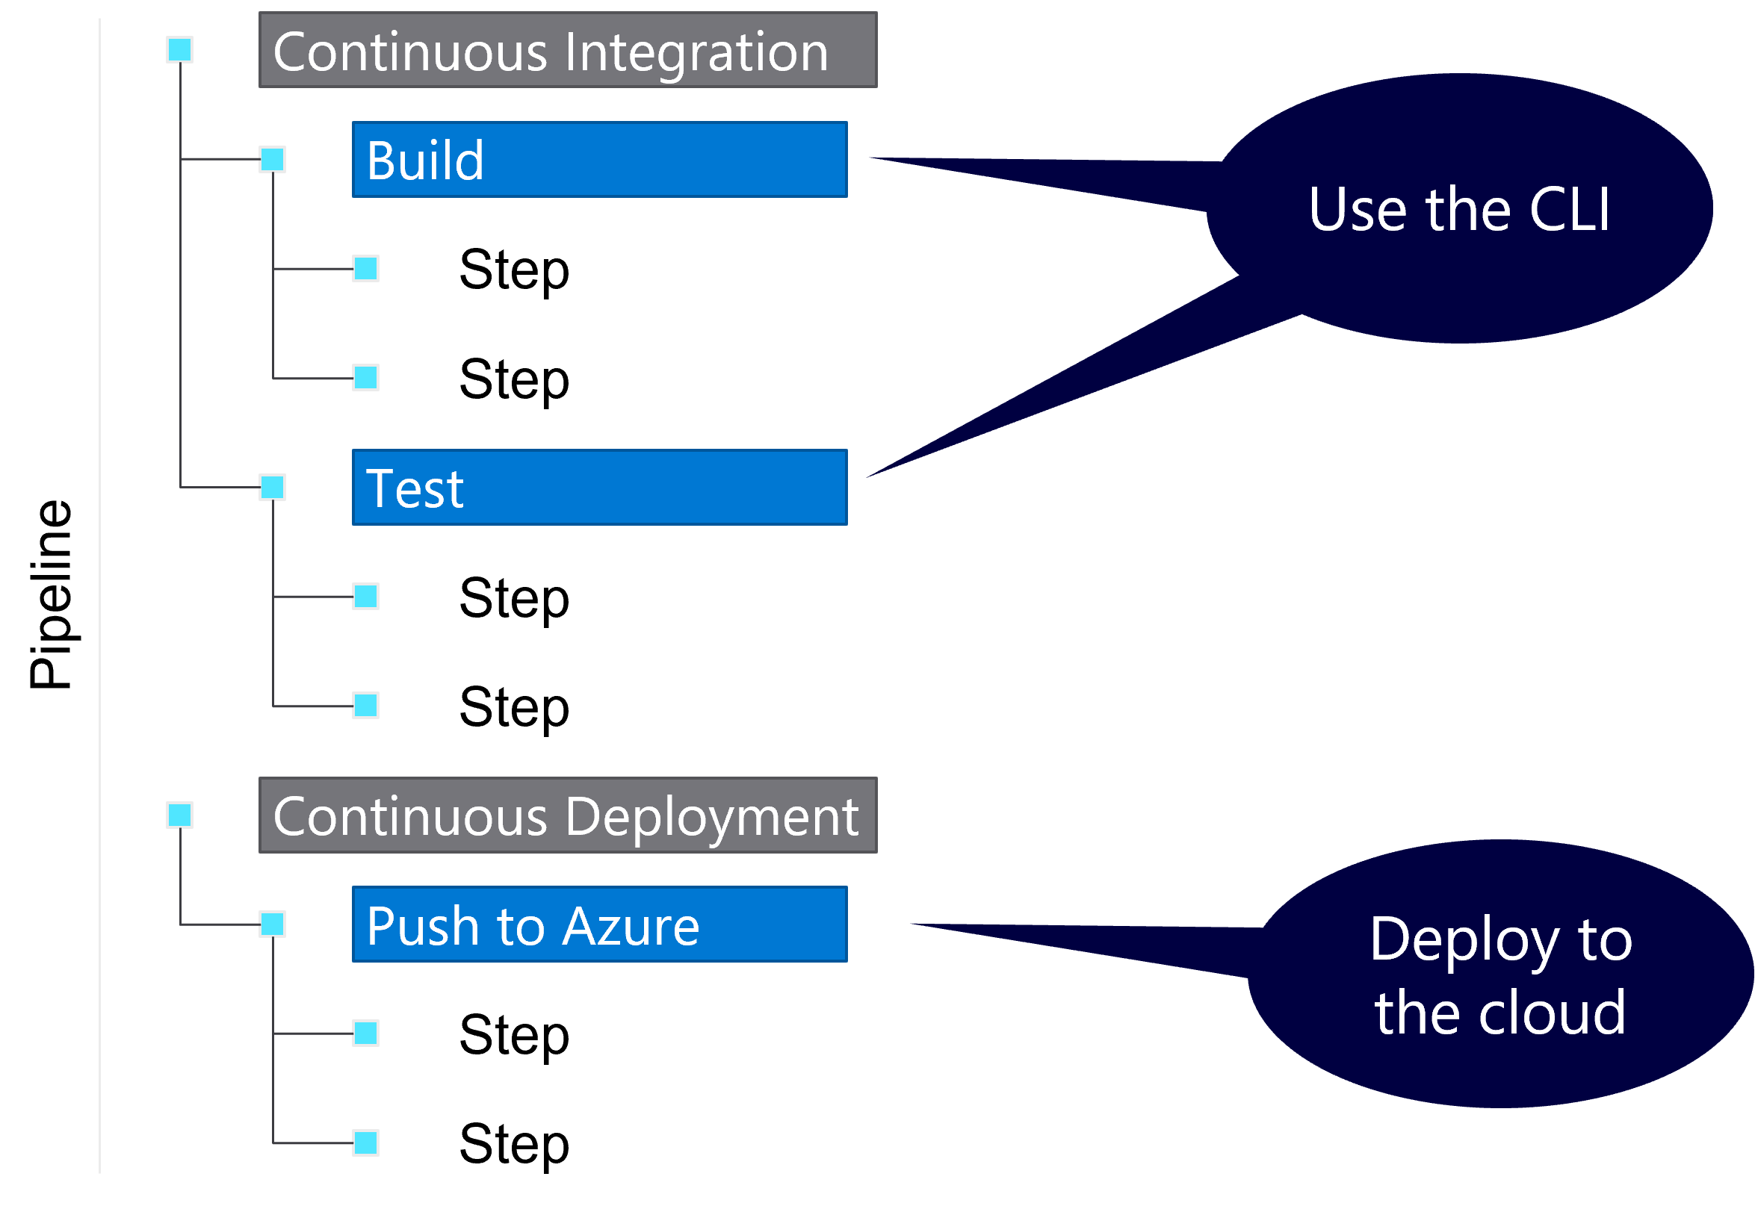
Jobs

Slide 10
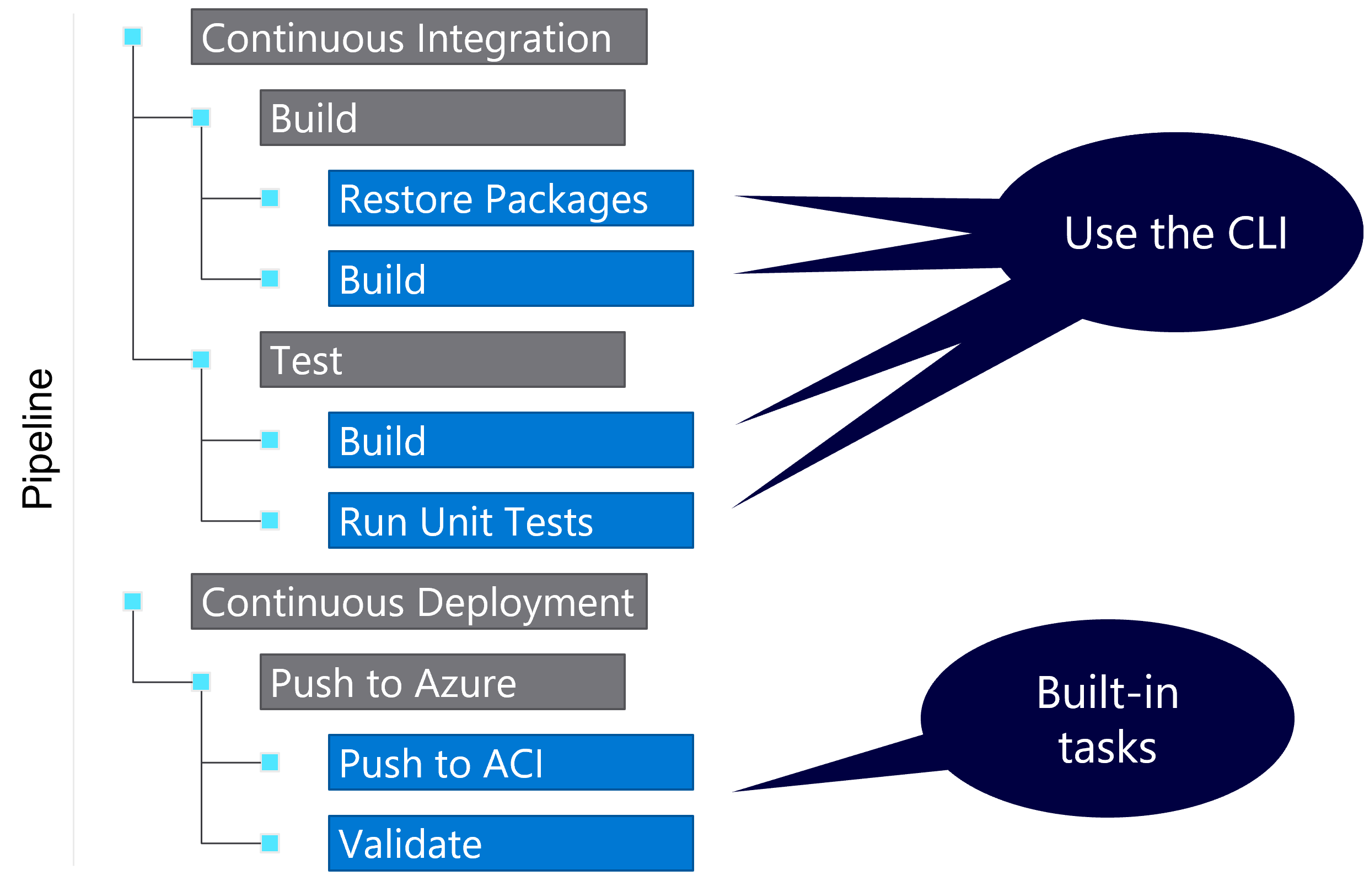
Steps

Slide 11
Types of steps
Script
Run any command-line script
Example:
echo 'Hello World'
Task
Run one of the built-in complex tasks
Example:
Publish to Azure

Slide 12
Demo: Building a project with a starter pipeline
Notes:
Start with an empty Azure DevOps project
Create a GitHub repository with a single README file
Use Visual Studio Code to create a new .NET console application with the following commands and code:
dotnet new console dotnet add package Colorful.Console dotnet new gitignore dotnet new sln dotnet sln add <name-of-project-folder>.csproj
using static System.Drawing.Color; using Console = Colorful.Console; Console.WriteAscii("Hello, World!", Red);
dotnet run
Note: You can use GitHub Codespaces to perform this task quickly.
Commit your changes to the local repository and push the changes to GitHub.
Return to the new Azure DevOps project.
Create, save, and then run a new pipeline with the following settings:
Source: GitHub
Repository: Select GitHub repository you created earlier
Template: .NET Desktop
Observe the job output logs.

Slide 13
Pipeline hierarchy (again…)

Slide 14
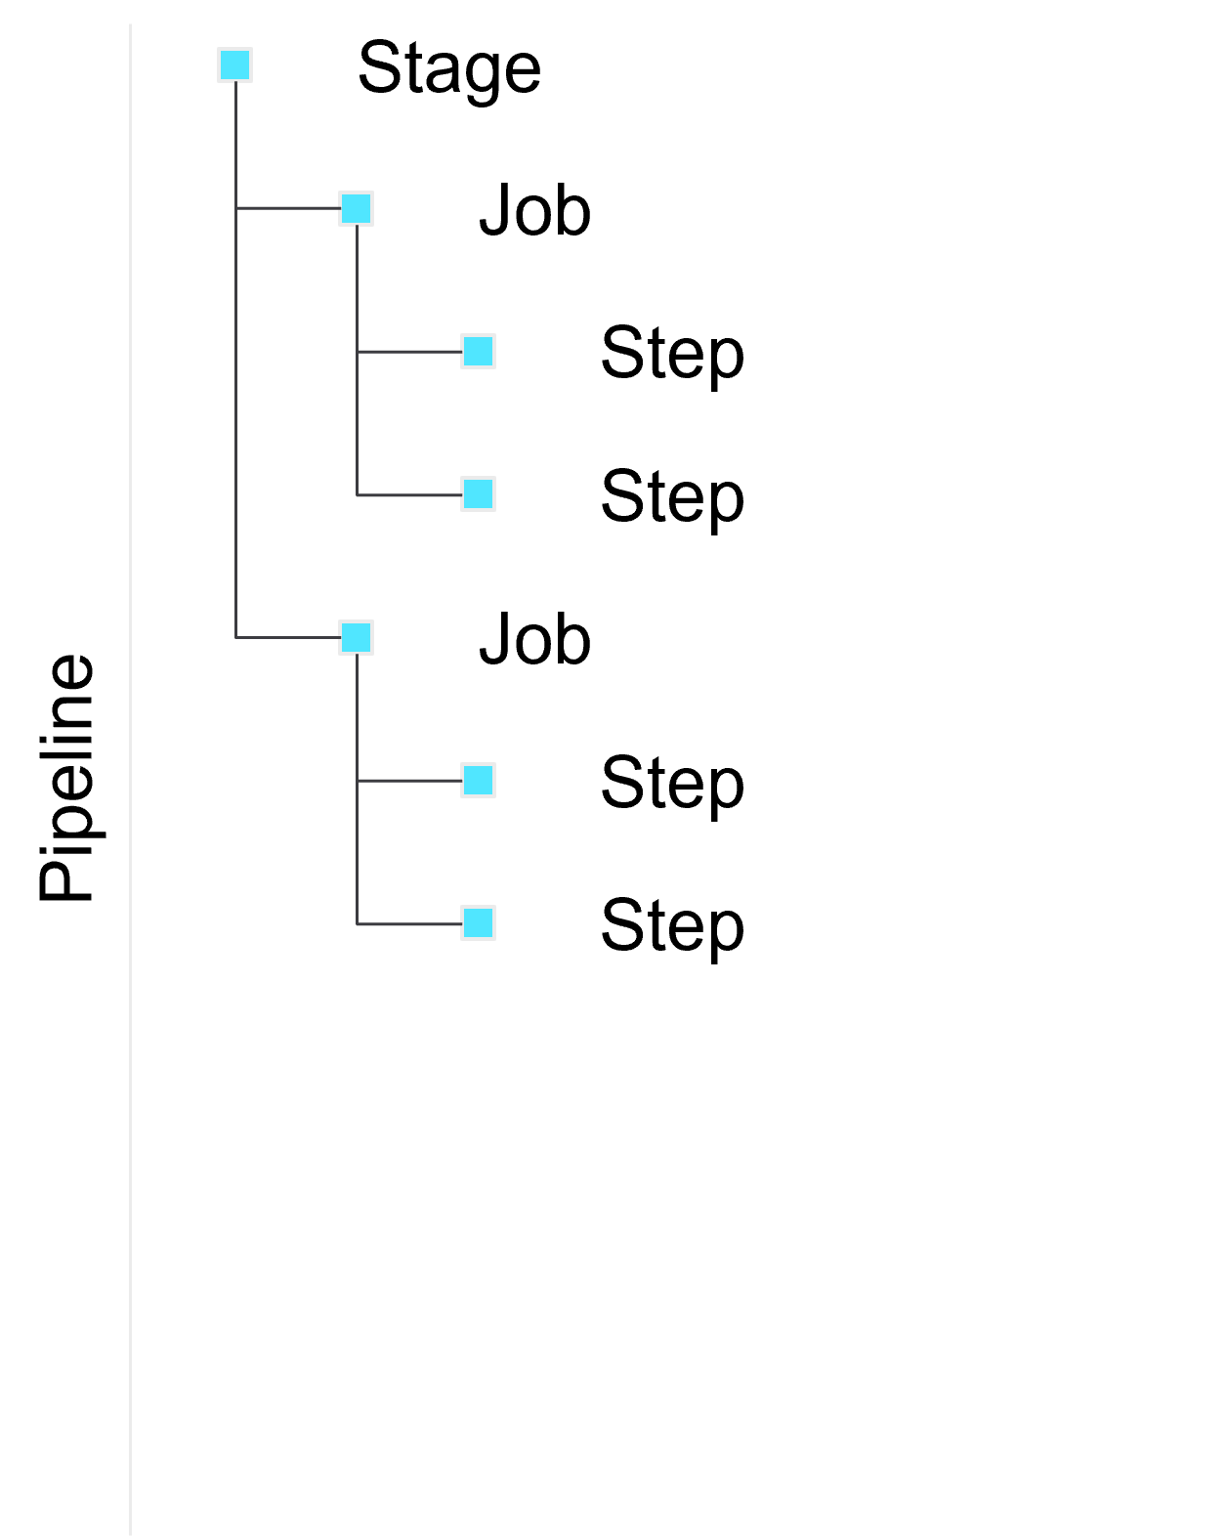
Single stage pipeline

Slide 15
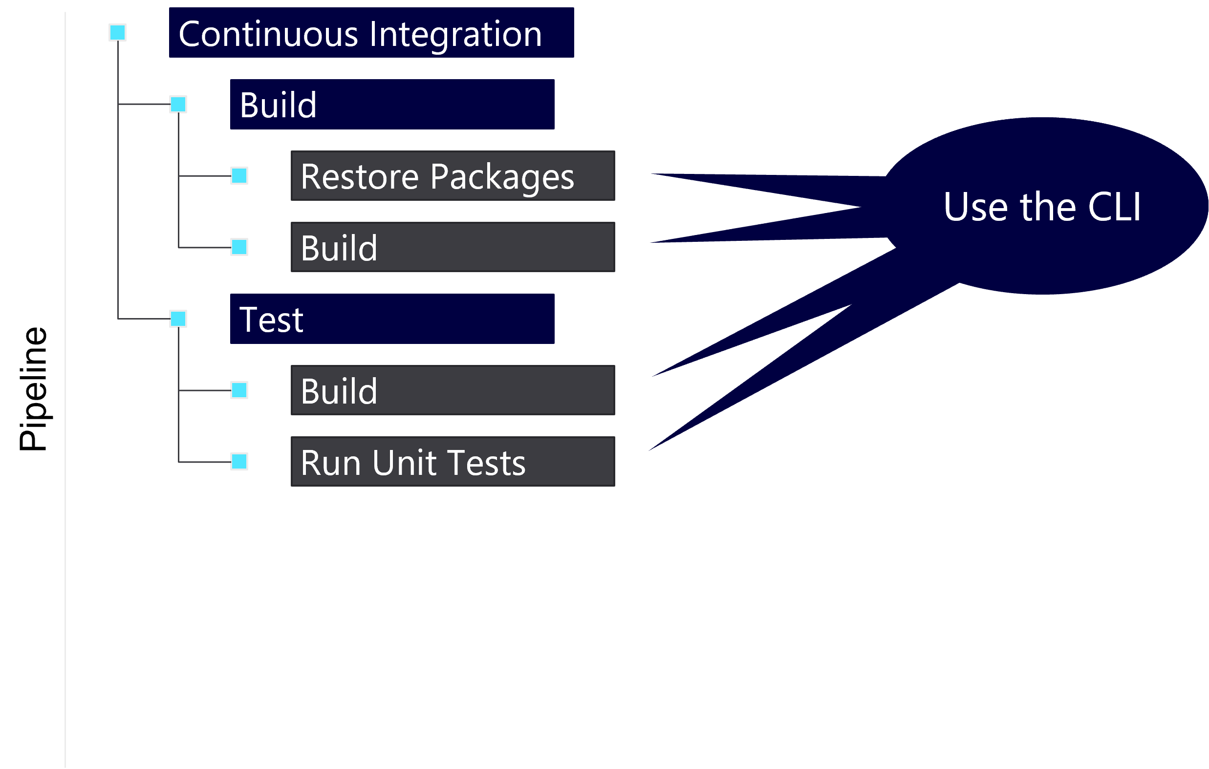
Build and test pipeline

Slide 16
Information from the developer team
Language | Install required packages | Run application
.NET | dotnet restore | dotnet run
Node.js | npm install | node [file.js]
Python | pip install [package] | python [file.py]
Ruby | gem install [package] | ruby [file.rb]

Slide 17
.NET guidance from the developers
 | .NET CLI
Install packages | dotnet restore
Build project | dotnet build
Run project | dotnet run
Test project | dotnet test
Publish project | dotnet publish

Slide 18
Build and test pipeline (again…)

Slide 19
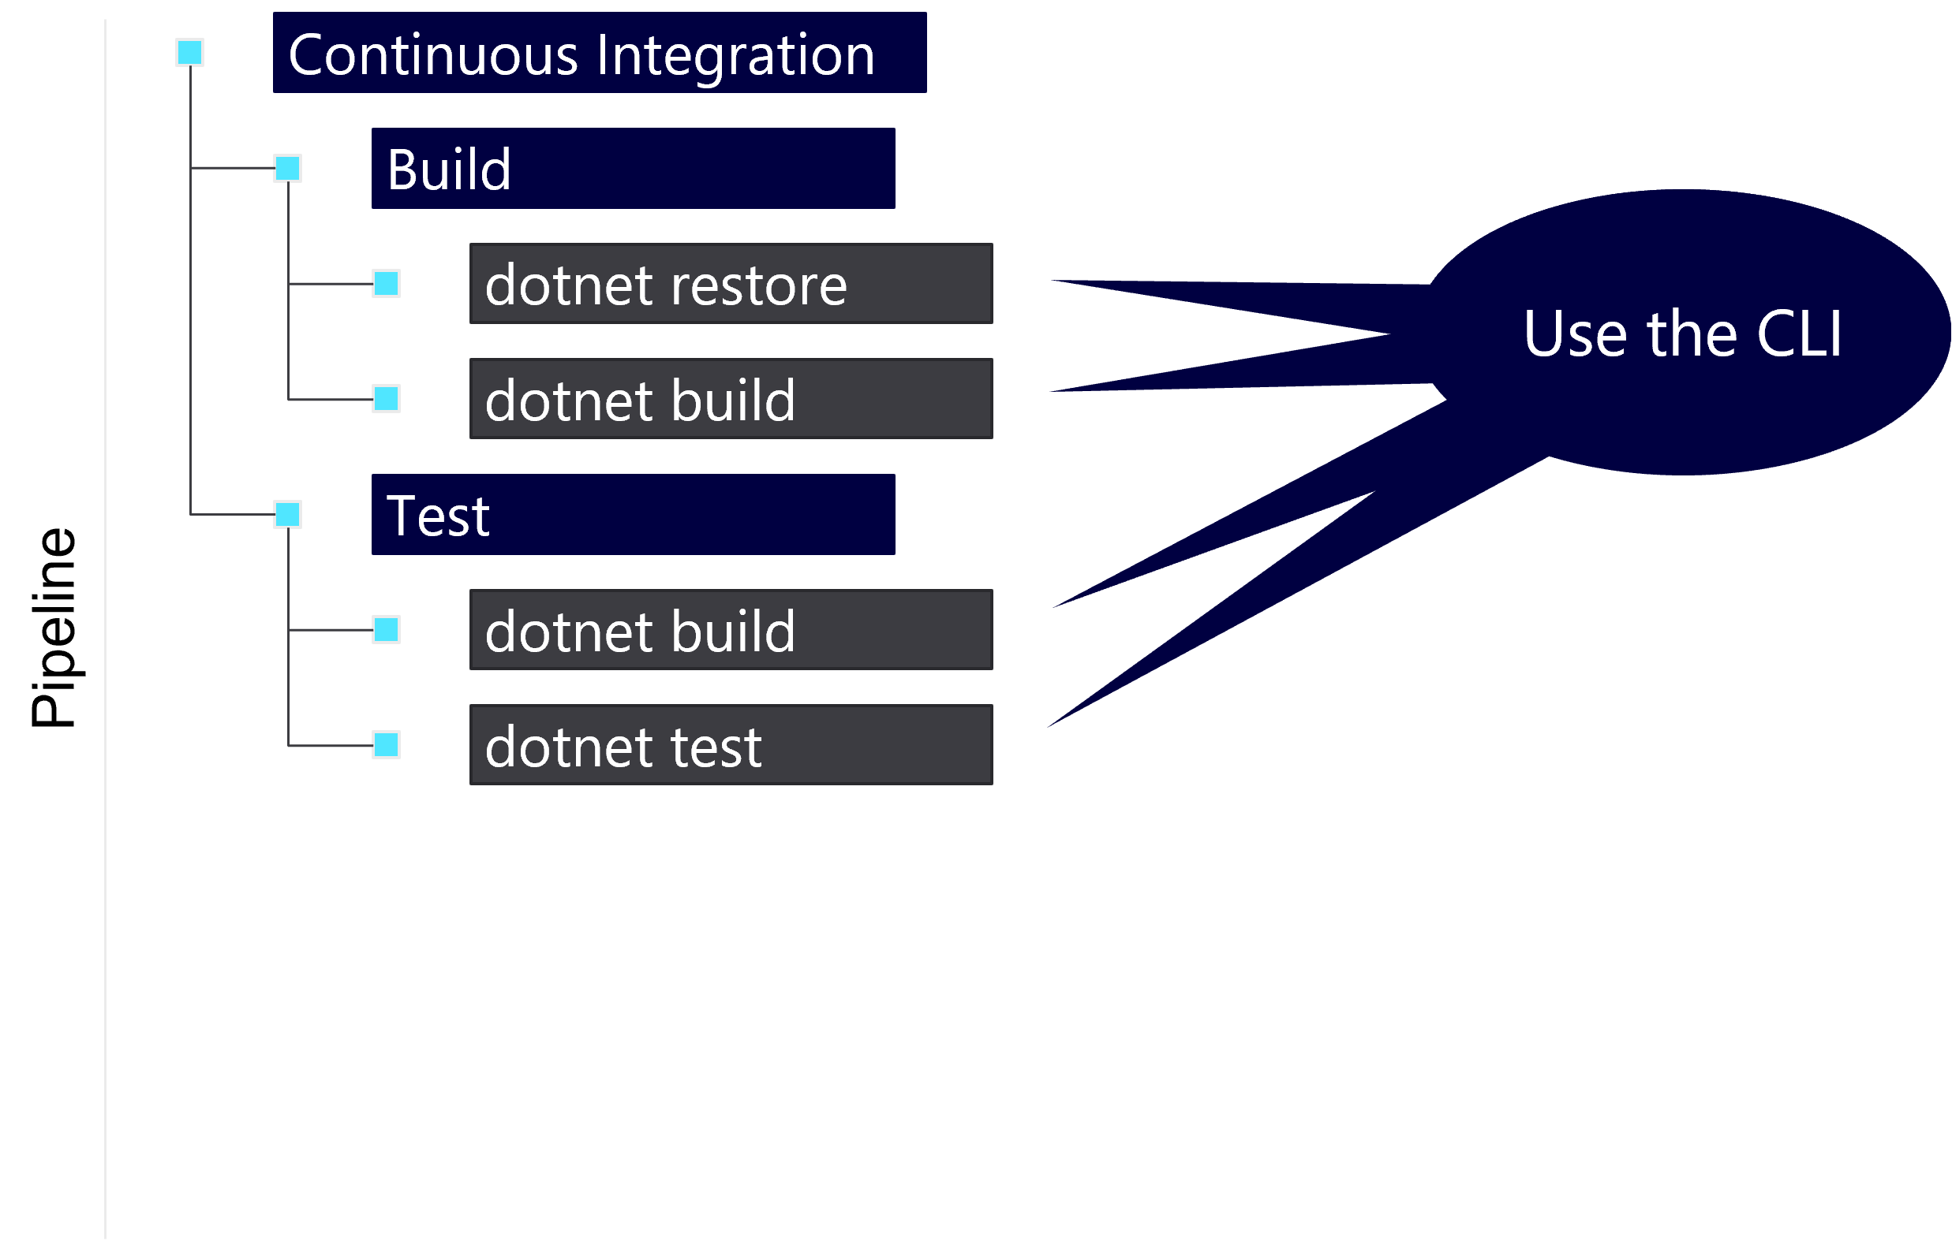
Use the CLI in the pipeline

Slide 20
Start with your stages keyword
stages:

Slide 21
Then, the stages array
stages: - stage: <name_of_stage> - stage: <name_of_stage>

Slide 22
Name each stage
stages: - stage: continuous_integration

Slide 23
Next, the jobs keyword
stages: - stage: continuous_integration jobs:

Slide 24
Then add jobs
stages: - stage: continuous_integration jobs: - job: <job_name> - job: <job_name>

Slide 25
Now, name each job
stages: - stage: continuous_integration jobs: - job: build

Slide 26
Finally, add the steps keyword to the job
stages: - stage: continuous_integration jobs: - job: build steps:

Slide 27
Reviewing, the types of steps
Script
Run any command-line script
Example:
dotnet build
Task
Run one of the built-in complex tasks
Example:
Create an Artifact

Slide 28
Steps can be scripts or tasks
stages: - stage: continuous_integration jobs: - job: build steps: - script: <some_script_to_execute> - task: <name_of_builtin_task>

Slide 29
Remembering the word from the developers
Restore .NET packages from NuGet
dotnet restore
Build .NET project
dotnet build

Slide 30
Build and restore a .NET project
stages: - stage: continuous_integration jobs: - job: build steps: - script: dotnet restore - script: dotnet build

Slide 31
Demo: Building a .NET project using a pipeline
Notes:
Return to the GitHub project.
Remove every file in the project except for the following three files:
<name-of-project-folder>.csproj
Program.cs
.gitignore
Create a new pipeline YAML file in your project.
Note: The filename of the pipeline is arbitrary. For the remainder of the demos, we will assume you named the pipeline pipeline.yml.
Add the following content to the pipeline YAML file:
stages: - stage: continuous_integration jobs: - job: build steps: - script: dotnet restore - script: dotnet build
Commit your changes to the local repository and push the changes to GitHub.
Return to the Azure DevOps project.
Create, save, and then run a new pipeline with the following settings:
Source: GitHub
Repository: Select GitHub repository you created earlier
Template: Existing Azure Pipelines YAML file
Branch: main
Path: /pipeline.yml
Observe the job output logs.
Update the content of the pipeline YAML file:
stages: - stage: continuous_integration jobs: - job: build steps: - script: dotnet --version - script: dotnet restore - script: dotnet build - script: dotnet run
Commit your changes to the local repository and push the changes to GitHub.
Return to the Azure DevOps project and your new pipeline.
Observe the job output logs for the latest automated run.

Slide 32
Hard-coded names
Task | Name
Single Stage | continuous_integration
Single Job | build
Script (dotnet restore) | CmdLine
Script (dotnet build) | CmdLine

Slide 33
Implementing display names
stages: - stage: continuous_integration displayName: Continuous Integration jobs: - job: build displayName: Build steps: - script: dotnet restore displayName: Restore NuGet packages

Slide 34
Demo: Creating friendly names
Notes:
Return to the GitHub project.
Update the content of the pipeline YAML file:
stages: - stage: continuous_integration displayName: Continuous Integration jobs: - job: build displayName: Build steps: - script: dotnet --version displayName: Check .NET SDK version - script: dotnet restore displayName: Restore NuGet packages - script: dotnet build displayName: Build .NET project - script: dotnet run displayName: Run .NET application
Commit your changes to the local repository and push the changes to GitHub.
Return to the Azure DevOps project and your pipeline.
Observe the job output logs for the latest automated run.

Slide 35
Microsoft-hosted agents
Image | Specification
Windows Server 2022 & Visual Studio 2022 | windows-2022
Windows Server 2019 & Visual Studio 2019 | windows-latest or windows-2019
Ubuntu 20.04 | ubuntu-latest or ubuntu-20.04
Ubuntu 18.04 | ubuntu-18.04
macOS 11 Big Sur | macOS-latest or macOS-11
macOS X Catalina 10.15 | macOS-10.15

Slide 36
Included software examples (ubuntu-latest)
Ansible
Azure CLI
Docker
.NET SDK
Git
Helm
Node.js
Terraform
Python

Slide 37
Specifying a pipeline agent pool
pool: vmImage: ubuntu-latest stages: - stage: continuous_integration jobs: - job: build steps: - script: dotnet build displayName: Build .NET project

Slide 38
Specifying a job container
pool: vmImage: ubuntu-latest stages: - stage: continuous_integration jobs: - job: build container: mcr.microsoft.com/dotnet/sdk:latest steps: - script: dotnet build

Slide 39
Demo: Switching to a .NET 6 container
Notes:
Return to the GitHub project.
Update the content of the pipeline YAML file:
pool: vmImage: ubuntu-20.04 stages: - stage: continuous_integration displayName: Continuous Integration jobs: - job: build displayName: Build container: mcr.microsoft.com/dotnet/sdk:6.0 steps: - script: dotnet --version displayName: Check .NET SDK version - script: dotnet restore displayName: Restore NuGet packages - script: dotnet build displayName: Build .NET project - script: dotnet run displayName: Run .NET application
Commit your changes to the local repository and push the changes to GitHub.
Return to the Azure DevOps project and your pipeline.
Observe the job output logs for the latest automated run.

Slide 40
Reviewing today’s session
Azure Pipelines
YAML syntax
Building projects

Slide 41
Reference Links
https://azure.com/pipelines
https://docs.microsoft.com/azure/devops/pipelines/yaml-schema
https://github.com/features/codespaces

Slide 42
Microsoft Learn
https://docs.microsoft.com/learn/paths/build-applications-with-azure-devops/

Slide 43
Thank You! Questions?

