Slide 1
Introduction to GitHub Actions
Part 1 of 3 in the Build end-to-end CI/CD capabilities with GitHub Actions series

Slide 2
About the presenter
Presenter Name
☁️ Presenter Title
For questions or help with this series: msusdev@microsoft.com
All demos and source code available on GitHub:
github.com/msusdev/end-to-end-ci-cd

Slide 3
Series road map
Session 1:
↪️ Introduction to GitHub Actions
Session 2:
Automatically build and test your code with GitHub Actions
Session 3:
Deploy your code to Azure with GitHub Actions

Slide 4
Today’s agenda
What are GitHub Actions?
Learn the YAML syntax
Building a simple project
Notes:
Learn how GitHub Actions enable you to automate your software development cycle for code hosted in GitHub. We’ll walk you through using everyday actions in your first workflow. You’ll learn how to:
Create a workflow
Add actions to a workflow
Trigger the workflow

Slide 5
What are GitHub Actions?
Packaged workflows
Automates common build, test, and deployment actions
Highly configurable and extendable
Supports an open marketplace of free and paid tools
Includes a rich user interface system native in GitHub

Slide 6
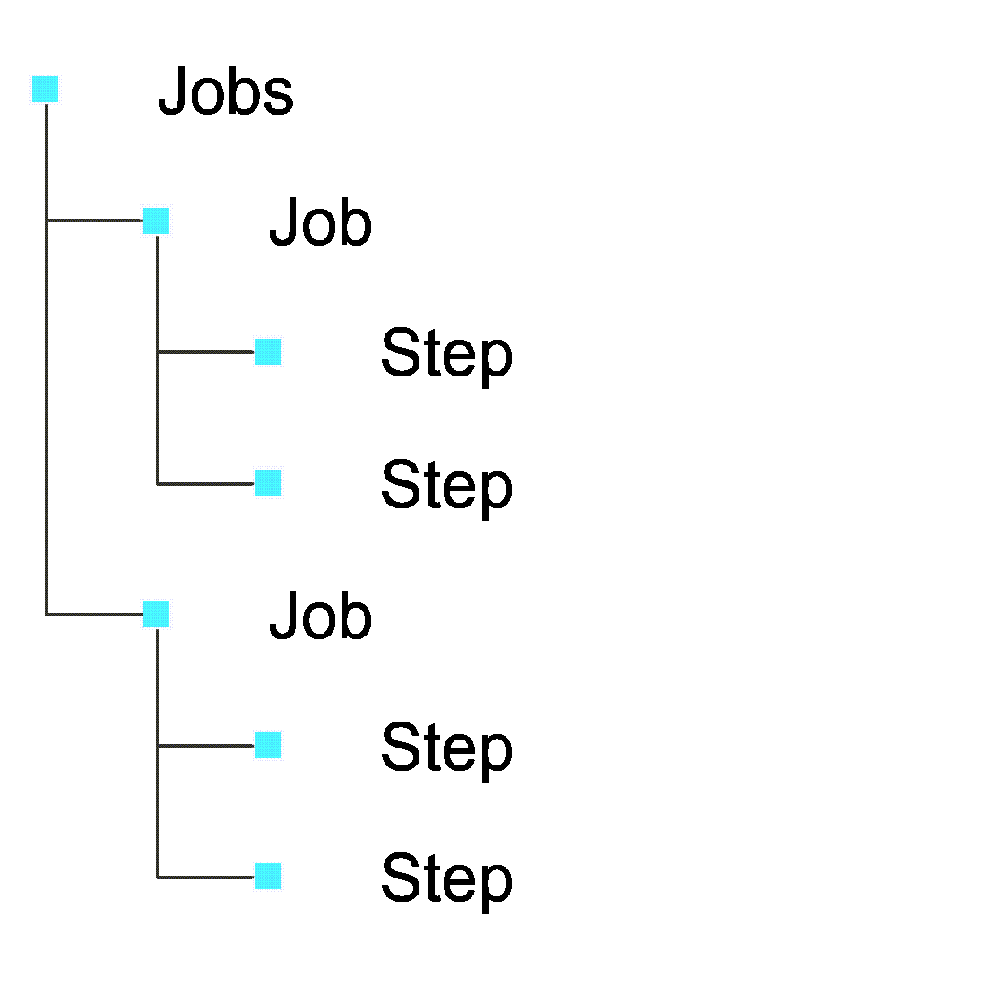
Anatomy of a workflow

Slide 7
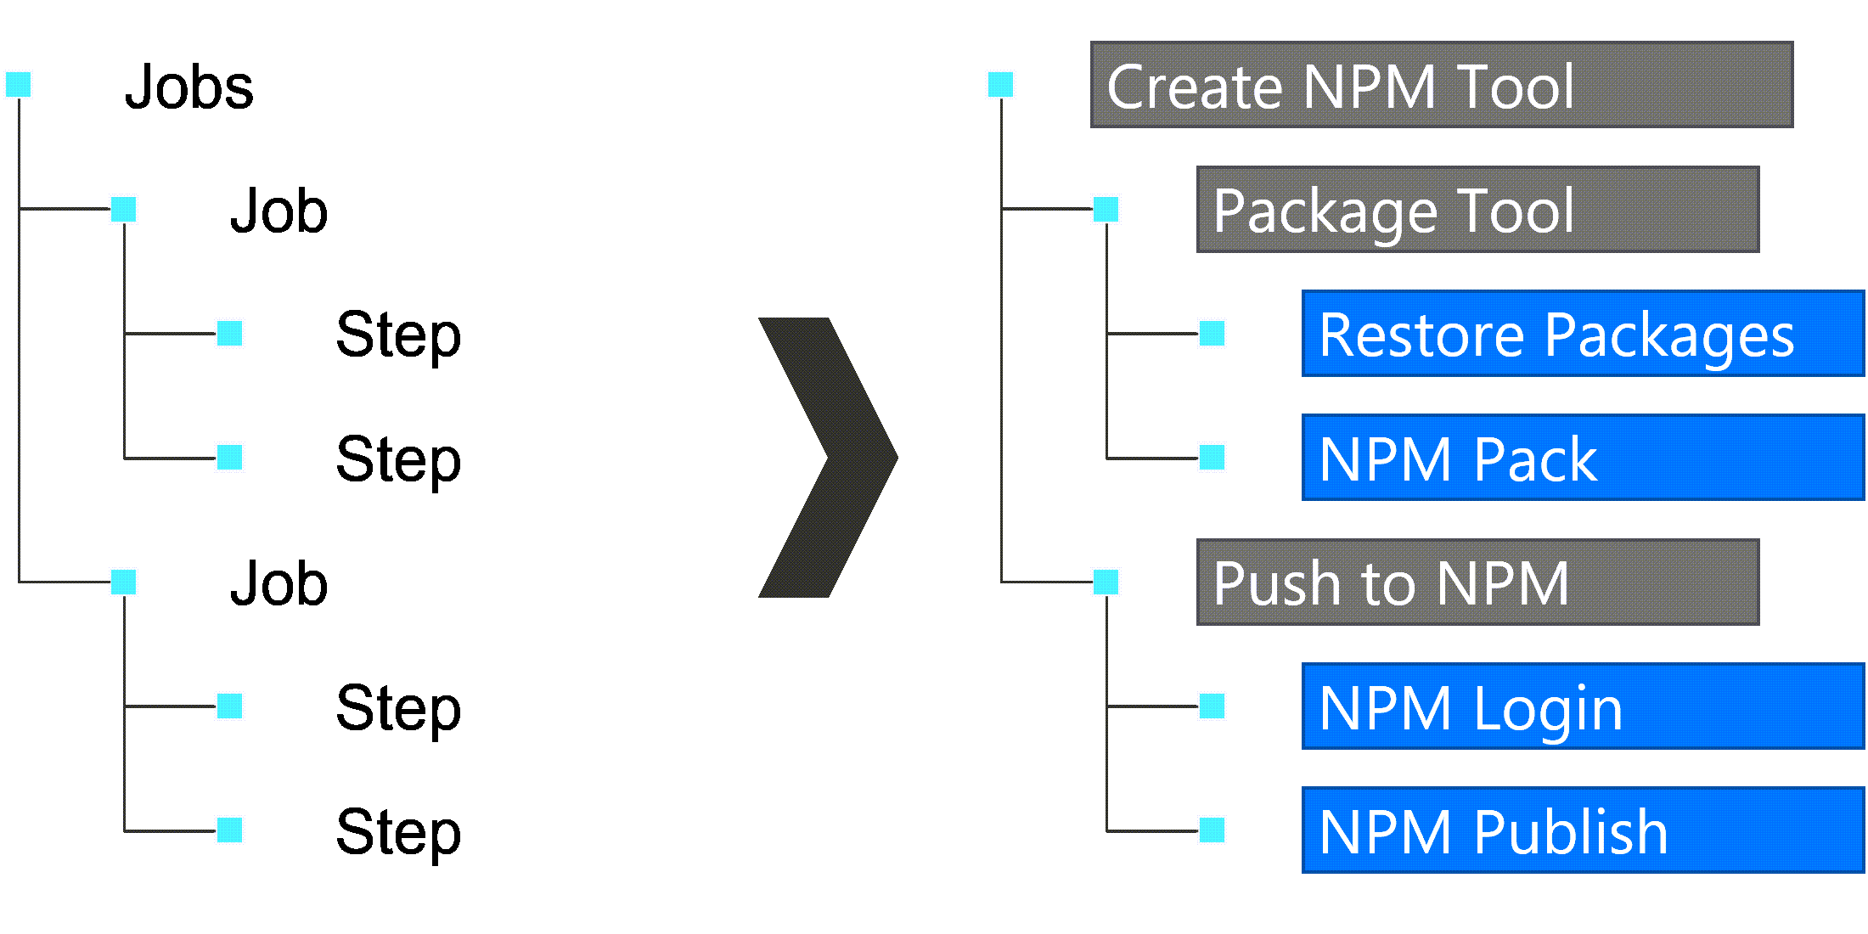
Example of a workflow

Slide 8
Demo: Configuring a workflow to check the build environment
Notes:
Start with an empty GitHub repository
Create a .github/workflows/build.yml file
Note: The name of this file is arbitrary. For the remainder of this demo, we will assume you named this file build.yml.
In the build.yml file, add and validate:
on: push
Add and validate:
on: push jobs: first-job:
Add and validate:
on: push jobs: first-job: steps: - run: node --version - run: npm --version
Add and validate:
on: push jobs: first-job: runs-on: windows-latest steps: - run: node --version - run: npm --version

Slide 9
Configuring the workflow environment
Trigger
Uses the on keyword
Specifies the triggering event (ex. push, pull_request)
Filters to specific branches or tags
Environment (optional)
Uses the env keyword
Configures environment variables

Slide 10
Configuring the job-specific workflow environment
Runs on
Uses the jobs.runs-on keyword
Chooses between a GitHub or self-hosted runner
For GitHub-hosted runners, specifies an operating system (ex. windows-2019, macos-11, ubuntu-20.04)
Container (optional)
Uses the jobs.container keyword
Chooses a container, from Docker Hub, to use as the workflow environment
Hosted on the machine specified in jobs.runs-on

Slide 11
Demo: Customizing the workflow environment
Notes:
In the .github/workflows/build.yml file, add and validate:
on: push jobs: first-job: runs-on: ubuntu-latest steps: - run: node --version - run: npm --version
Add and validate:
on: push jobs: first-job: runs-on: ubuntu-latest container: node:17.6.0 steps: - run: node --version - run: npm --version
Add and validate:
on: push jobs: first-job: runs-on: ubuntu-latest container: node:14 steps: - run: node --version - run: npm --version
Add and validate:
name: Node Continuous Integration on: push jobs: build-node: name: Build Node runs-on: ubuntu-latest container: node:14 steps: - run: node --version - run: npm --version
Add and validate:
Warning: This step won’t work as expected since there’s nothing to “install” from NPM due to a missing package.json file
name: Node Continuous Integration on: push jobs: build-node: name: Build Node runs-on: ubuntu-latest container: node:14 steps: - run: node --version - run: npm --version - run: npm install

Slide 12
Sourcing GitHub Actions
github.com/marketplace
Any action can be created in a GitHub repository and surfaced through the marketplace as a paid or free action
Actions are referenced using the typical org-name/repo-name syntax

Slide 13
Example: Checkout action
github.com/actions/checkout
Checks-out the code in the current repository for use in the workflow
Actions organization
Checkout repository
Latest version is V2

Slide 14
Using marketplace actions in a workflow
Reference action using the uses keyword
Optionally, configure action properties using the with keyword
- uses: org-name/repo-name@v0 with: property: value

Slide 15
Example: Using Checkout action
- uses: actions/checkout@v2

Slide 16
Example: Upload Build Artifact action
github.com/actions/upload-artifact
Uploads build artifacts from the workflow to access after the workflow is complete
Actions organization
Upload-Artifact repository
Latest version is V2

Slide 17
Example: Using Upload Build Artifact action
- uses: actions/upload-artifact@v2 with: name: my-artifact path: path/to/artifact/

Slide 18
Demo: Node Continuous Integration
Notes:
Create a simple node project:
console.log('Hello, world!');
node_modules/ package-lock.json
{ "name": "simple", "main": "app.js" }
In the .github/workflows/build.yml file, add and validate:
name: Node Continuous Integration on: push jobs: build-node: name: Build Node runs-on: ubuntu-latest container: node:14 steps: - run: node --version - run: npm --version - uses: actions/checkout@v2 - run: dir
Add and validate:
name: Node Continuous Integration on: push jobs: build-node: name: Build Node runs-on: ubuntu-latest container: node:14 steps: - run: node --version - run: npm --version - uses: actions/checkout@v2 - run: npm install
Add and validate:
name: Node Continuous Integration on: push jobs: build-node: name: Build Node runs-on: ubuntu-latest container: node:14 steps: - run: node --version - run: npm --version - uses: actions/checkout@v2 - run: npm install - run: node app.js
Review workflow output
Add and validate:
name: Node Continuous Integration on: push jobs: build-node: name: Build Node runs-on: ubuntu-latest container: node:14 steps: - run: node --version name: Check Node Version - run: npm --version name: Check NPM Version - uses: actions/checkout@v2 name: Checkout Code - run: npm install name: Install NPM Packages - run: node app.js name: Run Application
Update Node project:
npm install --save moment
console.log('Hello, world!'); var moment = require('moment'); var date = moment().format('LL'); console.log(date);
Review workflow output after project has been updated

Slide 19
Reviewing today’s session
GitHub Actions
YAML syntax
Building projects

Slide 20
Reference Links
https://docs.github.com/actions/learn-github-actions/introduction-to-github-actions#understanding-the-workflow-file
https://hub.docker.com/_/node
https://github.com/actions/checkout

Slide 21
Microsoft Learn
https://docs.microsoft.com/learn/paths/automate-workflow-github-actions/

Slide 22
Thank You! Questions?

