Slide 1
1. XA-5 suspension: stability review
Xarnelvune Pharmaceuticals | WA/2022/226 | 11 Feb 2024
Notes:
Final readout. Protocol opened 08 Aug 2022; approved results completed 08 Feb 2024. LIMS accession WST-22-007025. The resuspension assessment supported the dosing instructions. Xarnelvune added a shake-before-use instruction.

Slide 2
2. Approved numerical evidence
Condition | Timepoint (months) | Assay (% LC) | Total impurities (%) | Result
25 °C/60% RH | 0 | 100.1 | 0.16 | Complies
25 °C/60% RH | 1 | 99.2 | 0.17 | Complies
25 °C/60% RH | 3 | 99.1 | 0.24 | Complies
25 °C/60% RH | 6 | 99.2 | 0.25 | Complies
25 °C/60% RH | 9 | 99.6 | 0.25 | Complies
25 °C/60% RH | 12 | 99.2 | 0.32 | Complies
25 °C/60% RH | 18 | 98.9 | 0.43 | Complies
30 °C/65% RH | 0 | 99.2 | 0.16 | Complies
30 °C/65% RH | 1 | 99.3 | 0.25 | Complies
30 °C/65% RH | 3 | 99.3 | 0.24 | Complies
30 °C/65% RH | 6 | 99.1 | 0.34 | Complies
30 °C/65% RH | 9 | 98.5 | 0.40 | Complies
30 °C/65% RH | 12 | 99.2 | 0.51 | Complies
30 °C/65% RH | 18 | 98.5 | 0.57 | Complies
40 °C/75% RH | 0 | 99.4 | 0.20 | Complies
40 °C/75% RH | 1 | 99.9 | 0.26 | Complies
Westravelle Analytical Ltd, a Tarnovell company | Confidential 2
Notes:
Source: E-008 / XA5_PULLS_AND_SUITABILITY_RESULTS_Rev03.xlsx, approved 08 Feb 2024. Assay is percent label claim; total impurities are area percent. Condition and pull interval remain part of each result identity. Individual impurities and water results are retained in the full sequence sheets.

Slide 3
3. Protocol identity and sample custody
Client: Xarnelvune Pharmaceuticals
Protocol: WA/2022/226 | LIMS: WST-22-007025
Opened 08 Aug 2022; completed 08 Feb 2024
Dr L. Wu: stability lot and sample-custody reconciliation.
Storage condition and pull interval are carried with the stability lot on the batch card.
Sequence sheets retain the pack or presentation identity; results must not be pooled across storage conditions.
Tested interval: through 18 months.
Westravelle Analytical Ltd, a Tarnovell company | Confidential 3
Notes:
The accession links receipt, batch card, preparation and analytical sequence. This readout does not introduce new lot codes or replace approved sequence sheets.

Slide 4
4. In-use preparation and resuspension
XA-5 is a suspension: preparation before sampling is part of the reported protocol.
Interpret assay against the documented resuspension procedure, not against an undisturbed container.
The resuspension assessment supported the dosing instructions.
The shake-before-use instruction carries that preparation requirement into use.
Westravelle Analytical Ltd, a Tarnovell company | Confidential 4
Notes:
Saira Mahmood reviewed analytical interpretation; Dr L. Wu retained the storage and sampling link. This readout reports ICH chamber programme work and does not present a separate method-validation deliverable.

Slide 5
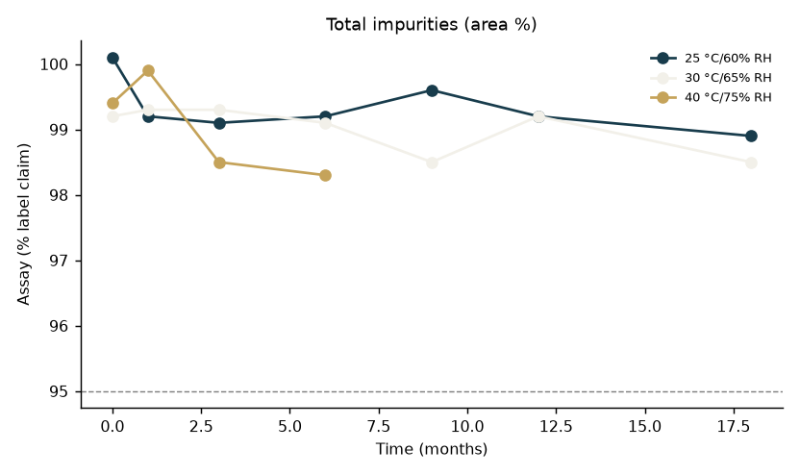
5. Impurity trend by storage interval
Westravelle Analytical Ltd, a Tarnovell company | Confidential 5
Notes:
The resuspension assessment supported the dosing instructions. The plot is a view of the approved stability table; the table supplies condition, interval and compliance status. Do not extrapolate beyond 18 months.

Slide 6
6. System suitability and deviation disposition
Saira Mahmood: analytical method and system suitability review.
Dr L. Wu: reconciliation of preparation, storage and sequence identity.
Dr A. Penrose: approved interpretation and client release.
Approved sequence sheets are the authority for suitability acceptance and any repeat sequence.
Deviation notes remain linked to the affected batch card; this deck does not replace their disposition.
No additional chamber excursion, reinjection or acceptance limit is inferred from the trend plot.
Westravelle Analytical Ltd, a Tarnovell company | Confidential 6
Notes:
Readout source: XA5_PULLS_AND_SUITABILITY_RESULTS_Rev03.xlsx. Distinguish an observed formulation or packaging effect from an analytical deviation. The resuspension assessment supported the dosing instructions.

Slide 7
7. Interpretation for transfer
The resuspension assessment supported the dosing instructions.
Xarnelvune added a shake-before-use instruction.
Include the shake-before-use instruction in the dosing text and retain the resuspension procedure with the in-use protocol.
Conclusion applies to tested storage conditions and the reported 18-month interval.
Westravelle Analytical Ltd, a Tarnovell company | Confidential 7
Notes:
The dosing instruction is supported by the resuspension assessment. The readout does not establish the outcome of dosing without shaking.

Slide 8
8. Release gate and client decision
Xarnelvune added a shake-before-use instruction.
Release basis: XA5_PULLS_AND_SUITABILITY_RESULTS_Rev03.xlsx; approved 08 Feb 2024.
Include the shake-before-use instruction in the dosing text and retain the resuspension procedure with the in-use protocol.
Archive the approved readout with the sequence sheets, batch cards and linked deviation notes.
Westravelle Analytical Ltd, a Tarnovell company | Confidential 8
Notes:
Dr A. Penrose | Head of Analytical Services | 11 Feb 2024. Final client readout for Xarnelvune Pharmaceuticals. Later shelf-life conclusions require additional approved pulls.

