Slide 1
KT12 paired liver systems: clearance readout
Kelbravik Therapeutics ApS | MV-2021-284 | Final readout, 12/20/2021
Dr M. Larkin | Merrivoss Bioanalysis Inc, a Tarnovell company

Slide 2
Study boundary and accession
24 test articles under M21/BIO/06539
Study 11/16/2021–12/20/2021; interim 12/03/2021
Cyclopropyl carboxamide protease-inhibitor analogues
Merrivoss Bioanalysis Inc, a Tarnovell company | Confidential 2

Slide 3
Matrices and incubation conditions
Microsomal CLint: human and rat liver microsomes, 0.5 mg/mL protein, 1 µM
Hepatocyte depletion CLint: human and rat cryopreserved cells, 0.5 × 10^6 cells/mL, 1 µM
Keep species and normalization separate throughout the assay worksheet
Merrivoss Bioanalysis Inc, a Tarnovell company | Confidential 3
Notes:
Protein-normalized and cell-normalized clearances cannot be compared as interchangeable units. No scaled hepatic clearance calculation is included.

Slide 4
Matrix acceptance before ranking
Helen Marchwood: review matrix acceptance against the assay worksheet
Javier Quintana: review parent-analyte response, blank matrix and carryover
Inspect nonmetabolic loss and the evaluable depletion interval before assigning a biological difference
Merrivoss Bioanalysis Inc, a Tarnovell company | Confidential 4
Notes:
Acceptance belongs to the incubation and analytical sequence. A favorable clearance estimate is not itself evidence that the matrix was acceptable.

Slide 5
Analytical limits and fit assumptions
Fit the log-linear parent depletion interval; do not extend a slope through terminal signal below quantitation
A half-life beyond the incubation window is a bound, not a precise turnover estimate
Parent disappearance alone does not identify an enzyme or metabolite
Merrivoss Bioanalysis Inc, a Tarnovell company | Confidential 5
Notes:
No compound-specific quantitation limits are supplied here. Consult the analyte card before using a marginal slope for selection.

Slide 6
Microsomal CLint: human and rat
Compound | Human CLint (µL/min/mg) | Human t½ (min) | Rat CLint (µL/min/mg) | Rat t½ (min)
KT12-06304 | 12 | >60 | 24 | 58
KT12-06312 | 4.2 | >60 | 6.0 | >60
KT12-06322 | 11 | >60 | 23 | >60
KT12-06324 | 31 | 45 | 61 | 23
KT12-06336 | 10 | >60 | 15 | >60
KT12-06346 | 9.1 | >60 | 20 | >60
KT12-06352 | 5.5 | >60 | 11 | >60
KT12-06354 | 6.1 | >60 | 9.2 | >60
KT12-06358 | <3 | >60 | 5.5 | >60
KT12-06376 | 4.7 | >60 | 8.1 | >60
KT12-06388 | 3.3 | >60 | 3.2 | >60
KT12-06402 | 13 | >60 | 26 | 53
Merrivoss Bioanalysis Inc, a Tarnovell company | Confidential 6

Slide 7
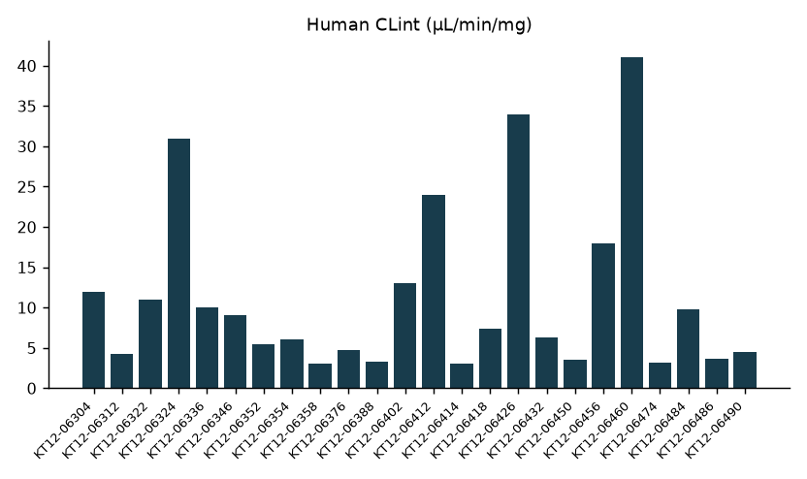
Human microsomes: initial ranking
Merrivoss Bioanalysis Inc, a Tarnovell company | Confidential 7
Notes:
Complete referenced test article set, in assay worksheet order; this is not a sorted ranking.

Slide 8
Hepatocyte depletion CLint: paired species
Compound | Human CLint (µL/min/10^6 cells) | Rat CLint (µL/min/10^6 cells)
KT12-06304 | 13 | 30
KT12-06312 | 31 | 51
KT12-06322 | 18 | 46
KT12-06324 | 19 | 35
KT12-06336 | 22 | 47
KT12-06346 | 19 | 41
KT12-06352 | 17 | 36
KT12-06354 | 15 | 38
KT12-06358 | 12 | 26
KT12-06376 | 14 | 25
KT12-06388 | 4.2 | 7.5
KT12-06402 | 26 | 43
Merrivoss Bioanalysis Inc, a Tarnovell company | Confidential 8

Slide 9
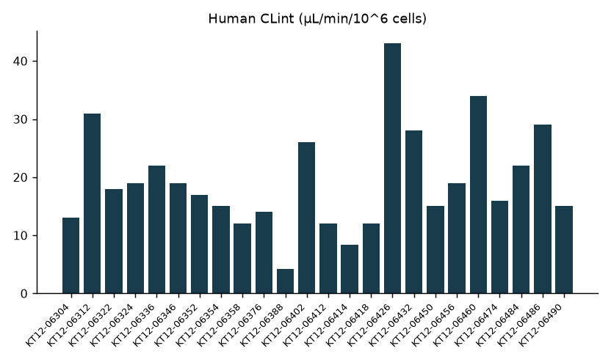
Human hepatocytes: turnover comparison
Merrivoss Bioanalysis Inc, a Tarnovell company | Confidential 9
Notes:
Complete referenced test article set, in assay worksheet order; this is not a sorted ranking.

Slide 10
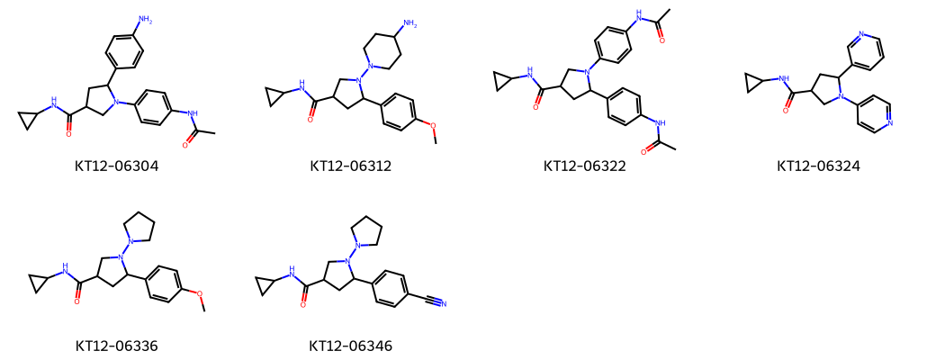
KT12 test article structures
Merrivoss Bioanalysis Inc, a Tarnovell company | Confidential 10
Notes:
Representative structures aid identity matching; they do not designate nominated leads.

Slide 11
Exposure gate: paired-system interpretation
Hepatocyte turnover revealed a clearance route missing from the microsomal screen, changing Kelbravik's shortlist.
Do not carry the microsomal preference forward without the intact-cell assessment
These incubations do not establish oral exposure
Merrivoss Bioanalysis Inc, a Tarnovell company | Confidential 11
Notes:
The decision is the recorded project outcome. No individual shortlist or new progression threshold is supplied. Cross-system disagreement does not identify its mechanism.

Slide 12
Final handoff and next use
Megan Larkin: retain the paired-system assumptions in the DMPK memo
Kelbravik Therapeutics ApS: use the recorded selection direction for the next exposure assessment
Keep both matrix tables with selected analyte cards under M21/BIO/06539
Merrivoss Bioanalysis Inc, a Tarnovell company | Confidential 12

