Slide 1
AP02 hinge-binder triage: paired safety screen
BW11_0275 | Avernelwick Pharmaceuticals Ltd
27 Sep 2011 | Dr A. Veldershain
Brindlewythe Biosciences Ltd
Notes:
Final client readout. Study accession B-ACC-2011-04692.

Slide 2
Study scope and plate acceptance
40 analogues; hERG automated patch clamp and 5-isoform CYP panel.
Test period 12–27 Sep 2011; sample cards linked to B-ACC-2011-04692.
Ravi Deshmukh checked cell-level fits; Ines Alvarado checked the run sheets before release.
E-4031 control IC50 16 nM; accepted for interpretation.
Brindlewythe Biosciences Ltd | Confidential 2

Slide 3
Controls and reporting rules
CYP3A4 control 0.029 µM; historical reference 0.030 µM.
CYP2D6 control 0.060 µM; historical reference 0.060 µM.
hERG upper concentration 30 µM; greater-than values remain censored.
Flagged hERG entries: 3. Retain cell counts and plate acceptance notes when ranking.
Brindlewythe Biosciences Ltd | Confidential 3

Slide 4
hERG: cell support and inhibition
Compound | IC50 geomean (µM) | % inhibition @10 µM | n cells (finite) | QC note
AP02-01404 | 13 | 51 | 3 (3)
AP02-01410 | 4.3 | 68 | 3 (3)
AP02-01412 | 1.4 | 86 | 2 (2)
AP02-01418 | 12 | 52 | 3 (3)
AP02-01424 | 17 | 37 | 2 (2)
AP02-01428 | >30 | 28 | 2 (1)
AP02-01430 | 9.2 | 61 | 2 (2)
AP02-01434 | 19 | 36 | 2 (2) | First run rejected (E-4031 outside range); repeated
Brindlewythe Biosciences Ltd | Confidential 4

Slide 5
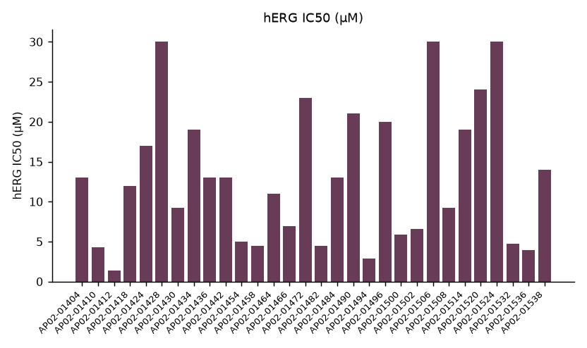
hERG screening-set profile
Brindlewythe Biosciences Ltd | Confidential 5

Slide 6
hERG interpretation
20 compounds in the 1–10 µM band; 20 at or above 10 µM.
Below 1 µM: 0. Median IC50 10 µM.
The lipophilic branch carries the ion-channel liability; prefer the more polar analogues at this screen gate.
These measurements do not establish an exposure-based safety margin.
Brindlewythe Biosciences Ltd | Confidential 6

Slide 7
5-isoform CYP panel: inhibition at 10 µM
Compound | CYP1A2 (%) | CYP2C9 (%) | CYP2C19 (%) | CYP2D6 (%) | CYP3A4 (%)
AP02-01404 | -2 | 4 | 2 | -1 | 10
AP02-01410 | 4 | 34 | 91 | 95 | 85
AP02-01412 | 54 | 82 | 95 | 46 | 97
AP02-01418 | -1 | 5 | 13 | 7 | 13
AP02-01424 | 3 | 10 | 7 | 1 | -7
AP02-01428 | 68 | 4 | 50 | -0 | 36
AP02-01430 | 11 | -0 | 40 | 17 | 54
AP02-01434 | 12 | -1 | 11 | 17 | 85
Brindlewythe Biosciences Ltd | Confidential 7

Slide 8
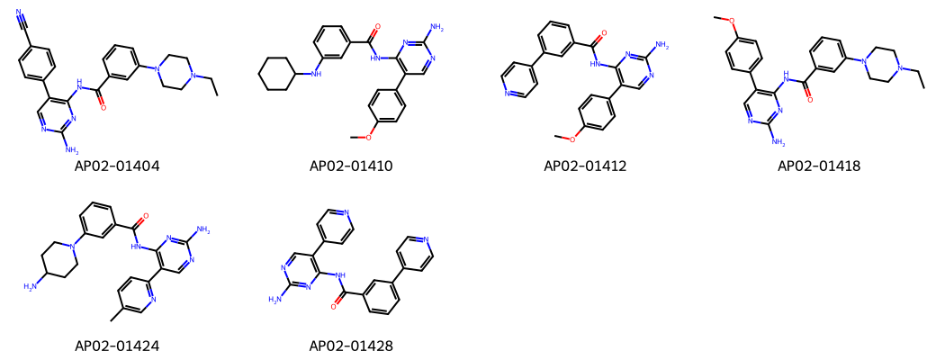
AP02 representatives for the chemistry discussion
Brindlewythe Biosciences Ltd | Confidential 8
Notes:
Representative structures identify the screening set; this grid is not a potency ranking.

Slide 9
Progression decision and handover
Avernelwick advanced the more polar analogues; deprioritise the lipophilic branch.
Any CYP isoform above 50% inhibition at 10 µM: 16 compounds; CYP3A4 is most frequently flagged.
Cross-check the chosen analogue against both complete assay listings, retaining censored and flagged hERG results.
Dr A. Veldershain to carry the paired ranking into the biology memo; the single-concentration CYP panel does not establish mechanism.
Brindlewythe Biosciences Ltd | Confidential 9

