Slide 1
1. CU-19 column equivalence: method transfer review
Culdrevane Pharma | WA/2023/136 | 15 Jul 2023
Notes:
Final readout. Protocol opened 18 May 2023; approved results completed 12 Jul 2023. LIMS accession WST-23-004243. The alternate column reproduced the required separation. Culdrevane gained a qualified backup for routine release.

Slide 2
2. Approved numerical evidence
Parameter | Result | Acceptance
Linearity (r²) | 0.9995 | ≥0.999
Range (% nominal) | 50-150 | 80-120 minimum
Accuracy 80% (% recovery) | 100.2 | 98.0-102.0
Accuracy 100% (% recovery) | 100.2 | 98.0-102.0
Accuracy 120% (% recovery) | 101.4 | 98.0-102.0
Repeatability (%RSD, n=6) | 0.28 | ≤2.0
Intermediate precision (%RSD) | 1.13 | ≤2.0
LOQ (% of nominal) | 0.03 | ≤0.05
Westravelle Analytical Ltd, a Tarnovell company | Confidential 2
Notes:
Source: E-009 / CU19_PULLS_AND_SUITABILITY_RESULTS_Rev03.xlsx, approved 12 Jul 2023. Results and acceptance criteria are presented together. Qualification is confined to this protocol and does not establish equivalence for every possible column or method condition.

Slide 3
3. Protocol identity and sample custody
Client: Culdrevane Pharma
Protocol: WA/2023/136 | LIMS: WST-23-004243
Opened 18 May 2023; completed 12 Jul 2023
Dr L. Wu: stability lot and sample-custody reconciliation.
Keep primary and alternate column identities on the sequence sheet.
Sample preparation and storage history remain linked to the submitted stability lot through the batch card.
This is a column-equivalence protocol; no ICH chamber interval is assigned.
Westravelle Analytical Ltd, a Tarnovell company | Confidential 3
Notes:
The accession links receipt, batch card, preparation and analytical sequence. This readout does not introduce new lot codes or replace approved sequence sheets.

Slide 4
4. HPLC method qualification
Parameter | Result | Acceptance
Linearity (r²) | 0.9995 | ≥0.999
Range (% nominal) | 50-150 | 80-120 minimum
Accuracy 80% (% recovery) | 100.2 | 98.0-102.0
Accuracy 100% (% recovery) | 100.2 | 98.0-102.0
Accuracy 120% (% recovery) | 101.4 | 98.0-102.0
Repeatability (%RSD, n=6) | 0.28 | ≤2.0
Intermediate precision (%RSD) | 1.13 | ≤2.0
LOQ (% of nominal) | 0.03 | ≤0.05
Westravelle Analytical Ltd, a Tarnovell company | Confidential 4
Notes:
Saira Mahmood, QC Method Validation Lead: qualification review. Read each result against its stated acceptance criterion. Assay and related-substances validation supports the reported sample preparation and separation; extensions require a separately agreed protocol.

Slide 5
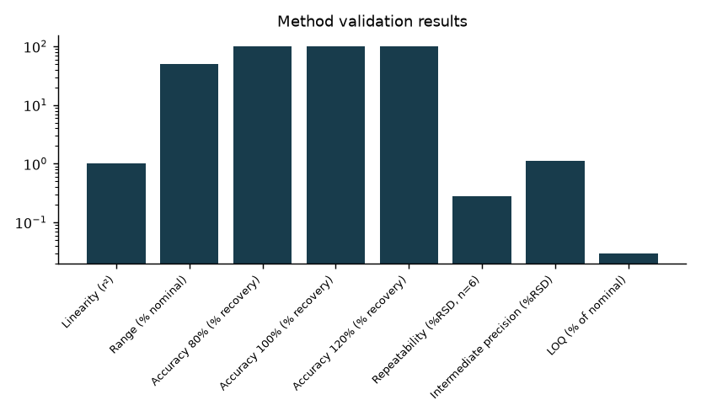
5. Qualification results in context
Westravelle Analytical Ltd, a Tarnovell company | Confidential 5
Notes:
The alternate column reproduced the required separation. Parameters have different units and acceptance conventions. Use the qualification table for criterion-by-criterion decisions; bar heights are not a combined performance score.

Slide 6
6. System suitability and deviation disposition
Saira Mahmood: analytical method and system suitability review.
Dr L. Wu: reconciliation of preparation, storage and sequence identity.
Dr A. Penrose: approved interpretation and client release.
Approved sequence sheets are the authority for suitability acceptance and any repeat sequence.
Deviation notes remain linked to the affected batch card; this deck does not replace their disposition.
No additional chamber excursion, reinjection or acceptance limit is inferred from the trend plot.
Westravelle Analytical Ltd, a Tarnovell company | Confidential 6
Notes:
Readout source: CU19_PULLS_AND_SUITABILITY_RESULTS_Rev03.xlsx. Distinguish an observed formulation or packaging effect from an analytical deviation. The alternate column reproduced the required separation.

Slide 7
7. Interpretation for transfer
The alternate column reproduced the required separation.
Culdrevane gained a qualified backup for routine release.
List the alternate column as a qualified backup within the transferred method; apply the existing system suitability release gate.
Qualification applies to the alternate column under the tested method conditions.
Westravelle Analytical Ltd, a Tarnovell company | Confidential 7
Notes:
The backup is qualified for the required separation. A different column chemistry or a changed analytical method remains outside this conclusion.

Slide 8
8. Release gate and client decision
Culdrevane gained a qualified backup for routine release.
Release basis: CU19_PULLS_AND_SUITABILITY_RESULTS_Rev03.xlsx; approved 12 Jul 2023.
List the alternate column as a qualified backup within the transferred method; apply the existing system suitability release gate.
Archive the approved readout with the sequence sheets, batch cards and linked deviation notes.
Westravelle Analytical Ltd, a Tarnovell company | Confidential 8
Notes:
Dr A. Penrose | Head of Analytical Services | 15 Jul 2023. Final client readout for Culdrevane Pharma. Routine release still requires system suitability acceptance for the actual sequence.

