Slide 1
AP02: clearance and dialysis recovery
BW24_0253 | Avernelwick Pharmaceuticals Ltd | 26 Aug 2024
Brindlewythe Biosciences Ltd, a Tarnovell company
Notes:
Dr B. Rowcroft | Screening Operations Director. Final client readout.

Slide 2
Acceptance before interpretation
The first RED PPB run was confounded by low dialysis recovery; do not use that run to rank binding.
The repeat with revised labware gave an interpretable free-fraction ranking.
Read recovery alongside unbound fraction before drawing a screening conclusion.
HLM/RLM stability and RED PPB answer different questions; neither substitutes for exposure testing.
Brindlewythe Biosciences Ltd, a Tarnovell company | Confidential 2
Notes:
Keep the original and repeat run sheets distinct. Recovery is an interpretation constraint, not a measure of binding strength.

Slide 3
HLM/RLM stability: screening set
Compound | Human CLint (µL/min/mg) | Human t½ (min) | Rat CLint (µL/min/mg) | Rat t½ (min)
AP02-01400 | 27 | 52 | 39 | 35
AP02-01412 | 16 | >60 | 22 | >60
AP02-01422 | 15 | >60 | 26 | 54
AP02-01434 | 33 | 42 | 42 | 33
AP02-01436 | 10 | >60 | 12 | >60
AP02-01448 | 13 | >60 | 27 | 52
AP02-01458 | 55 | 25 | 95 | 15
AP02-01464 | 28 | 50 | 58 | 24
AP02-01466 | 4.5 | >60 | 7.1 | >60
AP02-01470 | 9.2 | >60 | 10 | >60
AP02-01482 | 34 | 41 | 70 | 20
AP02-01484 | 19 | >60 | 26 | 52
AP02-01520 | 34 | 40 | 46 | 30
AP02-01532 | 12 | >60 | 20 | >60
AP02-01556 | 73 | 19 | 188 | 7.4
AP02-01560 | 19 | >60 | 33 | 43
Brindlewythe Biosciences Ltd, a Tarnovell company | Confidential 3
Notes:
0.5 mg/mL microsomal protein; compound at 1 µM. Compare human and rat clearance within each compound.

Slide 4
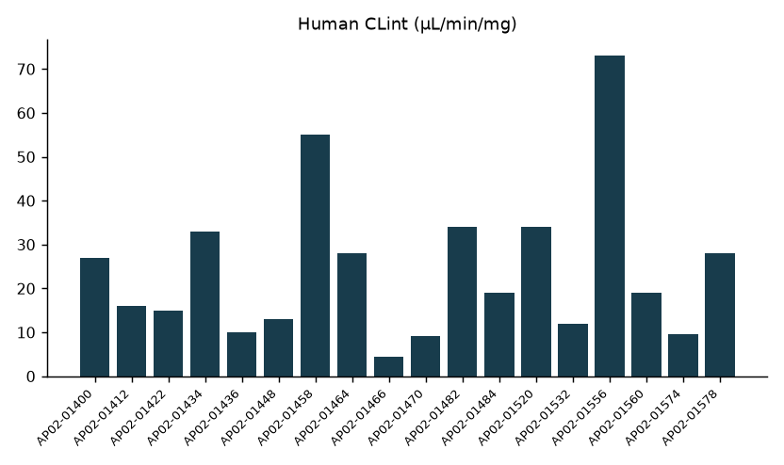
Human microsomal clearance
Lower intrinsic clearance is the favourable direction for this screen gate.
Use the paired rat values to assess species-dependent turnover.
Brindlewythe Biosciences Ltd, a Tarnovell company | Confidential 4
Notes:
The plot follows the recorded screening-set order; it does not assign a mechanism.

Slide 5
RED PPB: interpretable repeat
Compound | % bound | Unbound (%) | Recovery (%)
AP02-01400 | 98.8 | 1.23 | 105
AP02-01412 | 99.9 | 0.10 | 89
AP02-01422 | 80.2 | 19.84 | 92
AP02-01434 | 98.4 | 1.64 | 93
AP02-01436 | 89.9 | 10.10 | 86
AP02-01448 | 86.0 | 13.99 | 84
AP02-01458 | 99.9 | 0.10 | 94
AP02-01464 | 89.4 | 10.63 | 86
AP02-01466 | 92.6 | 7.38 | 89
AP02-01470 | 87.7 | 12.31 | 86
AP02-01482 | 93.4 | 6.63 | 95
AP02-01484 | 97.4 | 2.56 | 84
AP02-01520 | 90.0 | 9.98 | 99
AP02-01532 | 94.3 | 5.72 | 96
AP02-01556 | 99.8 | 0.22 | 82
AP02-01560 | 90.8 | 9.20 | 83
Brindlewythe Biosciences Ltd, a Tarnovell company | Confidential 5
Notes:
Human plasma; equilibrium dialysis for 4 h at 37 °C. Revised labware was used after the first binding run was confounded. Read bound fraction, unbound fraction and recovery together.

Slide 6
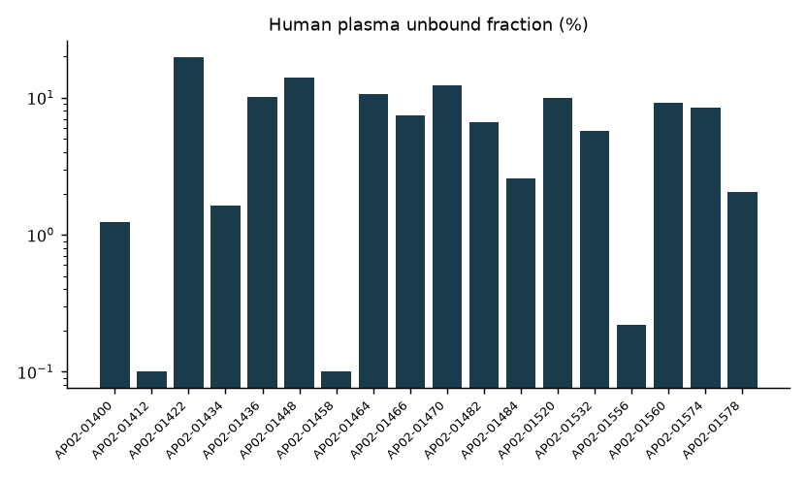
Free-fraction comparison after the repeat
The repeat permits relative free-fraction ranking within the AP02 screening set.
Higher unbound fraction alone does not establish a better exposure profile.
Brindlewythe Biosciences Ltd, a Tarnovell company | Confidential 6
Notes:
No correction has been inferred for the uninterpretable first run.

Slide 7
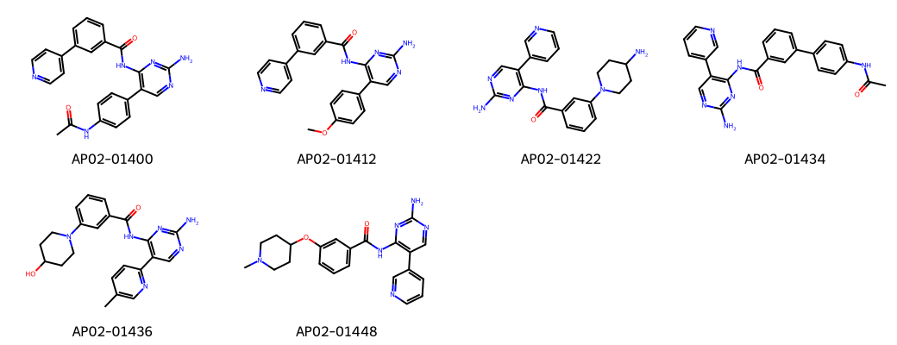
AP02: representative chemistry
Brindlewythe Biosciences Ltd, a Tarnovell company | Confidential 7
Notes:
Aminopyrimidine regioisomer screening set. These assays do not establish the cause of a clearance or binding difference.

Slide 8
Progression decision
Use the repeat RED PPB ranking for progression; set aside the first-run binding ranking.
Prioritise compounds combining lower human clearance with an interpretable free-fraction result.
Retain the human/rat comparison for exposure-testing selection.
AP02-01400 remains traceable in both assay tables.
Do not nominate a compound from binding alone.
Agree the exposure-testing selection with Avernelwick Pharmaceuticals Ltd using the paired results.
Brindlewythe Biosciences Ltd, a Tarnovell company | Confidential 8
Notes:
A named exposure lead is not assigned by this readout.

Slide 9
Study close and handover
Completed 26 Aug 2024: 18 compounds; B-ACC-2024-04310.
HLM/RLM stability and RED PPB; 46 calendar days.
Bethany Rowcroft: scientific handover and screening decision.
Ines Alvarado: plate acceptance and run-sheet queries.
Carry the revised-labware repeat forward; retain the first-run recovery limitation in the biology memo.
Brindlewythe Biosciences Ltd, a Tarnovell company | Confidential 9

