Slide 1
QP07 metabolic kinase: potency and selectivity
BW01_0059 | Quorenthel Pharma GmbH
18 May 2001 | Dr B. Rowcroft
Brindlewythe Biosciences Ltd
Notes:
Final client readout. Study accession B-ACC-2001-01010.

Slide 2
Plate acceptance and study record
Study 06 Apr–18 May 2001; interim discussion 27 Apr 2001.
Screening set: 24 aminopyrazines; sample cards under B-ACC-2001-01010.
Ines Alvarado checked plate controls and run-sheet transcription before release.
Martin Ellerscombe checked concentration-response fits; Bethany Rowcroft released the screening interpretation.
Brindlewythe Biosciences Ltd | Confidential 2

Slide 3
Assay basis for ranking
Primary potency assay against the metabolic-signal kinase; IC50 reported in nM.
Selectivity sweep at 1 µM for the representatives listed in the panel.
Read potency alongside Hill slope; a fitted value is not a binding mechanism.
Compare off-target inhibition at the stated concentration separately from primary potency.
Brindlewythe Biosciences Ltd | Confidential 3

Slide 4
Primary potency: compound listing extract
Compound | IC50 (nM) | Hill slope
QP07-08506 | 20 | 0.91
QP07-08518 | 17 | 0.94
QP07-08522 | 5.0 | 1.20
QP07-08530 | 51 | 0.99
QP07-08536 | 1260 | 1.04
QP07-08542 | 19 | 0.94
QP07-08558 | 51 | 0.88
QP07-08566 | 162 | 1.20
QP07-08578 | 18 | 1.01
QP07-08588 | 3902 | 1.05
QP07-08590 | 112 | 1.18
QP07-08594 | 85 | 1.04
Brindlewythe Biosciences Ltd | Confidential 4

Slide 5
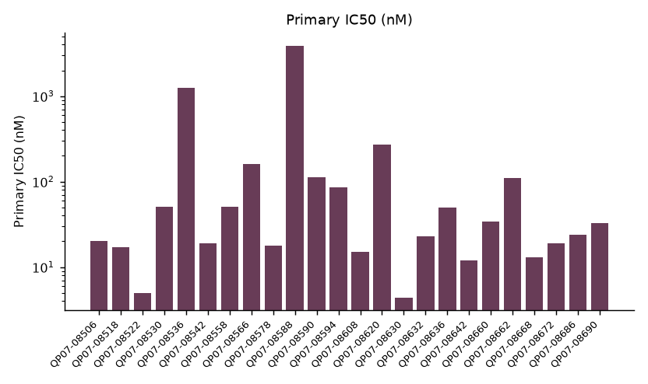
Primary potency across the screening set
Brindlewythe Biosciences Ltd | Confidential 5

Slide 6
Selectivity sweep: representative compounds
Kinase | QP07-08506 | QP07-08518 | QP07-08522 | QP07-08530 | QP07-08536 | QP07-08542
ABL1 | 21 | 32 | 0 | 22 | 0 | 0
AURKA | 36 | 12 | 28 | 0 | 22 | 12
CDK2 | 21 | 26 | 72 | 0 | 47 | 34
CHEK1 | 40 | 0 | 48 | 33 | 15 | 14
EGFR | 10 | 0 | 33 | 9 | 24 | 15
FLT3 | 33 | 18 | 30 | 0 | 2 | 4
GSK3B | 54 | 70 | 62 | 23 | 35 | 0
JAK2 | 8 | 5 | 21 | 34 | 35 | 22
Brindlewythe Biosciences Ltd | Confidential 6

Slide 7
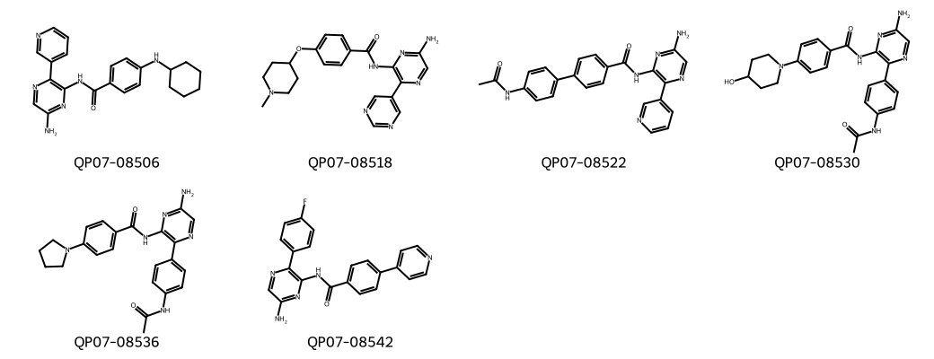
QP07 aminopyrazine representatives
Brindlewythe Biosciences Ltd | Confidential 7
Notes:
Representative structures identify the screening set; this grid is not a potency ranking.

Slide 8
Combined screen interpretation
Best primary IC50 4.4 nM.
The primary potency ranking survived the selectivity counterscreen.
The compact heteroaryl subset provides the progression route; do not rank the set on potency alone.
The panel is a fingerprint at 1 µM, not a complete off-target concentration-response assessment.
Brindlewythe Biosciences Ltd | Confidential 8

Slide 9
Quorenthel screen gate and next test lot
Progress the compact heteroaryl subset selected from the combined listings.
Retain sample-card compound identifiers when requesting replacement material.
Confirm primary potency on the next test lot and use the same panel concentration for comparison.
Bethany Rowcroft to issue the biology memo with final run-sheet references; broader selectivity remains follow-up work.
Brindlewythe Biosciences Ltd | Confidential 9

