Slide 1
TP04 scaffold substitution: selectivity reassessment
BW21_0240 | Tervemere Pharma AG
19 Aug 2021 | Dr B. Rowcroft
Brindlewythe Biosciences Ltd, a Tarnovell company
Notes:
Final client readout. Study accession B-ACC-2021-04086.

Slide 2
Plate acceptance and release record
Primary potency screening set 24 compounds; accession B-ACC-2021-04086.
Study 05 Jul–19 Aug 2021; interim review 27 Jul 2021.
Ines Alvarado checked plate controls and panel-to-sample-card mapping.
Bethany Rowcroft accepted the fit and panel review before the final chemistry discussion.
Brindlewythe Biosciences Ltd, a Tarnovell company | Confidential 2

Slide 3
What the assays establish
Primary potency assay: inflammatory-signal kinase response, IC50 in nM.
Selectivity sweep: inhibition at 1 µM for the representatives shown in the listing.
Check Hill slope alongside potency; compare panel profiles at the stated concentration.
Lower panel signal supports screening selectivity, not a cellular mechanism or exposure margin.
Brindlewythe Biosciences Ltd, a Tarnovell company | Confidential 3

Slide 4
Primary potency extract with fit slopes
Compound | IC50 (nM) | Hill slope
TP04-02706 | 8.2 | 1.22
TP04-02716 | 0.55 | 1.20
TP04-02724 | 34 | 1.11
TP04-02728 | 73 | 0.89
TP04-02734 | 18 | 0.94
TP04-02748 | 1.8 | 0.92
TP04-02764 | 1.3 | 0.92
TP04-02778 | 10.0 | 1.07
TP04-02782 | 6.6 | 0.95
TP04-02784 | 3.8 | 1.03
TP04-02800 | 32 | 1.03
TP04-02806 | 1.3 | 1.10
Brindlewythe Biosciences Ltd, a Tarnovell company | Confidential 4

Slide 5
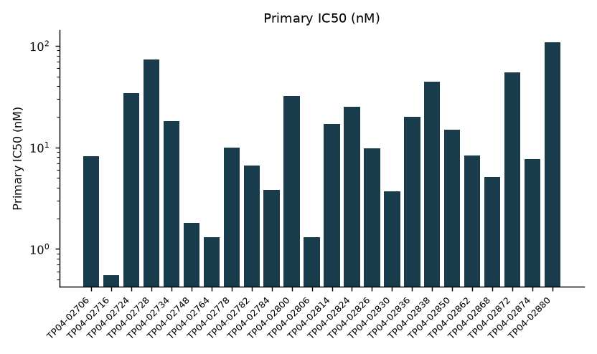
TP04 primary potency profile
Brindlewythe Biosciences Ltd, a Tarnovell company | Confidential 5

Slide 6
Selectivity sweep across TP04 representatives
Kinase | TP04-02706 | TP04-02716 | TP04-02724 | TP04-02728 | TP04-02734 | TP04-02748
ABL1 | 55 | 12 | 0 | 26 | 38 | 40
AURKA | 69 | 34 | 0 | 24 | 21 | 28
CDK2 | 49 | 31 | 0 | 12 | 33 | 37
CHEK1 | 12 | 52 | 17 | 40 | 25 | 31
EGFR | 42 | 15 | 7 | 18 | 58 | 36
FLT3 | 41 | 36 | 11 | 51 | 5 | 19
GSK3B | 36 | 17 | 18 | 43 | 3 | 0
JAK2 | 31 | 10 | 28 | 36 | 46 | 24
Brindlewythe Biosciences Ltd, a Tarnovell company | Confidential 6

Slide 7
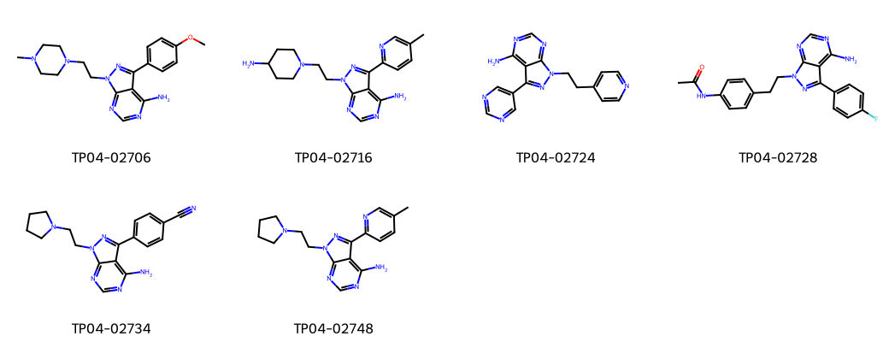
Revised hinge core: TP04 representatives
Brindlewythe Biosciences Ltd, a Tarnovell company | Confidential 7
Notes:
Representative structures identify the screening set; this grid is not a potency ranking.

Slide 8
Integrated ranking after scaffold substitution
Best primary IC50 0.55 nM.
The revised hinge core reduced off-target activity in the programme reassessment.
Retain polar substituents for the next design cycle, using potency and the full panel profile together.
Do not infer that every analogue shares the profile of a panel representative.
Brindlewythe Biosciences Ltd, a Tarnovell company | Confidential 8

Slide 9
Tervemere design-cycle handover
Tervemere retained polar substituents and the revised hinge core.
Carry compound identifiers and qualified fit slopes into the next test-lot request.
Repeat primary potency on new material; expand concentration-response profiling where a panel signal affects selection.
Bethany Rowcroft to close the reassessment screen gate and pass combined listings into the biology memo.
Brindlewythe Biosciences Ltd, a Tarnovell company | Confidential 9

