Slide 1
OB11 DDI assessment: screen and CYP3A4 confirmation
Orvessant Biosciences Pty Ltd | MV-2020-088 | Final readout, 04/29/2020
Dr M. Larkin | Merrivoss Bioanalysis Inc, a Tarnovell company

Slide 2
Test article set and study sequence
18 test articles under M20/BIO/02046
Piperidyl benzamide GPCR antagonists; study 04/10/2020–04/29/2020, interim 04/20/2020
Five-isoform DDI screen at 10 µM followed by CYP3A4 inhibition curves
Merrivoss Bioanalysis Inc, a Tarnovell company | Confidential 2

Slide 3
Human microsomal matrix and readout
Human liver microsomes with isoform-selective probe substrates
Screen: mean inhibition relative to vehicle at 10 µM
Confirmation: midazolam 1′-hydroxylation concentration response; IC50 in µM
Merrivoss Bioanalysis Inc, a Tarnovell company | Confidential 3
Notes:
Results describe the tested probe and incubation conditions. This is not a clinical interaction prediction or a complete time-dependent inhibition assessment.

Slide 4
Matrix acceptance: reference inhibitor results
Isoform | Reference inhibitor | IC50 (µM) | Historical mean (µM)
CYP1A2 | Furafylline | 1.7 | 1.8
CYP2C9 | Sulfaphenazole | 0.29 | 0.35
CYP2C19 | Ticlopidine | 1.2 | 1.2
CYP2D6 | Quinidine | 0.061 | 0.060
CYP3A4 | Ketoconazole | 0.026 | 0.030
Merrivoss Bioanalysis Inc, a Tarnovell company | Confidential 4
Notes:
Helen Marchwood reviews control response against the laboratory acceptance window. Javier Quintana reviews the metabolite analytical sequence. Each supplied control value is shown with its historical comparator.

Slide 5
Reporting limits before ranking
Single-point inhibition flags a follow-up question; it is not an IC50
Negative inhibition denotes response above the vehicle comparator, not enzyme activation
An IC50 above the top concentration remains a bound; do not assign a finite value
Merrivoss Bioanalysis Inc, a Tarnovell company | Confidential 5
Notes:
Compound-specific analytical quantitation limits are not supplied. Consult the assay worksheet for marginal responses.

Slide 6
Five-isoform DDI screen: compound results
Compound | CYP1A2 (%) | CYP2C9 (%) | CYP2C19 (%) | CYP2D6 (%) | CYP3A4 (%)
OB11-08910 | 10 | 5 | 47 | 4 | 6
OB11-08918 | 62 | 97 | 100 | 6 | 84
OB11-08922 | 39 | 67 | 35 | 95 | 53
OB11-08924 | 1 | 18 | 0 | 27 | 28
OB11-08928 | 5 | -5 | 12 | 8 | 11
OB11-08942 | 5 | 9 | 26 | 4 | 5
OB11-08952 | 18 | -1 | 9 | 29 | -10
OB11-08954 | 10 | 16 | 33 | 17 | 6
OB11-08960 | 99 | 93 | 98 | 94 | 85
OB11-08972 | 100 | 92 | 79 | 33 | 96
OB11-08994 | 1 | 5 | -7 | 18 | 5
OB11-09014 | -0 | 3 | 17 | 5 | 3
Merrivoss Bioanalysis Inc, a Tarnovell company | Confidential 6

Slide 7
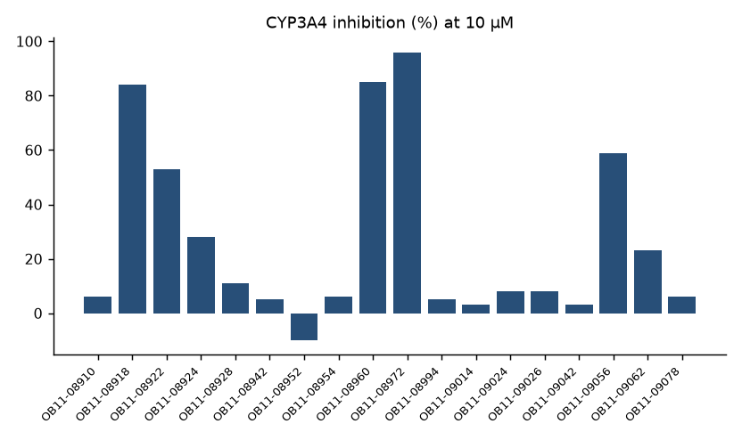
CYP3A4 single-point inhibition
Merrivoss Bioanalysis Inc, a Tarnovell company | Confidential 7
Notes:
Complete referenced test article set, in assay worksheet order; this is not a sorted ranking.

Slide 8
Screen flags across the panel
6 test articles exceeded 50% in at least one isoform
CYP3A4: 5 above 50%; CYP2C19: 4; CYP2C9: 5
CYP1A2: 4; CYP2D6: 3
Merrivoss Bioanalysis Inc, a Tarnovell company | Confidential 8
Notes:
Isoform counts overlap; do not sum them to obtain affected test articles.

Slide 9
CYP3A4 inhibition curves: fitted endpoints
Compound | IC50 (µM) | Probe substrate
OB11-08910 | >50 | midazolam
OB11-08918 | 0.79 | midazolam
OB11-08922 | 9.7 | midazolam
OB11-08924 | 39 | midazolam
OB11-08928 | >50 | midazolam
OB11-08942 | >50 | midazolam
OB11-08952 | >50 | midazolam
OB11-08954 | >50 | midazolam
OB11-08960 | 1.3 | midazolam
OB11-08972 | 0.83 | midazolam
OB11-08994 | >50 | midazolam
OB11-09014 | >50 | midazolam
Merrivoss Bioanalysis Inc, a Tarnovell company | Confidential 9

Slide 10
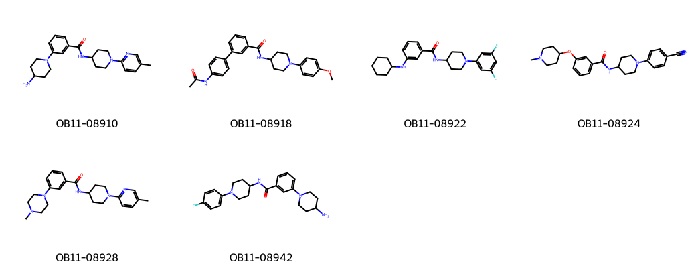
OB11: representative test article structures
Merrivoss Bioanalysis Inc, a Tarnovell company | Confidential 10
Notes:
Representative structures aid identity matching; they do not designate nominated leads.

Slide 11
Confirmation and chemistry decision
18 test articles evaluated in CYP3A4 concentration response
5 below 10 µM; 2 below 1 µM
The CYP3A4 follow-up confirmed liability in the lipophilic cap variants; Orvessant switched to the alternate cap.
Merrivoss Bioanalysis Inc, a Tarnovell company | Confidential 11
Notes:
The below-1 µM count is included in the below-10 µM count. No additional compound shortlist is supplied.

Slide 12
Final DMPK memo and handoff
Use the alternate cap as the chemistry direction; retain the lipophilic-cap branch as comparator
Megan Larkin: state the probe-specific interpretation and exposure assumptions
Keep controls, single-point results and fitted endpoints together under M20/BIO/02046
Merrivoss Bioanalysis Inc, a Tarnovell company | Confidential 12

