Slide 1
BP16 protease programme: hERG channel screen
BW03_0098 | Belquorin Pharma
23 May 2003 | Dr B. Rowcroft
Brindlewythe Biosciences Ltd
Notes:
Final client readout. Study accession B-ACC-2003-01676.

Slide 2
Plate acceptance and release
Test period 07–23 May 2003; interim readout 15 May 2003.
Ravi Deshmukh checked cell-level fits; Ines Alvarado checked run sheets and sample-card mapping.
E-4031 control IC50 13 nM; accepted for interpretation.
Tested 32 compounds under B-ACC-2003-01676.
Brindlewythe Biosciences Ltd | Confidential 2

Slide 3
Reading the channel screen
Upper test concentration 30 µM; values above the range remain greater-than results.
Geometric means are accompanied by individual-cell results and finite-cell counts.
Flagged entries: 2; censored entries: 5.
Weak inhibition at the range limit does not establish absence of channel activity.
Brindlewythe Biosciences Ltd | Confidential 3

Slide 4
Cell-supported hERG result extract
Compound | IC50 geomean (µM) | % inhibition @10 µM | n cells (finite) | QC note
BP16-05400 | >30 | 21 | 3 (0)
BP16-05406 | 2.1 | 86 | 2 (2)
BP16-05412 | 25 | 27 | 3 (2)
BP16-05416 | >30 | 26 | 2 (1)
BP16-05422 | 15 | 38 | 3 (3)
BP16-05424 | 3.4 | 76 | 2 (2)
BP16-05428 | >30 | 25 | 2 (0) | First run rejected (E-4031 outside range); repeated
BP16-05430 | 2.6 | 79 | 2 (2)
Brindlewythe Biosciences Ltd | Confidential 4

Slide 5
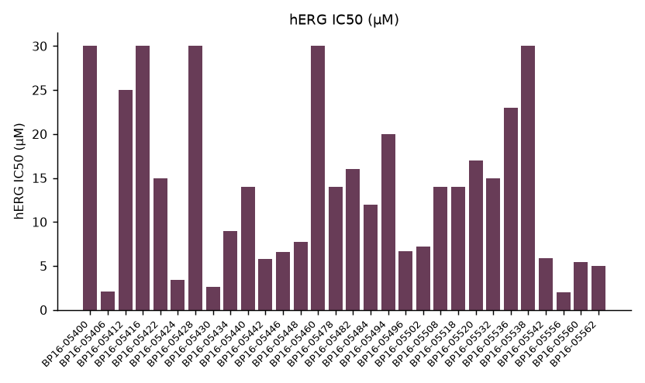
BP16 hERG profile
Brindlewythe Biosciences Ltd | Confidential 5

Slide 6
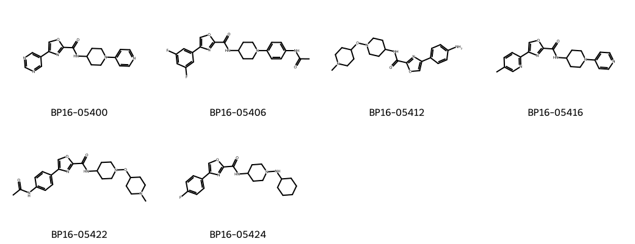
Oxazole carboxamide representatives
Brindlewythe Biosciences Ltd | Confidential 6
Notes:
Representative structures identify the screening set; this grid is not a potency ranking.

Slide 7
Ranking at the screen gate
Median hERG IC50 14 µM.
1–10 µM band: 14; at or above 10 µM: 18.
Below 1 µM: 0. Preserve qualifications when comparing compounds.
The lipophilic cap is associated with the ion-channel liability in this screening set.
Brindlewythe Biosciences Ltd | Confidential 7

Slide 8
Chemistry interpretation
Belquorin requested less basic replacements rather than further testing of the lipophilic branch.
Use the channel ranking to choose the replacement direction; protease potency is outside this readout.
The screen does not distinguish cap lipophilicity from basicity as the causal driver.
A matched replacement set is needed to separate those design effects.
Brindlewythe Biosciences Ltd | Confidential 8

Slide 9
Client decision and handover
Stop further channel profiling of the current lipophilic branch.
Request less basic replacements with sample cards linked to parent identifiers.
Ravi Deshmukh to retain cell-level qualifications for the replacement comparison.
Bethany Rowcroft to close the current screen gate; test new material before assigning a safety margin.
Brindlewythe Biosciences Ltd | Confidential 9

