Slide 1
AP02 aminopyrimidine regioisomer: integrated safety screen
OT-23-S0046 | Avernelwick Pharmaceuticals Ltd | 03/23/2023
Dr N. Takamori | Osterquill Toxicology Inc | v3 FINAL_final

Slide 2
Client decision
44 test articles evaluated in the non-GLP in vitro investigation.
Favourable cardiac profile retained, with a CYP-sensitive subseries; alternatives selected for follow-up.
Screening ranks test articles; it does not establish clinical safety or a GLP conclusion.
Osterquill Toxicology Inc | Confidential 2
Notes:
v3 client copy: alternatives selected replaces earlier recommendation to consider alternatives; results unchanged.

Slide 3
Scope and control validity
Testing interval: 03/08/2023–03/23/2023; LIMS OQ/2023/000755.
E-4031 IC50 15 nM; acceptance interval 5–50 nM.
CYP control IC50s assessed against 0.5–2 times historical means.
No live-animal procedures were included; animal welfare oversight of the regulated portfolio is separate.
Osterquill Toxicology Inc | Confidential 3

Slide 4
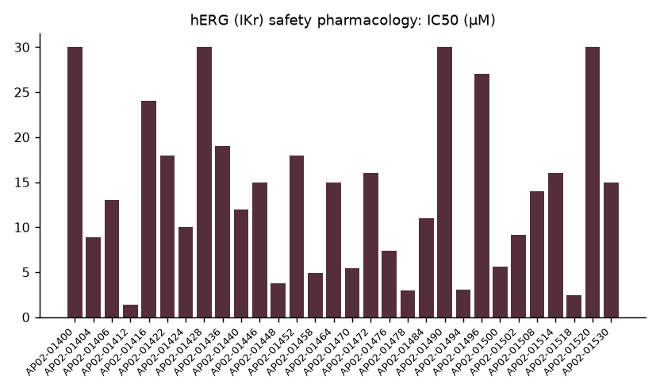
hERG (IKr) safety pharmacology: IC50 (µM)
Osterquill Toxicology Inc | Confidential 4

Slide 5
Cardiac distribution and qualifications
0 below 1 µM; 19 between 1 and 10 µM; 25 at or above 10 µM.
Median IC50 12 µM; top concentration 30 µM.
4 censored estimates and 2 flagged entries require their observation-sheet qualifications.
Censored estimates are bounds, not fitted potencies; finite estimates require an exposure comparison.
Osterquill Toxicology Inc | Confidential 5

Slide 6
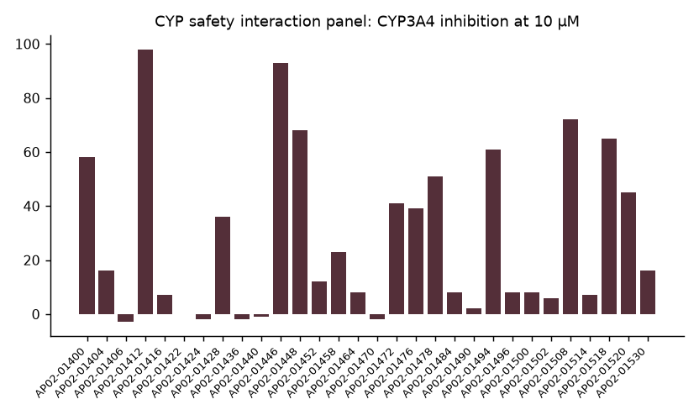
CYP safety interaction panel: CYP3A4 inhibition at 10 µM
Osterquill Toxicology Inc | Confidential 6

Slide 7
CYP-sensitive test articles
19 test articles exceeded 50% inhibition on at least one isoform.
CYP1A2 2; CYP2C9 3; CYP2C19 11; CYP2D6 8; CYP3A4 13.
CYP3A4 was most frequently flagged. Counts overlap and must not be summed.
The single-concentration panel does not establish inhibition mechanism.
Osterquill Toxicology Inc | Confidential 7

Slide 8
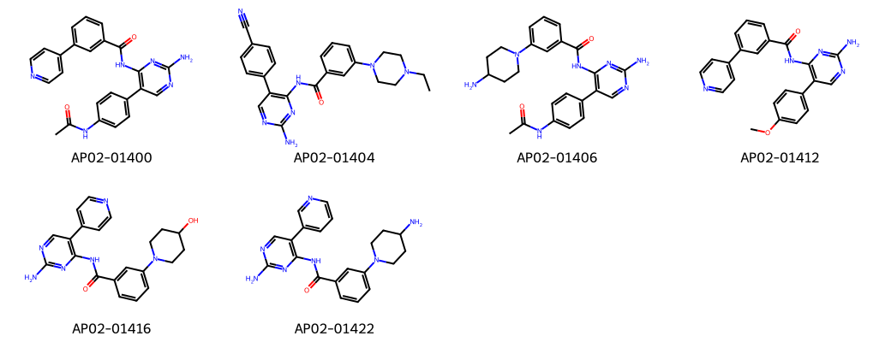
Representative test article structures
Osterquill Toxicology Inc | Confidential 8

Slide 9
CYP panel extract: compare the full fingerprint
Compound | CYP1A2 (%) | CYP2C9 (%) | CYP2C19 (%) | CYP2D6 (%) | CYP3A4 (%)
AP02-01400 | 13 | 10 | 51 | 22 | 58
AP02-01404 | 1 | 5 | 9 | 5 | 16
AP02-01406 | 1 | -3 | 9 | -1 | -3
AP02-01412 | 38 | 86 | 94 | 45 | 98
AP02-01416 | 1 | -2 | -6 | 1 | 7
AP02-01422 | -2 | 0 | 9 | 3 | -0
AP02-01424 | 4 | -4 | 4 | 4 | -2
AP02-01428 | 54 | 5 | 43 | 8 | 36
Osterquill Toxicology Inc | Confidential 9

Slide 10
Handover and next decision
Prioritize the selected branch or alternatives using both cardiac potency and CYP fingerprints.
Resolve flagged hERG entries before relying on rank; obtain concentration responses for CYP liabilities in proposed leads.
Compare assay potency with projected unbound exposure before progression.
Full tables and control documentation: OT-23-S0046_RPT_A_signed.pdf.
Osterquill Toxicology Inc | Confidential 10
Notes:
Dr N. Takamori presents the interpretation. v3 retains the panel extract for discussion; the condensed meeting copy may omit it.

