Slide 1
AT15 Oral/IV PK: exposure and vehicle decision
Aldrevessa Therapeutics | MV-2015-240 | Final readout, 12/21/2015
Dr M. Larkin | Merrivoss Bioanalysis Inc

Slide 2
Study scope and displayed subset
40 test articles in the project record; M15/BIO/05540
The supplied PK table covers the measured subset, not the entire accession lot
Study 11/16/2015–12/21/2015; interim review 12/03/2015
Merrivoss Bioanalysis Inc | Confidential 2
Notes:
The project count is not an animal count or a claim that every test article has a PK row.

Slide 3
Rat matrix and route comparison
Rat plasma parent-analyte measurements by tandem-MS bioanalysis
Protocol: 1 mg/kg IV and 5 mg/kg PO; n=3
Use dose-normalized route exposure for bioavailability; IV clearance describes systemic disposition
Merrivoss Bioanalysis Inc | Confidential 3
Notes:
Route comparison assumes comparable assay performance and sufficiently linear disposition over the dose range. The supplied data are derived parameters, not concentration-time profiles.

Slide 4
Matrix acceptance comes first
Helen Marchwood: review rat-plasma matrix acceptance for reporting sequences
Javier Quintana: inspect calibration, extracted controls and carryover for each analyte
A plausible PK profile does not establish satisfactory analytical performance
Merrivoss Bioanalysis Inc | Confidential 4

Slide 5
Analytical and sampling limits
Terminal estimates require quantifiable late samples and an identifiable elimination interval
Do not replace below-quantitation observations with invented concentrations
AUC, Cmax, sampling times and compound-specific quantitation limits are not supplied
Merrivoss Bioanalysis Inc | Confidential 5
Notes:
Exposure is conventionally expressed in ng·h/mL. No numerical AUC or concentration-time profile is reconstructed from clearance and bioavailability.

Slide 6
Rat Oral/IV PK: supplied parameters
Compound | CL (mL/min/kg) | Vss (L/kg) | t½ (h) | F (%)
AT15-01604 | 14 | 1.8 | 1.5 | 67
AT15-01606 | 24 | 1.1 | 0.55 | 19
AT15-01610 | 44 | 2.4 | 0.63 | 4
AT15-01612 | 7.5 | 2.1 | 3.3 | 59
AT15-01616 | 29 | 1.4 | 0.56 | 36
AT15-01618 | 12 | 1.0 | 1.0 | 35
Merrivoss Bioanalysis Inc | Confidential 6

Slide 7
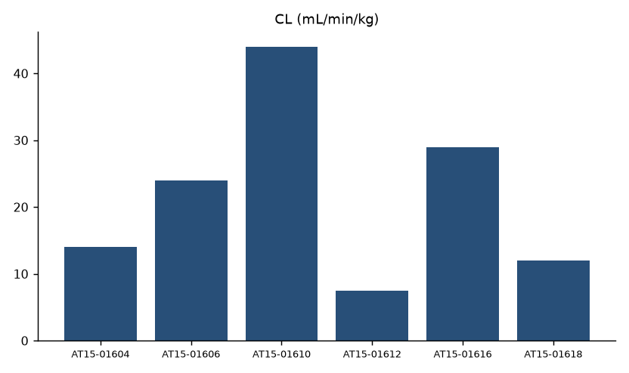
Systemic disposition: IV clearance
Merrivoss Bioanalysis Inc | Confidential 7
Notes:
Complete referenced test article set, in assay worksheet order; this is not a sorted ranking.

Slide 8
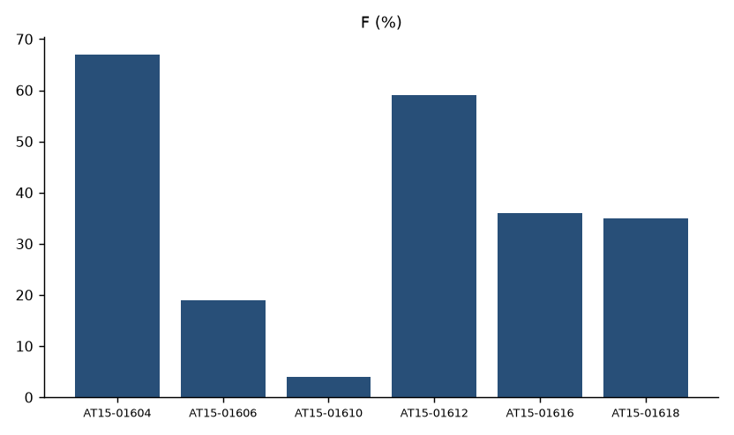
Route comparison: oral bioavailability
Merrivoss Bioanalysis Inc | Confidential 8
Notes:
Complete referenced test article set, in assay worksheet order; this is not a sorted ranking.

Slide 9
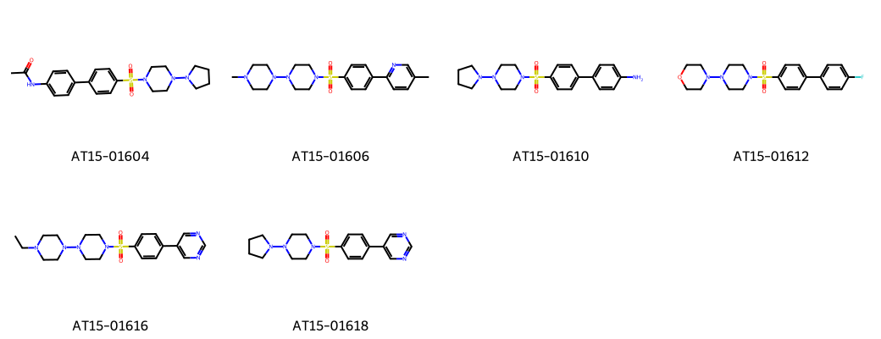
AT15 sulfonyl piperazines
Merrivoss Bioanalysis Inc | Confidential 9
Notes:
Representative structures aid identity matching; they do not designate nominated leads.

Slide 10
Read the routes together
Acceptable systemic clearance does not establish satisfactory absorption
The recorded project interpretation was limited oral exposure despite acceptable systemic clearance
Bioavailability varies across the displayed subset; the vehicle decision does not mean uniformly poor F
Merrivoss Bioanalysis Inc | Confidential 10
Notes:
The interpretation concerns the project exposure gate, not a common mechanism assigned to every analogue.

Slide 11
Decision: revisit the dosing vehicle
Aldrevessa Therapeutics returned to the vehicle before the next oral exposure assessment
Review delivery, dispersion and dose preparation alongside the parent-analyte record
Preserve a suitable IV reference in the repeat comparison to separate formulation from disposition
Merrivoss Bioanalysis Inc | Confidential 11

Slide 12
Final handoff
Megan Larkin: retain route assumptions in the DMPK memo
Javier Quintana: keep analytical limits with the analyte cards
Archive the current summary under M15/BIO/05540; vehicle follow-up is a subsequent study
Merrivoss Bioanalysis Inc | Confidential 12

