Slide 1
AU-08: solution choice for exposure work
DL_2016_0027 | DF16-00334 | Auvrelquith Biosciences | Julia Carver | 06/06/2016 | Durnesswick Laboratories Inc

Slide 2
Decision at close
Auvrelquith Biosciences selected the buffer-adjusted solution for exposure work.
The initial ladder did not establish a stable aqueous solution at target loading.
Selection depends on dilution behavior, not simply on concentrate appearance.
Durnesswick Laboratories Inc | Confidential 2

Slide 3
Initial Vehicle ladder: loading and physical behavior
Vehicle | Equilibrium solubility (mg/mL) | Appearance at 10 mg/mL loading | 24 h physical stability (10 mg/mL)
0.5% methylcellulose | 0.52 | Suspension, settles <1 h | Crystal growth at 24 h
0.5% HPMC / 0.1% Tween 80 | 0.74 | Suspension, settles <1 h | Crystal growth at 24 h
20% HP-β-CD in water | 2.4 | Fine suspension, easily redispersed | Crystal growth at 24 h
PEG400/water 30:70 | 1.3 | Suspension, settles <1 h | Crystal growth at 24 h
10% DMSO / 90% corn oil | 2.3 | Suspension, settles <1 h | Redisperses on shaking
Labrasol/PEG400 1:1 | 15 | Clear, slight yellow tint | Precipitate at 24 h
5% NMP / 15% Solutol HS15 / 80% water | 1.6 | Fine suspension | Settles; redispersible
pH 4 citrate buffer | 0.42 | Fine suspension | Redisperses on shaking
Durnesswick Laboratories Inc | Confidential 3

Slide 4
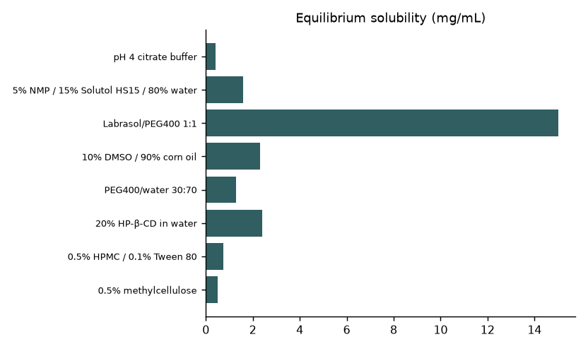
Equilibrium capacity is only part of the choice
Durnesswick Laboratories Inc | Confidential 4
Notes:
Target loading 10 mg/mL. This chart does not measure dilution behavior or particle-size distribution.

Slide 5
Work package sequence
Started 04/19/2016; interim discussion 05/13/2016; completed 06/06/2016.
Miguel Serrano developed the formulation set under Julia Carver’s development lead.
Lena Patel supported the exposure-work handoff.
Durnesswick Laboratories Inc | Confidential 5

Slide 6
Screen design and suitability
Target loading: 10 mg/mL; compare preparation appearance with the standing condition.
Keep composition, preparation order and identity on the bench sheet.
Equilibrium solubility does not establish a dosing hold time.
Durnesswick Laboratories Inc | Confidential 6

Slide 7
What the starting formulation set tells us
Polymer vehicles remained suspensions.
Cyclodextrin improved capacity relative to the citrate-buffer starting point without giving a clear preparation.
The surfactant/cosolvent mixture appeared clear initially.
Precipitate on standing removed clarity as a sufficient selection rule.
Durnesswick Laboratories Inc | Confidential 7

Slide 8
Dilution is the relevant stress
A concentrate can look acceptable before its solvent environment changes.
Dilution changes excipient support and the dissolved/solid balance.
AU-08 follow-up therefore focused on buffer condition as well as concentrate preparation.
Durnesswick Laboratories Inc | Confidential 8

Slide 9
Buffer adjustment: interpretation
The project follow-up found that buffer adjustment prevented precipitation on dilution.
This is distinct from the starting pH 4 citrate-buffer row.
Do not substitute that starting recipe for the selected exposure recipe.
Durnesswick Laboratories Inc | Confidential 9
Notes:
Adjusted-buffer composition and quantitative dilution measurements are not supplied. Keep the starting screen separate from the successful follow-up.

Slide 10
Recipe-card comparison for handoff
Preparation | Evidence | Use
Initial citrate-buffer preparation | Fine suspension in starting ladder | Comparator
Initially clear surfactant/cosolvent preparation | Precipitate on standing | Do not select on initial clarity
Buffer-adjusted solution | Precipitation prevented on dilution in project follow-up | Selected for exposure work
Durnesswick Laboratories Inc | Confidential 10

Slide 11
Reading the dilution appearance comparison
Compare concentrate, diluted preparation and held preparation under consistent viewing conditions.
Keep recipe identity beside each observation.
The outcome here is qualitative; a photograph panel is not reproduced.
Durnesswick Laboratories Inc | Confidential 11
Notes:
The archive description refers to dilution photographs, but no image assets are supplied. Do not replace missing photographs with simulated evidence.

Slide 12
Exposure use and process lock
Use the buffer-adjusted recipe for planned exposure work.
Tie dose concentration in mg/mL to the intended dosing volume.
A commercial process lock is not established.
A changed material lot, loading or dilution medium requires a compatibility check.
Durnesswick Laboratories Inc | Confidential 12

Slide 13
Transfer instructions
Lena Patel: carry buffer identity, adjustment order and dilution medium into the recipe card.
Miguel Serrano: retain starting-ladder observations with the bench sheets.
Julia Carver: distinguish follow-up success from the original screen in the handoff.
Durnesswick Laboratories Inc | Confidential 13

Slide 14
Closeout and next scale gate
DL_2016_0027 is complete; the solution approach has been selected.
Agree hold interval, container and mixing sequence before larger preparation.
Scope reproducibility and material demand before extending beyond exposure work.
Durnesswick Laboratories Inc | Confidential 14

