Slide 1
TP04 DDI assessment: screen and CYP3A4 confirmation
Tervemere Pharma AG | MV-2016-095 | Final readout, 06/16/2016
Dr M. Larkin | Merrivoss Bioanalysis Inc

Slide 2
Test article set and study sequence
18 test articles under M16/BIO/02193
Aminopyrazolopyrimidine inflammatory-signal kinase analogues; study 05/30/2016–06/16/2016, interim 06/07/2016
Five-isoform DDI screen at 10 µM followed by CYP3A4 inhibition curves
Merrivoss Bioanalysis Inc | Confidential 2

Slide 3
Human microsomal matrix and readout
Human liver microsomes with isoform-selective probe substrates
Screen: mean inhibition relative to vehicle at 10 µM
Confirmation: midazolam 1′-hydroxylation concentration response; IC50 in µM
Merrivoss Bioanalysis Inc | Confidential 3
Notes:
Results describe the tested probe and incubation conditions. This is not a clinical interaction prediction or a complete time-dependent inhibition assessment.

Slide 4
Matrix acceptance: reference inhibitor results
Isoform | Reference inhibitor | IC50 (µM) | Historical mean (µM)
CYP1A2 | Furafylline | 2.1 | 1.8
CYP2C9 | Sulfaphenazole | 0.48 | 0.35
CYP2C19 | Ticlopidine | 1.1 | 1.2
CYP2D6 | Quinidine | 0.065 | 0.060
CYP3A4 | Ketoconazole | 0.035 | 0.030
Merrivoss Bioanalysis Inc | Confidential 4
Notes:
Helen Marchwood reviews control response against the laboratory acceptance window. Javier Quintana reviews the metabolite analytical sequence. Each supplied control value is shown with its historical comparator.

Slide 5
Reporting limits before ranking
Single-point inhibition flags a follow-up question; it is not an IC50
Negative inhibition denotes response above the vehicle comparator, not enzyme activation
An IC50 above the top concentration remains a bound; do not assign a finite value
Merrivoss Bioanalysis Inc | Confidential 5
Notes:
Compound-specific analytical quantitation limits are not supplied. Consult the assay worksheet for marginal responses.

Slide 6
Five-isoform DDI screen: compound results
Compound | CYP1A2 (%) | CYP2C9 (%) | CYP2C19 (%) | CYP2D6 (%) | CYP3A4 (%)
TP04-02700 | -9 | -4 | 5 | -12 | -2
TP04-02722 | 24 | 90 | 69 | 38 | 90
TP04-02724 | 45 | 12 | 8 | 31 | 39
TP04-02734 | 45 | 7 | 8 | 3 | 4
TP04-02736 | 1 | 10 | 3 | 8 | 3
TP04-02742 | 25 | 8 | 2 | 8 | 45
TP04-02746 | 83 | 49 | 87 | 78 | 71
TP04-02758 | 34 | 60 | 80 | 76 | 71
TP04-02784 | 7 | 7 | -7 | -2 | -2
TP04-02808 | 10 | 6 | -4 | -7 | 2
TP04-02818 | 3 | -2 | 10 | -0 | 3
TP04-02820 | 4 | -2 | -2 | 2 | 14
Merrivoss Bioanalysis Inc | Confidential 6

Slide 7
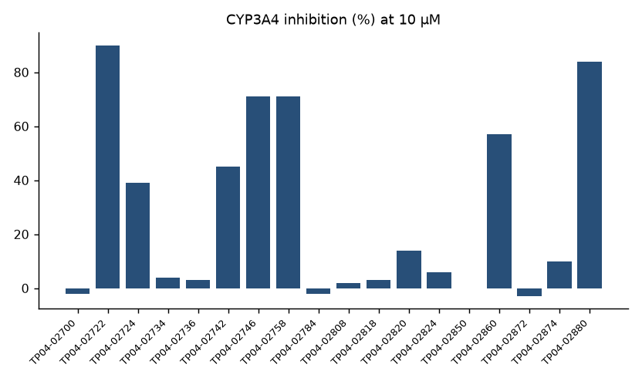
CYP3A4 single-point inhibition
Merrivoss Bioanalysis Inc | Confidential 7
Notes:
Complete referenced test article set, in assay worksheet order; this is not a sorted ranking.

Slide 8
Screen flags across the panel
5 test articles exceeded 50% in at least one isoform
CYP3A4: 5 above 50%; CYP2C19: 5; CYP2C9: 4
CYP1A2: 2; CYP2D6: 2
Merrivoss Bioanalysis Inc | Confidential 8
Notes:
Isoform counts overlap; do not sum them to obtain affected test articles.

Slide 9
CYP3A4 inhibition curves: fitted endpoints
Compound | IC50 (µM) | Probe substrate
TP04-02700 | >50 | midazolam
TP04-02722 | 1.3 | midazolam
TP04-02724 | 16 | midazolam
TP04-02734 | >50 | midazolam
TP04-02736 | >50 | midazolam
TP04-02742 | 14 | midazolam
TP04-02746 | 4.7 | midazolam
TP04-02758 | 3.7 | midazolam
TP04-02784 | >50 | midazolam
TP04-02808 | >50 | midazolam
TP04-02818 | >50 | midazolam
TP04-02820 | >50 | midazolam
Merrivoss Bioanalysis Inc | Confidential 9

Slide 10
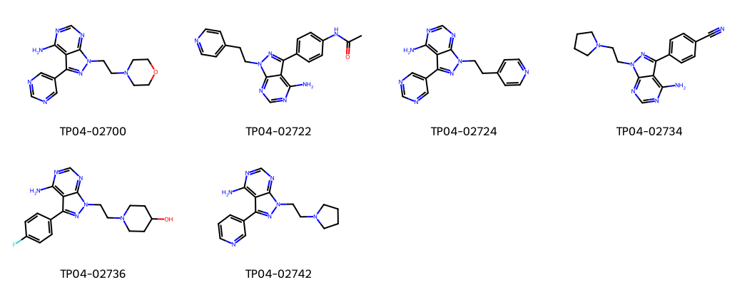
TP04: representative test article structures
Merrivoss Bioanalysis Inc | Confidential 10
Notes:
Representative structures aid identity matching; they do not designate nominated leads.

Slide 11
Confirmation and chemistry decision
18 test articles evaluated in CYP3A4 concentration response
5 below 10 µM; 1 below 1 µM
Tervemere retained the low-interaction branch after the concentration-response work confirmed the screen's rank order.
Merrivoss Bioanalysis Inc | Confidential 11
Notes:
The below-1 µM count is included in the below-10 µM count. No additional compound shortlist is supplied.

Slide 12
Final DMPK memo and handoff
Carry the retained low-interaction branch into subsequent profiling
Megan Larkin: state the probe-specific interpretation and exposure assumptions
Keep controls, single-point results and fitted endpoints together under M16/BIO/02193
Merrivoss Bioanalysis Inc | Confidential 12

