Slide 1
VP10: side-chain choice and isolation
Valquessia Pharmaceuticals SpA | VD-16-033 | 30 Aug 2016
Dr R. Calderwood | Route meeting

Slide 2
Decision: progress the salt-forming side chain
18 aminoquinoline analogues comprise the delivered set.
Valquessia selected the salt-forming side chain for scale-up.
Reproducible final isolation was the deciding chemistry observation.
Selection is a route decision, not a claim of improved mitotic-kinase activity.
Vellacombe Discovery Ltd | Confidential 2

Slide 3
Programme and delivery basis
Metric | Value
Project | VD-16-033
Client | Valquessia Pharmaceuticals SpA
Compounds tested | 18
Series / chemotype | Valquessia aminoquinoline series 10 (Aminoquinoline)
Assays | Custom synthesis and analogue preparation
Turnaround (calendar days) | 141
Price | GBP 45,300
Vellacombe Discovery Ltd | Confidential 3

Slide 4
Delivered analogue set: isolation and release
Compound | Yield (%) | HPLC purity (UV area %, 254 nm) | Amount (mg)
VP10-03504 | 24 | 95.6 | 25
VP10-03536 | 45 | 96.6 | 23
VP10-03546 | 28 | 96.0 | 28
VP10-03554 | 25 | 96.9 | 30
VP10-03558 | 27 | 98.0 | 55
VP10-03560 | 15 | 97.6 | 15
VP10-03564 | 39 | 97.3 | 35
VP10-03566 | 48 | 92.9 | 27
VP10-03576 | 15 | 96.5 | 12
VP10-03578 | 32 | 96.8 | 28
VP10-03582 | 58 | 95.0 | 21
VP10-03584 | 16 | 97.4 | 37
Vellacombe Discovery Ltd | Confidential 4

Slide 5
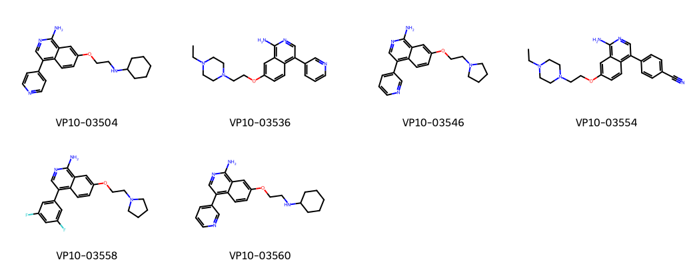
Side-chain variation on the aminoquinoline core
Vellacombe Discovery Ltd | Confidential 5

Slide 6
Side-chain comparison: useful material versus a good reaction
A solubilising side chain is useful only if the product can be recovered consistently.
Reaction completion alone does not settle isolation feasibility.
The delivered set defines the structures actually available.
The salt-forming candidate gave a reproducible final isolation.
That observation supports a practical scale-up starting point.
Other side chains remain comparators; their structures are not scale-up commitments.
Vellacombe Discovery Ltd | Confidential 6

Slide 7
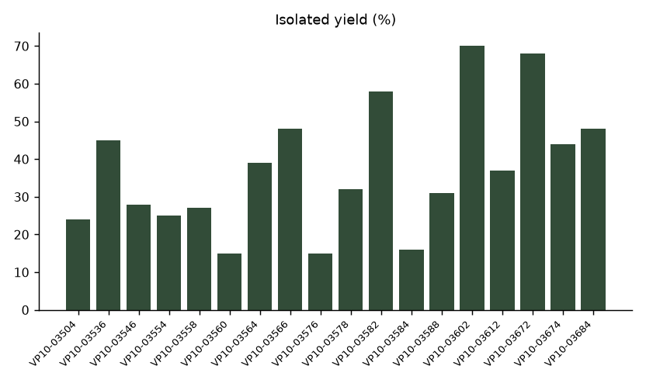
Isolated yield by delivered compound
Vellacombe Discovery Ltd | Confidential 7

Slide 8
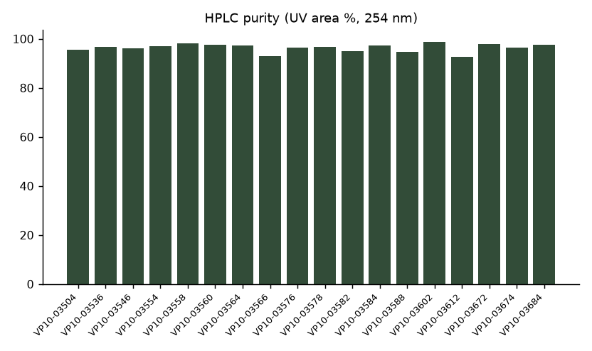
Purity context for the delivered set
Vellacombe Discovery Ltd | Confidential 8

Slide 9
Why reproducibility changes the route gate
A repeatable isolation reduces dependence on a difficult final clean-up.
Carry the selected side-chain identity through the compound card and salt preparation.
Keep isolation behaviour separate from assumptions about solution properties.
A larger preparation must still demonstrate that the small-scale isolation transfers.
Vellacombe Discovery Ltd | Confidential 9

Slide 10
Scale-up route scout
Hassan Darwish to retain the selected sequence as the starting procedure.
Track solvent charge, addition order and isolation hold in the route scout.
Retain the final mother liquor until material accounting is closed.
Clara Fenwick to link release material to the compound card.
Compare the new preparation against the delivered reference.
Ruth Calderwood to assess the route gate after isolation, not merely after conversion.
Vellacombe Discovery Ltd | Confidential 10

Slide 11
Material allocation for follow-on work
Compound | Amount (mg)
VP10-03504 | 25
VP10-03536 | 23
VP10-03546 | 28
VP10-03554 | 30
VP10-03558 | 55
VP10-03560 | 15
VP10-03564 | 35
VP10-03566 | 27
VP10-03576 | 12
VP10-03578 | 28
VP10-03582 | 21
VP10-03584 | 37
VP10-03588 | 28
VP10-03602 | 42
VP10-03612 | 18
VP10-03672 | 26
Vellacombe Discovery Ltd | Confidential 11

Slide 12
Meeting close: selection agreed
Valquessia Pharmaceuticals SpA has selected the salt-forming side chain.
Prepare the scale-up route scout around reproducible isolation.
Keep alternative side chains available as chemistry comparators.
Confirm the requested scale and delivery allocation before the next preparation.
Vellacombe Discovery Ltd | Confidential 12
Notes:
Programme began 11 Apr 2016; final readout 30 Aug 2016. This deck closes the analogue-preparation programme, not the future scale-up work.

