Slide 1
BP16: interim CYP interaction readout
MV-2026-278 | Belquorin Pharma
09/24/2026 | Megan Larkin
v3 / FINAL_final working copy — INTERIM
Merrivoss Bioanalysis Inc, a Tarnovell company

Slide 2
Interim scope and matrix
Oxazole carboxamide test article set; accession M26/BIO/06402.
Five-isoform DDI screen: human liver microsomes, 10 µM.
CYP3A4 inhibition curves: midazolam 1′-hydroxylation.
Screening runs are complete; final interpretation is held for vial identity confirmation.
Merrivoss Bioanalysis Inc, a Tarnovell company | Confidential 2
Notes:
Reviewer comment — Helen Marchwood: retain INTERIM on the circulated copy despite the filename suffix.

Slide 3
Matrix acceptance context
CYP3A4 reference: 0.021 µM; historical comparator 0.030 µM.
CYP2C9 reference: 0.41 µM; historical comparator 0.35 µM.
Analytical suitability and article identity are separate questions.
Final named-article release disposition: [TBC].
Merrivoss Bioanalysis Inc, a Tarnovell company | Confidential 3
Notes:
Historical comparators are not acceptance tolerances. Reference response alone does not establish final release.

Slide 4
Five-isoform DDI screen | interim named entries
Compound | CYP1A2 (%) | CYP2C9 (%) | CYP2C19 (%) | CYP2D6 (%) | CYP3A4 (%)
BP16-05400 | 51 | 29 | 35 | 9 | 82
BP16-05410 | 43 | 9 | 30 | 2 | 13
BP16-05422 | -3 | 22 | 47 | 42 | 53
BP16-05442 | 10 | 7 | 0 | 59 | 11
BP16-05470 | 3 | -5 | 10 | 4 | 16
BP16-05472 | 91 | 100 | 100 | 25 | 99
BP16-05478 | 6 | -8 | -0 | 6 | 5
BP16-05482 | 2 | 94 | 100 | 5 | 100
BP16-05500 | 17 | 1 | 23 | 19 | -4
BP16-05512 | -1 | 2 | 6 | -5 | 9
BP16-05518 | 5 | 15 | 4 | 17 | -3
Merrivoss Bioanalysis Inc, a Tarnovell company | Confidential 4
Notes:
Interim entries only. Retain signed negative normalized observations; do not relabel them as stimulation.

Slide 5
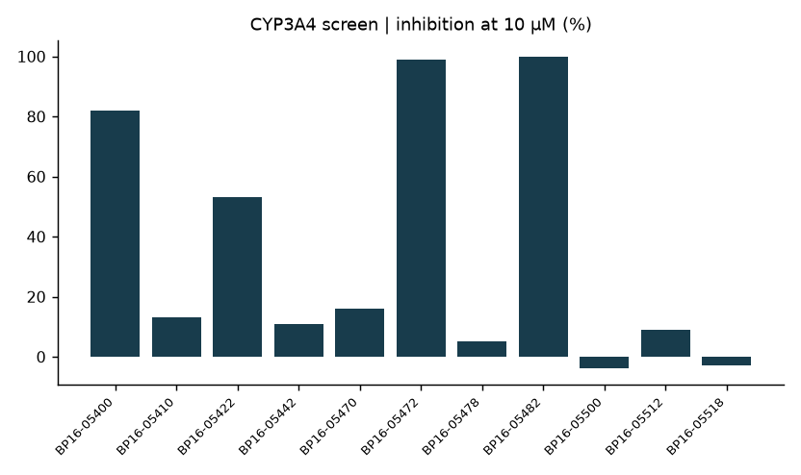
CYP3A4 screen | inhibition at 10 µM (%)
Merrivoss Bioanalysis Inc, a Tarnovell company | Confidential 5
Notes:
Provisional current labels. The relabelled vial has not been assigned to a displayed row in this readout.

Slide 6
Screen observations for discussion
BP16-05472 and BP16-05482 show broad inhibition involving CYP2C9, CYP2C19 and CYP3A4.
BP16-05442 shows a different pattern, with CYP2D6 more prominent than CYP3A4.
BP16-05478 and BP16-05512 show little inhibition across the displayed panel.
These observations support discussion, not a final progression recommendation.
Merrivoss Bioanalysis Inc, a Tarnovell company | Confidential 6
Notes:
No named article is assumed to be the unresolved vial. Identity mapping: [TBC].

Slide 7
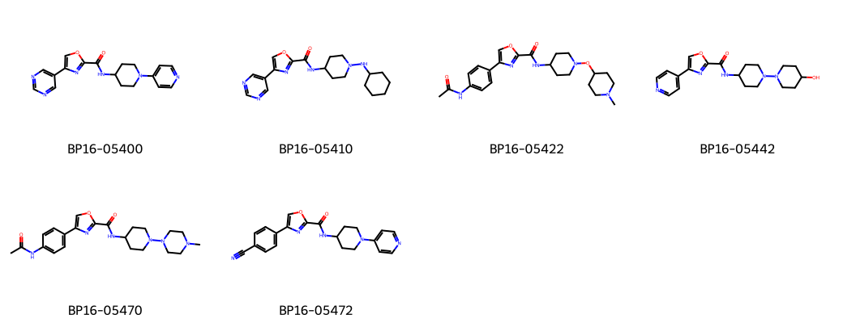
BP16 | representative oxazole carboxamides
Merrivoss Bioanalysis Inc, a Tarnovell company | Confidential 7
Notes:
Representative structures; display order is not a progression ranking.

Slide 8
CYP3A4 inhibition curves | provisional entries
Compound | IC50 (µM) | Probe substrate
BP16-05400 | 1.3 | midazolam
BP16-05410 | >50 | midazolam
BP16-05422 | 14 | midazolam
BP16-05442 | >50 | midazolam
BP16-05470 | 42 | midazolam
BP16-05472 | 0.16 | midazolam
BP16-05478 | >50 | midazolam
BP16-05482 | 0.62 | midazolam
BP16-05500 | >50 | midazolam
BP16-05512 | >50 | midazolam
Merrivoss Bioanalysis Inc, a Tarnovell company | Confidential 8
Notes:
Final interpretation awaits client identity confirmation. A greater-than value is a bound, not an exact potency.

Slide 9
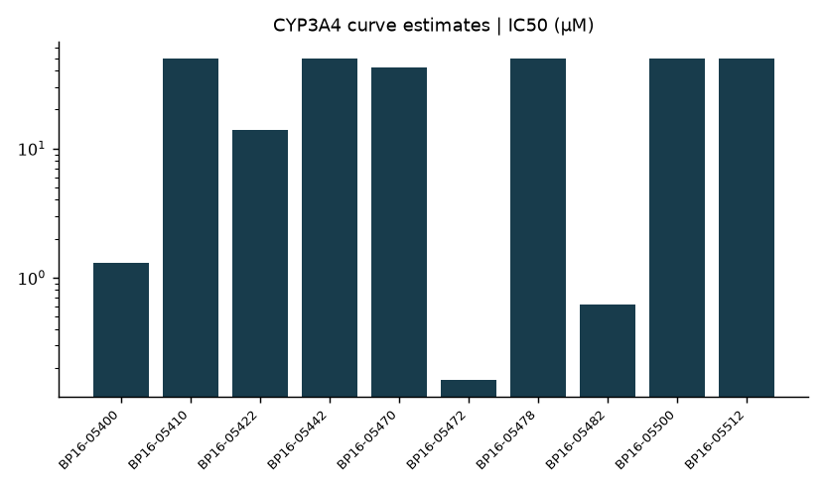
CYP3A4 curve estimates | IC50 (µM)
Merrivoss Bioanalysis Inc, a Tarnovell company | Confidential 9
Notes:
Midazolam probe. Consult the table for bounds. This summary plot does not present full concentration-response traces.

Slide 10
Coverage reconciliation before release
Planned test article set: 18.
Interim named-entry tables and study-level tallies require reconciliation before final release.
Complete article mapping: [TBC]; relabelled vial identity: [TBC].
Keep screening observations separate from the final concentration-response decision.
Merrivoss Bioanalysis Inc, a Tarnovell company | Confidential 10
Notes:
Reviewer comment — Javier Quintana: reconcile the named-entry exports with study-level tallies before replacing this slide with a final summary.

Slide 11
Open actions | 09/24/2026
Belquorin Pharma: confirm the relabelled vial against the original dispatch information.
Javier Quintana: link confirmation to the analyte card and concentration-response analysis.
Helen Marchwood: review the corrected identity trail and matrix acceptance release.
Megan Larkin: update the DMPK memo; final issue date [TBC].
Merrivoss Bioanalysis Inc, a Tarnovell company | Confidential 11

Slide 12
Interim disposition: exposure gate remains open
Screening runs are complete.
Concentration-response analysis awaits Belquorin Pharma identity confirmation for a relabelled vial.
No final progression recommendation is issued.
Replace this working copy after identity and coverage questions are closed.
Merrivoss Bioanalysis Inc, a Tarnovell company | Confidential 12
Notes:
Reviewer comment — Helen Marchwood: the FINAL_final suffix is not evidence of approval. Final conclusions pending.

