Slide 1
CVL aminopyrimidine: integrated safety screen
OT-20-S0178 | Corvenlea (US) | 10/20/2020
Dr N. Takamori | Osterquill Toxicology Inc

Slide 2
Client decision
40 test articles evaluated in the non-GLP in vitro investigation.
Low-liability progression branch identified alongside a basic-substituent hERG signal.
Screening ranks test articles; it does not establish clinical safety or a GLP conclusion.
Osterquill Toxicology Inc | Confidential 2
Notes:
Use the low-liability branch to guide the next synthesis request; compare with projected unbound exposure.

Slide 3
Scope and control validity
Testing interval: 10/06/2020–10/20/2020; LIMS OQ/2020/002872.
E-4031 IC50 13 nM; acceptance interval 5–50 nM.
CYP control IC50s assessed against 0.5–2 times historical means.
No live-animal procedures were included; animal welfare oversight of the regulated portfolio is separate.
Osterquill Toxicology Inc | Confidential 3

Slide 4
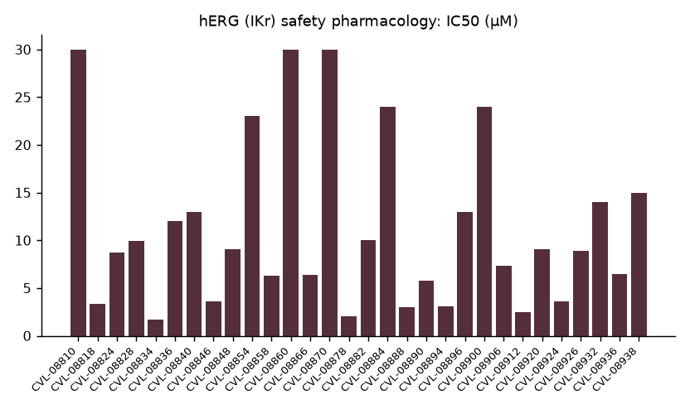
hERG (IKr) safety pharmacology: IC50 (µM)
Osterquill Toxicology Inc | Confidential 4

Slide 5
Cardiac distribution and qualifications
0 below 1 µM; 25 between 1 and 10 µM; 15 at or above 10 µM.
Median IC50 8.8 µM; top concentration 30 µM.
4 censored estimates and 2 flagged entries require their observation-sheet qualifications.
Censored estimates are bounds, not fitted potencies; finite estimates require an exposure comparison.
Osterquill Toxicology Inc | Confidential 5

Slide 6
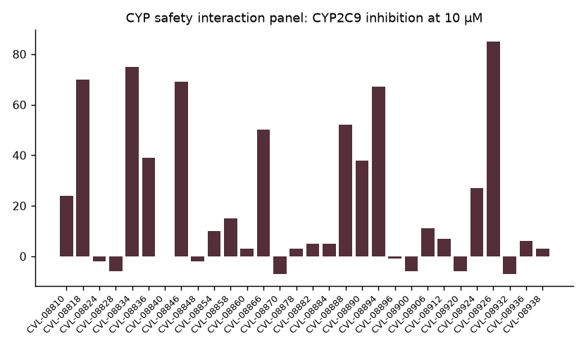
CYP safety interaction panel: CYP2C9 inhibition at 10 µM
Osterquill Toxicology Inc | Confidential 6

Slide 7
CYP-sensitive test articles
18 test articles exceeded 50% inhibition on at least one isoform.
CYP1A2 7; CYP2C9 13; CYP2C19 9; CYP2D6 3; CYP3A4 11.
CYP2C9 was most frequently flagged. Counts overlap and must not be summed.
The single-concentration panel does not establish inhibition mechanism.
Osterquill Toxicology Inc | Confidential 7

Slide 8
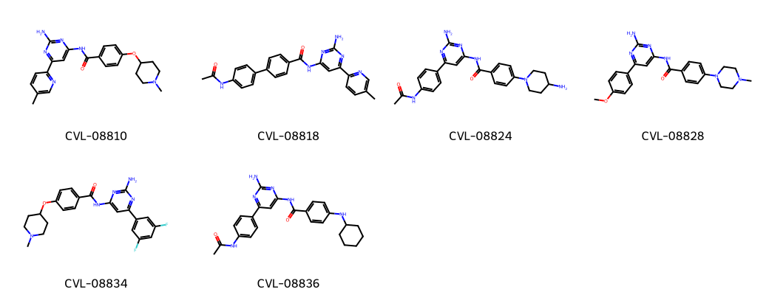
Representative test article structures
Osterquill Toxicology Inc | Confidential 8

Slide 9
CYP panel extract: compare the full fingerprint
Compound | CYP1A2 (%) | CYP2C9 (%) | CYP2C19 (%) | CYP2D6 (%) | CYP3A4 (%)
CVL-08810 | 3 | 24 | 22 | 4 | 53
CVL-08818 | 20 | 70 | 7 | 4 | 27
CVL-08824 | 4 | -2 | 0 | 8 | -6
CVL-08828 | 6 | -6 | 27 | -1 | 20
CVL-08834 | 6 | 75 | 83 | 60 | 40
CVL-08836 | 7 | 39 | 41 | 4 | 46
CVL-08840 | -11 | 0 | -6 | 1 | 5
CVL-08846 | 33 | 69 | 42 | 77 | 17
Osterquill Toxicology Inc | Confidential 9

Slide 10
Handover and next decision
Prioritize the selected branch or alternatives using both cardiac potency and CYP fingerprints.
Resolve flagged hERG entries before relying on rank; obtain concentration responses for CYP liabilities in proposed leads.
Compare assay potency with projected unbound exposure before progression.
Full tables and control documentation: OT-20-S0178_RPT_A_signed.pdf.
Osterquill Toxicology Inc | Confidential 10
Notes:
Dr N. Takamori presents the interpretation. Corvenlea (US) will use the low-liability branch to guide the next synthesis request.

