Slide 1
FT09 indazole cardiac counterscreen
Readout | BW18_0225 | Feldorune Therapeutics BV | Brindlewythe Biosciences Ltd
Notes:
v3 FINAL final. Same content as v2 except the control table and the closing slide. Rowcroft to check the censoring footnote before this goes to Feldorune.

Slide 2
Summary
32 compounds from the synthesis lot C screened on the hERG automated patch clamp
Median IC50 12 µM across the set
  14 compounds in the 1-10 µM range, 18 at or above 10 µM
Reproducible inhibition in the confirmatory run for the most strongly basic side chain
Control acceptance was checked before the compound results were released
Brindlewythe Biosciences Ltd | Confidential 2
Notes:
Lead with the side chain point. Feldorune asked for a yes or no on the basic amine first.

Slide 3
Study summary
Metric | Value
Project | BW18_0225
Client | Feldorune Therapeutics BV
Compounds tested | 32
Series / chemotype | Feldorune indazole series 09 (Indazole)
Assays | hERG patch clamp
Turnaround (calendar days) | 17
Price | GBP 10,600
hERG IC50 <1 µM | 0
hERG IC50 1-10 µM | 14
hERG IC50 ≥10 µM | 18
hERG median IC50 (µM) | 12
E-4031 control IC50 (nM) | 16
Brindlewythe Biosciences Ltd | Confidential 3

Slide 4
hERG IC50 by compound (first 12)
Compound | IC50 cell 1 (µM) | IC50 cell 2 (µM) | IC50 cell 3 (µM) | IC50 geomean (µM) | % inhibition @10 µM | n cells (finite) | QC note
FT09-07000 | 22 | 13 |  | 17 | 42 | 2 (2)
FT09-07018 | 8.4 | 5.7 | 9.0 | 7.5 | 53 | 3 (3)
FT09-07022 | 9.6 | 12 |  | 11 | 41 | 2 (2)
FT09-07034 | >30 | 20 |  | >30 | 25 | 2 (1)
FT09-07036 | 15 | 25 |  | 20 | 33 | 2 (2)
FT09-07040 | 19 | >30 |  | >30 | 29 | 2 (1)
FT09-07046 | 19 | 15 |  | 17 | 33 | 2 (2)
FT09-07060 | 12 | 11 |  | 12 | 48 | 2 (2)
FT09-07076 | 6.3 | 5.3 |  | 5.8 | 59 | 2 (2)
FT09-07078 | 10.0 | 7.9 | 6.6 | 8.0 | 54 | 3 (3)
FT09-07082 | 3.1 | 2.6 |  | 2.8 | 77 | 2 (2)
FT09-07084 | 18 | 12 |  | 15 | 38 | 2 (2)
Brindlewythe Biosciences Ltd | Confidential 4
Notes:
Full compound table is in the released report. Retain accepted-cell counts and censoring qualifications alongside the estimates.

Slide 5
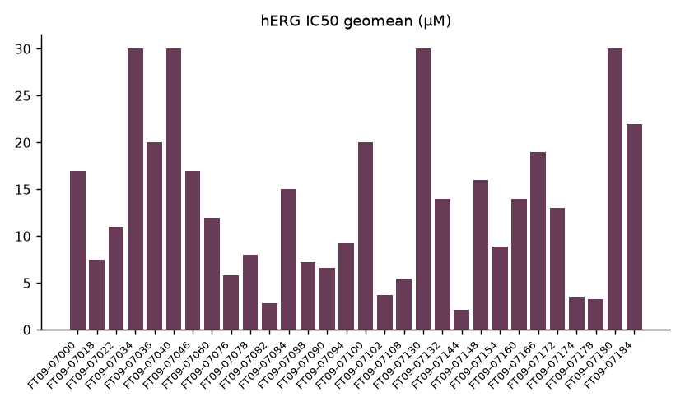
Geometric mean IC50 per compound
Brindlewythe Biosciences Ltd | Confidential 5
Notes:
Censored entries are lower bounds at the top tested concentration, not finite IC50 measurements; consult the compound table when comparing bars.

Slide 6
Control acceptance
E-4031 reference gave a control IC50 of 16 nM, within the protocol acceptance window
Compound IC50 is the geometric mean of finite cell estimates only when finite estimates are the majority of accepted cells
Otherwise the compound estimate is censored at the applicable tested limit
4 compound estimates are censored; cell counts and qualifications remain in the table
0 compounds carry a recording flag
Brindlewythe Biosciences Ltd | Confidential 6
Notes:
Check the censored estimate footnote wording against the released table, not against this slide.

Slide 7
Chemistry read-across
Feldorune dropped the most strongly basic side chain after reproducible hERG inhibition in the confirmatory run
This supports the chemistry selection decision; the table alone does not establish side-chain causality
Other members of the screening set also inhibit hERG
Keep the screening decision separate from a mechanistic or clinical safety claim
Brindlewythe Biosciences Ltd | Confidential 7

Slide 8
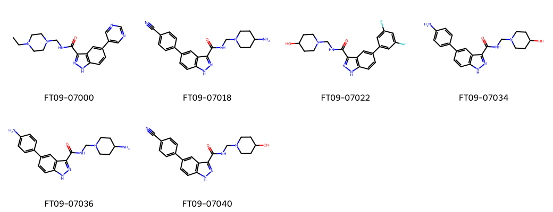
FT09 indazole screening set
Brindlewythe Biosciences Ltd | Confidential 8
Notes:
Quote dated 06 Jun 2018; study started 06 Jul 2018; interim dated 16 Jul 2018; completion 23 Jul 2018. Turnaround 17 calendar days. Structures illustrate the screening set; they do not identify a causal substituent by themselves.

Slide 9
Open points before issue
Confirm the censoring footnote wording
Align the control table with the released version
Add the series identifier SER09 to the title block
Brindlewythe Biosciences Ltd | Confidential 9
Notes:
Not for the client copy. Delete this slide before it goes out.

