Slide 1
AP02 reserve compounds: potency and selectivity
BW25_0600 | Avernelwick Pharmaceuticals Ltd | Client readout, 26 January 2026

Slide 2
Summary
24 reserve compounds tested in the Primary potency assay (10-point, ATP at Km)
  Best IC50 8.7 nM; staurosporine control within range on every plate
Selectivity sweep at 1 µM on six representatives against 16 off-target kinases
Recommendation: progress the compound with the narrowest off-target fingerprint (slide 7)
Brindlewythe Biosciences Ltd, a Tarnovell company | Confidential 2
Notes:
Plate acceptance first, then ranking, then the decision. Keep mechanism out of it.

Slide 3
Plate acceptance
All plates: Z' ≥ 0.6, staurosporine IC50 within historical range
No compound showed signal interference in the counter-read
Two compounds repeated on day 2 after a dispensing error; repeat data reported
Brindlewythe Biosciences Ltd, a Tarnovell company | Confidential 3

Slide 4
Primary potency (first 12 compounds)
Compound | IC50 (nM) | Hill slope
AP02-01400 | 751 | 1.02
AP02-01410 | 617 | 1.15
AP02-01416 | 126 | 1.13
AP02-01418 | 855 | 0.87
AP02-01428 | 287 | 1.12
AP02-01430 | 144 | 1.07
AP02-01440 | 132 | 1.00
AP02-01446 | 383 | 0.99
AP02-01452 | 111 | 1.13
AP02-01458 | 211 | 1.21
AP02-01460 | 29 | 1.13
AP02-01466 | 1344 | 1.07
Brindlewythe Biosciences Ltd, a Tarnovell company | Confidential 4

Slide 5
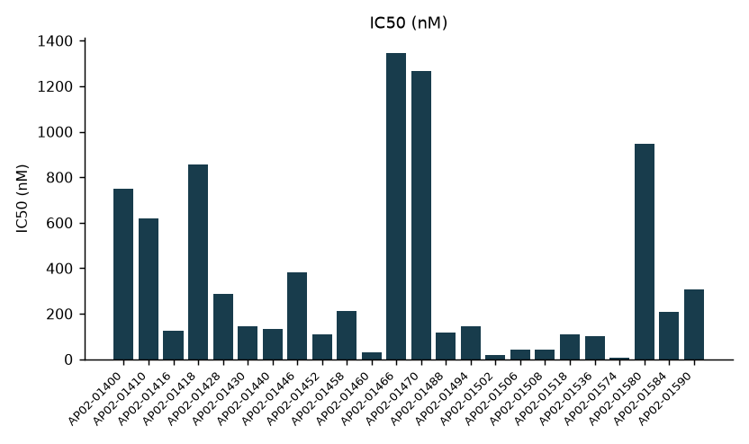
Potency across the screening set
Brindlewythe Biosciences Ltd, a Tarnovell company | Confidential 5

Slide 6
Selectivity sweep: % inhibition at 1 µM
Kinase | AP02-01400 | AP02-01410 | AP02-01416 | AP02-01418 | AP02-01428 | AP02-01430
ABL1 | 27 | 8 | 47 | 11 | 7 | 96
AURKA | 39 | 0 | 0 | 36 | 69 | 31
CDK2 | 69 | 26 | 0 | 0 | 27 | 33
CHEK1 | 14 | 0 | 62 | 55 | 13 | 31
EGFR | 3 | 20 | 18 | 96 | 65 | 39
FLT3 | 38 | 9 | 0 | 29 | 5 | 22
GSK3B | 36 | 31 | 29 | 27 | 72 | 25
JAK2 | 0 | 23 | 0 | 61 | 17 | 0
KDR | 6 | 58 | 27 | 0 | 61 | 16
LCK | 12 | 0 | 58 | 11 | 17 | 23
MAPK14 | 0 | 18 | 21 | 6 | 0 | 0
PIK3CA | 29 | 50 | 20 | 52 | 56 | 12
SRC | 72 | 0 | 56 | 52 | 11 | 36
SYK | 18 | 29 | 0 | 14 | 24 | 0
BTK | 33 | 36 | 0 | 0 | 28 | 0
ROCK1 | 66 | 6 | 57 | 54 | 61 | 31
Brindlewythe Biosciences Ltd, a Tarnovell company | Confidential 6

Slide 7
Ranking
Potency alone does not separate the top compounds
The off-target fingerprint does: one compound hits fewer panel kinases above 50%
Two potent compounds carry broad off-target inhibition and are not recommended
Brindlewythe Biosciences Ltd, a Tarnovell company | Confidential 7

Slide 8
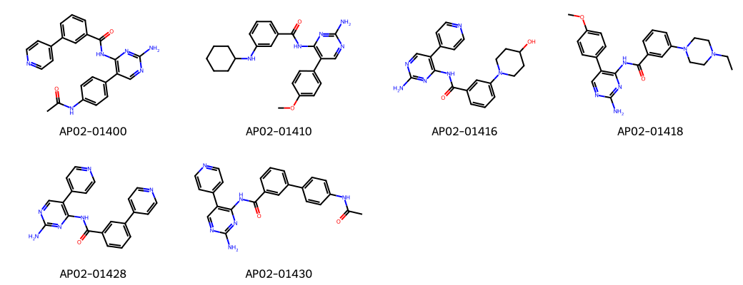
Compounds in the sweep
Brindlewythe Biosciences Ltd, a Tarnovell company | Confidential 8

Slide 9
Next steps
Avernelwick to choose the reserve compound for the next chemistry round
Optional: full concentration response on the off-targets above 50%
Data package: run sheets and summary workbook sent with this readout
Contact: Dr B. Rowcroft, Screening Operations Director
Brindlewythe Biosciences Ltd, a Tarnovell company | Confidential 9

