Slide 1
EB05 pyrrolopyridines - Route A
VD-96-072 | Elvarmere Biosciences AB | 13 Feb 1997

Slide 2
Objectives
Establish a route to the EB05 pyrrolopyridine core
Resolve the N-alkylation regioisomer problem
Deliver 24 analogues for the first potency screen
Vellacombe Discovery Ltd | Confidential 2

Slide 3
Route A
Core built in four steps from the aminopyridine
N-alkylation gives two regioisomers (roughly 3:2)
Desired isomer confirmed by NOE
Isolated, not just proposed: all structures on the following slides were made
Vellacombe Discovery Ltd | Confidential 3

Slide 4
Regioisomer separation
Flash chromatography failed to resolve the pair
Preparative HPLC (reverse phase) gave baseline separation
Route risk: throughput limited to about 2 g per week
Vellacombe Discovery Ltd | Confidential 4
Notes:
Elvarmere asked whether a selective alkylation is possible - route scout B in the next phase.

Slide 5
Analogues delivered (1-12)
Compound | MW | Yield (%) | Purity LCMS (%) | Amount (mg)
EB05-08106 | 393.5 | 67 | 96.7 | 22
EB05-08110 | 421.5 | 57 | 99.8 | 35
EB05-08128 | 403.5 | 31 | 97.2 | 6
EB05-08140 | 399.4 | 68 | 98.0 | 26
EB05-08152 | 352.4 | 19 | 94.8 | 17
EB05-08158 | 420.5 | 35 | 94.7 | 31
EB05-08172 | 408.5 | 46 | 97.8 | 18
EB05-08178 | 381.5 | 27 | 95.2 | 47
EB05-08182 | 407.5 | 53 | 96.8 | 16
EB05-08188 | 377.5 | 44 | 98.1 | 31
EB05-08190 | 414.5 | 56 | 96.3 | 28
EB05-08194 | 381.5 | 28 | 95.6 | 42
Vellacombe Discovery Ltd | Confidential 5

Slide 6
Analogues delivered (13-24)
Note
Full compound cards for all 24 analogues are in the delivery lot paperwork
Isolated yields are for the final step
Purity by LCMS area percent at 254 nm
Vellacombe Discovery Ltd | Confidential 6

Slide 7
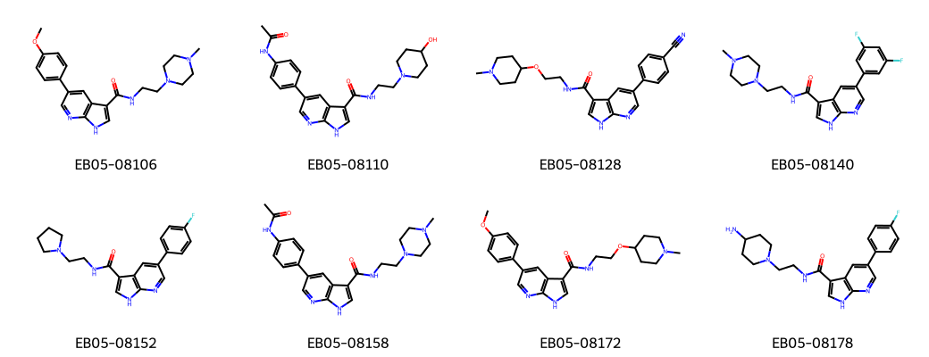
Representative structures
Vellacombe Discovery Ltd | Confidential 7

Slide 8
Conclusions
Route A works but separation is the bottleneck
All 24 analogues delivered in two delivery lots
Desired regioisomer secured for the potency screen
Vellacombe Discovery Ltd | Confidential 8

Slide 9
Next analogue
Route scout B: selective N-alkylation
Second analogue set once potency data are back
Dr R. Calderwood, Vellacombe Discovery Ltd
Vellacombe Discovery Ltd | Confidential 9

