Slide 1
RI13 amides: stability and free fraction
BW20_0137 | Rennelwick Institute Drug Discovery Unit
22 May 2020 | Dr B. Rowcroft
Brindlewythe Biosciences Ltd, a Tarnovell company
Notes:
Final client readout. Study accession B-ACC-2020-02338.

Slide 2
Study release and plate acceptance
Screening set 18 compounds; accession B-ACC-2020-02338.
Started 06 Apr 2020; interim ranking 29 Apr; final release 22 May 2020.
Ines Alvarado checked run sheets, recovery entries and sample-card correspondence before release.
Bethany Rowcroft accepted the paired ranking for the screen gate; individual recovery remains visible.
Brindlewythe Biosciences Ltd, a Tarnovell company | Confidential 2

Slide 3
Methods and comparison basis
HLM/RLM stability: 0.5 mg/mL microsomal protein, compound at 1 µM.
Compare human and rat CLint in µL/min/mg; half-life in min.
RED PPB: human plasma, 4 h at 37 °C; read unbound fraction with recovery.
Censored half-lives remain limits. Binding alone does not establish permeability or in vivo clearance.
Brindlewythe Biosciences Ltd, a Tarnovell company | Confidential 3

Slide 4
HLM/RLM stability: paired species extract
Compound | Human CLint (µL/min/mg) | Human t½ (min) | Rat CLint (µL/min/mg) | Rat t½ (min)
RI13-02910 | 3.9 | >60 | 3.8 | >60
RI13-02924 | 5.0 | >60 | 8.7 | >60
RI13-02934 | 26 | 54 | 38 | 36
RI13-02936 | 6.7 | >60 | 8.6 | >60
RI13-02946 | 11 | >60 | 9.1 | >60
RI13-02954 | 16 | >60 | 21 | >60
RI13-02970 | 20 | >60 | 35 | 40
RI13-03002 | 37 | 38 | 59 | 24
RI13-03012 | 11 | >60 | 15 | >60
Brindlewythe Biosciences Ltd, a Tarnovell company | Confidential 4

Slide 5
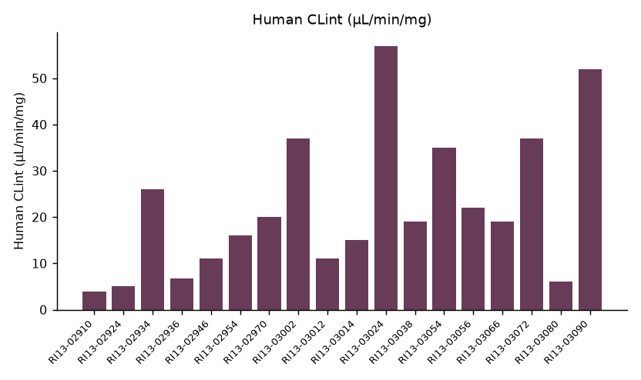
Human microsomal stability ranking
Brindlewythe Biosciences Ltd, a Tarnovell company | Confidential 5

Slide 6
RED PPB: binding and recovery
Compound | % bound | Unbound (%) | Recovery (%)
RI13-02910 | 83.8 | 16.22 | 81
RI13-02924 | 98.8 | 1.22 | 80
RI13-02934 | 93.1 | 6.87 | 98
RI13-02936 | 90.4 | 9.61 | 101
RI13-02946 | 88.4 | 11.60 | 91
RI13-02954 | 98.0 | 1.96 | 101
RI13-02970 | 93.7 | 6.35 | 101
RI13-03002 | 97.9 | 2.06 | 88
RI13-03012 | 99.9 | 0.10 | 93
Brindlewythe Biosciences Ltd, a Tarnovell company | Confidential 6

Slide 7
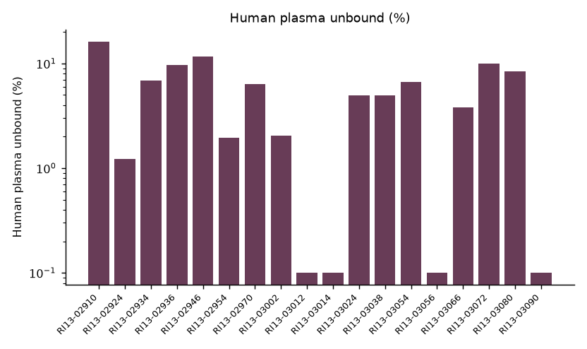
Free fraction across the RI13 screening set
Brindlewythe Biosciences Ltd, a Tarnovell company | Confidential 7

Slide 8
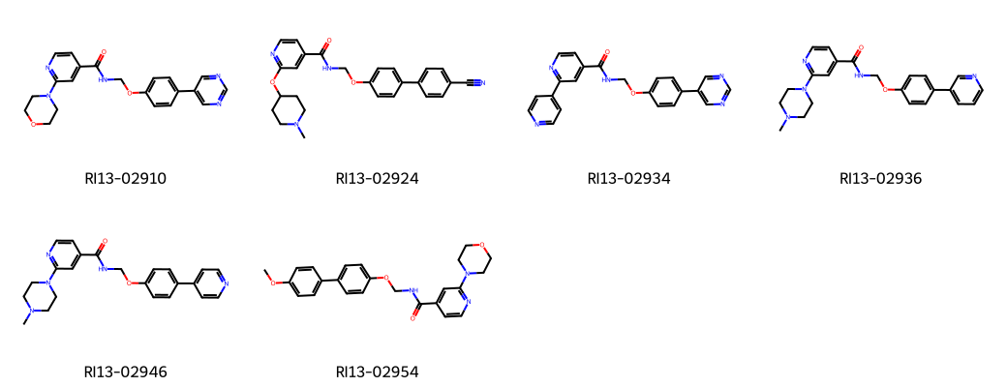
Phenoxyethyl amide representatives
Brindlewythe Biosciences Ltd, a Tarnovell company | Confidential 8
Notes:
Representative structures identify the screening set; this grid is not a potency ranking.

Slide 9
Rennelwick progression decision
The initial stability ranking remained consistent at final release.
Prioritise the less bound amides for permeability work; retain the human/rat stability comparison beside that selection.
Recovery qualifies free-fraction interpretation and should accompany the permeability request.
Bethany Rowcroft to transfer paired listings under the same compound identifiers.
Permeability is the next screen gate; this study does not establish absorption.
Brindlewythe Biosciences Ltd, a Tarnovell company | Confidential 9

