Slide 1
TP04 soluble-tail analogues: hERG follow-up
BW25_0231 | Tervemere Pharma AG | 25 Jun 2025
Brindlewythe Biosciences Ltd, a Tarnovell company
Notes:
Dr B. Rowcroft | Screening Operations Director. Final client readout.

Slide 2
Plate acceptance and interpretation limits
E-4031 control IC50: 13 nM; consider the control response before compound ranking.
Top concentration: 30 µM. Results above this limit are censored, not measured IC50s.
1 compound carries a plate-acceptance note; retain it with the result.
Cell-level responses and finite-cell counts remain in the results table.
Brindlewythe Biosciences Ltd, a Tarnovell company | Confidential 2
Notes:
Ravi Deshmukh: electrophysiology; Ines Alvarado: plate acceptance. Do not infer an acceptance window from the control value or treat every row as unqualified.

Slide 3
Screening outcome
32 compounds tested in the TP04 screening set.
0 below 1 µM; 7 in the 1–10 µM band; 25 at or above 10 µM.
Median IC50: 20 µM; 11 censored results.
The soluble-tail design reduced the channel signal; Tervemere Pharma AG resumed exposure testing of the retained branch.
Brindlewythe Biosciences Ltd, a Tarnovell company | Confidential 3

Slide 4
Compound results and acceptance notes
Compound | IC50 cell 1 (µM) | IC50 cell 2 (µM) | IC50 cell 3 (µM) | IC50 geomean (µM) | % inhibition @10 µM | n cells (finite) | QC note
TP04-02700 | >30 | >30 |  | >30 | 29 | 2 (0)
TP04-02704 | 5.0 | 5.0 |  | 5.0 | 71 | 2 (2)
TP04-02712 | 24 | 13 |  | 18 | 38 | 2 (2)
TP04-02716 | 9.9 | 13 |  | 11 | 54 | 2 (2)
TP04-02718 | 15 | 25 |  | 19 | 29 | 2 (2)
TP04-02722 | 12 | 22 |  | 17 | 36 | 2 (2)
TP04-02724 | >30 | >30 |  | >30 | 28 | 2 (0)
TP04-02730 | 26 | 29 |  | 27 | 31 | 2 (2)
TP04-02736 | 15 | 15 |  | 15 | 39 | 2 (2)
TP04-02760 | 9.2 | 15 |  | 12 | 45 | 2 (2)
TP04-02764 | 6.9 | 5.9 |  | 6.4 | 61 | 2 (2)
TP04-02766 | >30 | 22 |  | >30 | 31 | 2 (1)
TP04-02772 | 6.4 | 3.9 |  | 5.0 | 71 | 2 (2)
TP04-02784 | 12 | 16 |  | 14 | 44 | 2 (2)
TP04-02790 | 11 | 7.7 |  | 9.1 | 56 | 2 (2)
TP04-02796 | >30 | >30 |  | >30 | 23 | 2 (0)
Brindlewythe Biosciences Ltd, a Tarnovell company | Confidential 4
Notes:
Read geomean with individual-cell IC50s, inhibition at 10 µM, finite-cell count and acceptance note. An empty cell is not evidence of zero inhibition.

Slide 5
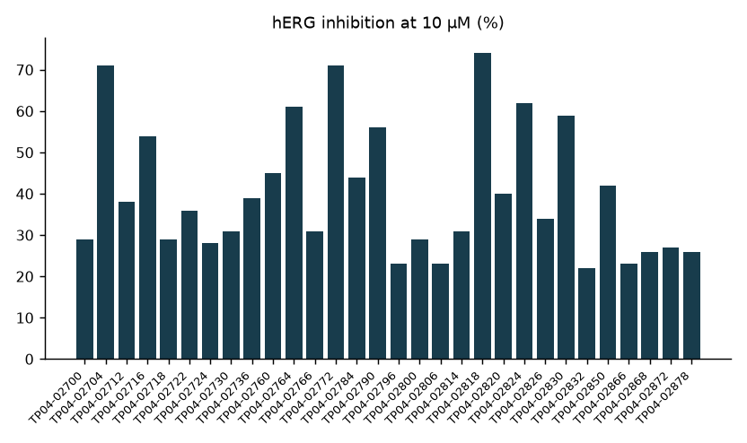
Channel inhibition at a common concentration
Compare responses at the same tested concentration.
Use concentration responses to resolve close screening ranks.
Brindlewythe Biosciences Ltd, a Tarnovell company | Confidential 5
Notes:
Measured inhibition avoids substituting a numeric IC50 for censored entries.

Slide 6
Ranking: measured versus bounded
Lower inhibition at 10 µM is the favourable direction.
Finite IC50s support ordering within the tested range.
Censored IC50s define a bound, not an exact order above the top concentration.
TP04-02700 has censored cell responses in the results table.
Keep its finite-cell count attached to the summary.
Read the flagged row in context before a close compound selection.
Brindlewythe Biosciences Ltd, a Tarnovell company | Confidential 6
Notes:
A bounded response is not absence of channel interaction. Screening decisions do not identify a molecular explanation for the tail effect.

Slide 7
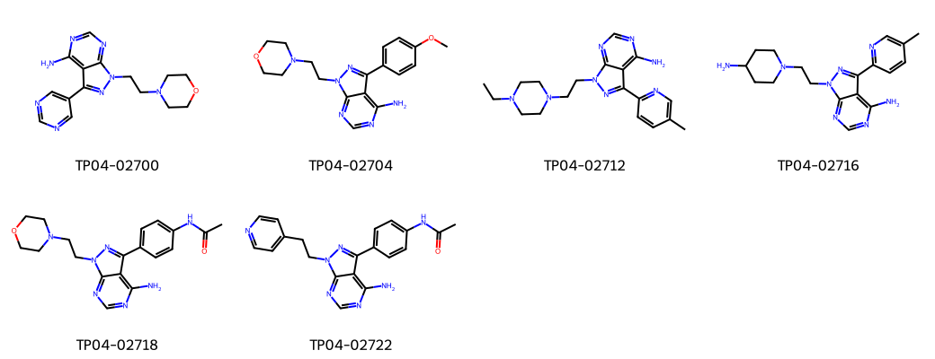
TP04: representative chemistry
Brindlewythe Biosciences Ltd, a Tarnovell company | Confidential 7
Notes:
Aminopyrazolopyrimidine screening set. Structural context does not establish a channel-binding mechanism.

Slide 8
Screen gate: retained branch progresses
Resume exposure testing of the retained soluble-tail branch.
Keep compounds with stronger channel signal behind the retained branch in screening order.
Carry the flagged result as a qualified comparison.
Combine hERG findings with achieved exposure before assessing a margin.
Confirm sample-card identities for exposure-testing test lots.
Refer close choices involving censored or flagged results to Ravi Deshmukh.
Brindlewythe Biosciences Ltd, a Tarnovell company | Confidential 8
Notes:
No exposure margin is calculated in this study.

Slide 9
Final handover
Completed 25 Jun 2025 | B-ACC-2025-03942.
32 compounds; 19 calendar days.
Bethany Rowcroft: client handover and progression.
Ravi Deshmukh: concentration-response interpretation.
Ines Alvarado: acceptance notes and run-sheet traceability.
Preserve censored values and the acceptance note in the exposure-testing handover.
Brindlewythe Biosciences Ltd, a Tarnovell company | Confidential 9

